Slide 1

14 Glycolysis, Gluconeogenesis, and the Pentose Phosphate Pathway
© 2021 Macmillan Learning

Slide 2
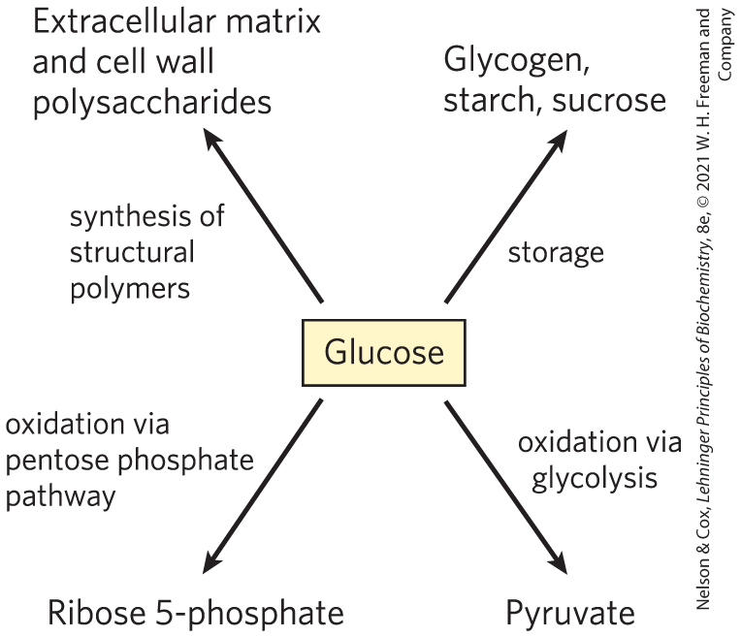
Major Pathways of
Glucose Utilization

Slide 3

Principle 1 (1 of 7)
Metabolites like glucose are often activated with a high-energy group before their catabolism. Glycolysis is a nearly universal 10-step metabolic pathway for producing ATP by the oxidation of glucose. In this process, two molecules of ATP are invested to activate glucose, but the products of the pathway include four ATP, as well as NADH (a form of reducing power) and the triose pyruvate, which can be metabolized further in other pathways.

Slide 4

Principle 2 (1 of 3)
Glucose and other hexoses and hexose phosphates obtained from stored polysaccharides or dietary carbohydrates feed into the glycolytic pathway. By using a common pathway for a number of starting materials, the cell economizes on the number of enzymes that must be synthesized and simplifies the regulation of the common pathway.

Slide 5

Principle 3 (1 of 7)
Pyruvate formed under anaerobic conditions is reduced to lactate with electrons from NADH, recycling NADH to NAD⁺ and allowing continued glycolysis in the processes of lactate or alcohol fermentation. Manipulation of the fermentable material and the microorganisms present allows the synthesis of a variety of industrial products and foods.

Slide 6
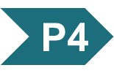
Principle 4 (1 of 5)
Gluconeogenesis is the synthesis of glucose from simpler precursors like pyruvate and lactate. Although it uses seven of the ten enzymes that also act in glycolysis, gluconeogenesis must bypass three of the most exergonic steps in glycolysis with energetically favorable reactions unique to gluconeogenesis.

Slide 7
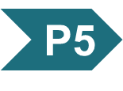
Principle 5 (1 of 6)
Glycolysis and gluconeogenesis are reciprocally regulated so that both processes don’t occur simultaneously in a futile cycle. Most regulatory mechanisms act on reactions that are unique to each pathway.

Slide 8
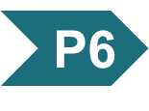
Principle 6 (1 of 5)
The pentose phosphate pathway is an alternative pathway for glucose oxidation. It yields pentoses for nucleotide synthesis and reduced cofactors for biosynthesis of fatty acids, sterols, and many other compounds.

Slide 9
14.1 Glycolysis

Slide 10
Glycolysis is an Almost Universal Central Pathway of Glucose Catabolism
glycolysis = process by which a molecule of glucose is degraded in a series of enzyme-catalyzed reactions to yield two molecules of the three-carbon compound pyruvate
  some free energy is conserved as ATP and NADH

Slide 11
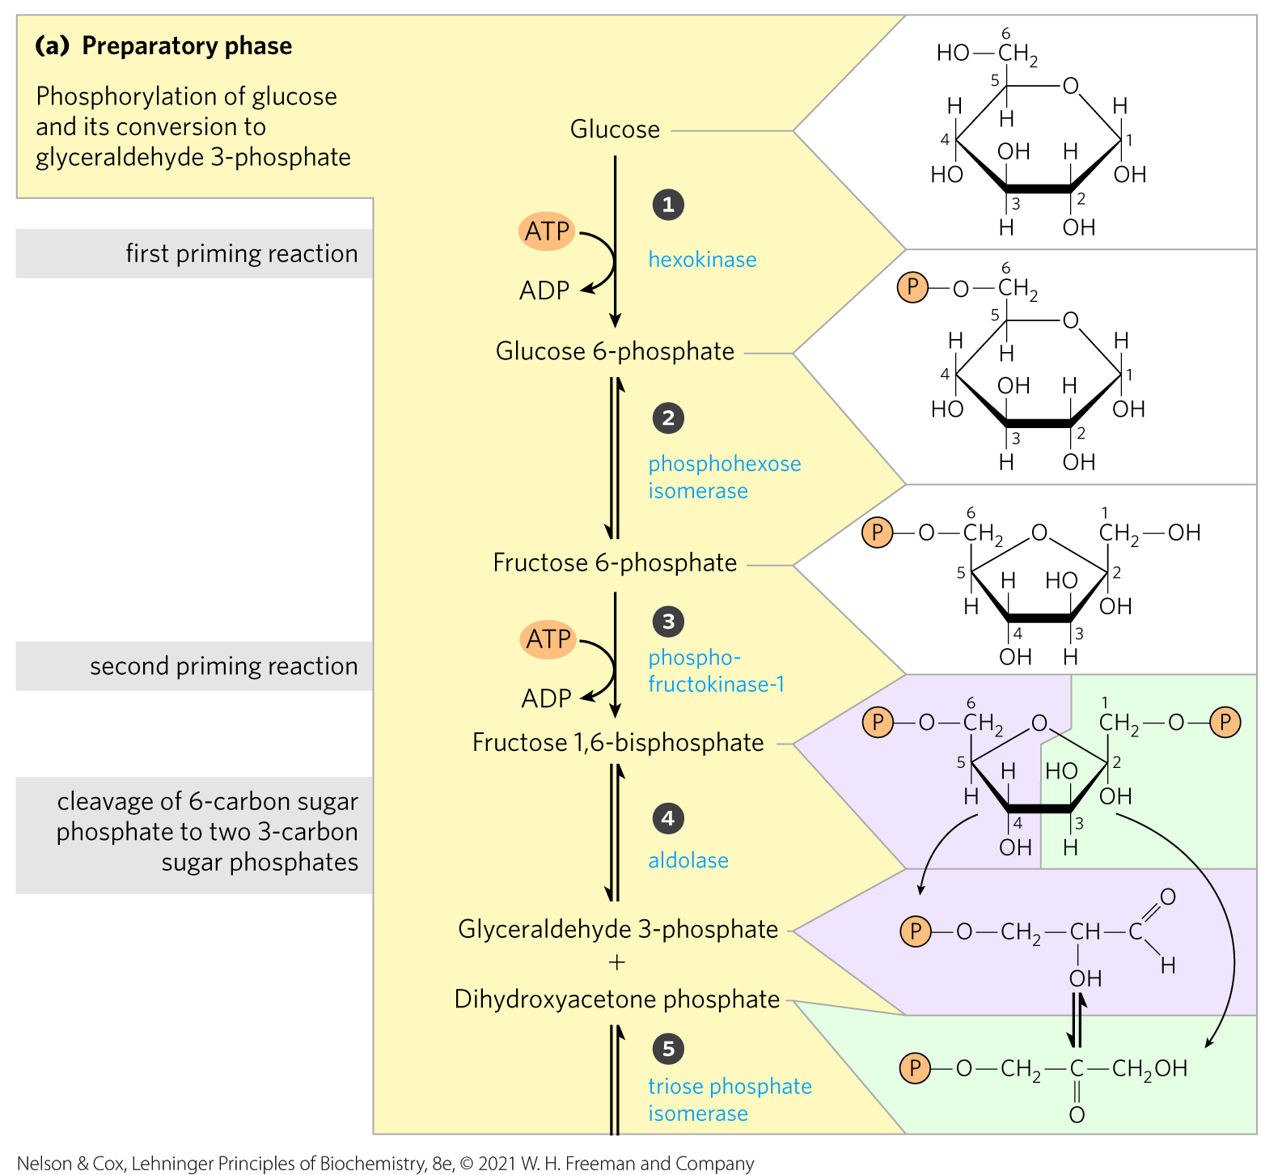
An Overview: Glycolysis Has
Two Phases
in the preparatory phase:
  ATP is consumed
  ∆G of the intermediates increases
  hexose carbon chains are converted to glyceraldehyde 3-phosphate

Slide 12
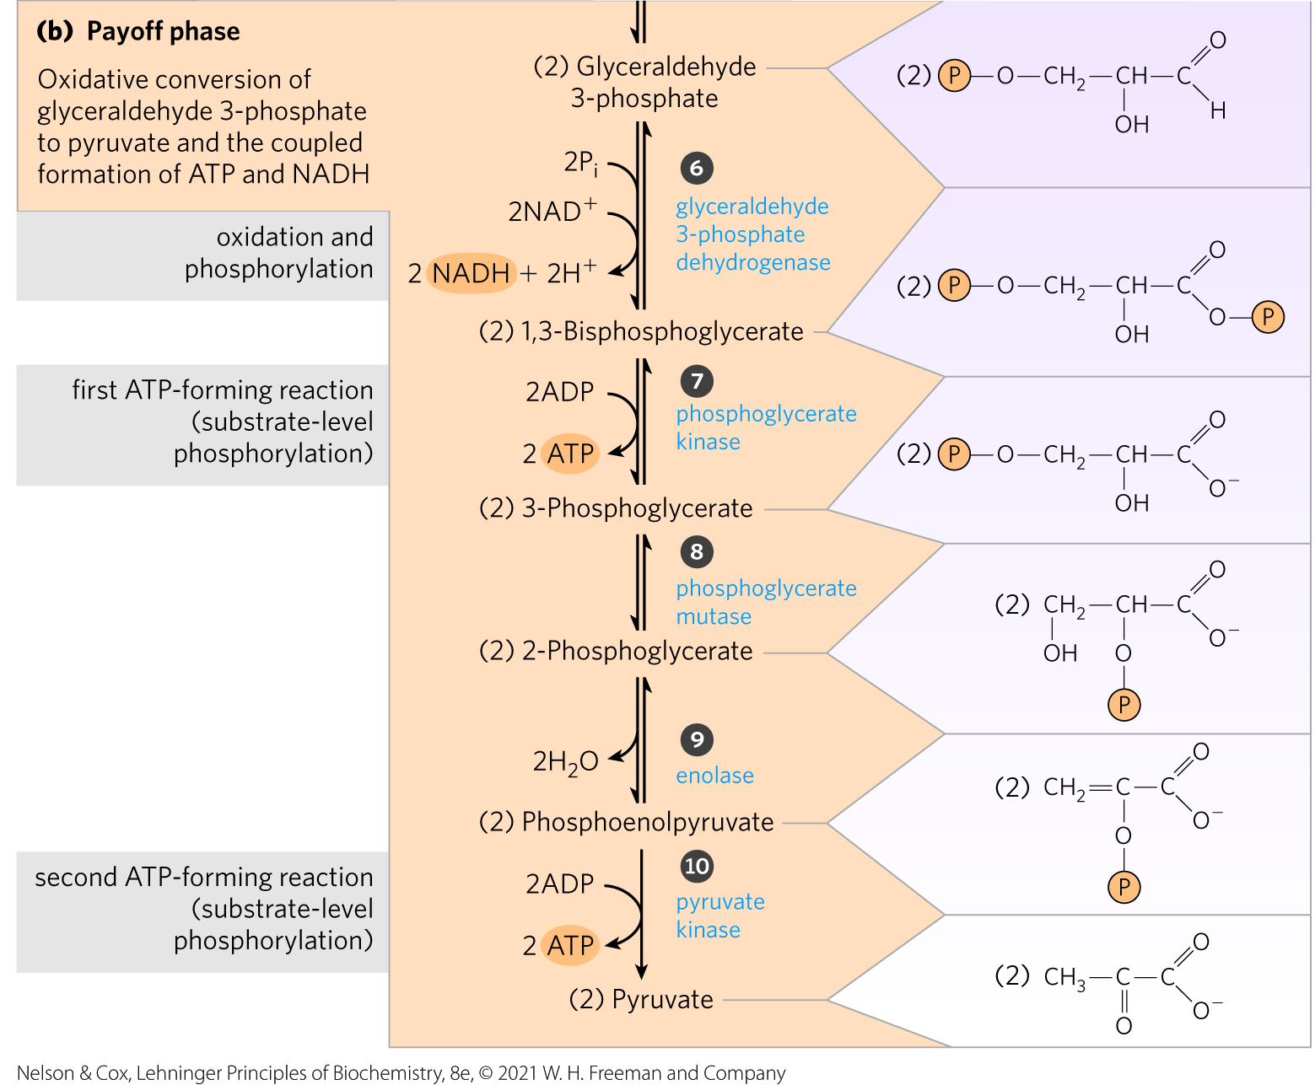
The Payoff Phase of Glycolysis
the payoff phase yields:
  energy conserved as 2 ATP and 2 NADH
  2 pyruvate

Slide 13
Noteworthy Chemical Transformations of Glycolysis
three noteworthy chemical transformations:
  degradation of the carbon skeleton of glucose to yield pyruvate
  phosphorylation of ADP to ATP by compounds with high phosphoryl group transfer potential, formed during glycolysis
  transfer of a hydride ion to NAD+, forming NADH

Slide 14
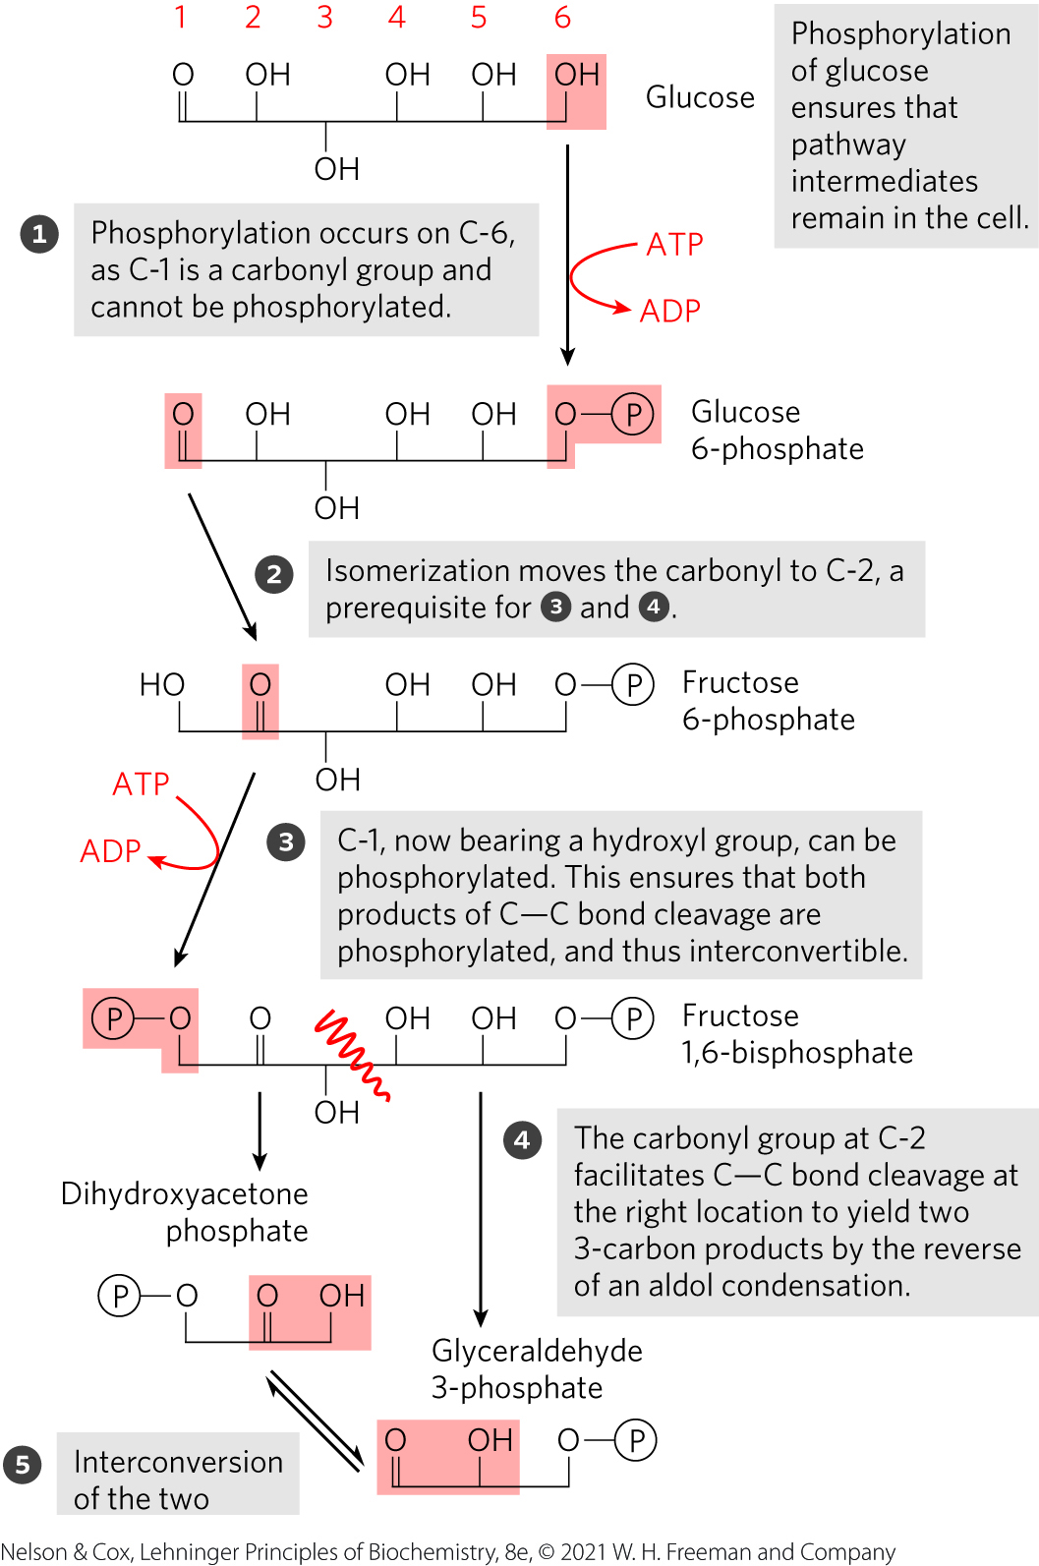
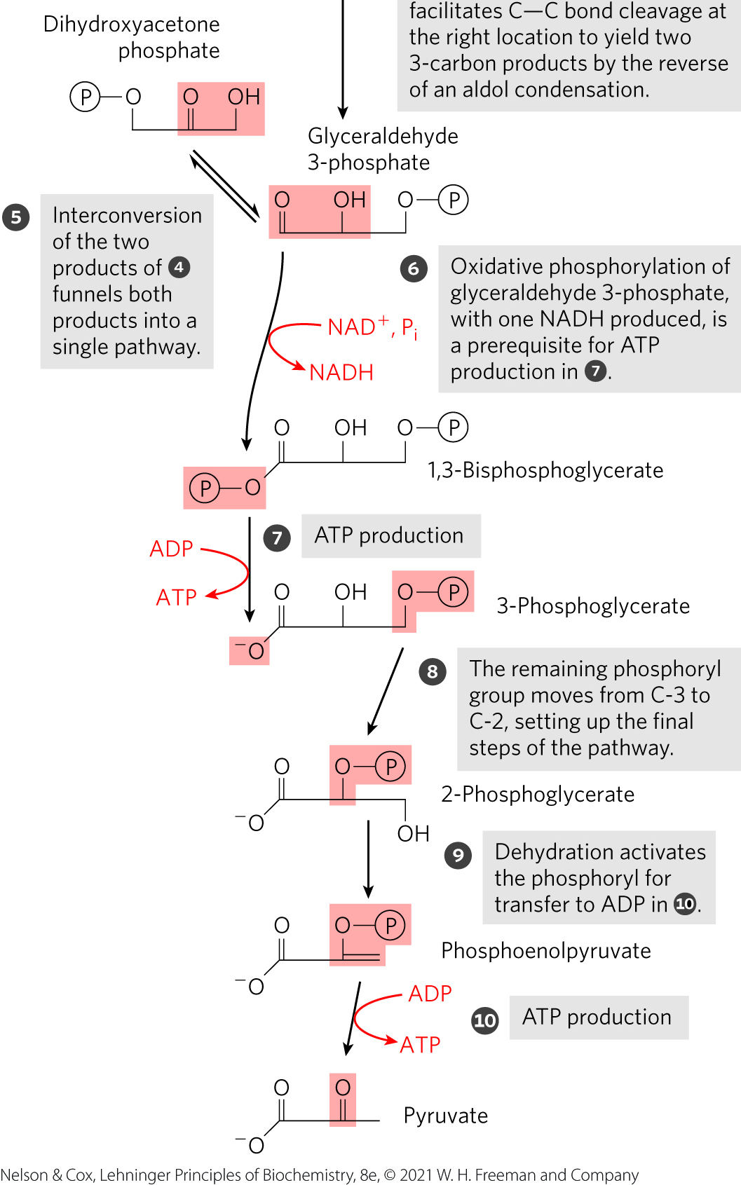
The Chemical Logic of the
Glycolytic Pathway

Slide 15
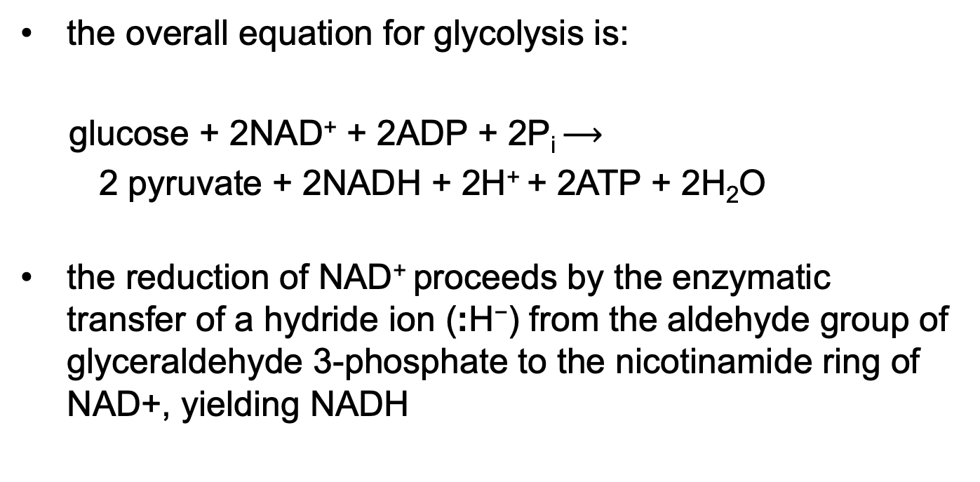
ATP and NADH Formation Coupled to Glycolysis
the overall equation for glycolysis is:
glucose + 2NAD⁺ + 2ADP + 2P_{i} $⟶$
2 pyruvate + 2NADH + 2H⁺ + 2ATP + 2H₂O
the reduction of NAD⁺ proceeds by the enzymatic transfer of a hydride ion (:H⁻) from the aldehyde group of glyceraldehyde 3-phosphate to the nicotinamide ring of NAD+, yielding NADH
(14-1)

Slide 16
Energy Remaining in Pyruvate
energy stored in pyruvate can be extracted by:
  aerobic processes:
    oxidative reactions in the citric acid cycle
    oxidative phosphorylation
  anaerobic processes
    reduction to lactate
    reduction to ethanol
pyruvate can provide the carbon skeleton for alanine synthesis or fatty acid synthesis

Slide 17
Importance of Phosphorylated Intermediates
all nine intermediates are phosphorylated
functions of the phosphoryl groups:
  prevent glycolytic intermediates from leaving the cell
  serve as essential components in the enzymatic conservation of metabolic energy
  lower the activation energy and increase the specificity of the enzymatic reactions

Slide 18
The Preparatory Phase of Glycolysis Requires ATP
in the preparatory phase of glycolysis:
  two molecules of ATP are invested to activate glucose to fructose 1,6-bisphosphate
  the bond between C-3 and C-4 of fructose 1,6-bisphosphate is then broken to yield two molecules of triose phosphate

Slide 19
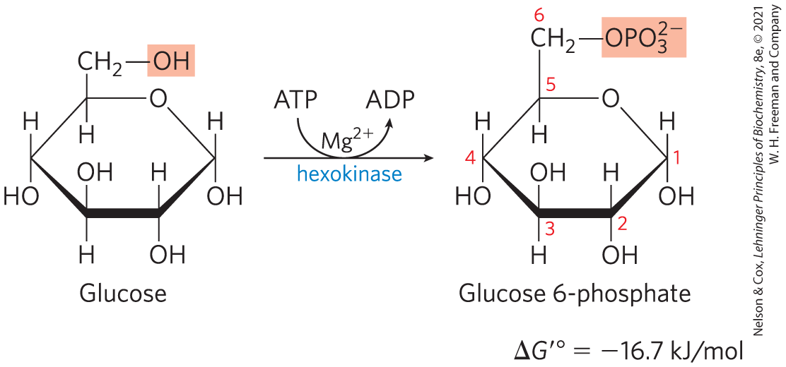
Phosphorylation of Glucose
hexokinase activates glucose by phosphorylating at C-6 to yield glucose 6-phosphate
  ATP serves as the phosphoryl donor
  hexokinase requires Mg²⁺ for its activity
  irreversible under intracellular conditions

Slide 20
Hexokinase is Present in Nearly All Organisms
humans encode 4 hexokinases (I to IV) that catalyze the same reaction
isozymes = two or more enzymes that catalyze the same reaction but are encoded by different genes

Slide 21
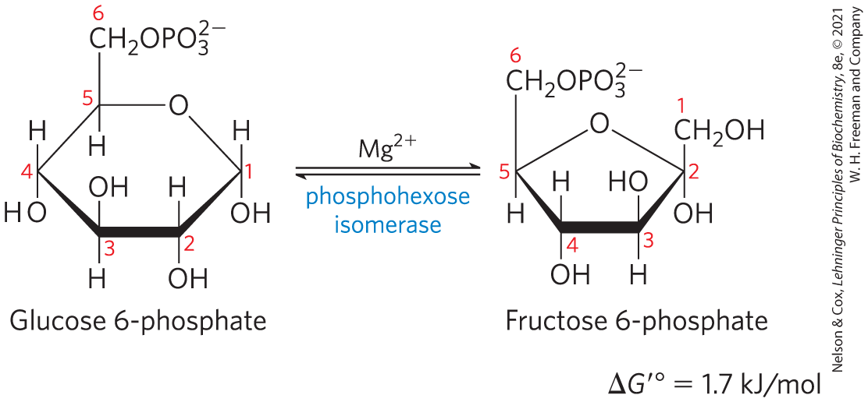
Conversion of Glucose 6-Phosphate to Fructose 6-Phosphate
phosphohexose isomerase (phosphoglucose isomerase) catalyzes the reversible isomerization of glucose 6-phosphate to fructose 6-phosphate
  mechanism involves an enediol intermediate
  reaction readily proceeds in either direction

Slide 22
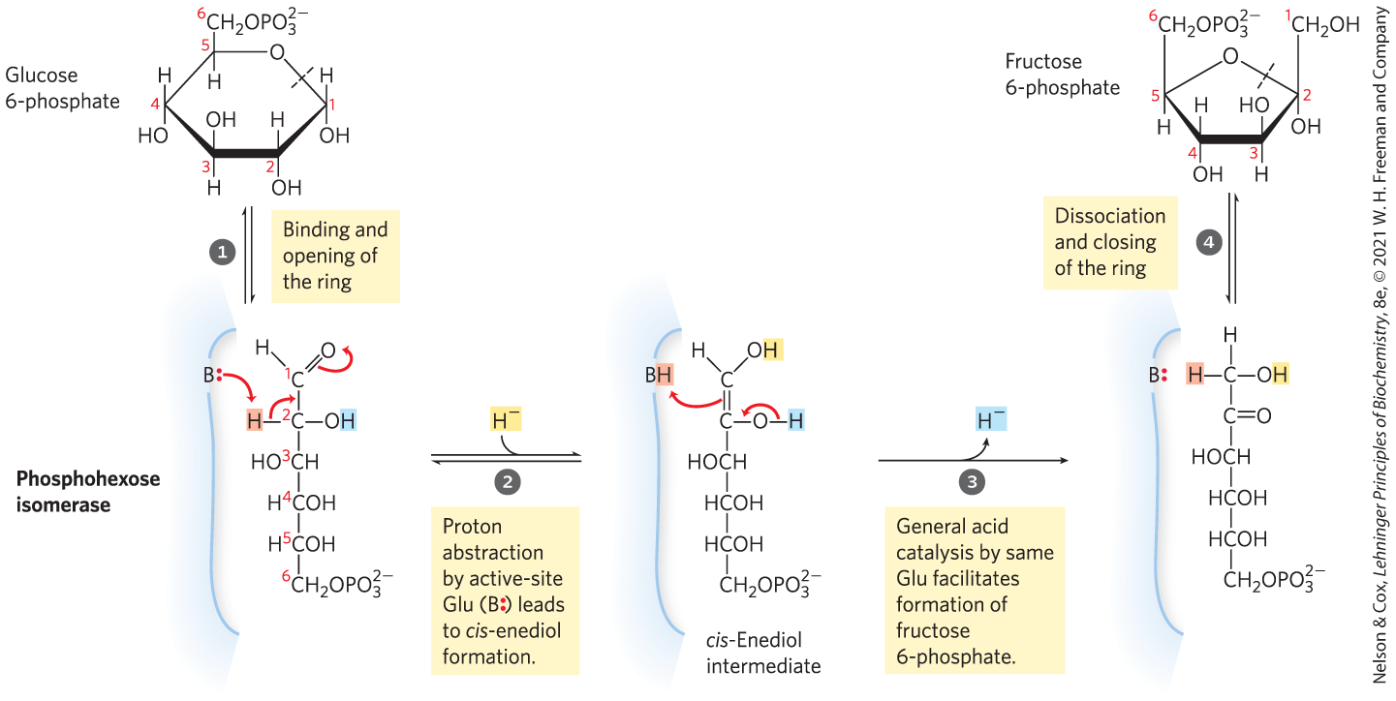
The Phosphohexose Isomerase Reaction

Slide 23
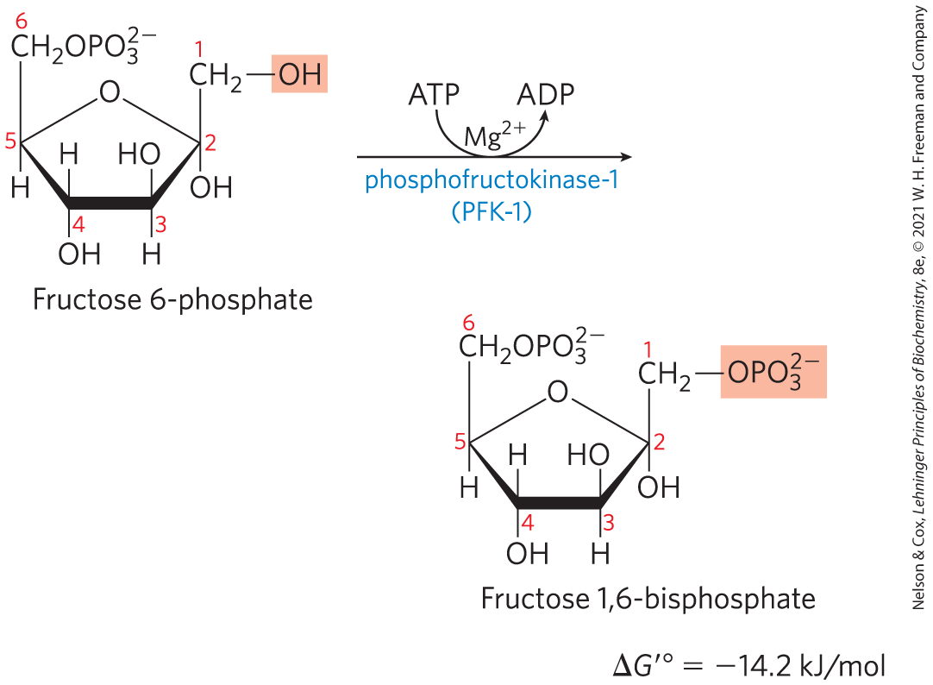
Phosphorylation of Fructose 6-Phosphate to Fructose 1,6-Bisphosphate
phosphofructokinase-1 (PFK-1) catalyzes the transfer of a phosphoryl group from ATP to fructose 6-phosphate to yield fructose 1,6-bisphosphate
  essentially irreversible under cellular conditions
  the first “committed” step in the glycolytic pathway

Slide 24
Allosteric Regulation of Phosphofructokinase-1
activity increases when:
  ATP supply is depleted
  ADP and AMP accumulate
fructose 2,6-bisphosphate is a potent allosteric activator
ribulose 5-phosphate indirectly activates

Slide 25
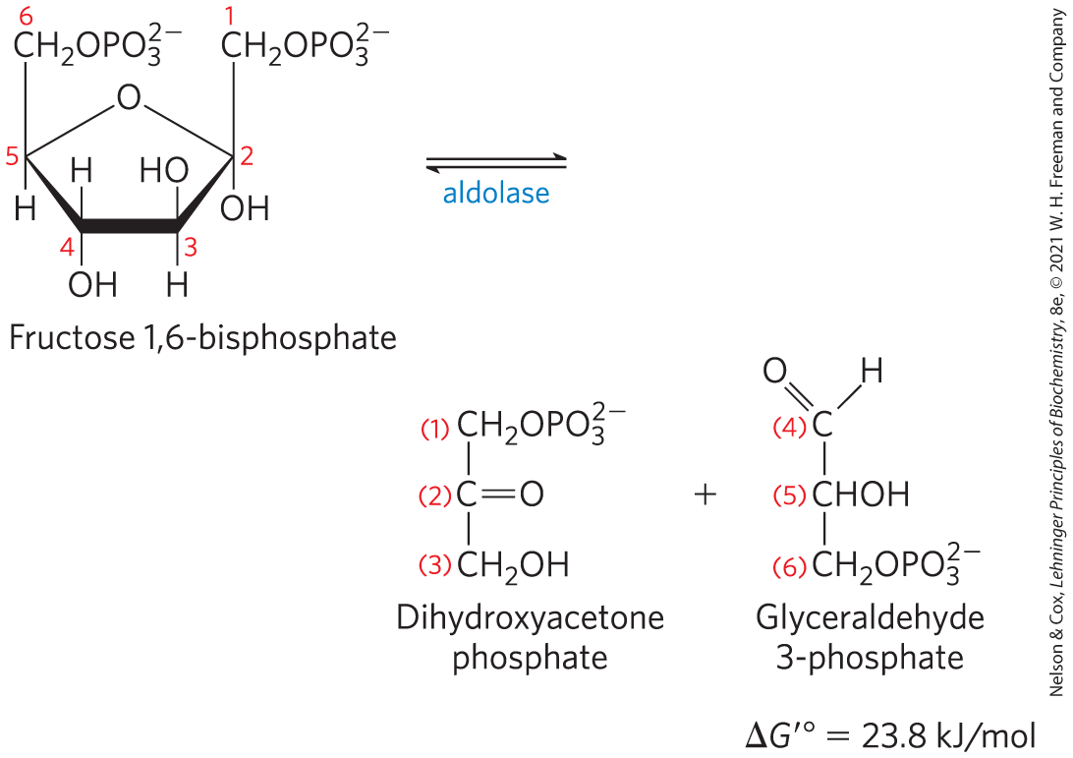
Cleavage of Fructose
1,6-Bisphosphate
fructose 1,6-bisphosphate aldolase (aldolase) catalyzes a reverse aldol condensation and cleaves fructose 1,6-bisphosphate to yield glyceraldehyde 3-phosphate and dihydroxyacetone phosphate
  reversible because reactant concentrations are low in the cell

Slide 26
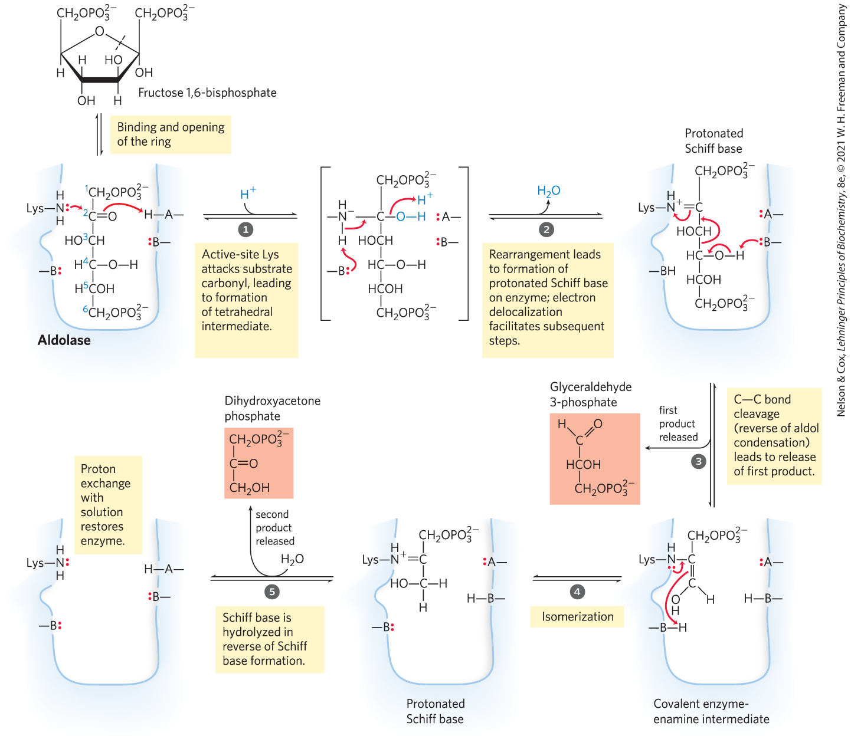
The Class I Aldolase Reaction
Class I = found in animals and plants
Class II = found in fungi and bacteria
  do not form the Schiff base intermediate

Slide 27
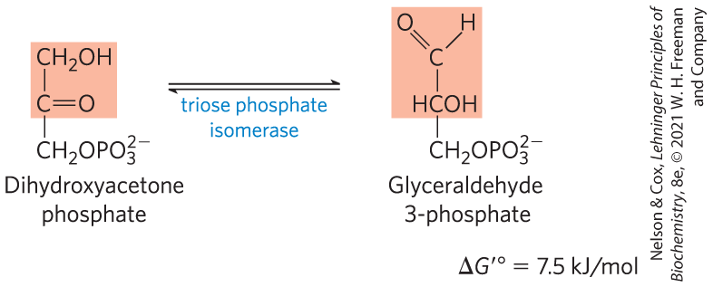
Interconversion of the Triose Phosphates
triose phosphate isomerase converts dihydroxyacetone phosphate to glyceraldehyde 3-phosphate
  reversible
  final step of the preparatory phase of glycolysis

Slide 28
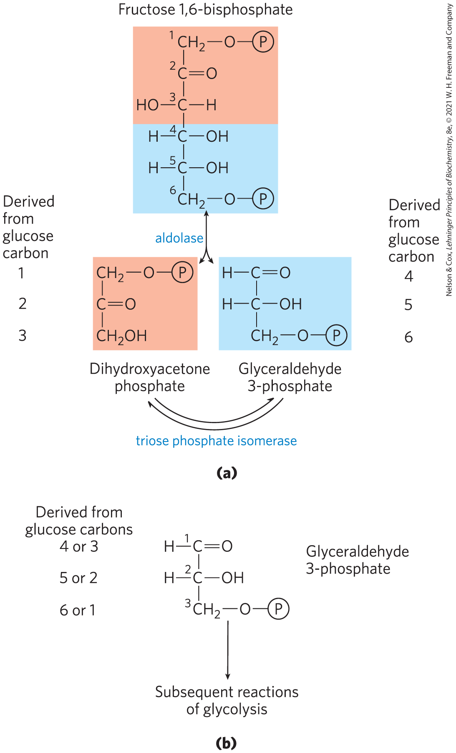
Fate of the Glucose Carbons in the Formation of Glyceraldehyde
3-Phosphate
after step 5 of glycolysis, the carbon atoms derived from C-1, C-2, and C-3 of the starting glucose are chemically indistinguishable from C-6, C-5, and C-4, respectively

Slide 29
The Payoff Phase of Glycolysis Yields ATP and NADH
in the payoff phase of glycolysis:
  each of the two molecules of glyceraldehyde 3-phosphate undergoes oxidation at C-1
  some energy from the oxidation reaction is conserved in the form of one NADH and two ATP per triose phosphate oxidized

Slide 30
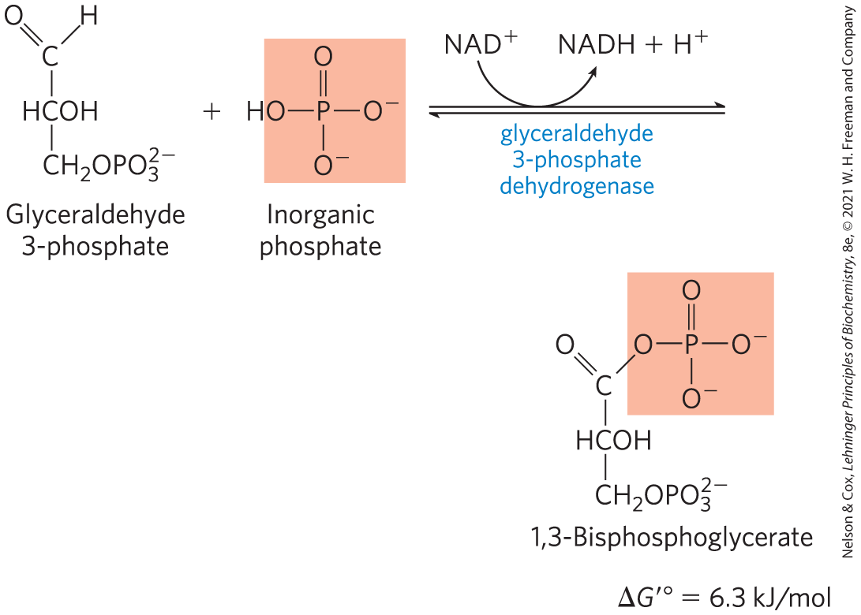
Oxidation of Glyceraldehyde
3-Phosphate to 1,3-Bisphosphoglycerate
glyceraldehyde 3-phosphate dehydrogenase catalyzes the oxidation glyceraldehyde 3-phosphate to 1,3-bisphosphoglycerate
  energy-conserving reaction

Slide 31
The First Step of the Payoff Phase is an Energy-Conserving Reaction
formation of the acyl phosphate group at C-1 of 1,3-bisphosphoglycerate conserves the free energy of oxidation
acyl phosphates have a very high standard free energy of hydrolysis (∆G′° = −49.3 kJ/mol)

Slide 32
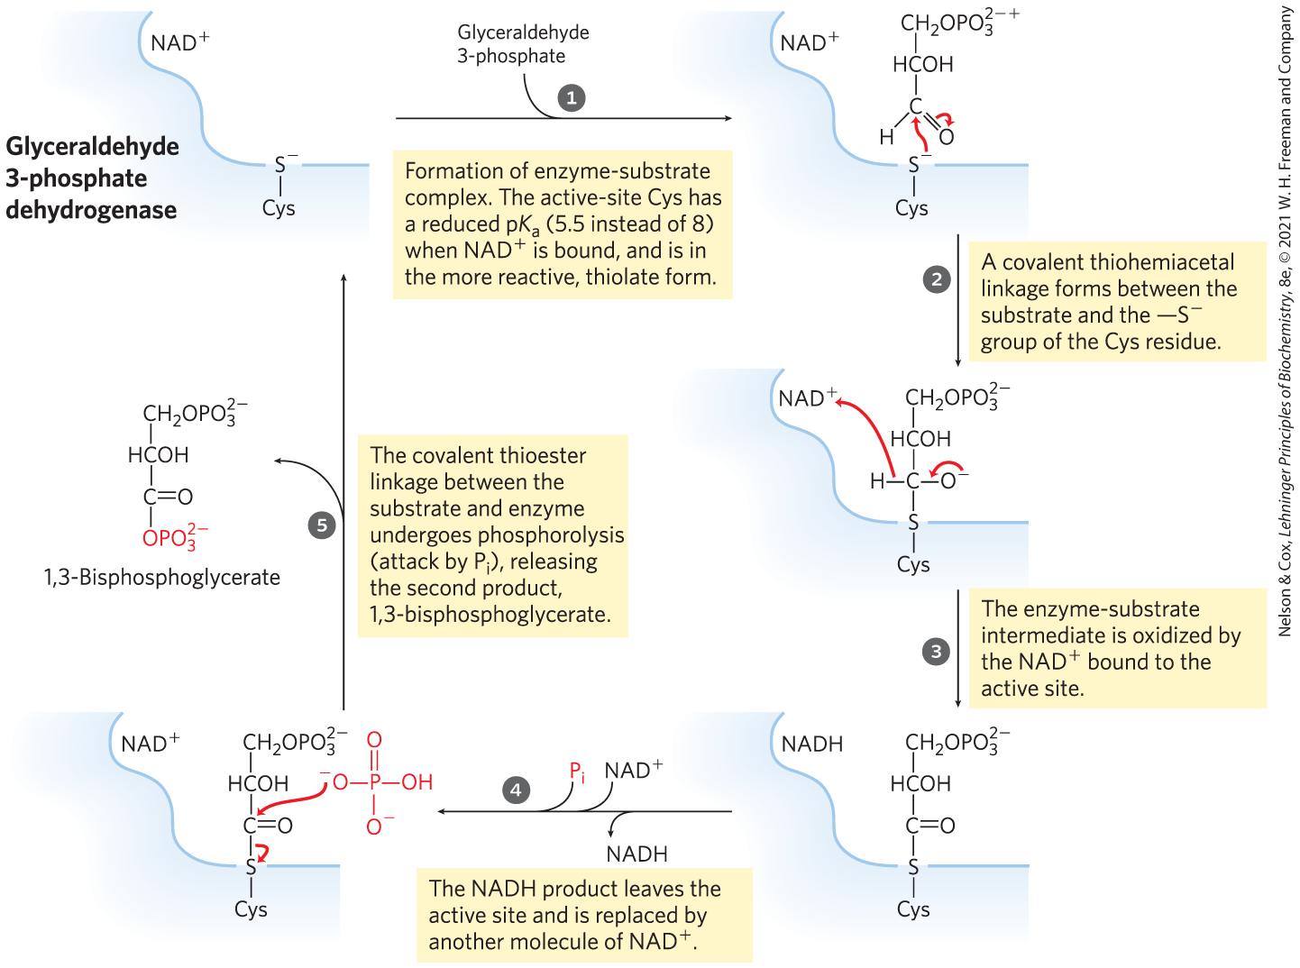
The Glyceraldehyde 3-Phosphate Dehydrogenase Reaction

Slide 33
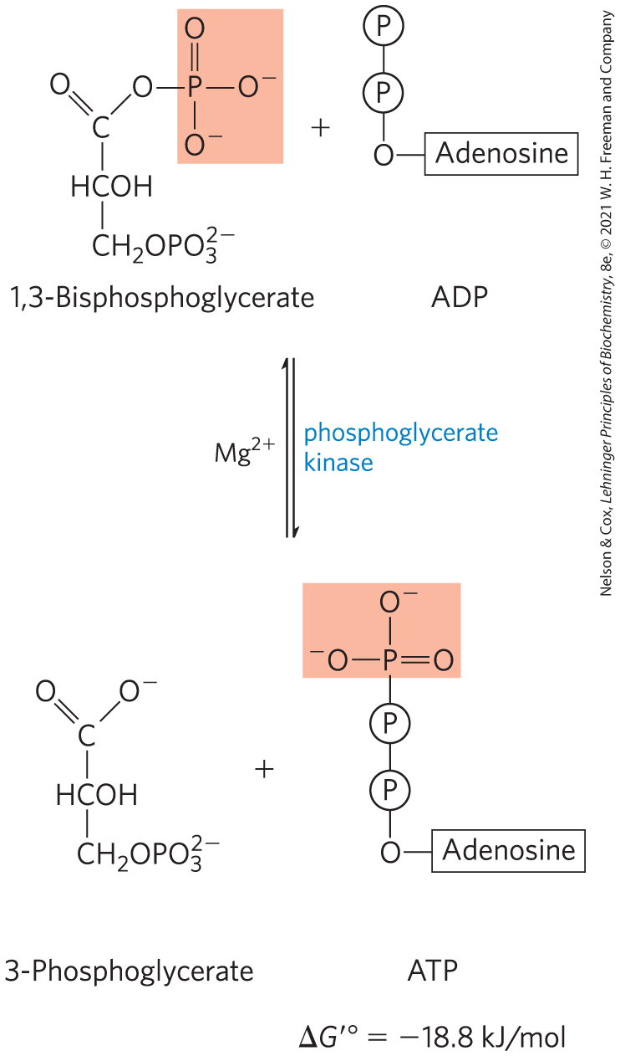
Phosphoryl Transfer from 1,3-Bisphosphoglycerate to ADP
phosphoglycerate kinase transfers the high-energy phosphoryl group from the carboxyl group of 1,3-bisphosphoglycerate to ADP, forming ATP and 3-phosphoglycerate

Slide 34
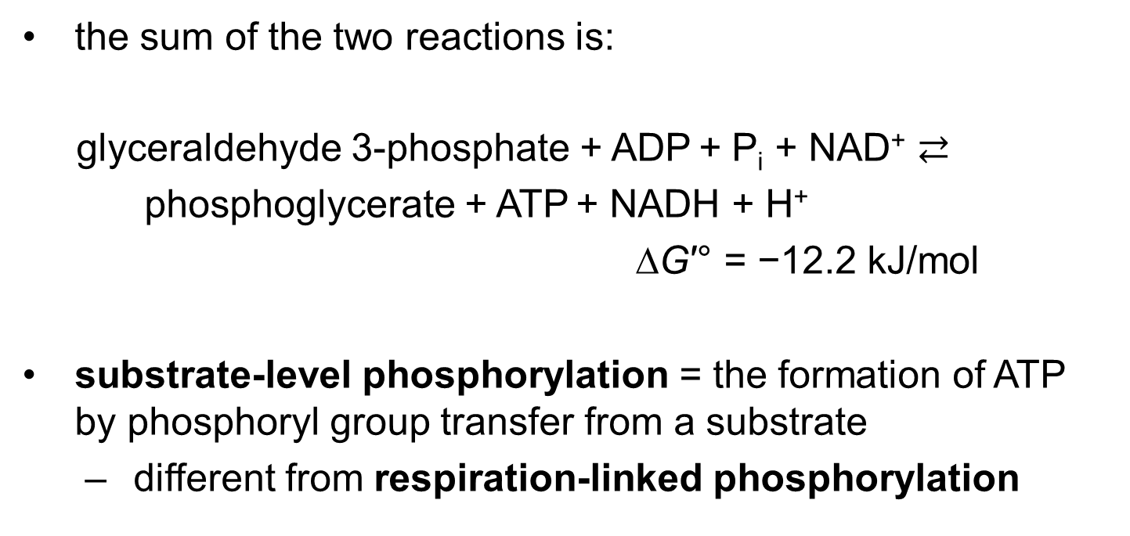
Steps 6 and 7 of Glycolysis Constitute an Energy-Coupling Process
the sum of the two reactions is:
glyceraldehyde 3-phosphate + ADP + P_{i} + NAD⁺ $⇄$
phosphoglycerate + ATP + NADH + H⁺
∆G′° = −12.2 kJ/mol
substrate-level phosphorylation = the formation of ATP by phosphoryl group transfer from a substrate
  different from respiration-linked phosphorylation

Slide 35
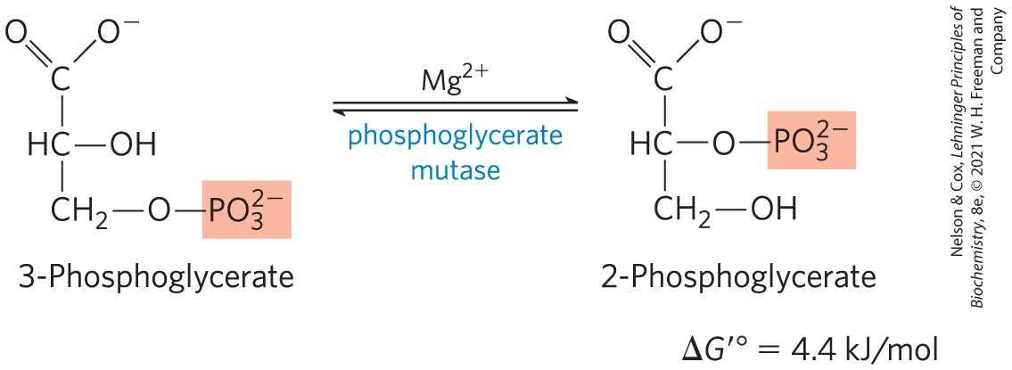
Conversion of 3-Phosphoglycerate to 2-Phosphoglycerate
phosphoglycerate mutase catalyzes a reversible shift of the phosphoryl group between C-2 and C-3 of glycerate
  requires Mg²⁺

Slide 36
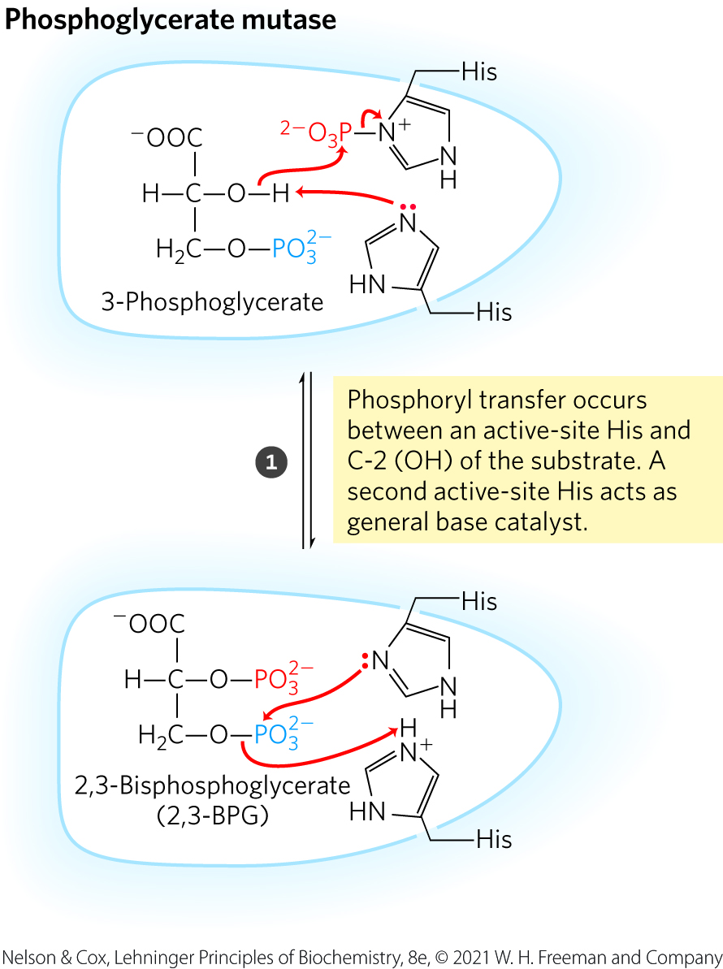
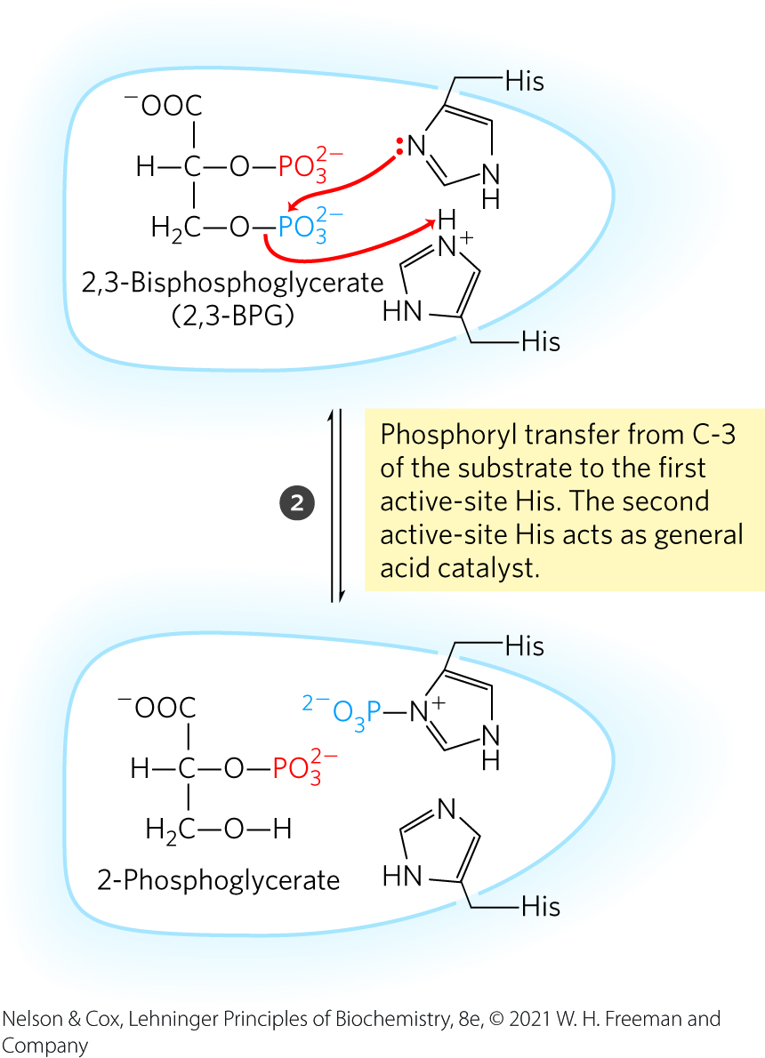
The Phosphoglycerate Mutase Reaction

Slide 37
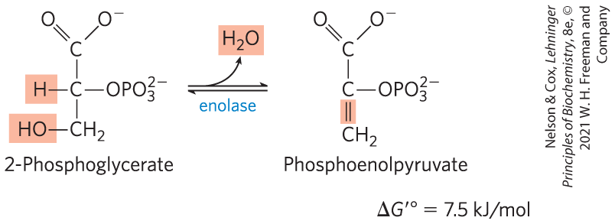
Dehydration of 2-Phosphoglycerate to Phosphoenolpyruvate
enolase promotes reversible removal of a molecule of water from 2-phosphoglycerate to yield phosphoenolpyruvate (PEP)
  energy-conserving reaction
  mechanism involves a Mg²⁺-stabilized enolic intermediate

Slide 38
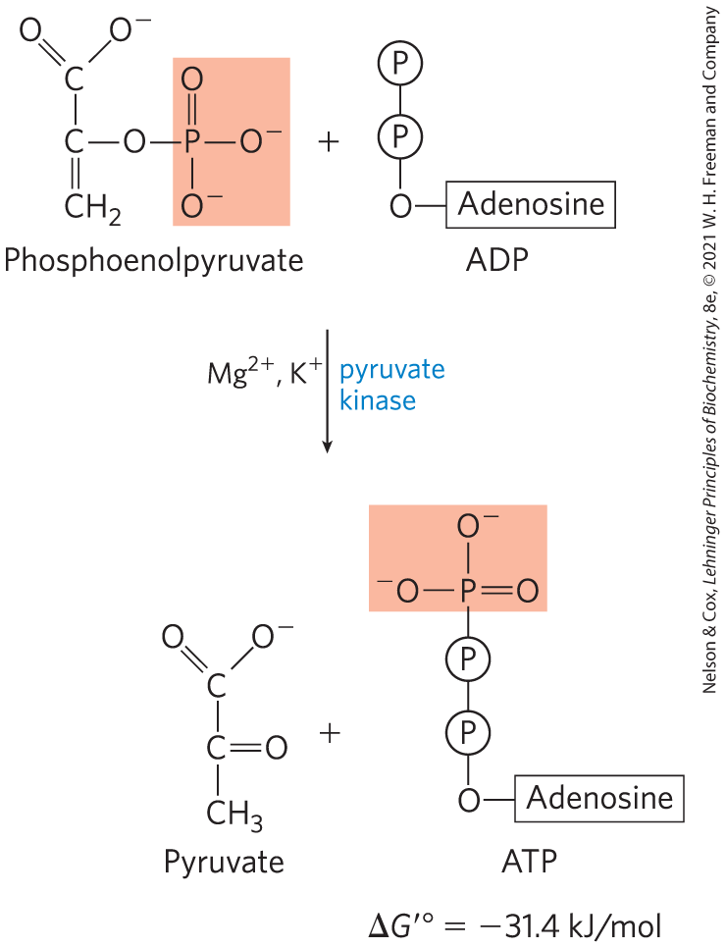
Transfer of the Phosphoryl Group from Phosphoenolpyruvate to ADP
pyruvate kinase catalyzes the transfer of the phosphoryl group from phosphoenolpyruvate to ADP, yielding pyruvate
  requires K⁺ and either Mg²⁺ or Mn²⁺

Slide 39
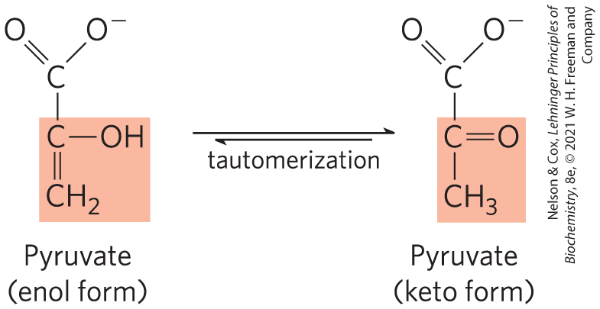
Pyruvate in its Enol Form Spontaneously Tautomerizes to its Keto Form
pyruvate kinase catalyzes the transfer of the phosphoryl group from phosphoenolpyruvate to ADP, yielding pyruvate
  requires K⁺ and either Mg²⁺ or Mn²⁺

Slide 40
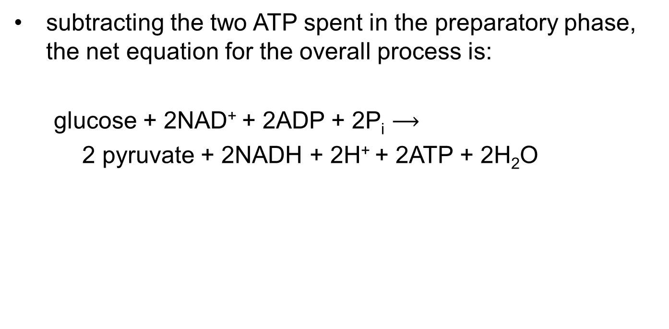
The Overall Balance Sheet Shows a Net Gain of Two ATP and Two NADH Per Glucose
subtracting the two ATP spent in the preparatory phase, the net equation for the overall process is:
glucose + 2NAD⁺ + 2ADP + 2P_{i} $⟶$
2 pyruvate + 2NADH + 2H⁺ + 2ATP + 2H₂O

Slide 41
14.2 Feeder Pathways for Glycolysis

Slide 42
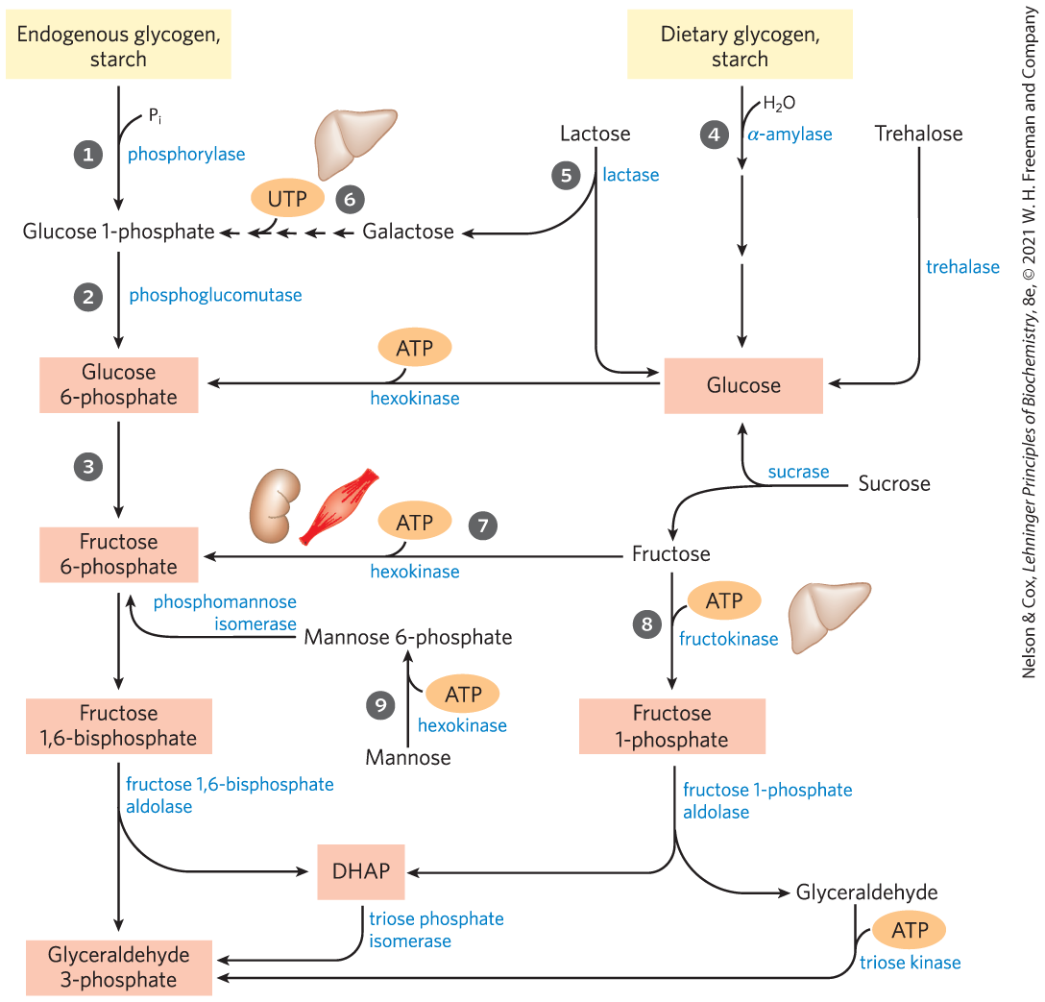
Entry of Dietary Glycogen, Starch, Disaccharides, and Hexoses into the Preparatory Stage of Glycolysis

Slide 43
Lactose Digestion and
Lactose Intolerance
lactase = converts lactose to glucose and galactose
  present in infants but often absent in adults, producing lactose intolerance
lactase persistence phenotype = production of lactase into adulthood
lactose intolerance = inability to digest lactose due to the disappearance of lactase in adulthood
  causes abdominal cramps and diarrhea

Slide 44
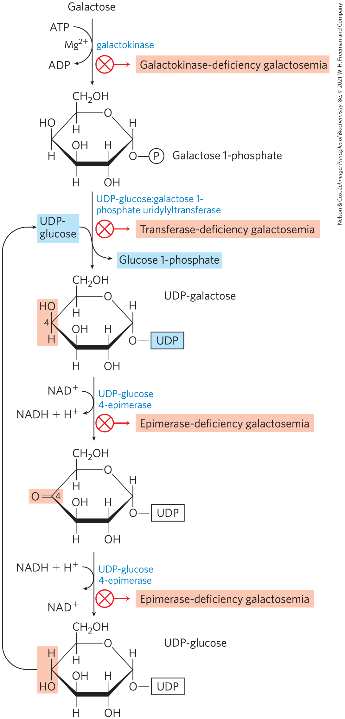
Conversion of Galactose to
Glucose 1-Phosphate
conversion proceeds through UDP-galactose and UDP-glucose intermediates
galactosemia diseases = caused by a genetic defect in enzymes of this pathway
  treatment involves carefully controlling dietary galactose

Slide 45
Fructose and Mannose
fructose and mannose can be phosphorylated and funneled into glycolysis
hexokinase = phosphorylates fructose in the small intestine
fructose 1-phosphate aldolase = phosphorylates fructose in the liver

Slide 46
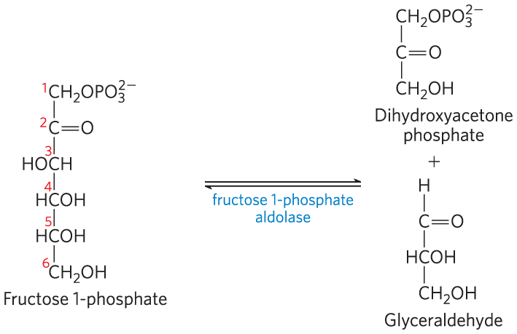
Fructose 1-Phosphate Aldolase
fructose 1-phosphate aldolase = cleaves fructose 1-phosphate to glyceraldehyde and dihydroxyacetone

Slide 47

Products of Fructose 1-Phosphate Hydrolysis Enter Glycolysis as Glyceraldehyde 3-Phosphate
triose phosphate isomerase = converts dihydroxyacetone phosphate to glyceraldehyde 3-phosphate
triose kinase = uses ATP to phosphorylate glyceraldehyde to glyceraldehyde 3-phosphate

Slide 48
Mannose Enters Glycolysis as Fructose 6-Phosphate
hexokinase = phosphorylates mannose at C-6
phosphohexose isomerase = converts mannose 6-phosphate to fructose 6-phosphate

Slide 49
14.3 Fates of Pyruvate

Slide 50
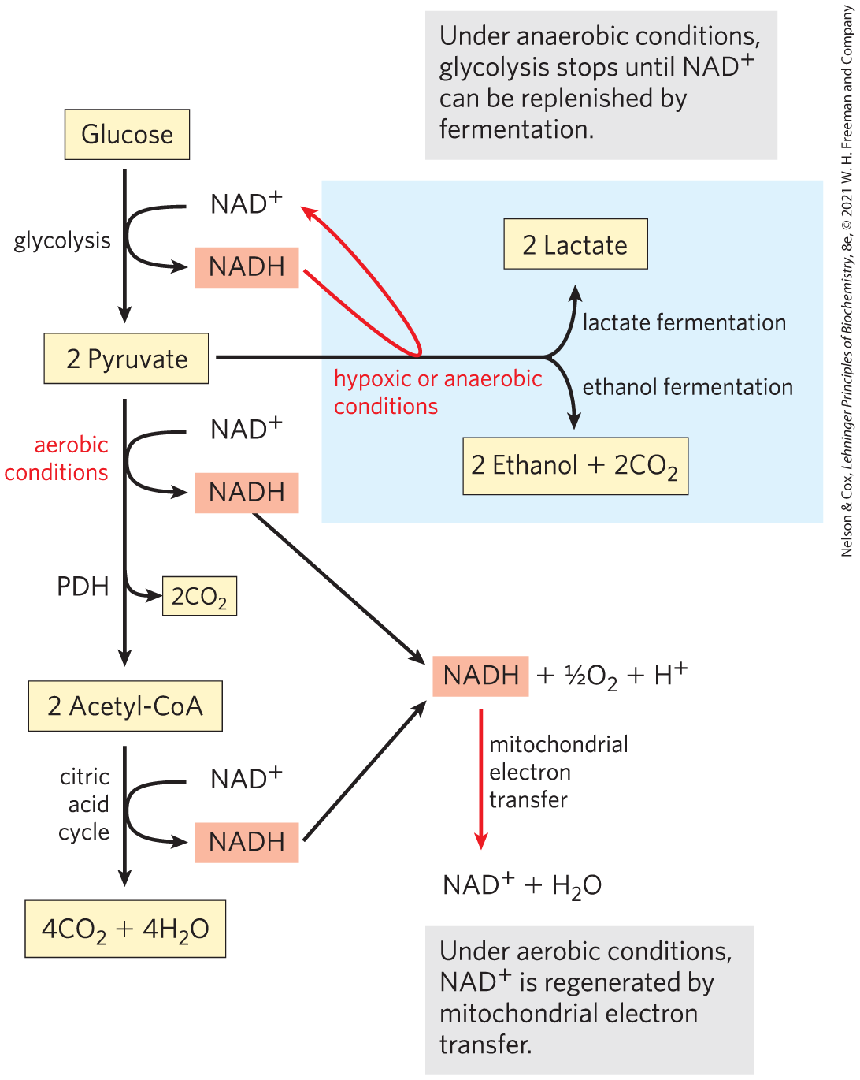
Three Catabolic Fates of Pyruvate
NADH must be recycled to regenerate NAD⁺
under aerobic conditions, pyruvate is oxidized to acetyl-CoA
under anaerobic conditions or low oxygen condition (hypoxia), pyruvate is reduced to lactate or ethanol

Slide 51
Fermentation
fermentation = general term for processes that extract energy (as ATP) but do not consume oxygen or change the concentrations of NAD⁺ or NADH
lactic acid fermentation = pyruvate accepts electrons from NADH and is reduced to lactate while regenerating the NAD⁺ necessary for glycolysis
ethanol (alcohol) fermentation = pyruvate is further catabolized to ethanol

Slide 52
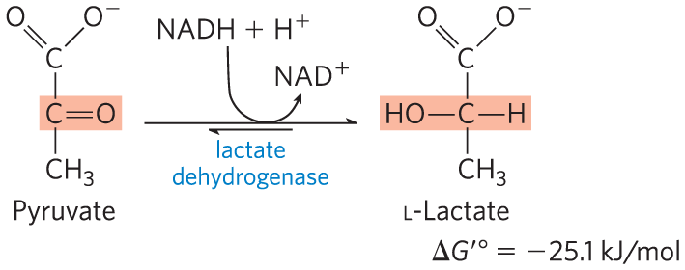
Pyruvate Is the Terminal Electron Acceptor in Lactic Acid Fermentation
organisms can regenerate NAD⁺ by transferring electrons from NADH to pyruvate, forming lactate
lactate dehydrogenase = catalyzes the reduction of pyruvate to lactate

Slide 53
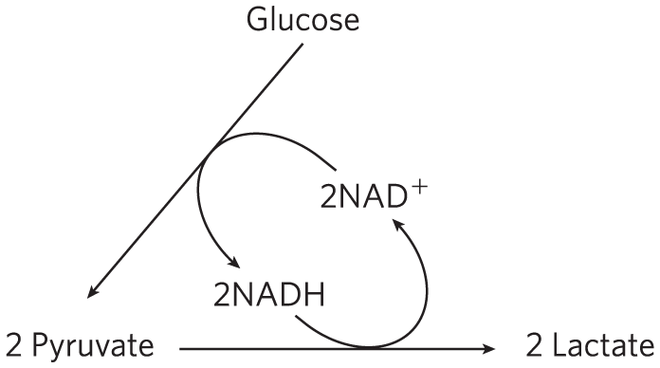
Reduction of Pyruvate to Lactate Regenerates NAD⁺
glycolysis converts 2NAD⁺ to 2NADH
reduction of pyruvate to lactate regenerates 2NAD⁺
there is no net change in NAD⁺ or NADH

Slide 54
14.4 Gluconeogenesis

Slide 55
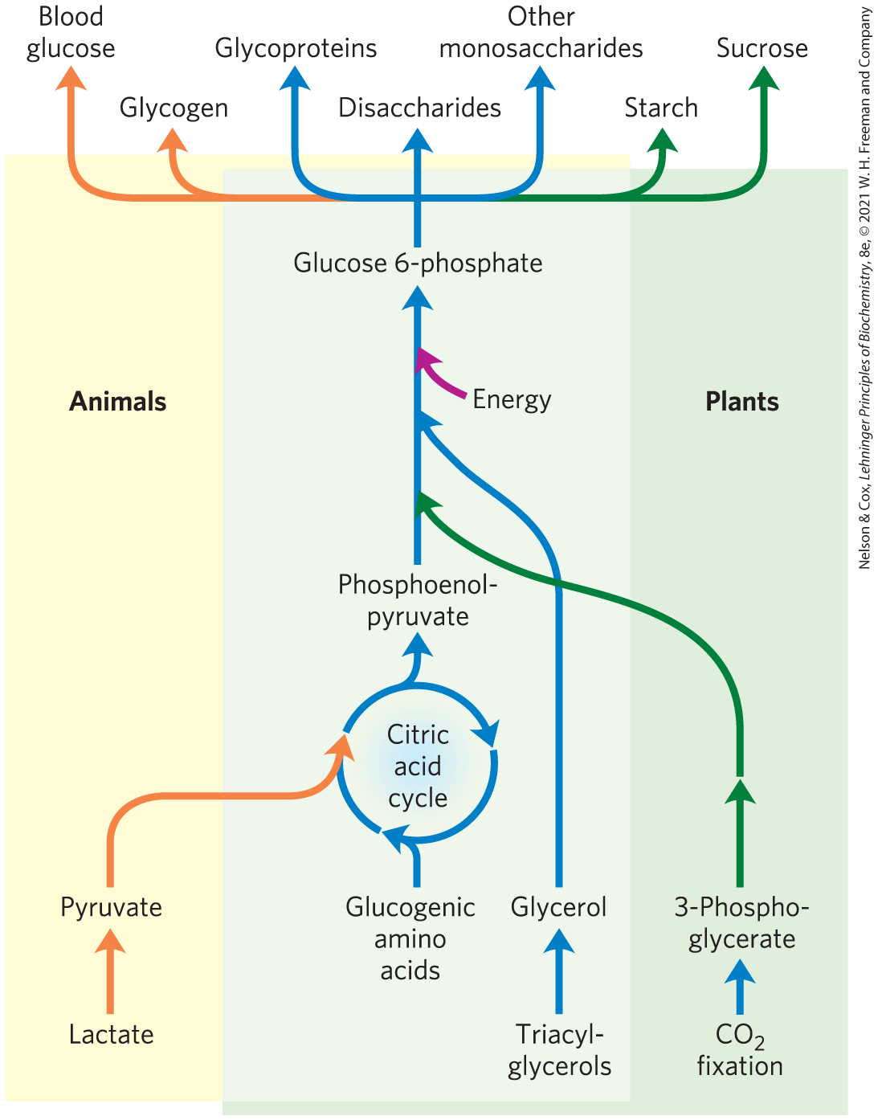
Gluconeogenesis
gluconeogenesis = pathway that converts pyruvate and related three- and four-carbon compounds to glucose
occurs in all animals, plants, fungi, and microorganisms
mainly occurs in the liver in mammals

Slide 56
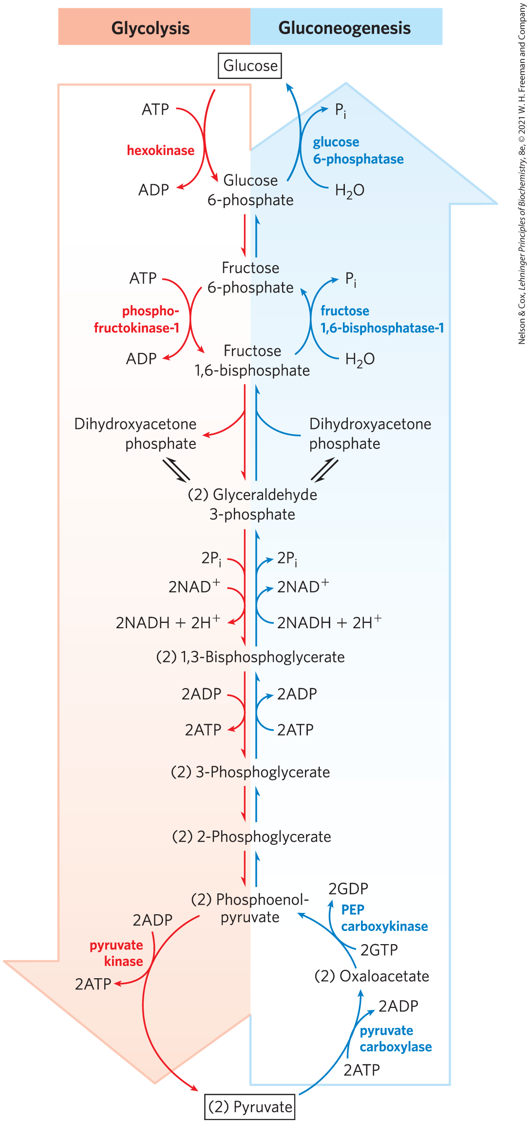
Gluconeogenesis and Glycolysis Share Several Steps
gluconeogenesis and glycolysis are not identical pathways running in opposite directions
3 glycolysis reactions are essentially irreversible in vivo and cannot be used in gluconeogenesis
  must be bypassed with exergonic reactions

Slide 57
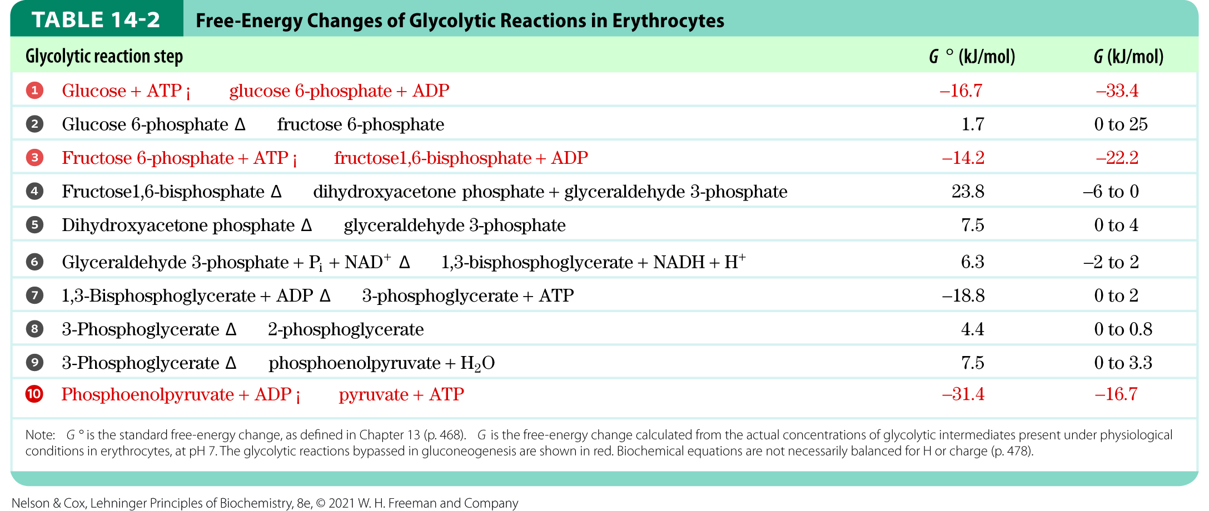
Free-Energy Changes of Glycolytic Reactions
the essentially irreversible glycolytic reactions are characterized by a large negative ∆G

Slide 58
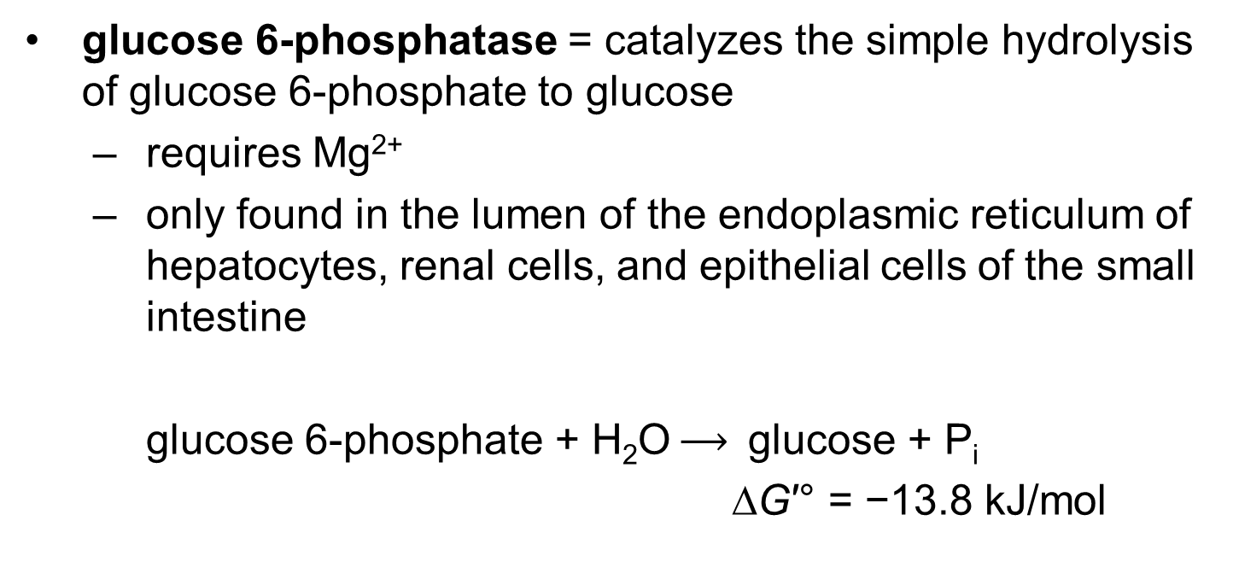
The Third Bypass Reaction
glucose 6-phosphatase = catalyzes the simple hydrolysis of glucose 6-phosphate to glucose
  requires Mg²⁺
  only found in the lumen of the endoplasmic reticulum of hepatocytes, renal cells, and epithelial cells of the small intestine
glucose 6-phosphate + H₂O $⟶$ glucose + P_{i}
∆G′° = −13.8 kJ/mol

Slide 59
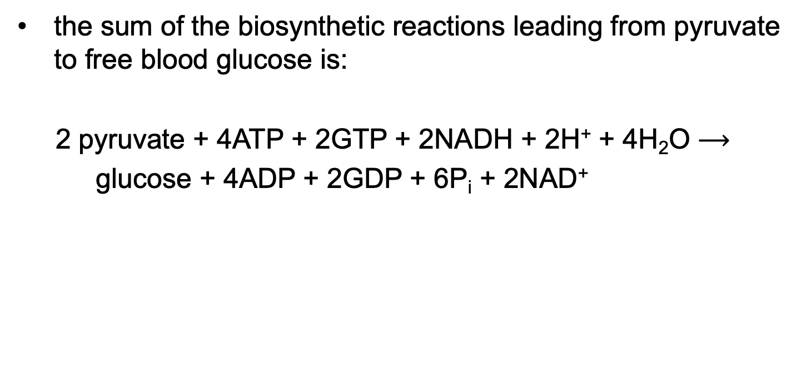
Gluconeogenesis Is Energetically Expensive, But Essential
the sum of the biosynthetic reactions leading from pyruvate to free blood glucose is:
2 pyruvate + 4ATP + 2GTP + 2NADH + 2H⁺ + 4H₂O $⟶$
glucose + 4ADP + 2GDP + 6P_{i} + 2NAD⁺
(14-9)

Slide 60
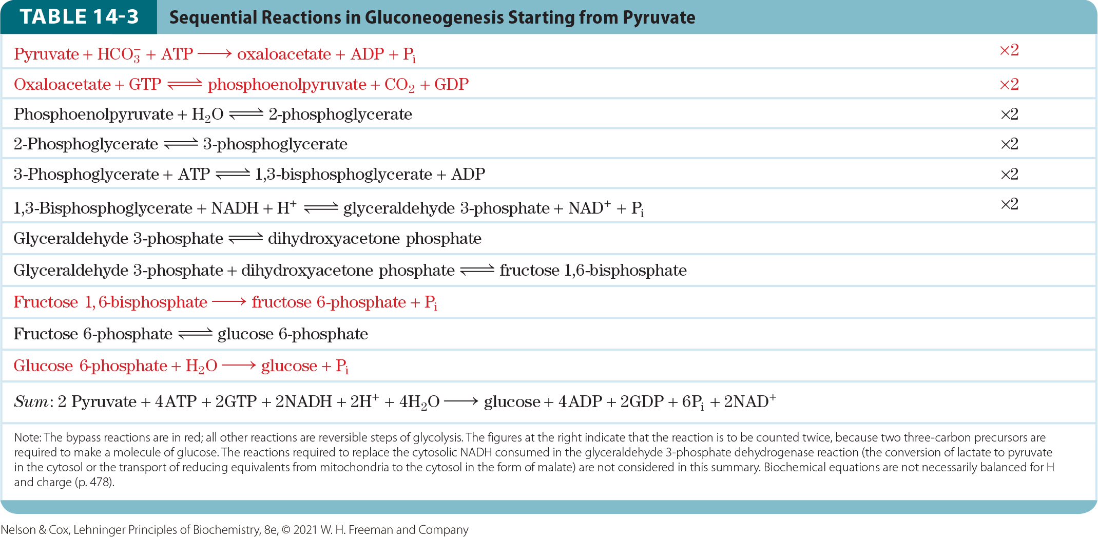
Sequential Reactions in Gluconeogenesis

Slide 61
Glucogenic Amino Acids
glucogenic amino acids = able to undergo net conversion to glucose
intermediates of the citric acid cycle can also undergo oxidation to oxaloacetate
Table 14-4 Glucogenic Amino Acids, Grouped by Site of Entry
Pyruvate | α-Ketoglutarate | Succinyl-CoA | Fumarate | Oxaloacetate
Alanine | Arginine | Isoleucine | Phenylalanine | Asparagine
Cysteine | Glutamate | Methionine | Tyrosine | Asparate
Glycine | Glutamine | Threonine
Serine | Histidine | Valine
Threonine | Proline
Tryptophan

Slide 62
Mammals Cannot Convert Fatty Acids to Glucose; Plants and Microorganisms Can
animals lack the enzymatic machinery to convert acetyl-CoA from fatty acids to pyruvate.
plants and microorganisms have the glyoxylate pathway, which allows them to make glucose from fatty acids

Slide 63
Glyceroneogenesis
glyceroneogenesis = conversion of pyruvate to dihydroxyacetone phosphate via the early reactions of gluconeogenesis, followed by reduction to glycerol 3-phosphate
  carried out in adipocytes

Slide 64
Glycolysis and Gluconeogenesis Are Reciprocally Regulated
simultaneous operation of both pathways at each of the three bypass points would consume ATP without accomplishing chemical or biological work
regulation prevents wasteful operation of both pathways at the same time

Slide 65
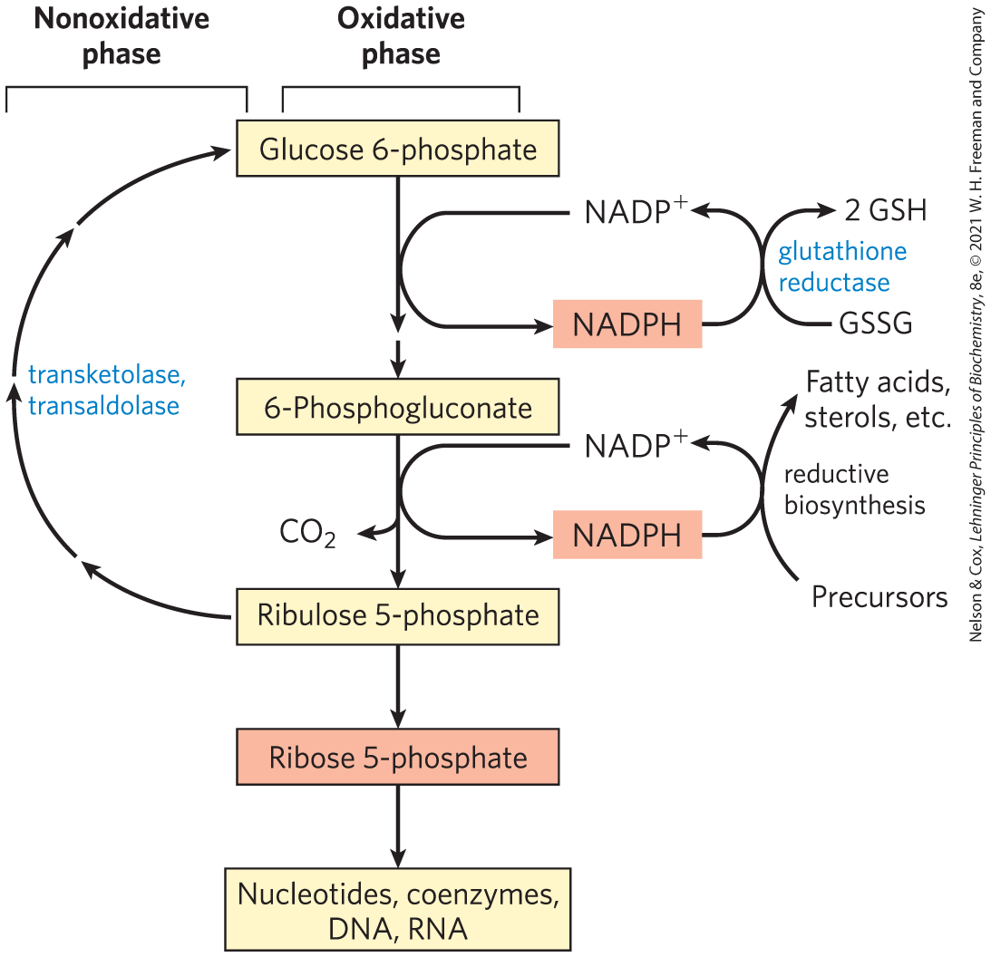
The Pentose Phosphate Pathway
pentose phosphate pathway (phosphogluconate pathway, hexose monophosphate pathway) = pathway that oxidizes glucose 6-phosphate, producing pentose phosphates and NADPH

Slide 66
Cells and Tissues That Use the Pentose Phosphate Pathway
rapidly dividing cells use ribose 5-phosphate to make RNA, DNA, and coenzymes
tissues that carry out extensive fatty acid synthesis (liver, adipose, lactating mammary gland) require the NADPH provided by this pathway.
tissues that actively synthesize cholesterol and steroid hormones (liver, adrenal glands, gonads) require the NADPH provided by this pathway.

Slide 67
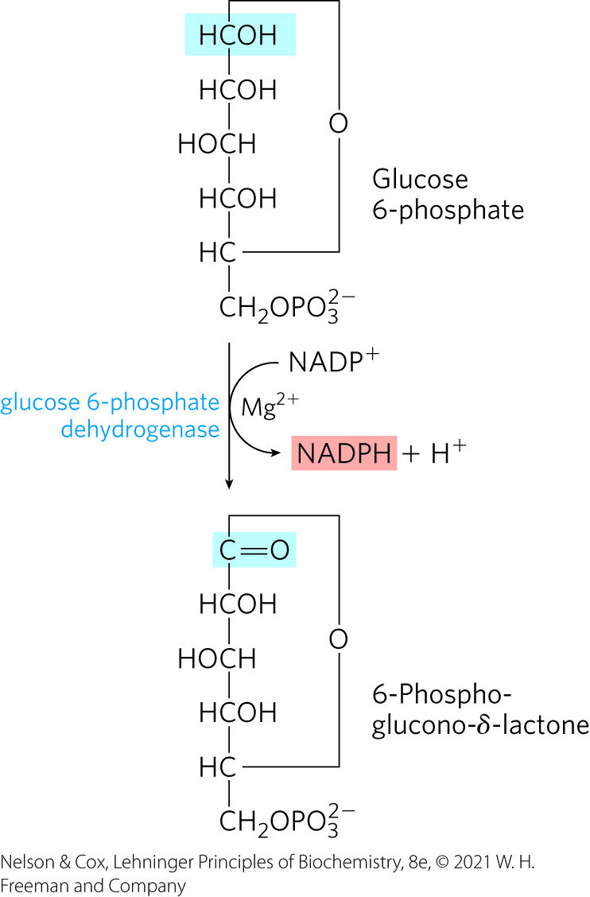
The Oxidative Phase Produces NADPH and Pentose Phosphates
glucose 6-phosphate dehydrogenase (G6PD) = catalyzes the oxidation of glucose 6-phosphate to 6-phosphoglucono-δ-lactone using NADP⁺ as the electron acceptor

Slide 68
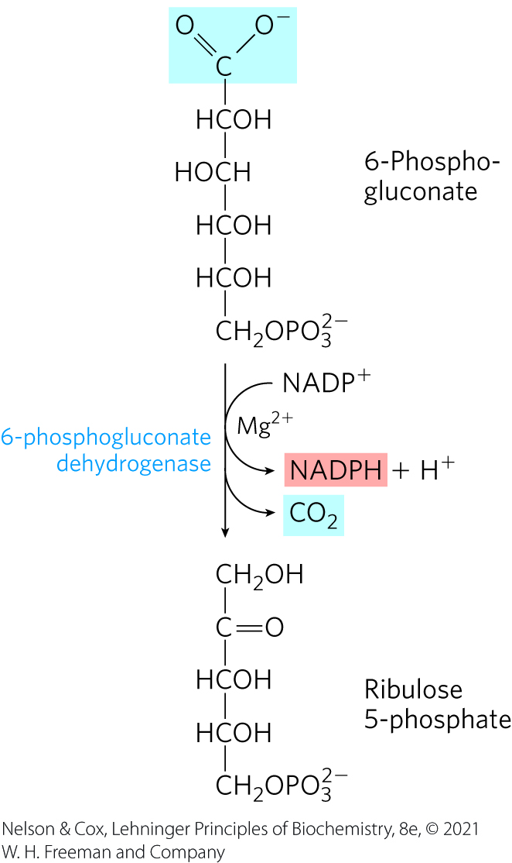
6-Phosphogluconate Dehydrogenase Forms Ribulose 5-Phosphate
6-phosphogluconate dehydrogenase = catalyzes the oxidation and decarboxylation of 6-phosphogluconate to form ribulose 5-phosphate and NADPH

Slide 69
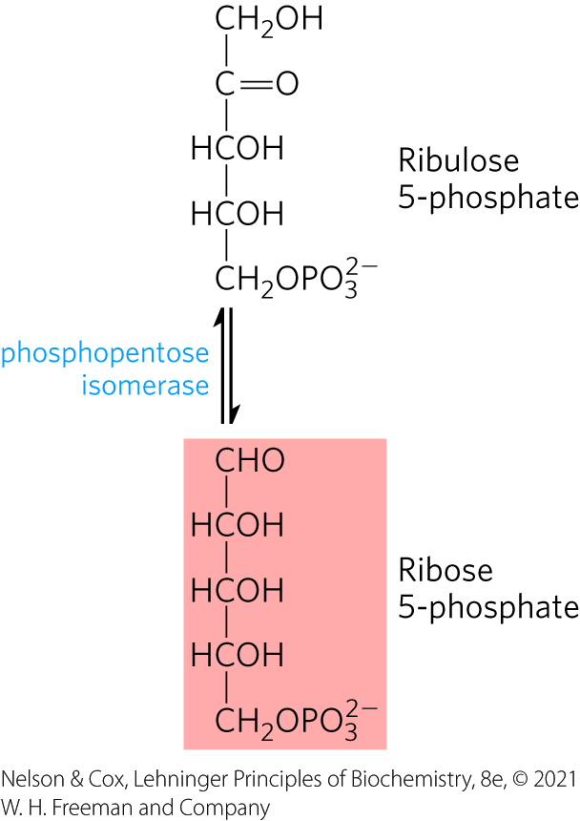
Phosphopentose Isomerase Generates Ribose 5-Phosphate
phosphopentose isomerase = converts ribulose 5-phosphate to its aldose isomer, ribose 5-phosphate

Slide 70

The Overall Equation for the Pentose Phosphate Pathway
the overall equation for this pathway is:
glucose 6-phosphate + 2NADP⁺ + H₂O $⟶$
ribulose 5-phosphate + CO₂ + 2NADPH + 2H⁺

Slide 71
The Reductive Pentose Phosphate Pathway
reductive pentose phosphate pathway = converts hexose phosphates to pentose phosphates
  central to the photosynthetic assimilation of CO₂ by plants
  essentially the reversal of the nonoxidative reactions of the pentose phosphate pathway

Slide 72
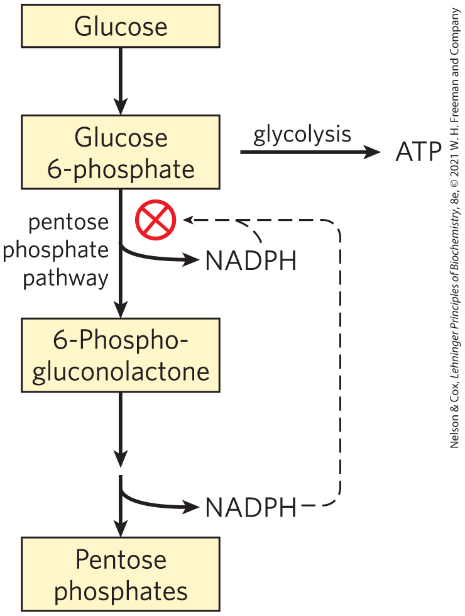
Glucose 6-Phosphate Is Partitioned between Glycolysis and the Pentose Phosphate Pathway
the relative concentrations of NADP⁺ and NADPH determine whether glucose 6-phosphate enters glycolysis or the pentose phosphate pathway

