Slide 1

13 Introduction to Metabolism
© 2021 Macmillan Learning

Slide 2
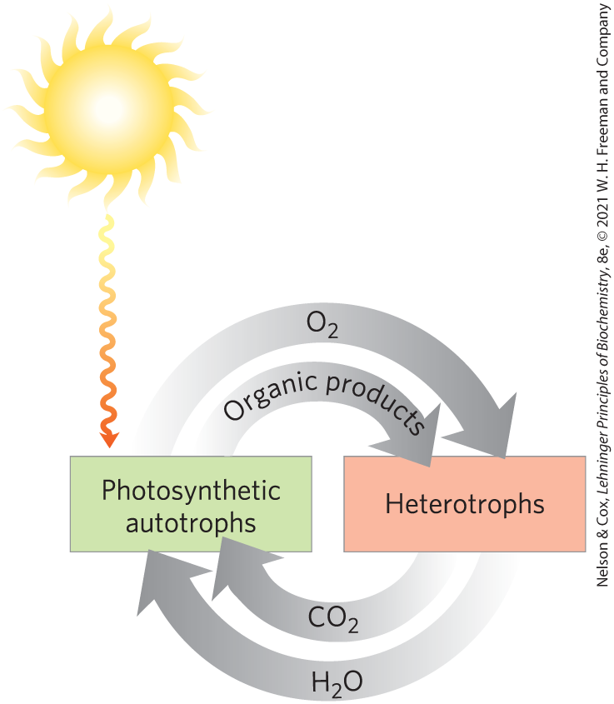
Autotrophs and Heterotrophs
autotrophs = use CO₂ from the atmosphere as their sole source of carbon
heterotrophs = cannot use atmospheric CO₂ and must obtain carbon from their environment

Slide 3
Metabolites and Intermediary Metabolism
metabolites = series of intermediates through which precursors are converted to products
intermediary metabolism = the combined activities of all the metabolic pathways that interconvert precursors, metabolites, and products of low molecular weight

Slide 4
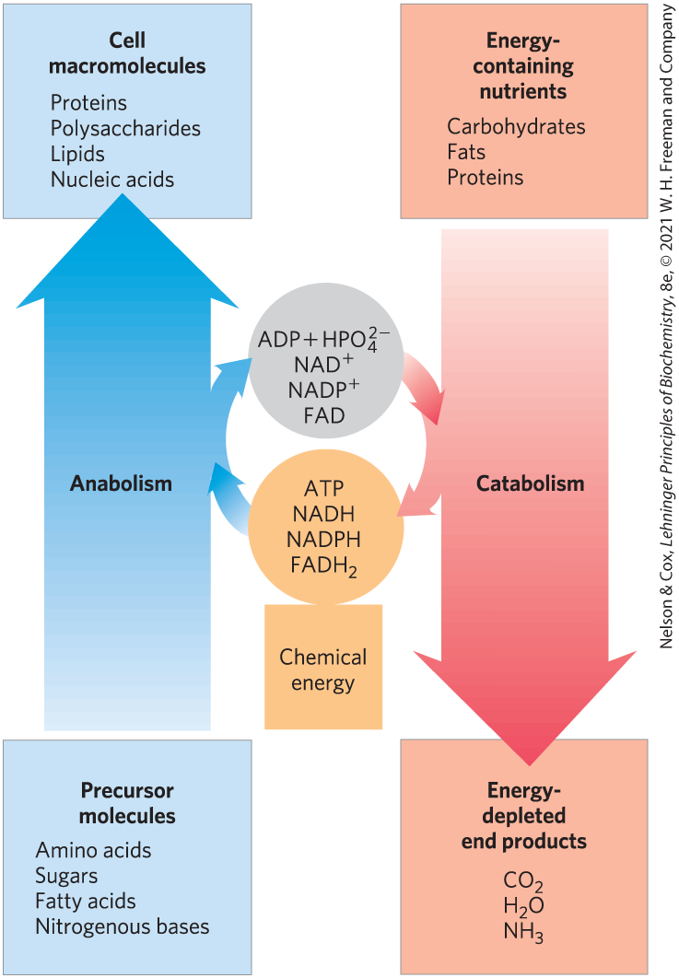
The Relationship Between Catabolic and Anabolic Pathways
catabolism = the degradative phase of metabolism
  releases energy
anabolism (biosynthesis) = the building phase of metabolism
  requires energy

Slide 5
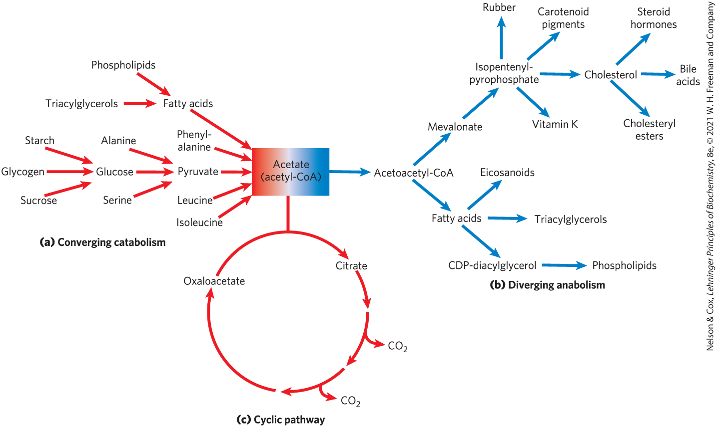
Catabolic Pathways Converge and Anabolic Pathways Diverge

Slide 6

Principle 1 (1 of 4)
The chemical changes and energy transductions in living organisms follow the laws of thermodynamics.

Slide 7

Principle 2 (1 of 3)
The free-energy change is the maximum energy made available to do work when a chemical reaction occurs. If two reactions can be combined to yield a third reaction, the overall free energy change is the sum of the two. Cells accomplish energy-requiring chemical work by coupling an energy-releasing (exergonic) reaction, such as the cleavage of ATP, to an endergonic reaction (which requires energy input).

Slide 8

Principle 3 (1 of 4)
Although thousands of different chemical reactions occur in the biosphere, most of them fall within a small set of reaction types.

Slide 9
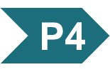
Principle 4 (1 of 5)
ATP is the universal energy currency in living organisms. Transfer of its phosphoryl group to a water molecule or metabolic intermediates provides the energetic push for muscle contraction, the pumping of solutes against concentration gradients, and the synthesis of complex molecules.

Slide 10
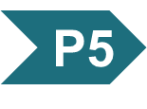
Principle 5 (1 of 5)
Oxidation-reduction reactions indirectly provide much of the energy needed to make ATP. Reduced substrates such as glucose are oxidized in several steps, with the energy of oxidation steps conserved in the form of a reduced cofactor, NADH. Energy stored in NADH is used to drive the synthesis of ATP.

Slide 11
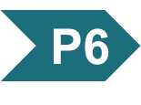
Principle 6 (1 of 5)
To respond to changes in external circumstances, cells must regulate enzyme activities by changing either the number of enzyme molecules or the catalytic activity of preexisting enzyme molecules.

Slide 12
13.1 Bioenergetics and Thermodynamics

Slide 13
Bioenergetics Is the Quantitative Study of Energy Transductions
energy transductions = changes of one form of energy into another

Slide 14
Biological Energy Transformations Obey the Laws of Thermodynamics
the first law of thermodynamics is the principle of the conservation of energy
the second law of thermodynamics says that the universe always tends toward increasing disorder

Slide 15
Systems and Their Surroundings
reacting system = the collection of matter that is undergoing a particular chemical or physical process
  can be closed or open
universe = the reacting system and its surroundings together
living cells and organisms are open systems, exchanging material and energy with their surroundings

Slide 16
Free Energy, G
free energy, G = expresses the amount of energy capable of doing work during a reaction at constant temperature and pressure
  when ∆G is negative, free energy is released and the reaction is exergonic
  when ∆G is positive, free energy is gained and the reaction is endergonic

Slide 17
Enthalpy, H
enthalpy, H = the heat content of the reacting system
  reflects the number and kinds of chemical bonds (covalent and noncovalent) in the reactants and products
  when ∆H is negative, the reaction releases heat and the reaction is exothermic
  when ∆H is positive, the reaction takes up heat and the reaction is endothermic

Slide 18
Entropy, S
entropy, S = a quantitative expression for the randomness or disorder in a system
  when ∆S is negative, the reactants are less complex and more disordered than the products
  when ∆S is positive, the products are less complex and more disordered than the reactants

Slide 19
Free Energy Change, ∆G
free-energy change, ∆G = ∆H − T∆S
  ∆H is negative for a reaction that releases heat
  ∆S is positive for a reaction that increases the system’s randomness
spontaneous reactions occur when ∆G is negative
(13-1)

Slide 20
Living Cells and the Second Law of Thermodynamics
the order produced within cells as they grow and divide is compensated for by the disorder they create in their surroundings
  living organisms take free energy from, and return heat and entropy to, their surroundings

Slide 21
Standard Free-Energy Changes of Some Chemical Reactions
Reaction type | ΔG′˚ (kJ/mol) | ΔG′˚ (kcal/mol)
Hydrolysis reactions
Acid anhydrides
Acetic anhydride + H₂O→2 acetate | −91.1 | −21.8
ATP + H₂O→ADP + P_{i} | −30.5 | −7.3
ATP + H₂O→AMP + PP_{i} | −45.6 | −10.9
PP_{i} + H₂O→2P_{i} | −19.2 | −4.6
UDP-glucose + H₂O→UMP + glucose 1-phosphate | −43.0 | −10.3
Esters
Ethyl acetate + H₂O→ethanol + acetate | −19.6 | −4.7
Glucose 6-phosphate + H₂O→glucose + P_{i} | −13.8 | −3.3
Amides and peptides
Glutamine + H₂O→glutamate + NH⁺₄ | −14.2 | −3.4
Glycylglycine + H₂O→2 glycine | −9.2 | −2.2
Glycosides
Maltose + H₂O→2 glucose | −15.5 | −3.7
Lactose + H₂O→glucose + galactose | −15.9 | −3.8
Rearrangements
Glucose 1-phosphate→glucose 6-phosphate | −7.3 | −1.7
Fructose 6-phosphate→glucose 6-phosphate | −1.7 | −0.4
Elimination of water
Malate →fumarate + H₂O | 3.1 | 0.8
Oxidations with molecular oxygen
Glucose + 6O₂→6CO₂+ 6H₂O | −2,840 | −686
Palmitate + 23O₂→16CO₂+ 16H₂O | −9,770 | −2,338
to describe the energy released under the conditions existing in cells, an expression for the actual free-energy change is needed
Table 13-4 Standard Free-Energy Changes of Some Chemical Reactions

Slide 22
Free-Energy Changes and Enzymes
the free-energy change for a reaction is independent of the pathway by which the reaction occurs
enzymes cannot change equilibrium constants
  can increase the rate at which a reaction proceeds

Slide 23
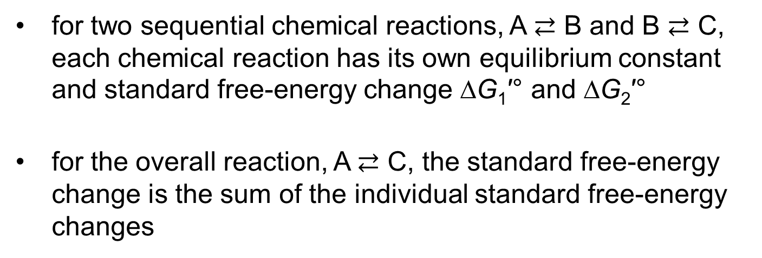
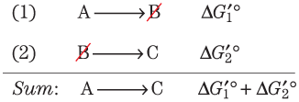
Standard Free-Energy Changes
Are Additive

Slide 24
Thermodynamically Unfavorable Reactions Can Be Coupled to Favorable Reactions
a thermodynamically unfavorable (endergonic) reaction can be driven in the forward direction by coupling it to a highly exergonic reaction
  often involves coupling to ATP hydrolysis (∆G′° = -30.5 kJ/mol)

Slide 25
13.2 Chemical Logic and Common Biochemical Reactions

Slide 26
Biochemical Reactions Occur in Repeating Patterns
five general categories of reactions in living cells:
  reactions that make or break carbon–carbon bonds
  internal rearrangements, isomerizations, and eliminations
  free-radical reactions
  group transfers
  oxidation-reductions

Slide 27
Kinases, Phosphorylases, and Phosphatases
kinases = transfer a phosphoryl group from ATP to an acceptor molecule
  catalyze a phosphorylation reaction
phosphorylases = catalyze a displacement reaction where phosphate attacks and becomes covalently attached at the point of bond breakage
  catalyze a phosphorolysis reaction
phosphatases = catalyze the removal of a phosphoryl group from a phosphate ester
  catalyze dephosphorylation reactions

Slide 28
Synthases, Synthetases,
Ligases, and Lyases
synthases = catalyze condensation reactions in which no nucleotide triphosphate is required
synthetases = catalyze condensation reactions that require a nucleotide triphosphate
ligases = catalyze condensation reactions in which two atoms are joined using ATP or another energy source
lyases = catalyze cleavages or additions in which electronic rearrangements occur

Slide 29
Oxidases and Oxygenases
oxidases = catalyze biological oxidation reactions where oxygen is the electron acceptor and oxygen does not appear in the oxidized product
  mixed function oxidases = oxidize two different substrates simultaneously
oxygenases = catalyze biological oxidation reactions where oxygen is the electron acceptor and oxygen does appear in the oxidized product
  monooxygenases = one oxygen atom is incorporated in the product
  dioxygenases = two oxygen atoms are incorporated in the product

Slide 30
Dehydrogenases
dehydrogenases = catalyze oxidation-reductase reactions in which NAD⁺ is the electron acceptor and molecular oxygen is not involved

Slide 31
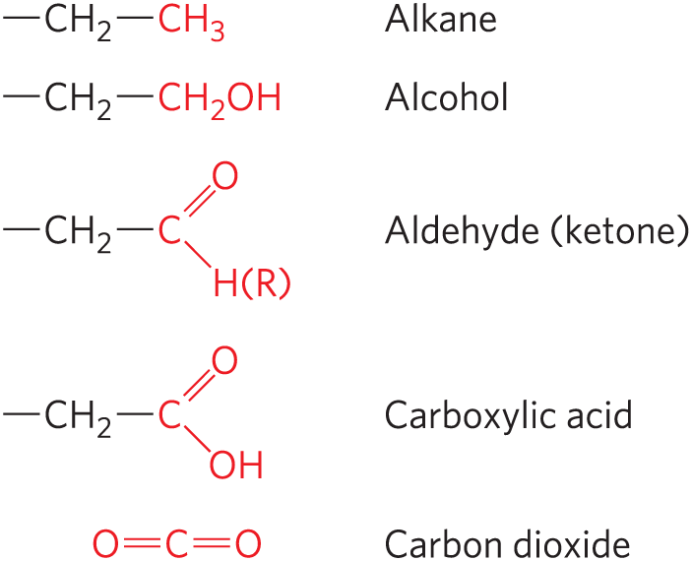
Oxidation-Reduction Reactions
least oxidized
carbon atoms exist in different oxidation states, depending on the elements with which they share electrons
most oxidized

Slide 32
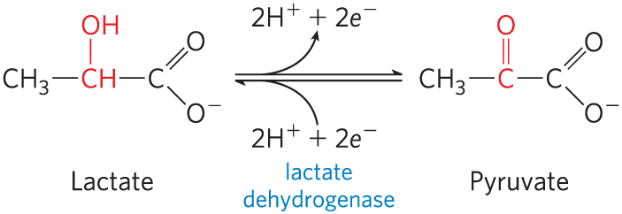
An Oxidation-Reduction Reaction
in many biological oxidations, a compound loses two electrons and two hydrogen ions
  catalyzed by dehydrogenases
in some biological oxidations, a carbon atom becomes bonded to an oxygen
  catalyzed by oxidases or oxygenases

Slide 33
Oxidations Are Accompanied by Reductions
oxidation-reduction reactions involve the loss or gain of electrons
  one reactant gains electrons and is reduced
  the other loses electrons and is oxidized
oxidation reactions generally release energy
  living cells oxidize metabolic fuels (carbohydrates, fat)

Slide 34
Biochemical and Chemical Equations Are Not Identical
biochemical equations:
  do not balance for H⁺ or Mg²⁺
  do not attempt to describe the state of phosphate ionization
chemical equations account for all atoms and charges in a reaction

Slide 35
13.3 Phosphoryl Group Transfers and ATP

Slide 36
The Special Role of ATP
ATP is the chemical link between catabolism and anabolism
  energy obtained from catabolism of nutrient molecules is used to make ATP from ADP and P_{i}
  the exergonic conversion of ATP to ADP and P_{i} (or to AMP and PP_{i}) is coupled to many endergonic reactions and processes

Slide 37
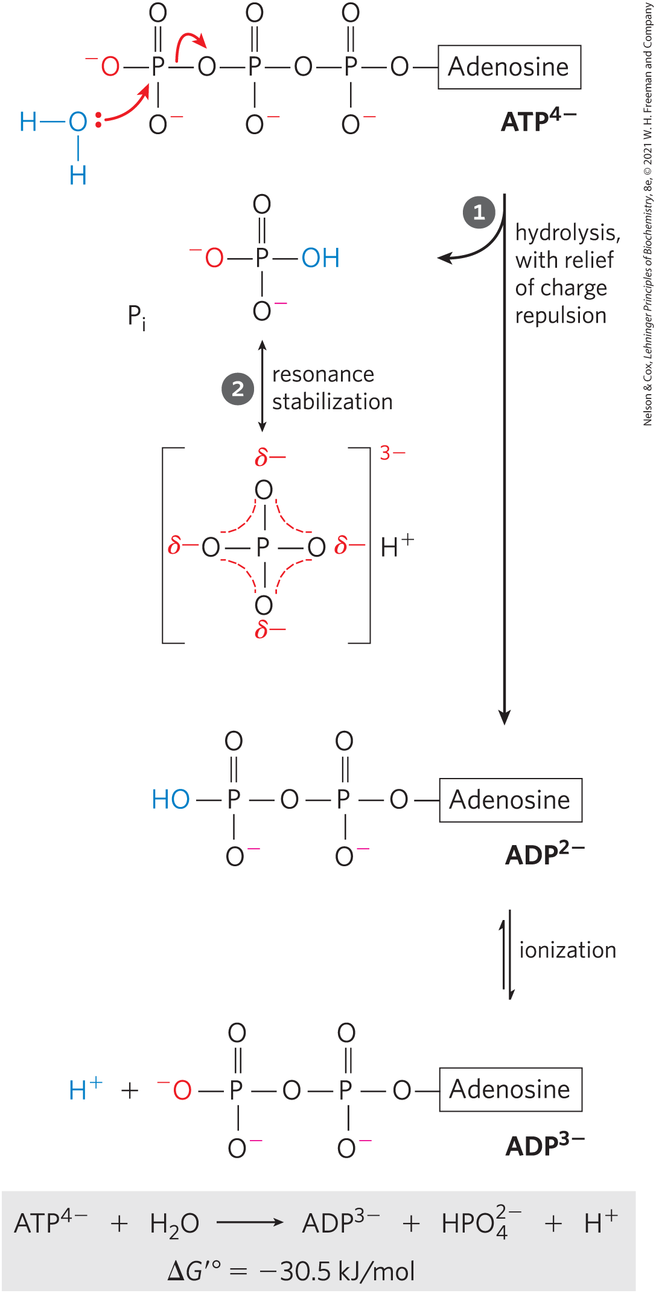
The Free-Energy Change for ATP Hydrolysis Is Large and Negative
the hydrolytic cleavage of the terminal phosphoanhydride bond in ATP relieves some of the internal electrostatic repulsion in ATP

Slide 38
Cellular Conditions of ATP,
ADP, and P_{i}
Table 13-5 Total Concentrations of Adenine Nucleotides, Inorganic Phosphate, and Phosphocreatine in Some Cells
Cell type | Concentration (mM): ATP | Concentration (mM): ADP | Concentration (mM): AMP | Concentration (mM): P_{i} | Concentration (mM): PCr
Rat hepatocyte | 3.38 | 1.32 | 0.29 | 4.8 | 0
Rat myocyte | 8.05 | 0.93 | 0.04 | 8.05 | 27
Rat neuron | 2.59 | 0.73 | 0.06 | 2.72 | 4.7
Human erythrocyte | 2.25 | 0.25 | 0.02 | 1.65 | 0
E. coli cell | 9.6 | 0.56 | 0.28 | ⸻ | ⸻

Slide 39
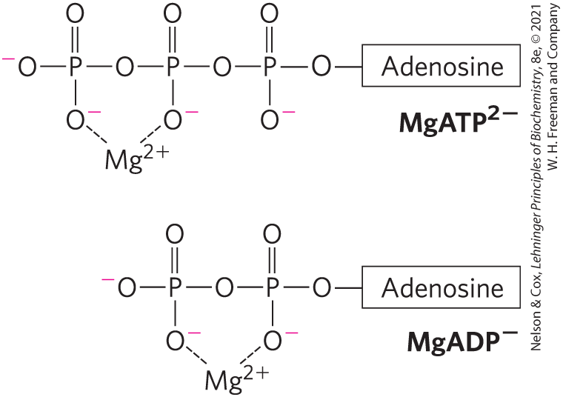
Mg²⁺ and ATP
Mg²⁺ in the cytosol binds to ATP and ADP
for most enzymatic reactions involving ATP, the true substrate is MgATP²⁻

Slide 40
The Free-Energy Change for
ATP Hydrolysis Under Cellular Conditions
phosphorylation potential, ∆G_{p} = the actual free energy of hydrolysis of ATP under intracellular conditions
  varies from cell to cell and over time
in vivo, the energy released by ATP hydrolysis is greater than the standard free-energy change, ∆G′°

Slide 41
Cellular ATP Levels
due to strong selective pressure over the course of evolution, regulatory mechanisms hold cellular [ATP] far above the equilibrium concentrations for the hydrolysis reaction
when the ATP level drops:
  the amount of fuel decreases
  the fuel itself loses its potency

Slide 42
Other Phosphorylated Compounds and Thioesters Also Have Large, Negative Free Energies of Hydrolysis
in these phosphate-releasing reactions, the several resonance forms available to P_{i} stabilize this product relative to the reactant
Table 13-6 Standard Free Energies of Hydrolysis of Some Phosphorylated Compounds and Acetyl-CoA (a Thioester)
Compounds and Acetyl-CoA | ΔG′°: (kJ/mol) | ΔG′°: (kcal/mol)
Phosphoenolpyruvate | −61.9 | −14.8
1,3-Bisphosphoglycerate (→3-phosphoglycerate + P_{i}) | −49.3 | −11.8
Phosphocreatine | −43.0 | −10.3
ADP (→AMP + P_{i}) | −32.8 | −7.8
ATP (→ADP + P_{i}) | −30.5 | −7.3
ATP (→AMP + PP_{i}) | −45.6 | −10.9
AMP (→adenosine + P_{i}) | −14.2 | −3.4
PP_{i}(→2P_{i}) | −19.2 | −4.0
Glucose 3-phosphate | −20.9 | −5.0
Fructose 6-phosphate | −15.9 | −3.8
Glucose 6-phosphate | −13.8 | −3.3
Glycerol 3-phosphate | −9.2 | −2.2
Acetyl-CoA | −31.4 | −7.5

Slide 43
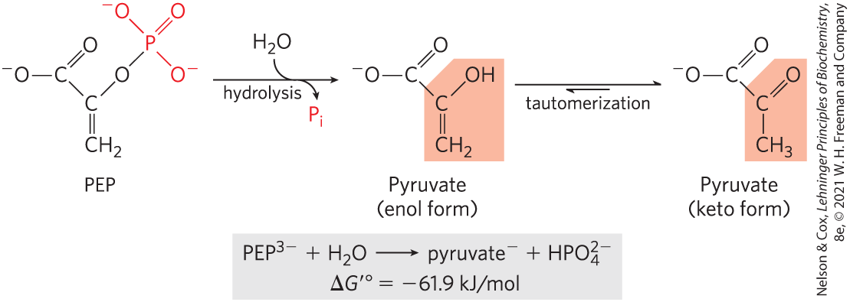
Hydrolysis of Phosphoenolpyruvate (PEP)
high standard free energy of hydrolysis because:
  the reaction occurs with a gain in entropy
  greater resonance stabilization in the P_{i} released by PEP cleavage

Slide 44
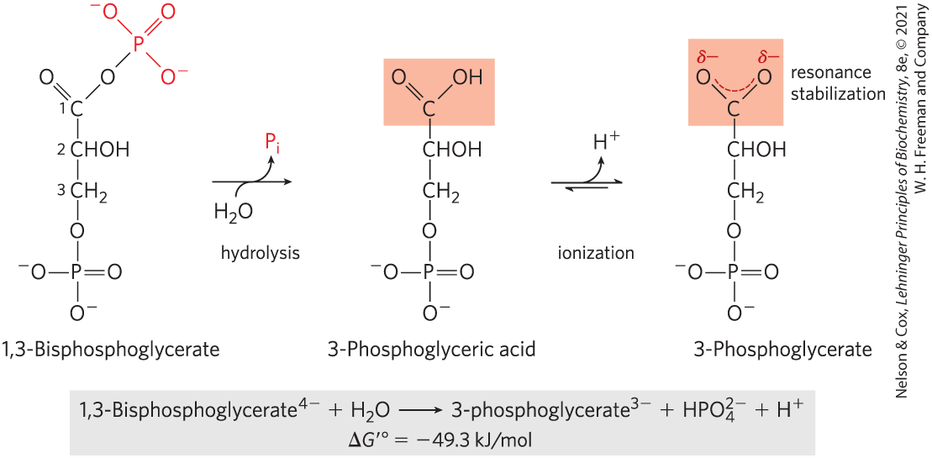
Hydrolysis of 1,3-Bisphosphoglycerate
large standard free energy of hydrolysis because:
  3-phosphoglycerate has two resonance forms
  removal of 3-phosphoglyceric acid by further metabolism and formation of the ion favor the forward reaction

Slide 45
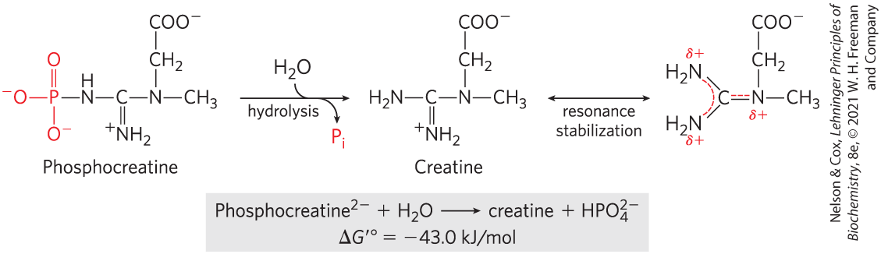
Hydrolysis of Phosphocreatine
large standard free energy of hydrolysis because the release of P_{i} and the resonance stabilization of creatine favor the forward reaction

Slide 46
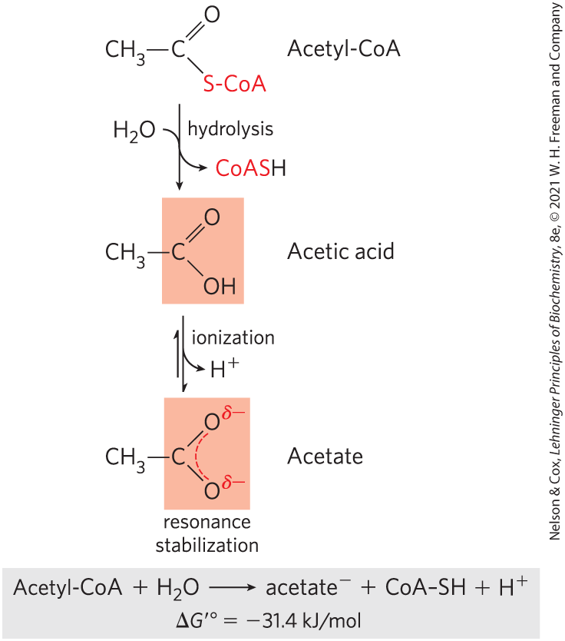
Hydrolysis of Acetyl-Coenzyme A
thioesters = have a sulfur atom that has replaced the oxygen in the ester bond

Slide 47
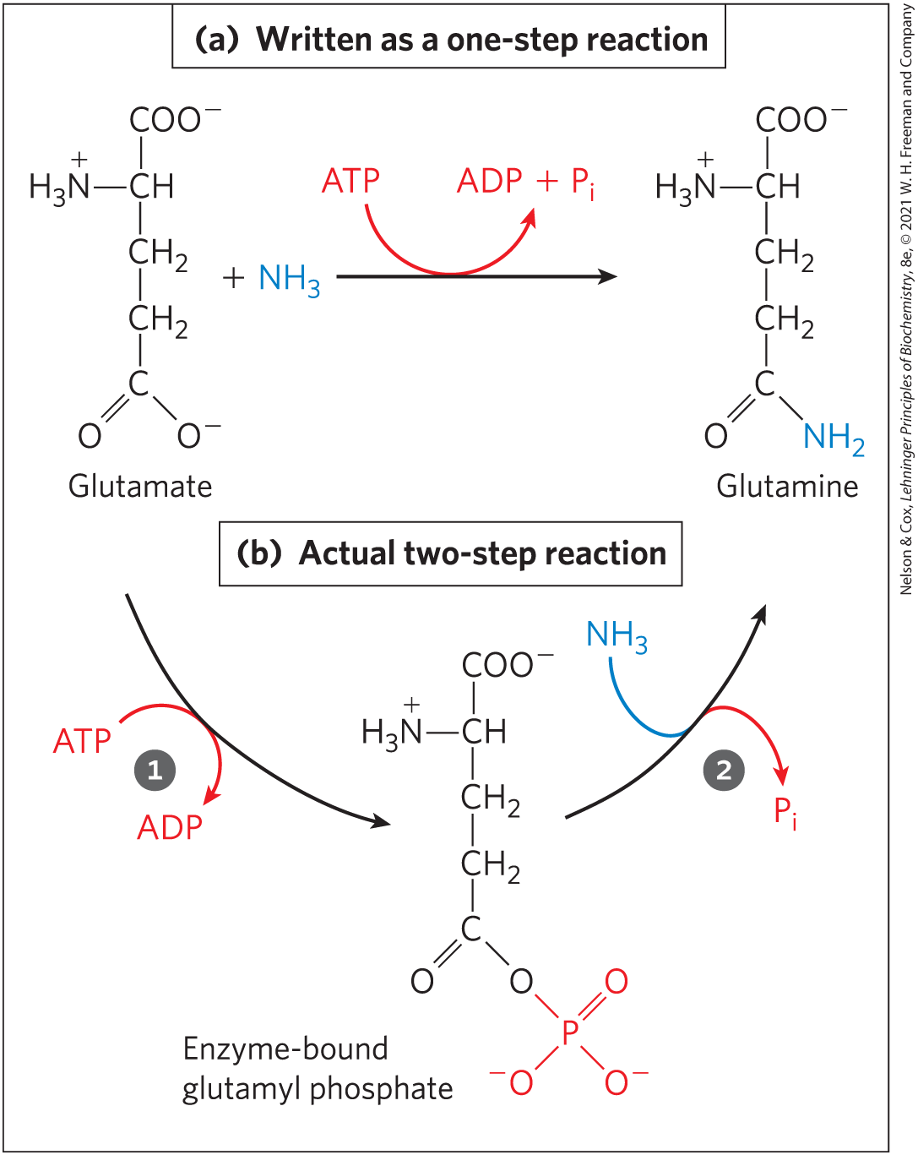
ATP Provides Energy by Group Transfers, Not by Simple Hydrolysis
first step = transfer of part of the ATP molecule to a substrate molecule or to an amino acid residue, activating it
second step = displacement of the phosphate-containing moiety, generating P_{i}, PP_{i}, or AMP as the leaving group

Slide 48
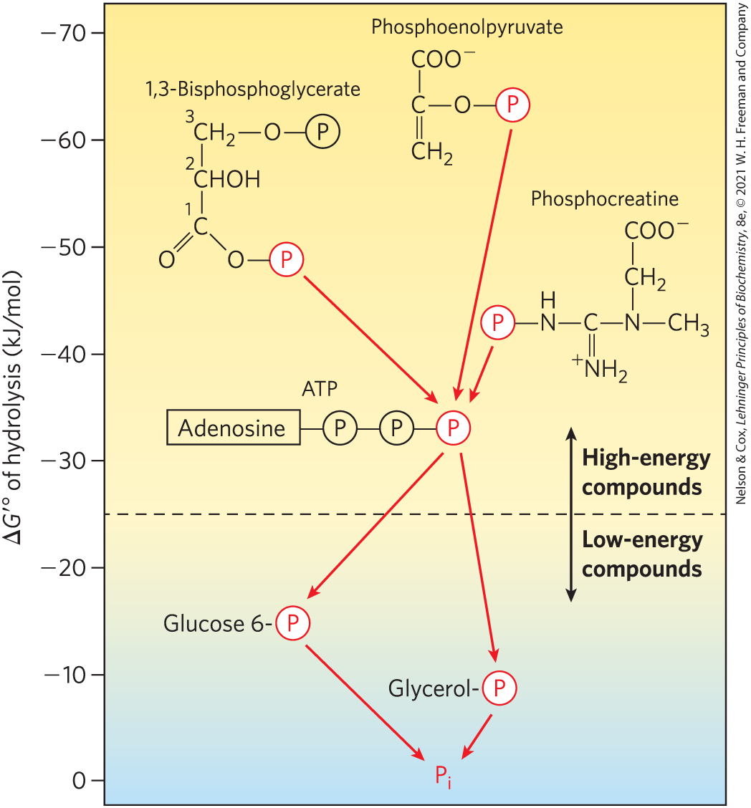
Ranking of Biological Phosphate Compounds by ∆G′°
“high-energy” compounds have a ∆G′° more negative than -25 kJ/mol
“low-energy” compounds have a less negative ∆G′°

Slide 49
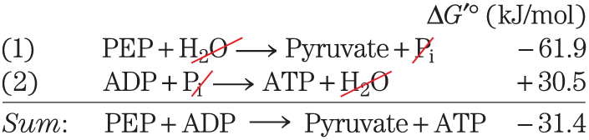
Phosphate Compounds with High ∆G′° of Hydrolysis Donate their Phosphoryl Group
any phosphorylated compound can be synthesized by coupling the synthesis to the breakdown of another phosphorylated compound with a more negative free energy of hydrolysis

Slide 50
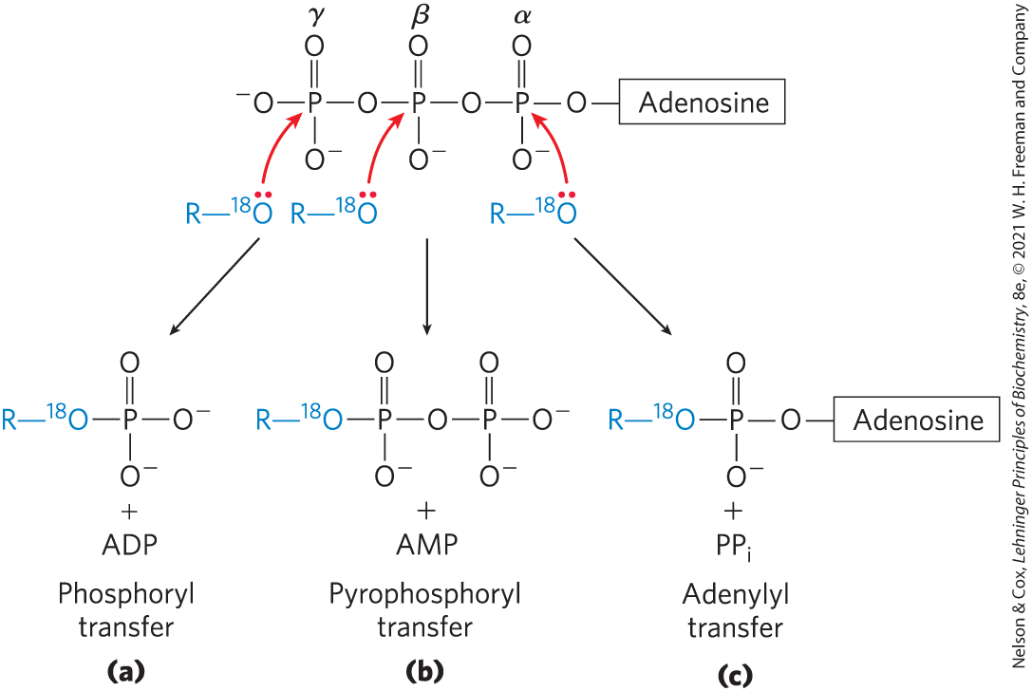
ATP Donates Phosphoryl, Pyrophosphoryl, and Adenylyl Groups
each of the three phosphates of ATP is susceptible to nucleophilic attack

Slide 51
Adenylylation Reactions
adenylylation = reaction that transfers adenylate (5′-AMP) as an adenyl group
  often the method of energy coupling
thermodynamically very favorable
  hydrolysis of the α–β phosphoanhydride bond releases more energy than hydrolysis of the β–γ bond
  PP_{i} formed as a byproduct is hydrolyzed to two P_{i} by inorganic pyro­phosphatase, releasing additional energy

Slide 52
Assembly of Informational Macromolecules Requires Energy
through group transfer reactions, ATP provides the energy for:
  the synthesis of informational macromolecules (DNA, RNA, protein)
  the transport of molecules and ions across membranes against gradients
through hydrolysis, ATP provides the energy for muscle contraction

Slide 53
Transphosphorylations between Nucleotides Occur in All Cell Types
the other nucleoside triphosphates (GTP, UTP, and CTP) and all deoxynucleoside triphosphates (dATP, dGTP, dTTP, and dCTP) are energetically equivalent to ATP
nucleoside diphosphate kinase = carries phosphoryl groups from ATP to other nucleotides
  high [ATP]/[ADP] ratio normally drives the reaction forward

Slide 54
Adenylate Kinase and Creatine Kinase
adenylate kinase = lowers the ADP concentration and replenishes ATP during periods of intense demand for ATP
  guanylate kinase is a similar enzyme
creatine kinase = uses the phosphocreatine reservoir to replenish ATP at a rapid rate
  lower phyla organisms employ phosphagens (phosphocreatine-like molecules) as phosphoyl reservoirs

Slide 55
13.4 Biological Oxidation-Reduction Reactions

Slide 56
The Flow of Electrons in Oxidation-Reduction Reactions
electron flow in oxidation-reduction reactions is responsible for all work done by living organisms
electrons move from metabolic intermediates to electron carriers to acceptors with higher electron affinities
  release energy

Slide 57
The Flow of Electrons Can Do Biological Work
electromotive force (emf) = force proportional to the difference in electron affinity between chemical species
  drives electron flow spontaneously through a circuit
biological “circuit” = electrons from glucose flow through a series of electron-carrier intermediates to another chemical species, such as O₂

Slide 58
Conjugate Redox Pairs
reducing agent or reductant = electron-donating molecule
oxidizing agent or oxidant = electron-accepting molecule
conjugate redox pair = consists of an electron donor and an electron acceptor

Slide 59
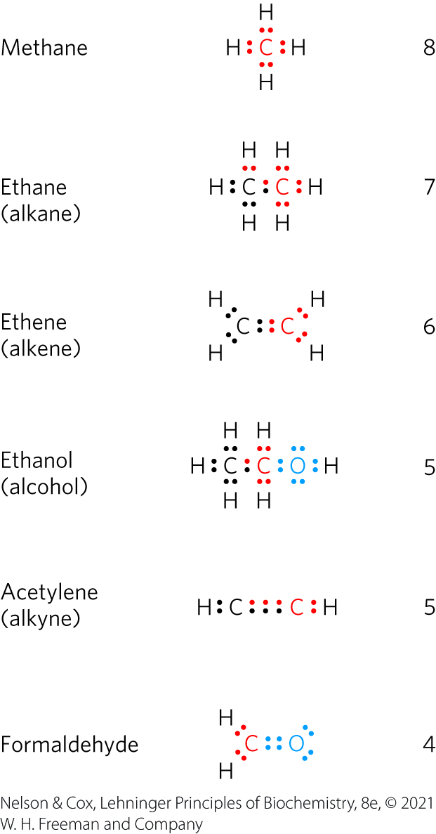
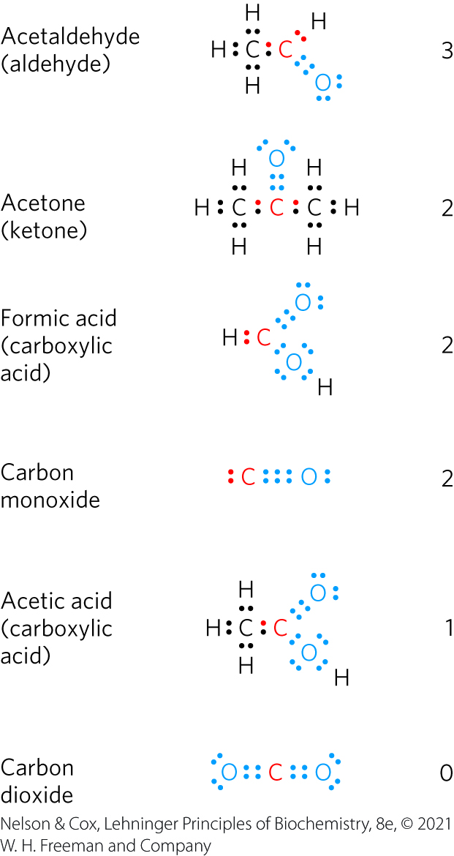
Biological Oxidations Often Involve Dehydrogenation
the more electro-negative atom “owns” the bonding electrons it shares with another atom

Slide 60
Oxidation Is Often Synonymous
With Dehydrogenation
dehydrogenation = reaction where a compound loses two electrons and two hydrogen ions
  catalyzed by dehydrogenases
electrons are transferred from the electron donor to the electron acceptor:
  directly as electrons
  as hydrogen atoms
  as a hydride ion (:H⁻)
  through direct combination with oxygen

Slide 61
A Few Types of Coenzymes and Proteins Serve as Universal Electron Carriers
NAD, NADP, FMN, and FAD are water-soluble coenzymes that undergo reversible oxidation and reduction in many of the electron-transfer reactions
  NAD and NADP are freely diffusible
  FMN and FAD are usually enzyme-bound

Slide 62
The Pyridine Nucleotides
pyridine nucleotides = compounds with a nicotinamide ring that resembles pyridine
  nicotinamide adenine dinucleotide (NAD; NAD⁺ when oxidized)
  nicotinamide adenine dinucleotide phosphate (NADP; NADP⁺ when oxidized)

Slide 63
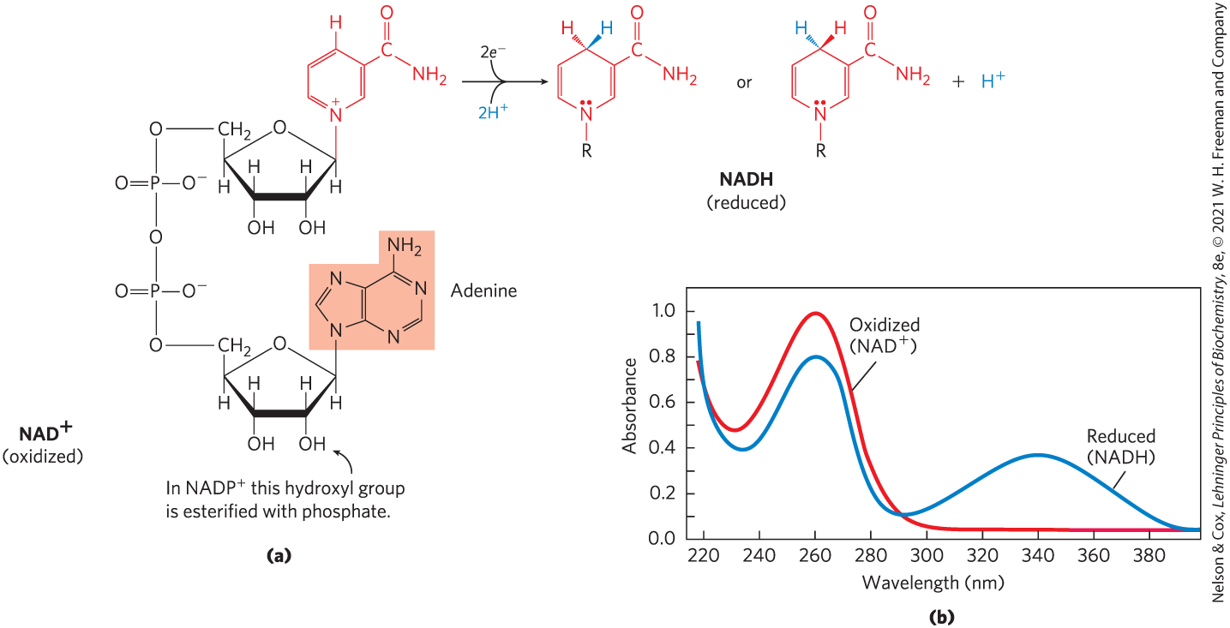
NAD and NADP Undergo Reversible Reduction of the Nicotinamide Ring

Slide 64
Oxidoreductase (Dehydrogenases)
oxidoreductases = also called dehydrogenases = catalyze oxidation-reductase reactions using NAD⁺ (or NADP⁺) as coenzymes

Slide 65
NAD Has Important Functions in Addition to Electron Transfer
NAD⁺ is:
  the source of the activating AMP group in the bacterial DNA ligase reaction
  the source of ADP-ribose in the cholera toxin reaction
  hydrolyzed in the deacetylation of the ε-amino group of an acetylated Lys residue by sirtuin proteins
    regulates inflammation, apoptosis, aging, and DNA transcription (through histones)

Slide 66
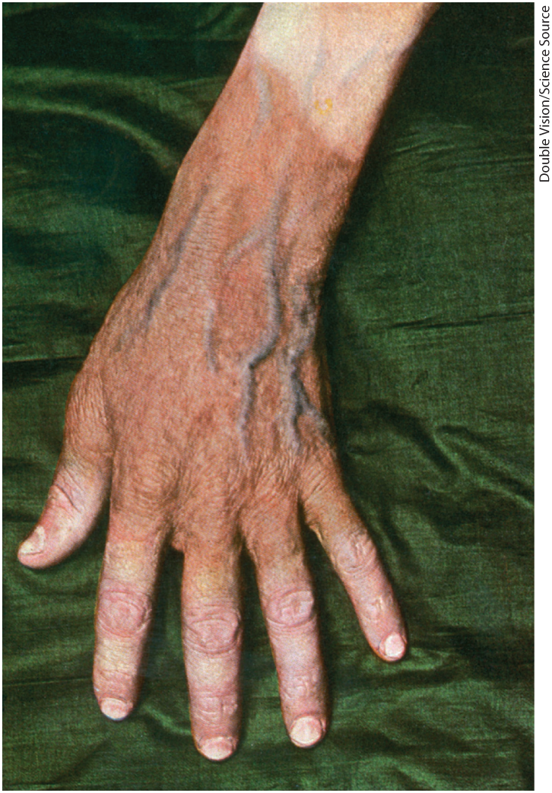
Insufficient Niacin in the Diet
Causes Pellagra
dietary deficiency of niacin (the vitamin form of NAD and NADP) prevents NAD synthesis and causes pellagra
  characterized by the “three Ds”: dermatitis, diarrhea, and dementia
black tongue = related disease in dogs

Slide 67
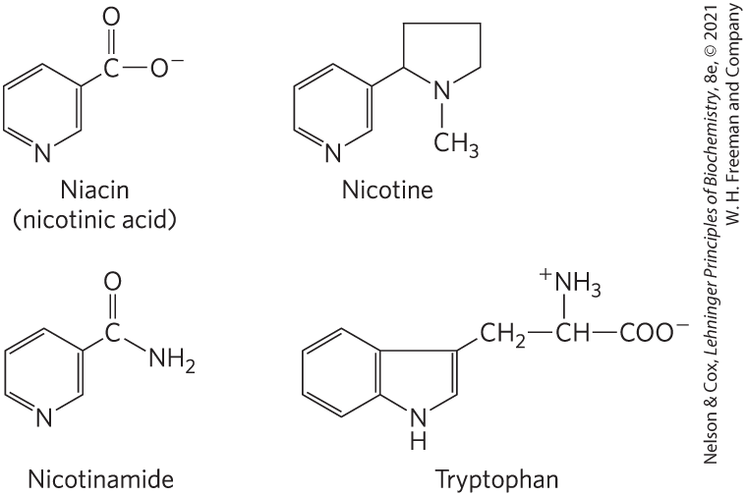
Niacin (Nicotinic Acid) and Its Derivative Nicotin-Amide
tryptophan = the biosynthetic precursor
nicotinic acid and nicotinamide cure pellagra
nicotine (from cigarettes) has no curative activity

Slide 68
Flavin Nucleotides Are Tightly Bound in Flavoproteins
flavoproteins = enzymes that catalyze oxidation- reduction reactions using either flavin mononucle- otide (FMN) or flavin adenine dinucleotide (FAD) as coenzyme
flavin nucleotides = enzymes derived from the vitamin riboflavin
  reduction potentials depend on the flavoprotein with which they are associated

Slide 69
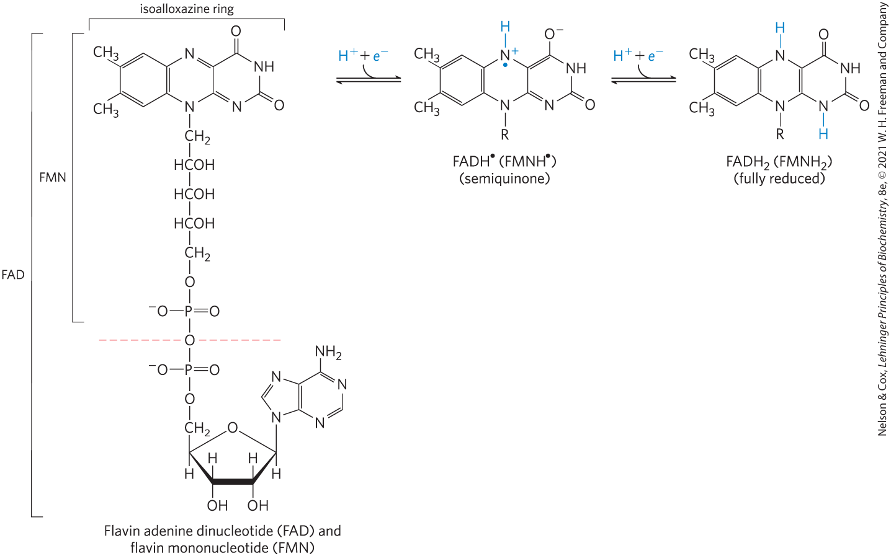
Oxidized and Reduced FAD and FMN
can accept either one or two electrons in the form of one or two hydrogen atoms from a reduced substrate

Slide 70
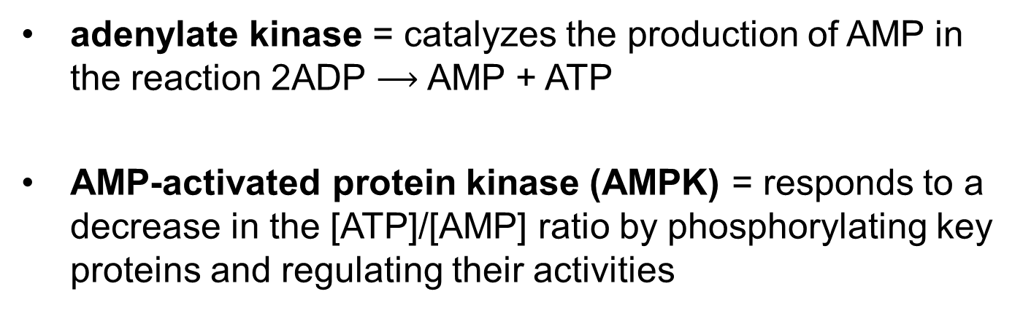
Adenylate Kinase and AMP-Activated Protein Kinase (AMPK)

