Slide 1

11 Biological Membranes and Transport
© 2021 Macmillan Learning

Slide 2

Principle 1 (1 of 3)
The biological membrane is a lipid bilayer with proteins of various functions (enzymes, transporters) embedded in or associated with the bilayer. The hydrophobic effect stabilizes structures (lipid bilayers and vesicles) in which lipids with some polar and some nonpolar regions can protect their nonpolar regions from interaction with the very polar solvent, water. Membrane proteins are associated with the lipid bilayer more or less tightly, and proteins and lipids are both allowed limited lateral motion in the plane of the bilayer.

Slide 3

Principle 2 (1 of 8)
All of the internal membranes of cells are part of an interconnected, functionally specialized, and dynamic endomembrane system. Proteins and lipids synthesized in the endoplasmic reticulum move through the Golgi apparatus, and they are targeted to the membranes of organelles or to the plasma membrane, where they provide the essential properties of these structures. During this membrane trafficking, some proteins are covalently altered, and some lipids are segregated into different organelles or are concentrated in one of the bilayer leaflets. Rafts are functionally specialized regions with unique lipid and protein compositions.

Slide 4

Principle 3 (1 of 11)
Although the lipid bilayer is impermeable to charged or polar solutes, cells of all kinds have many membrane transporters and
ion channels that catalyze transmembrane movement of specific solutes. Some transporters merely speed the movement of solutes in the direction that simple diffusion takes them, whereas others use an energy source to move solutes against a concentration gradient.

Slide 5
11.1 The Composition and Architecture of Membranes

Slide 6
The Lipid Bilayer Is Stable in Water
glycerophospholipids, sphingolipids, and sterols:
  virtually insoluble in water
  spontaneously form microscopic lipid aggregates when mixed with water
hydrophobic interactions = the clustering of hydrophobic molecule surfaces in an aqueous environment to find the lowest-energy environment by reducing the hydrophobic surface area exposed to water

Slide 7
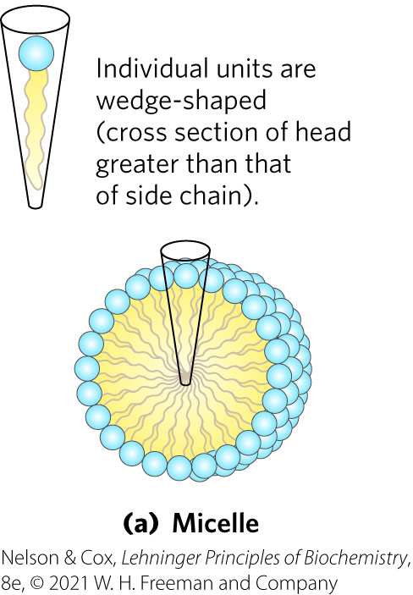
Micelle Formation
micelles = spherical structures containing amphipathic molecules arranged with hydrophobic regions in the interior and hydrophilic head groups on the exterior
  favored when the cross-sectional area of the head group is greater than that of the acyl side chain(s)

Slide 8
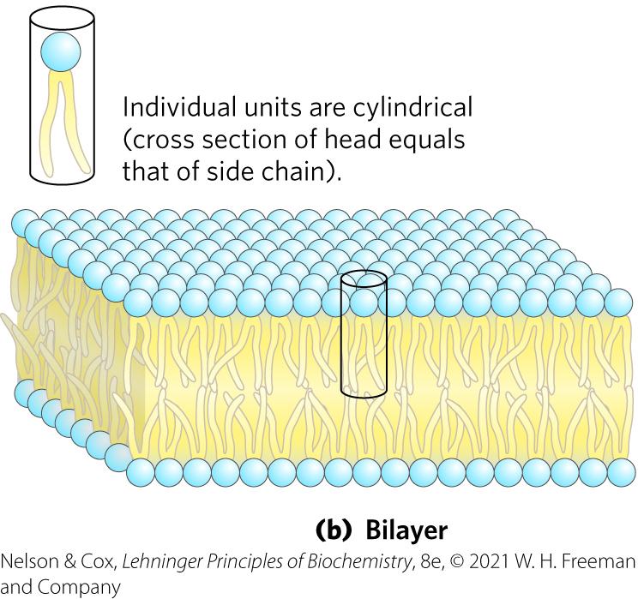
Bilayer Formation
bilayer = lipid aggregate in which two lipid monolayers (leaflets) form a two-dimensional sheet
  favored when the cross-sectional areas of the head group and acyl side chain(s) are similar

Slide 9
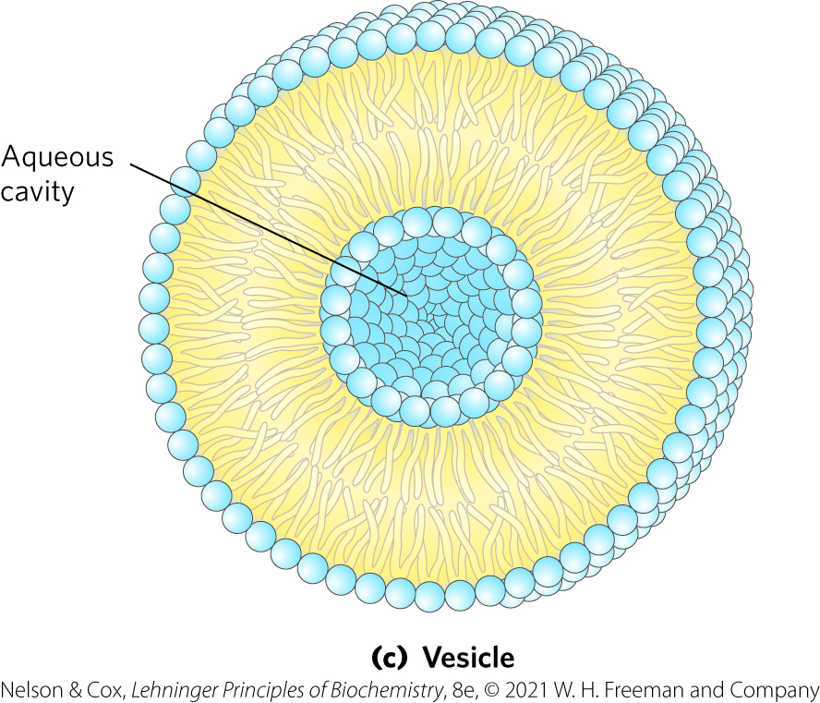
Vesicle Formation
vesicle (liposome) = forms spontaneously when a bilayer sheet folds back on itself to form a hollow sphere

Slide 10
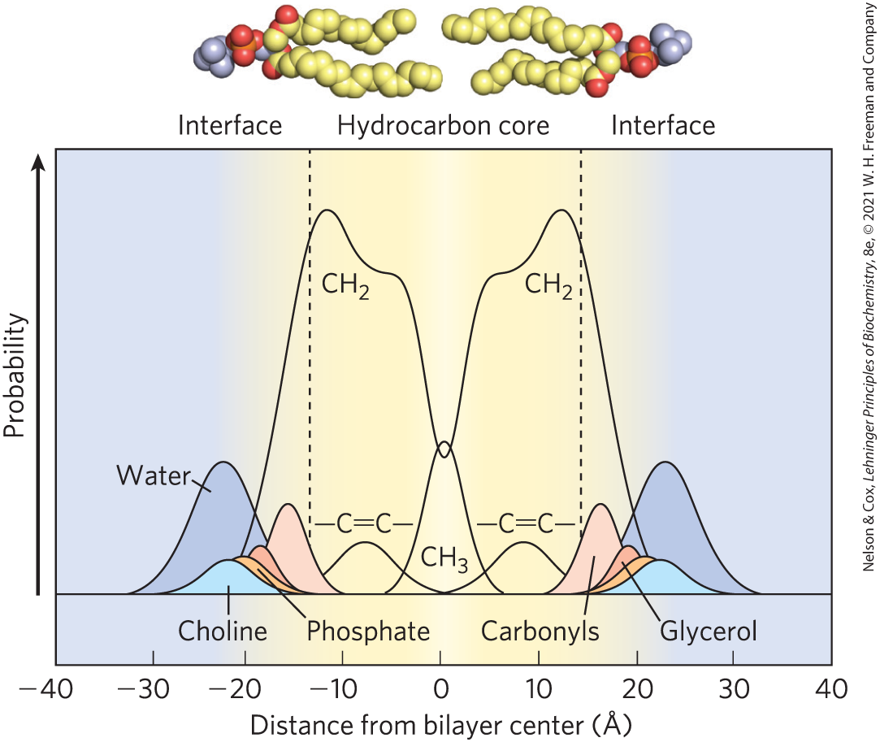
Distribution of Membrane Lipids in an Artificial Membrane
hydrocarbon core of the bilayer = ~30 Å
biological membranes (including protruding proteins) = ~50 – 80 Å

Slide 11
Principle 1 (2 of 3)
The biological membrane is a lipid bilayer with proteins of various functions (enzymes, transporters) embedded in or associated with the bilayer. The hydrophobic effect stabilizes structures (lipid bilayers and vesicles) in which lipids with some polar and some nonpolar regions can protect their nonpolar regions from interaction with the very polar solvent, water. Membrane proteins are associated with the lipid bilayer more or less tightly, and proteins and lipids are both allowed limited lateral motion in the plane of the bilayer.

Slide 12
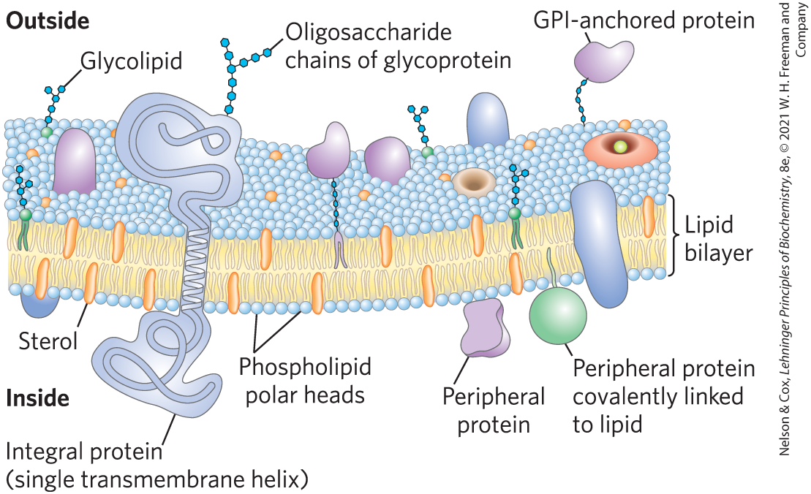
Bilayer Architecture Underlies the Structure and Function of Biological Membranes
fluid mosaic = pattern formed by individual lipid and protein units in a membrane
  pattern can change while maintaining the permeability membrane

Slide 13
Functions of Biological Membranes
permit shape changes that accompany cell growth and movement
permit exocytosis, endocytosis, and cell division
serve as molecular gatekeepers

Slide 14
Proteins and Enzymes In and On Membranes
transporters = move specific organic solutes and inorganic ions across the membrane
receptors = sense extracellular signals and trigger molecular changes in the cell
ion channels = mediate electrical signaling between cells
adhesion molecules = hold neighboring cells together

Slide 15
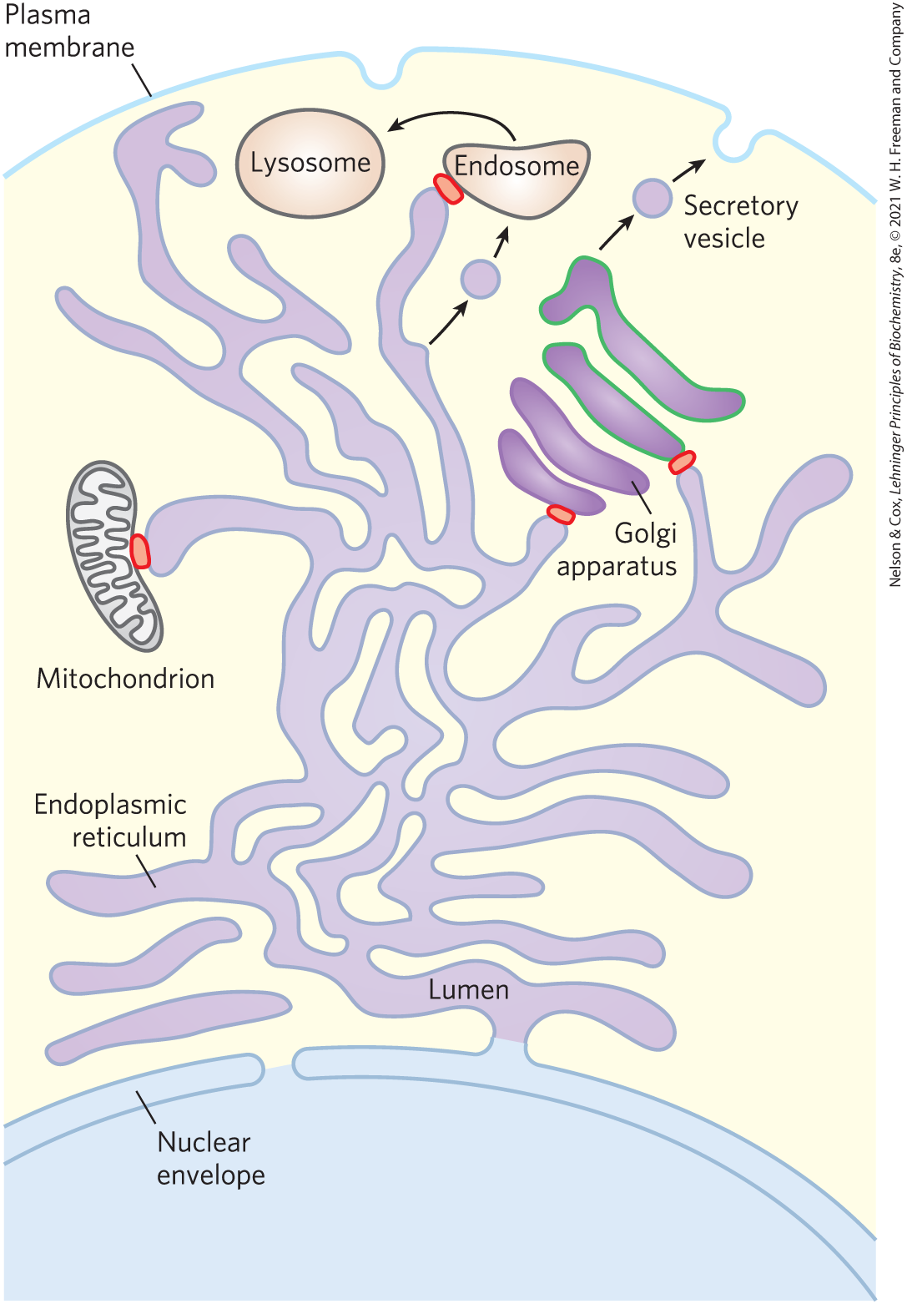
The Endomembrane System Is Dynamic and Functionally Differentiated
single membrane surrounds:
  endoplasmic reticulum (ER)
  Golgi apparatus
  lysosomes
  various small vesicles
double membrane surrounds:
  nucleus
  mitochondrion
  chloroplasts (in plants)

Slide 16
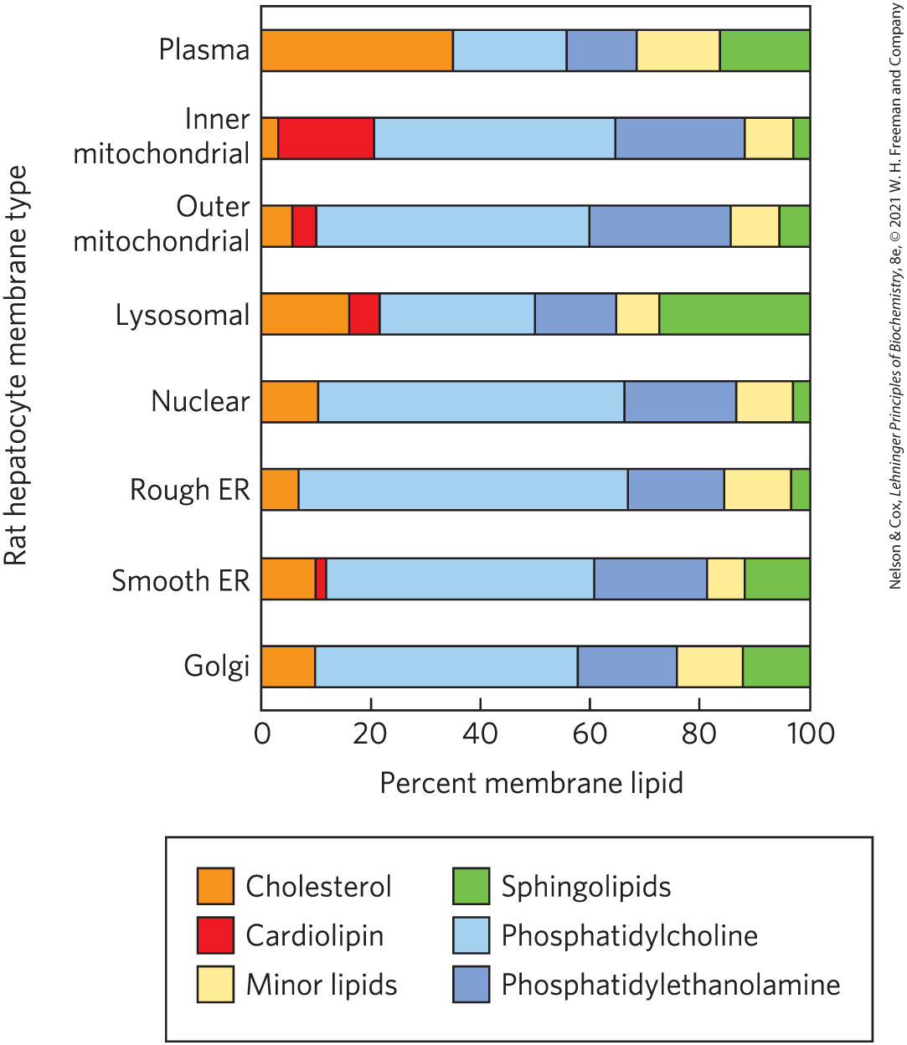
Lipid Composition of the Plasma and Organelle Membranes
the functional specialization of each membrane type is reflected in its unique lipid composition

Slide 17
Membrane Trafficking
membrane trafficking = process by which membrane lipids and proteins that are synthesized in the ER move to their destination organelles or to the plasma membrane
lipids and proteins undergo covalent modifications in the Golgi apparatus
  dictates the eventual location of the mature protein

Slide 18
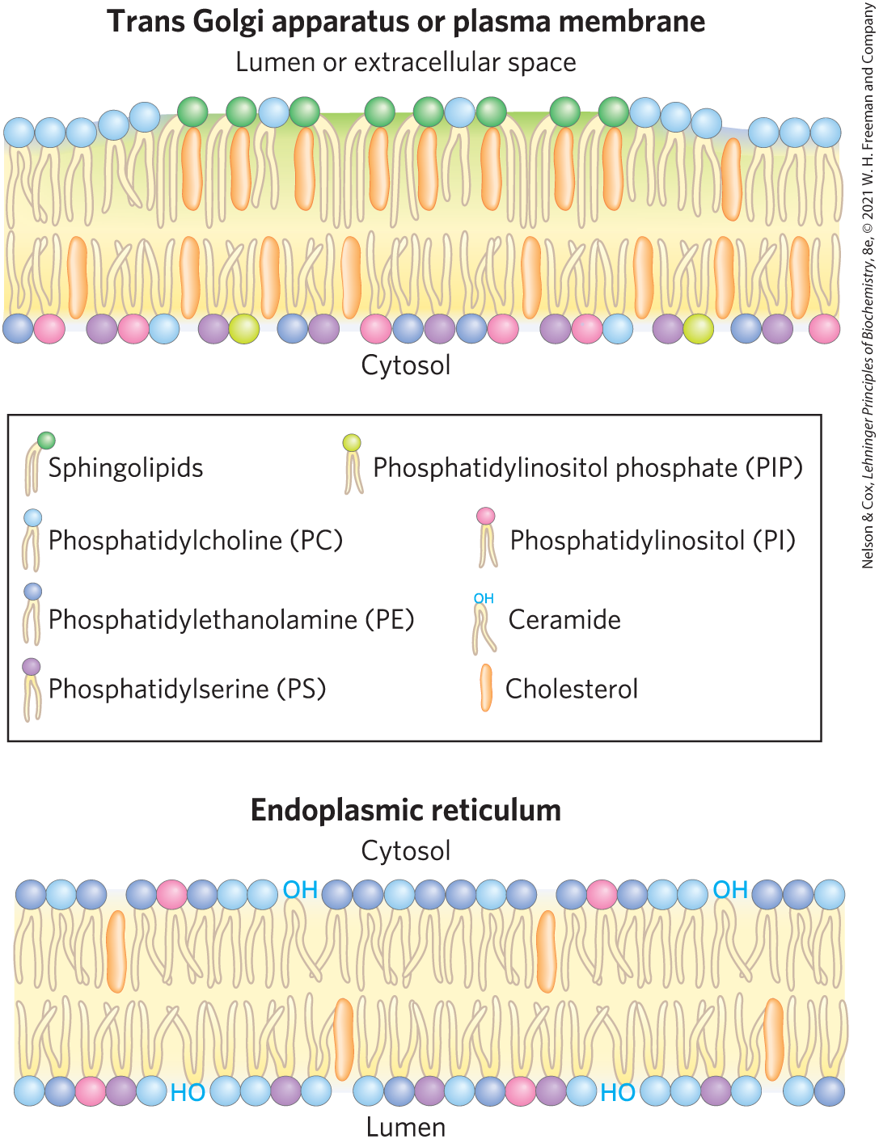
Changes in Lipid Composition During Membrane Trafficking
sphingolipids and cholesterol largely replace phosphatidylcholine
plasma membrane lipids are asymmetrically distributed between the two leaflets of the bilayer

Slide 19
Membrane Proteins Are Receptors, Transporters, and Enzymes
groups of membrane proteins:
  receptors for extracellular signals
  transporters to carry specific polar or charged compounds across the plasma membrane or between organelles
  enzymes

Slide 20
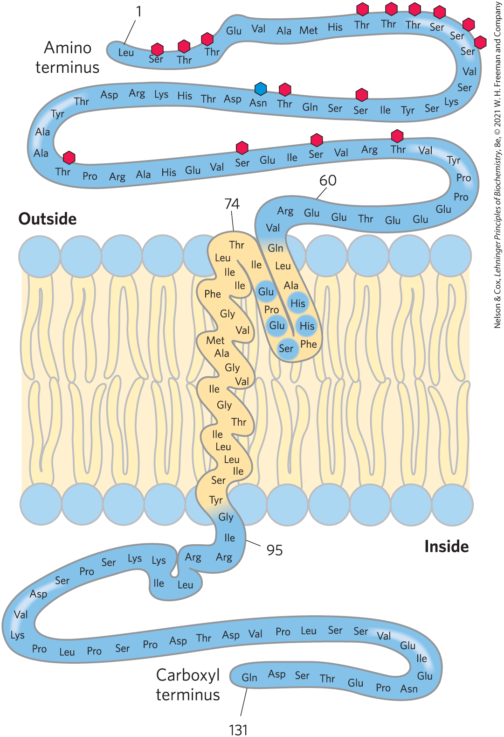
Posttranslational Modification of Membrane Proteins
glycosylation = attachment of oligosaccharides to proteins
  typically on the outer face of the plasma membrane
attachment of 1+ lipids = serve as hydrophobic anchors or targeting tags

Slide 21
Membrane Proteins Differ in the Nature of Their Association with the Membrane Bilayer
integral membrane proteins = firmly embedded within the lipid bilayer
peripheral membrane proteins = associate with the membrane through electrostatic interactions and hydrogen bonding
amphitropic proteins = associate reversibly with membranes
  found in both membranes and the cytosol

Slide 22
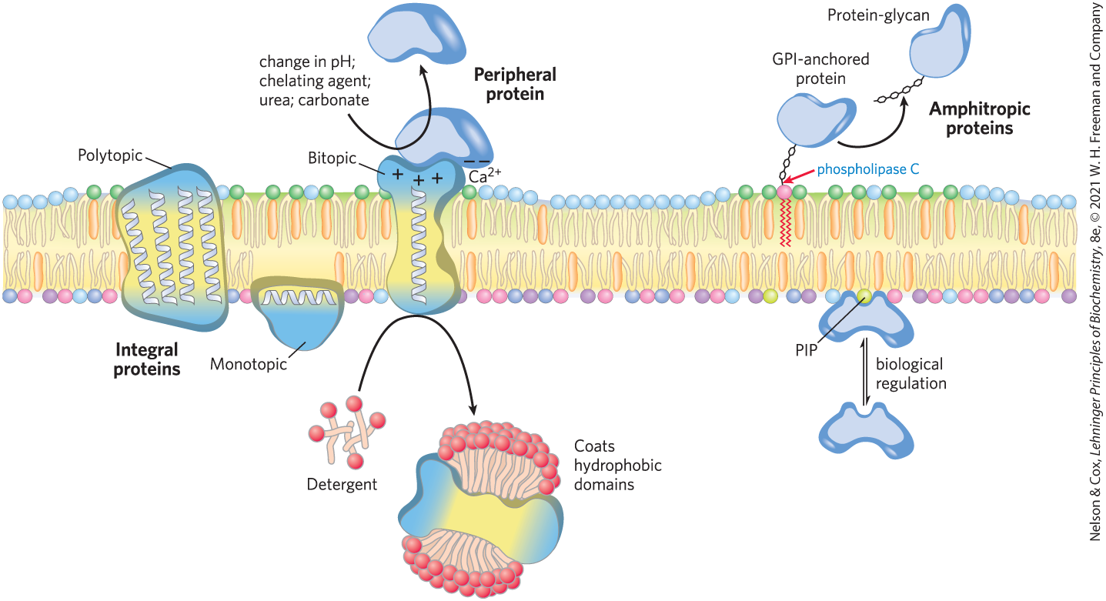
Integral, Peripheral, and Amphitropic Proteins

Slide 23
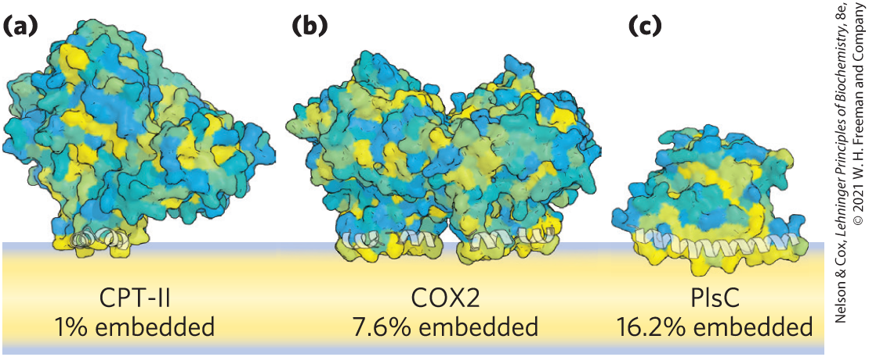
Monotopic Proteins
monotopic = have small hydrophobic domains that interact with only a single leaflet of the membrane

Slide 24
Bitopic Proteins
bitopic = span the bilayer once, extending on either surface
  have a single hydrophobic sequence somewhere in the molecule

Slide 25
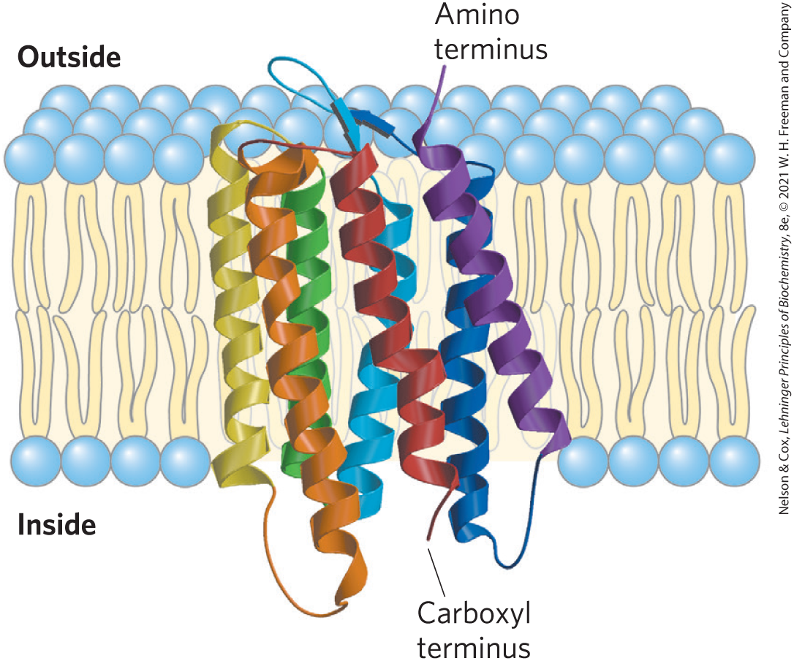
Polytopic Proteins
polytopic = cross the membrane several times
  have multiple hydrophobic sequences of ~20 residues that each cross the membrane when in the α-helical conformation
bacteriorhodopsin

Slide 26
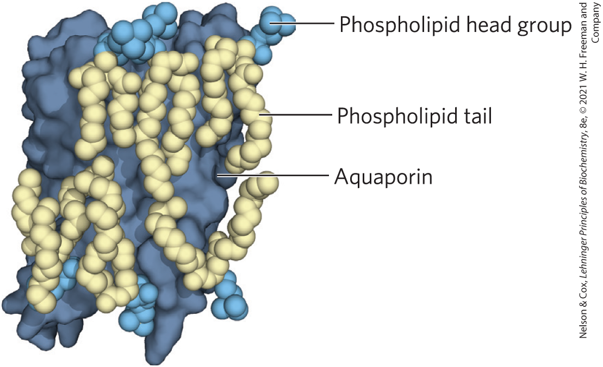
Many Membrane Proteins Co-Crystallize with Phospholipid Molecules
phospholipids lie:
  on the protein surface
  at interfaces between monomers of multisubunit proteins, forming a “grease seal”

Slide 27
The Topology of an Integral Membrane Protein Can Often Be Predicted from Its Sequence
an α-helical sequence of 20-25 residues (each 1.5 Å) is just long enough to span the thickness (30 Å) of the lipid bilayer
  stabilized by intrachain hydrogen bonding and the hydrophobic effect
in many organisms, 20-30% of proteins are integral proteins

Slide 28
β Strands of Membrane Proteins
in β conformation:
  seven to nine residues are needed to span a membrane
  alternating side chains project above and below the sheet
in β strands of membrane proteins:
  every second residue in the membrane-spanning segment is hydrophobic and interacts with the lipid bilayer
  aromatic side chains are commonly found at the lipid-protein interface

Slide 29
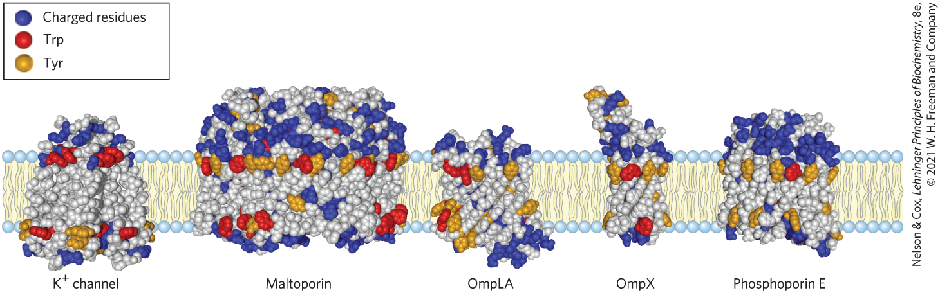
Amino Acid Locations Relative to the Bilayer
Tyr and Trp side chains serve as membrane interface anchors
positive-inside rule = positively charged Lys and Arg residues in the extramembrane loop of membrane proteins occur more commonly on the cytoplasmic face

Slide 30
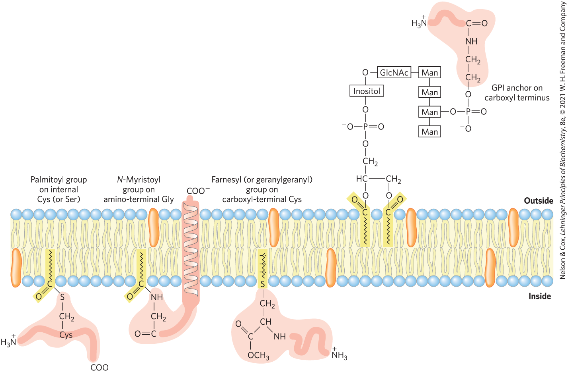
Covalently Attached Lipids Anchor or Direct Some Membrane Proteins
GPI-anchored protein = exclusively on the outer face and are clustered in certain regions

Slide 31
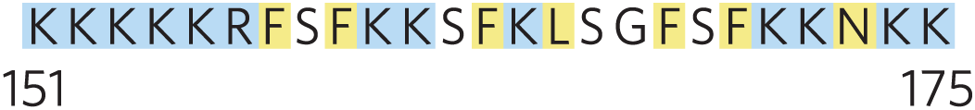
Ionic Attractions Can Add to the Anchoring Effect of a Covalently Bound Lipid
ionic attractions between positively charged residues in the protein and negatively charged lipid head groups add to the protein’s affinity for the membrane
  example: the plasma membrane protein MARCKS (myristoylated alanine-rich C-kinase substrate)

Slide 32
11.2 Membrane Dynamics

Slide 33
Principle 1 (3 of 3)
The biological membrane is a lipid bilayer with proteins of various functions (enzymes, transporters) embedded in or associated with the bilayer. The hydrophobic effect stabilizes structures (lipid bilayers and vesicles) in which lipids with some polar and some nonpolar regions can protect their nonpolar regions from interaction with the very polar solvent, water. Membrane proteins are associated with the lipid bilayer more or less tightly, and proteins and lipids are both allowed limited lateral motion in the plane of the bilayer.

Slide 34
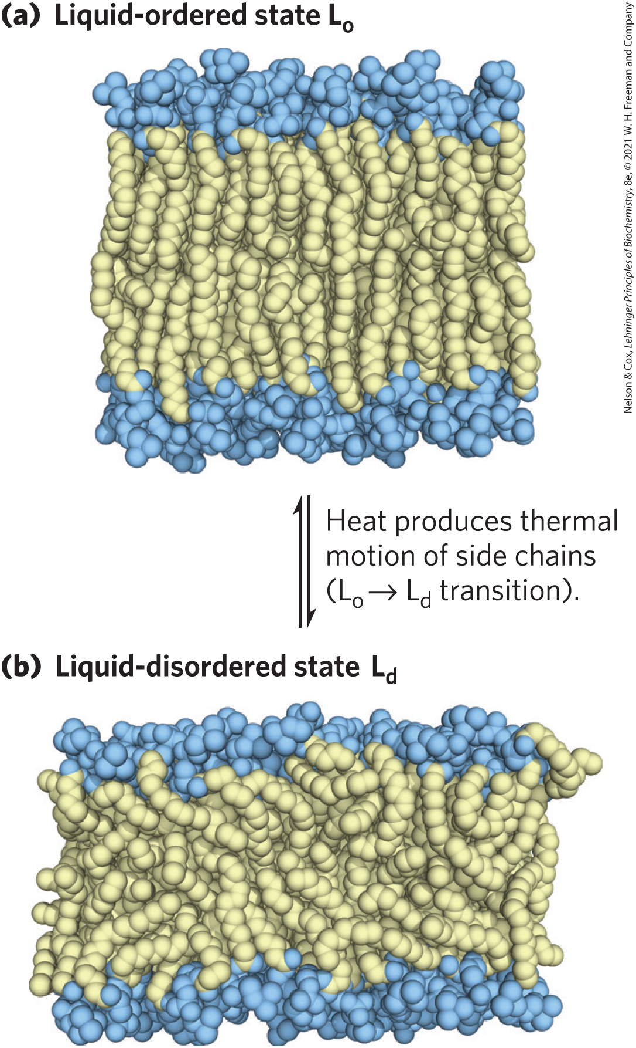
Acyl Groups in the Bilayer Interior Are Ordered to Varying Degrees
liquid-ordered (L_{o}) state = gel-like state in which all types of motion of individual molecules are strongly constrained
liquid-disordered (L_{d}) state = state in which individual hydrocarbon chains are in constant motion (lateral and rotational)

Slide 35
Fatty Acid Composition Affects Membrane Fluidity
at physiological temperatures:
  long-chain saturated fatty acids tend to pack into an L_{o} phase
  kinks in unsaturated fatty acids interfere with packing, favoring the L_{d} state
  shorter-chain fatty acyl groups favor the L_{d} state

Slide 36
Sterol Content Affects Membrane Fluidity
sterols have paradoxical effects on bilayer fluidity:
  they interact with phospholipids containing unsaturated fatty acyl chains, compacting them and constraining their motion
  they associate with sphingolipids and phospholipids having long, saturated fatty acyl chains, making the bilayer fluid

Slide 37
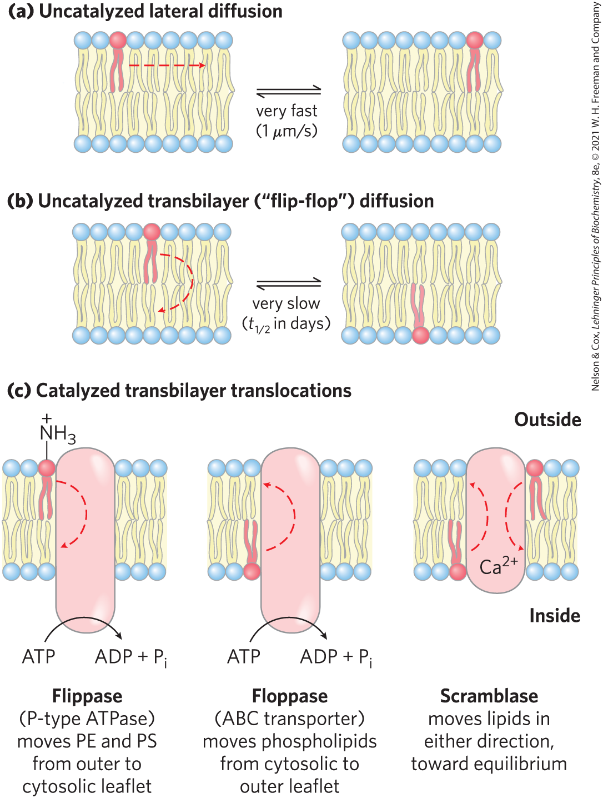
Transbilayer Movement of Lipids Requires Catalysis
transbilayer (“flip-flop”) movement has a large, positive free-energy change
membrane proteins facilitate the translocation of individual lipid molecules

Slide 38
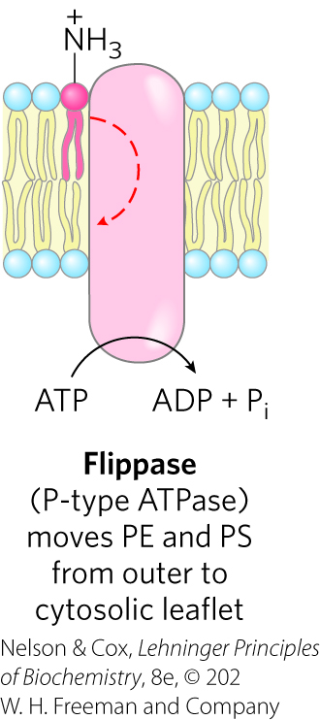
Flippases
flippases = catalyze translocation of the amino- phospholipids phosphatidylethanolamine (PE) and phosphatidylserine (PS) from the extracellular to the cytoplasmic leaflet of the plasma membrane
  consume ~1 ATP per molecule of phospholipid translocated
  related to the P-type ATPases (active transporters)

Slide 39
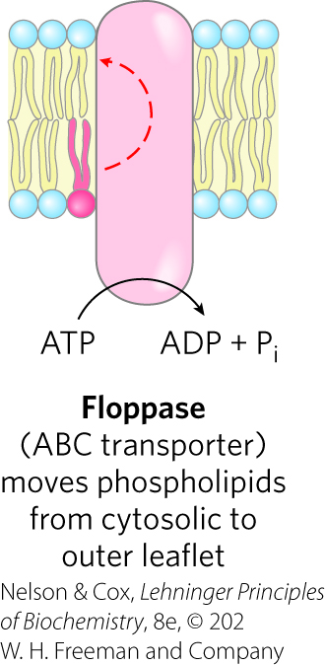
Floppases
floppases = move plasma membrane phospholipids and sterols from the cytoplasmic leaflet to the extracellular leaflet
  are ATP-dependent
  members of the ABC transporter family
  each specializes in movement of specific lipids

Slide 40
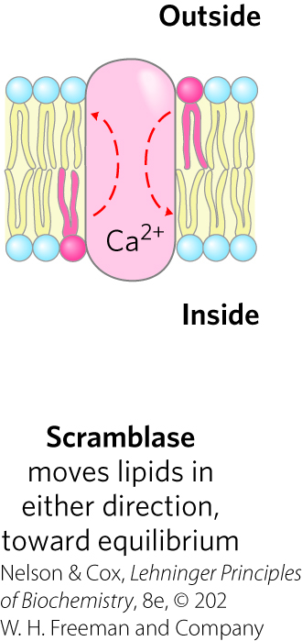
Scramblases
scramblases = move any membrane phospholipid across the bilayer down its concentration gradient
  not dependent on ATP; some require Ca²⁺
  lead to controlled randomization of the head-group composition on the two faces of the bilayer

Slide 41
Phosphatidylinositol Transfer Proteins
phosphatidylinositol transfer proteins = move phosphatidylinositol lipids across lipid bilayers
  believed to have roles in lipid signaling and membrane trafficking

Slide 42
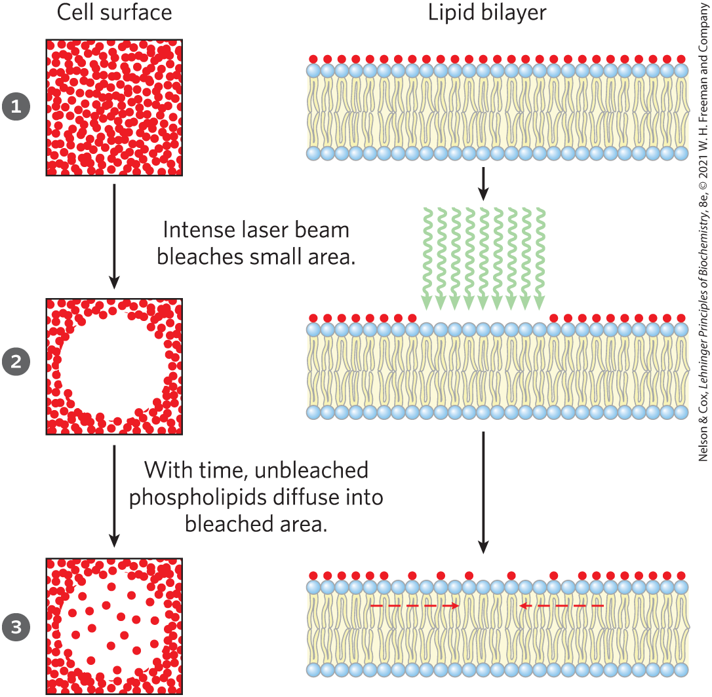
Lipids and Proteins Diffuse Laterally in the Bilayer
individual lipid molecules undergo Brownian movement
FRAP = fluorescence recovery after photobleaching
  rate is a measure of the rate of lateral diffusion of the lipids

Slide 43
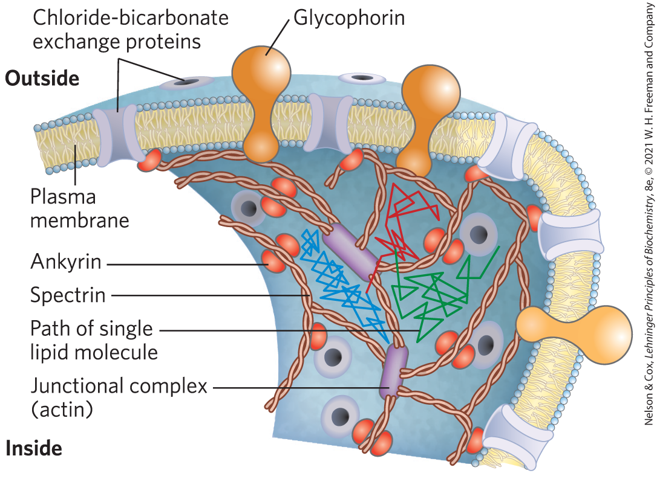
Some Membrane Proteins Are Free to Diffuse, Whereas Others Are Not
membrane proteins are limited in movement by:
  associating to form large aggregates (“patches”)
  anchoring to internal structures

Slide 44
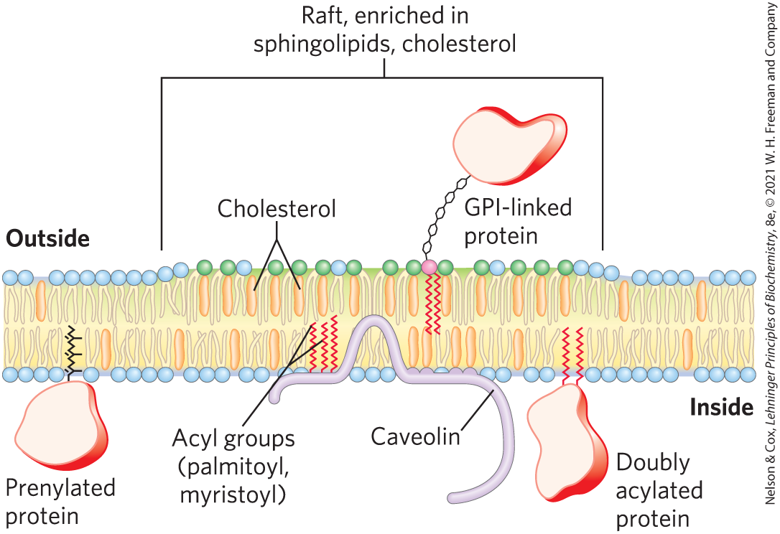
Sphingolipids and Cholesterol Cluster Together in Membrane Rafts
microdomains (rafts) = clusters of cholesterol and sphingolipids that make the bilayer slightly thicker and more ordered than neighboring, phospholipid-rich regions
  can be up to 50% of the cell surface

Slide 45
Proteins and Lipid Rafts
proteins must have hydrophobic helical sections long enough to segregate into the thicker bilayer regions of rafts
lipid rafts are enriched in:
  proteins that have two long-chain saturated fatty acids covalently attached through Cys residues
  GPI-anchored proteins

Slide 46
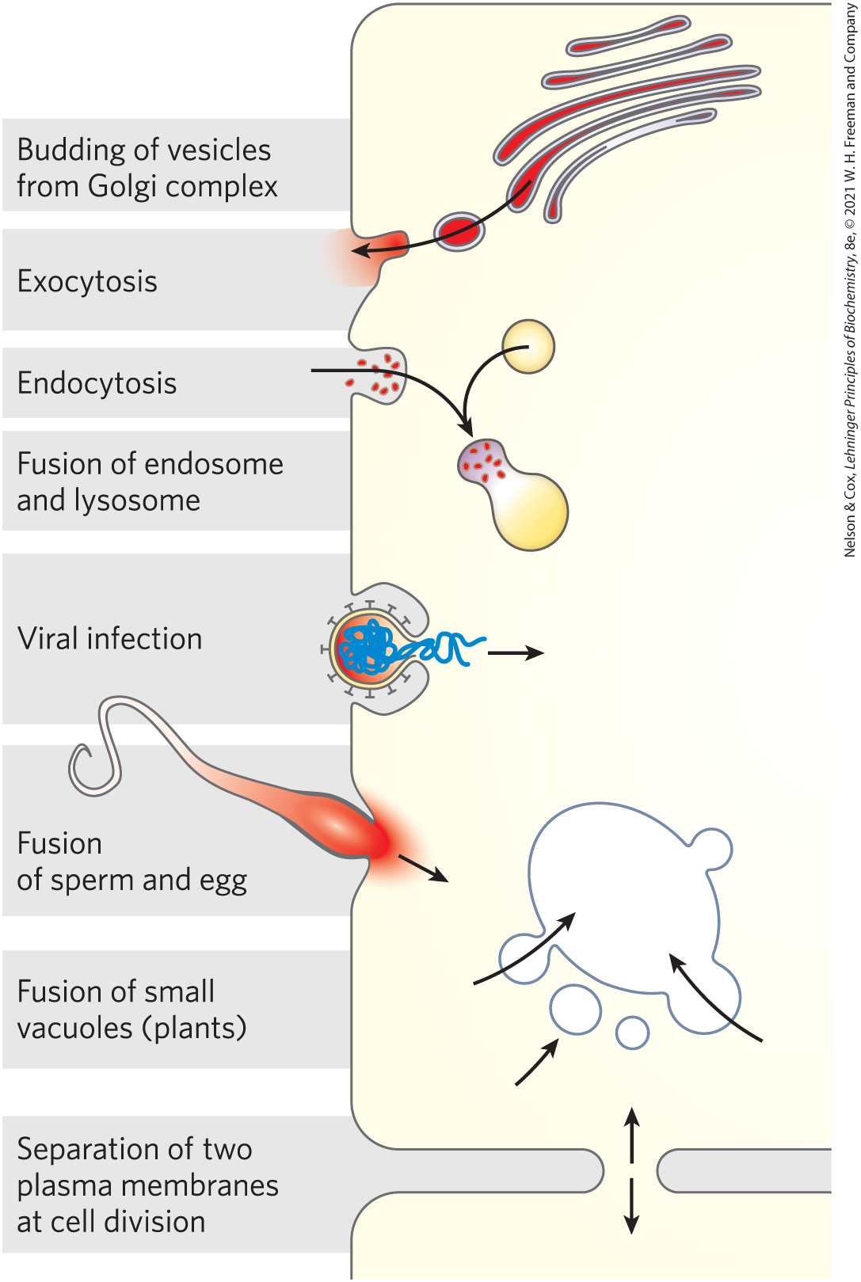
Membrane Curvature and Fusion
Are Central to Many Biological Processes
curvature changes are central to the ability of biological membranes to undergo fusion with other membranes without losing continuity

Slide 47
Integral Proteins of the Plasma Membrane Are Involved in Surface Adhesion, Signaling, and Other Cellular Processes
integrins = surface adhesion proteins that mediate a cell’s interaction with the extracellular matrix and with other cells
  carry signals in both directions across the plasma membrane
  heterodimeric proteins composed of two unlike subunits, α and β

Slide 48
11.3 Solute Transport across Membranes

Slide 49
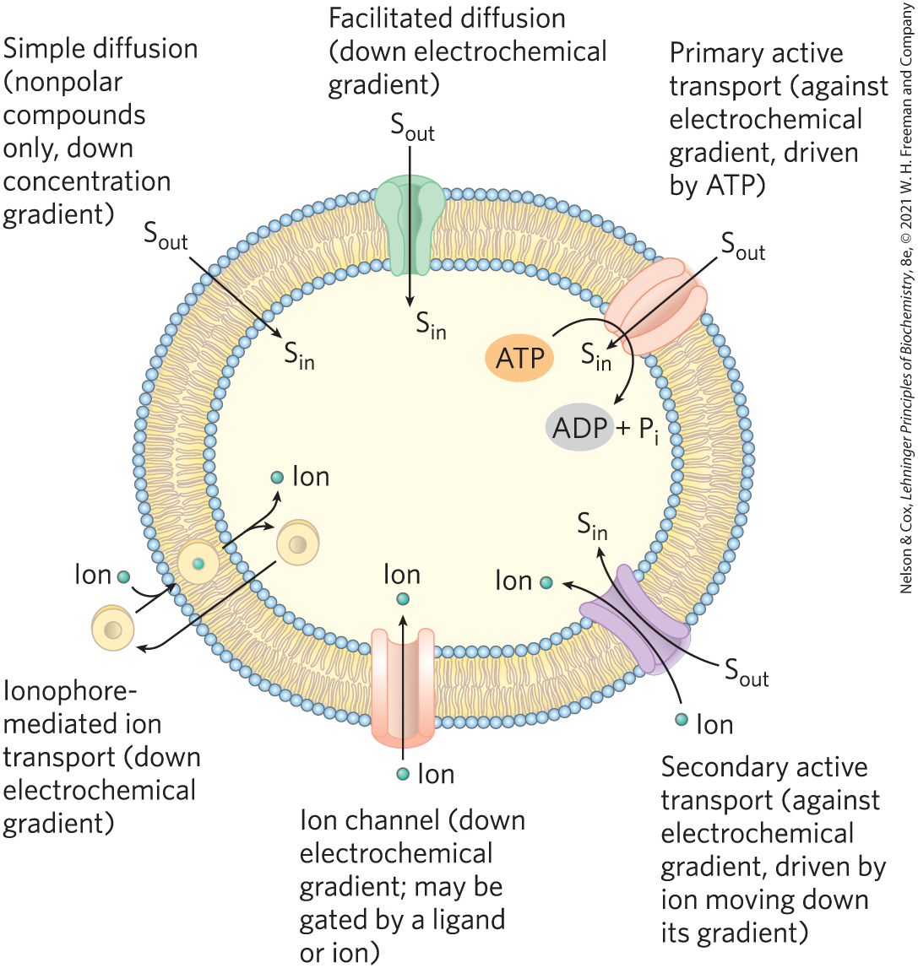
Summary of Transport Types
nonpolar compounds can dissolve in the lipid bilayer and cross a membrane unassisted
polar compounds and ions require a specific membrane protein carrier

Slide 50
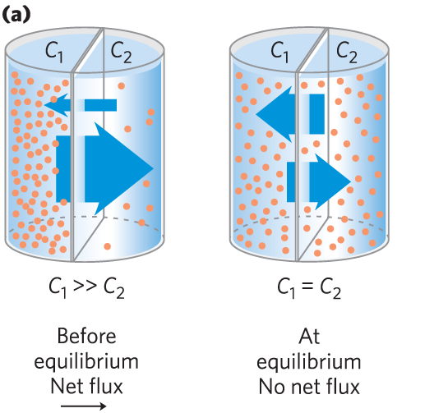
Transport May Be Passive or Active
simple diffusion = movement of a solute from the region of higher concentration to the region of lower concentration

Slide 51
Electrochemical Gradient
electrochemical gradient (electrochemical potential) = determines the direction in which a charged solute moves across a membrane
  composed of:
    the chemical gradient
    the electrical gradient (V_{m})

Slide 52
Passive and Active Transporters
passive transporters = facilitate movement down a concentration gradient, increasing the transport rate
  process is called passive transport or facilitated diffusion
active transporters = move substrates across a membranes against a concentration gradient or an electrical potential
  process is called active transport

Slide 53
Types of Active Transporters
primary active transporters = use energy provided directly by a chemical reaction
secondary active transporters = couple uphill transport of one substrate with downhill transport of another

Slide 54
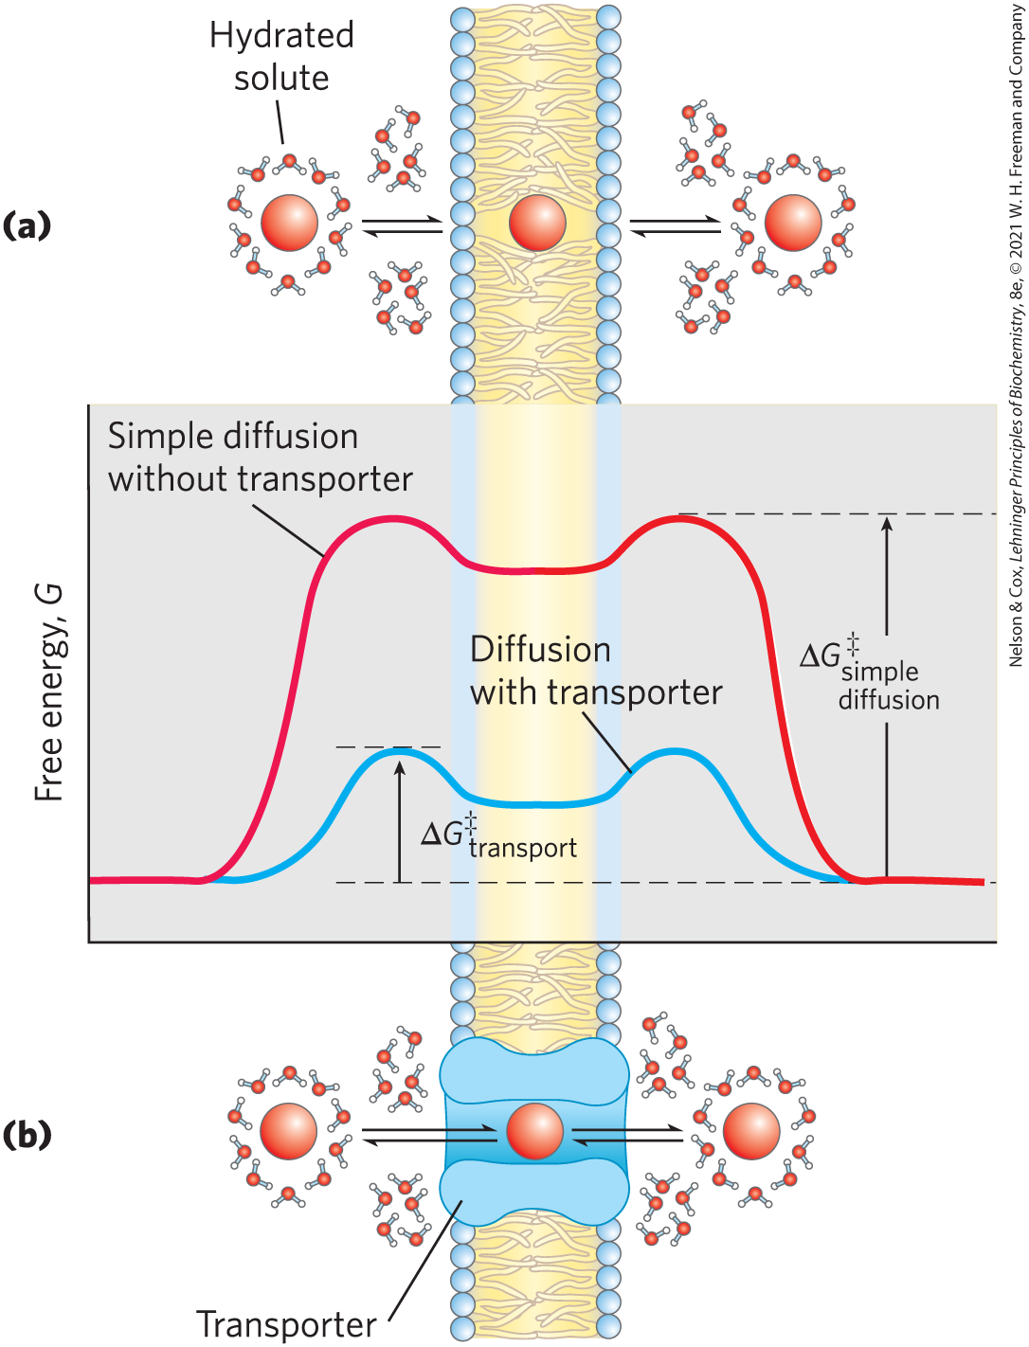
Transporters and Ion Channels Share Some Structural Properties but Have Different Mechanisms
transporter proteins reduce the energy of activation (∆G‡) for diffusion by:
  forming noncovalent interactions with the dehydrated solute
  providing a hydrophilic transmembrane pathway

Slide 55
Ion Channels
ion channels = provide an aqueous path across the membrane through which inorganic ions can diffuse at very high rates
  most have a “gate” regulated by a biological signal
  typically show some specificity for an ion
  are not saturable with their ion substrate
  flow stops either when the gate is closed or when there is no longer an electrochemical gradient

Slide 56
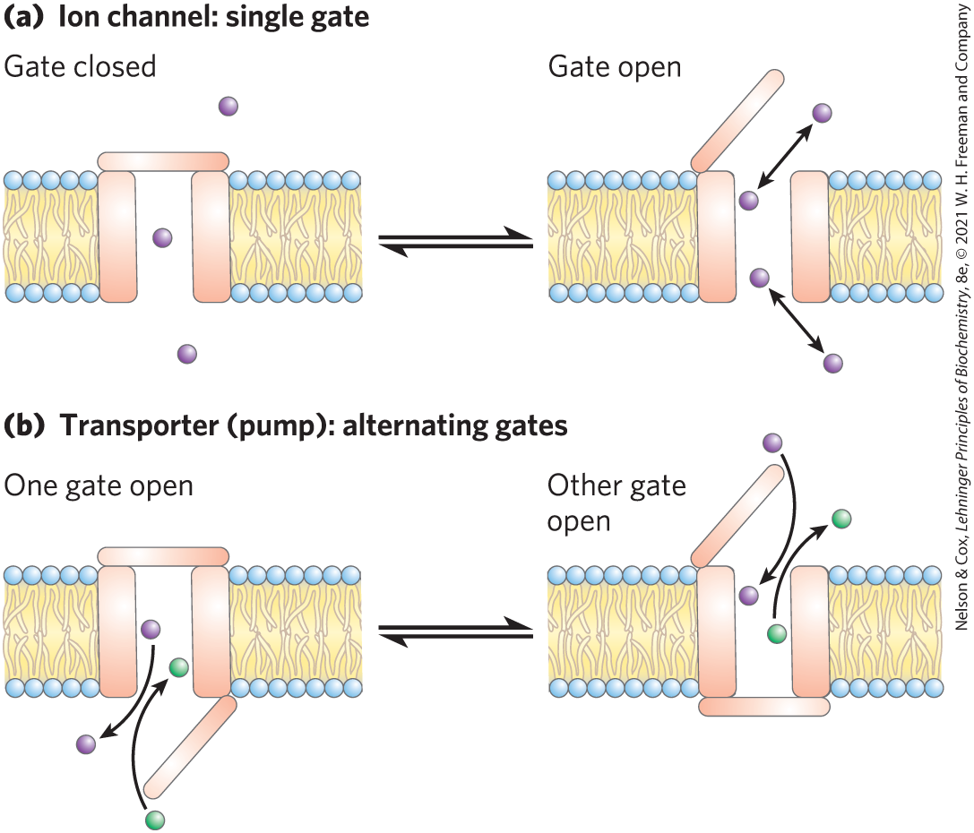
Differences Between Ion Channels and Transporters

Slide 57
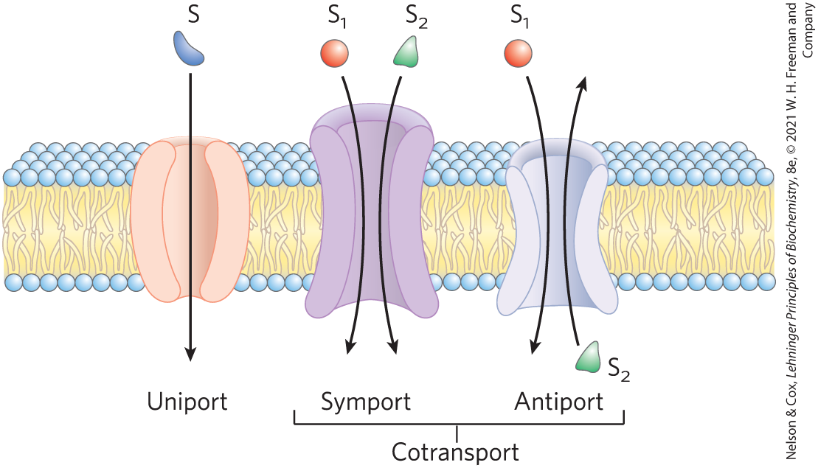
Three General Classes of Transport Systems
cotransport systems = simultaneously transport two solutes across a membrane
  antiport = moves in opposite directions
  symport = moves in the same direction
uniport systems = carry only one substrate

Slide 58
Active Transport Results in Solute Movement against a Concentration or Electrochemical Gradient
results in the accumulation of a solute above the equilibrium point
thermodynamically unfavorable (endergonic)
  must be directly or indirectly coupled to an exergonic process

Slide 59
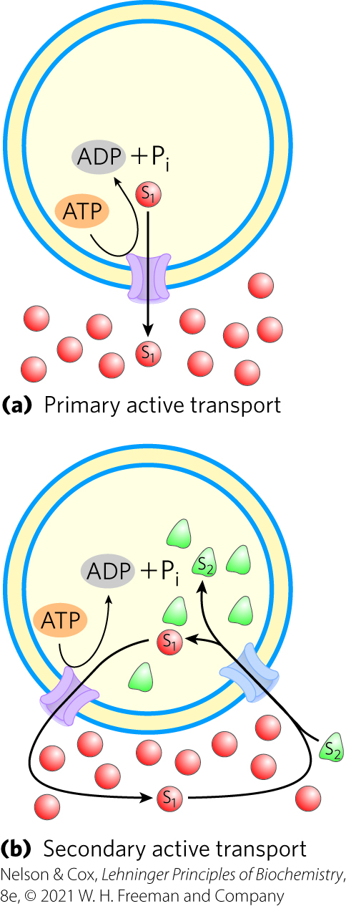
Two Types of Active Transport
primary active transport = solute accumulation is coupled directly to an exergonic chemical reaction
secondary active transport = endergonic transport of one solute is coupled to the exergonic flow of a different solute that was originally pumped uphill by primary active transport

Slide 60
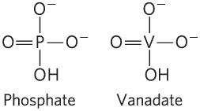
P-Type ATPases Undergo Phosphorylation during Their Catalytic Cycles
P-type ATPases = family of cation transporters that are reversibly phosphorylated by ATP as part of the transport cycle
  integral proteins with 8 or 10 predicted membrane-spanning regions
  sensitive to inhibition by the transition-state analog vanadate

Slide 61
Examples of P-Type ATPases
Na⁺ K⁺ ATPase = animal cell antiporter for Na⁺ and K⁺
H⁺ ATPase = plant and fungi transporter
sarcoplasmic/endoplasmic reticulum Ca²⁺ ATPase (SERCA) pump and the plasma membrane Ca²⁺ ATPase pump = uniporters for Ca²⁺ ions

Slide 62
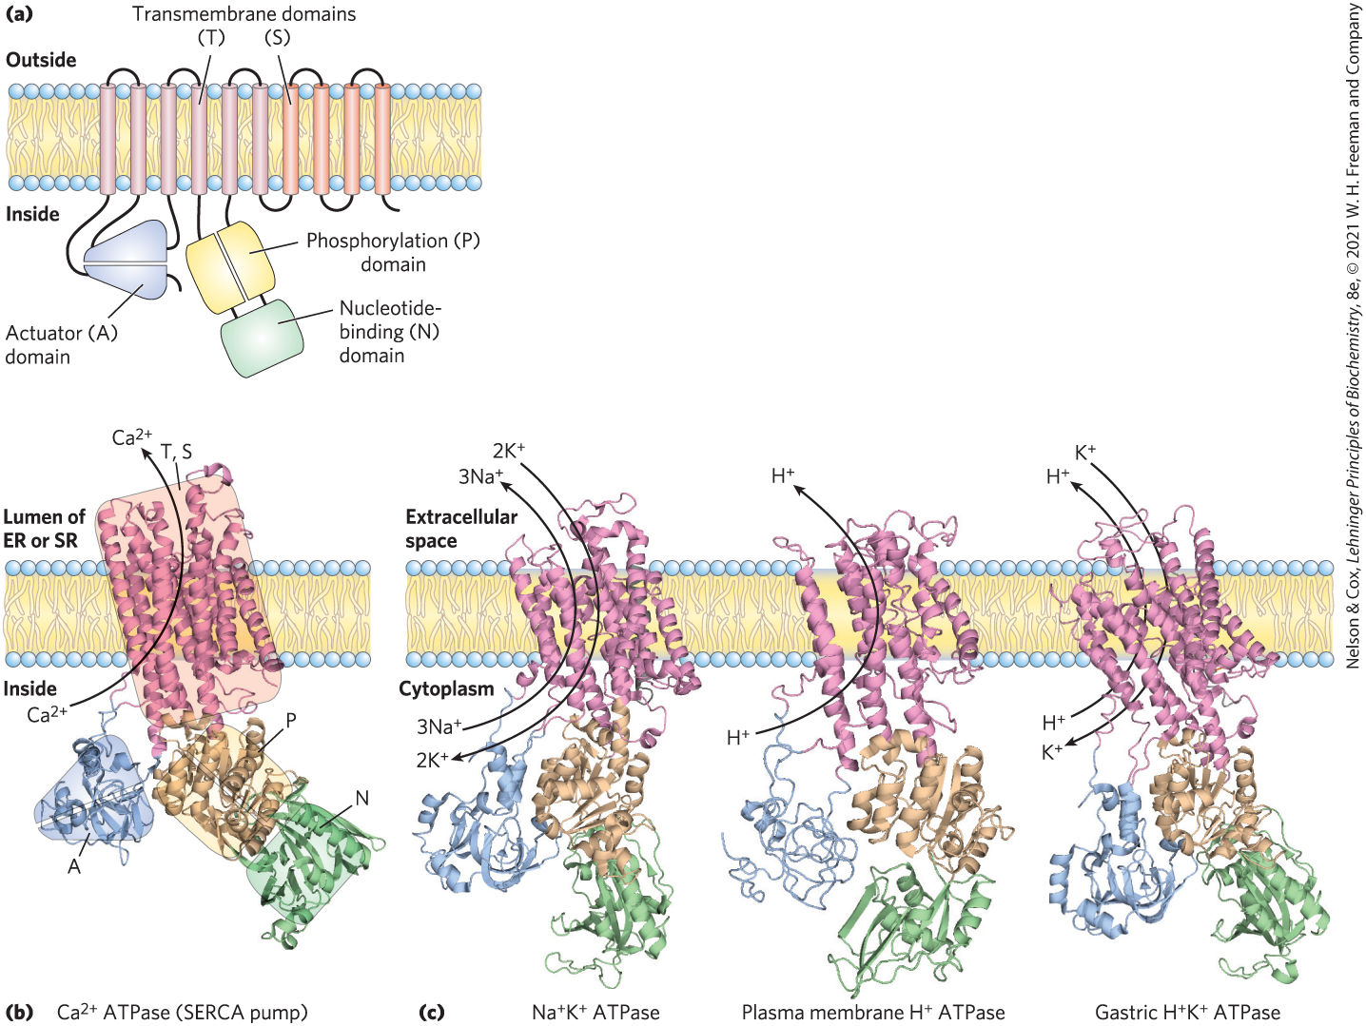
General Structure of the P-Type ATPases
critical Asp residue in the P domain undergoes phosphorylation and dephosphorylation

Slide 63
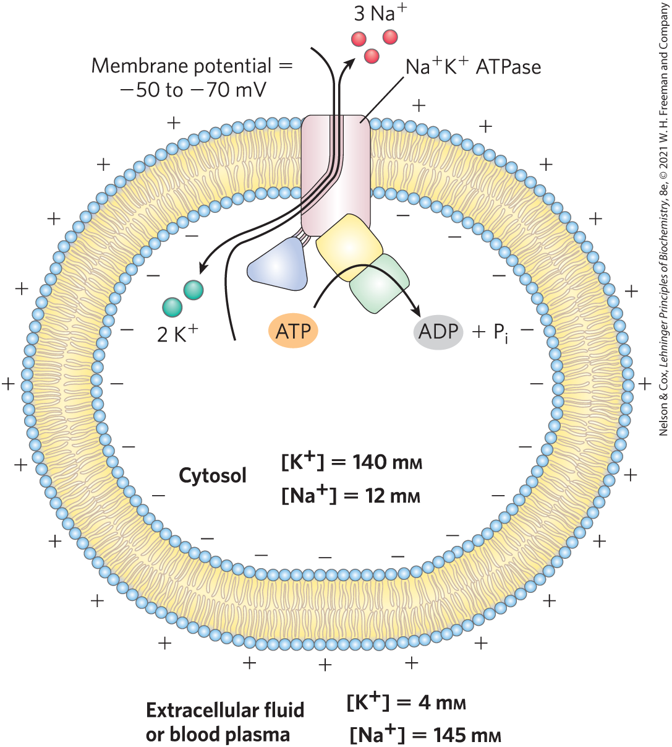
Role of the Na⁺ K⁺ ATPase in Animal Cells
Na⁺ K⁺ ATPase = couples phosphorylation-dephosphorylation of the critical Asp residue to the movement of Na⁺ and K⁺ against their electrochemical gradients
  maintains low [Na⁺] and high [K⁺] in the cell
  essential to the conduction of action potentials in neurons

