Slide 1

10 Lipids
© 2021 Macmillan Learning

Slide 2
Fats and Oils Used as Stored Energy Are Derivatives of Fatty Acids
fatty acids = hydrocarbon derivatives
oxidation of fatty acids (to CO₂ and H₂O) is highly exergonic

Slide 3
Fatty Acids Are Hydrocarbon Derivatives
fatty acids = carboxylic acids with hydrocarbon tails ranging from 4 to 36 carbons long (C₄ to C₃₆)
  can be saturated or unsaturated
  can be branched or unbranched

Slide 4
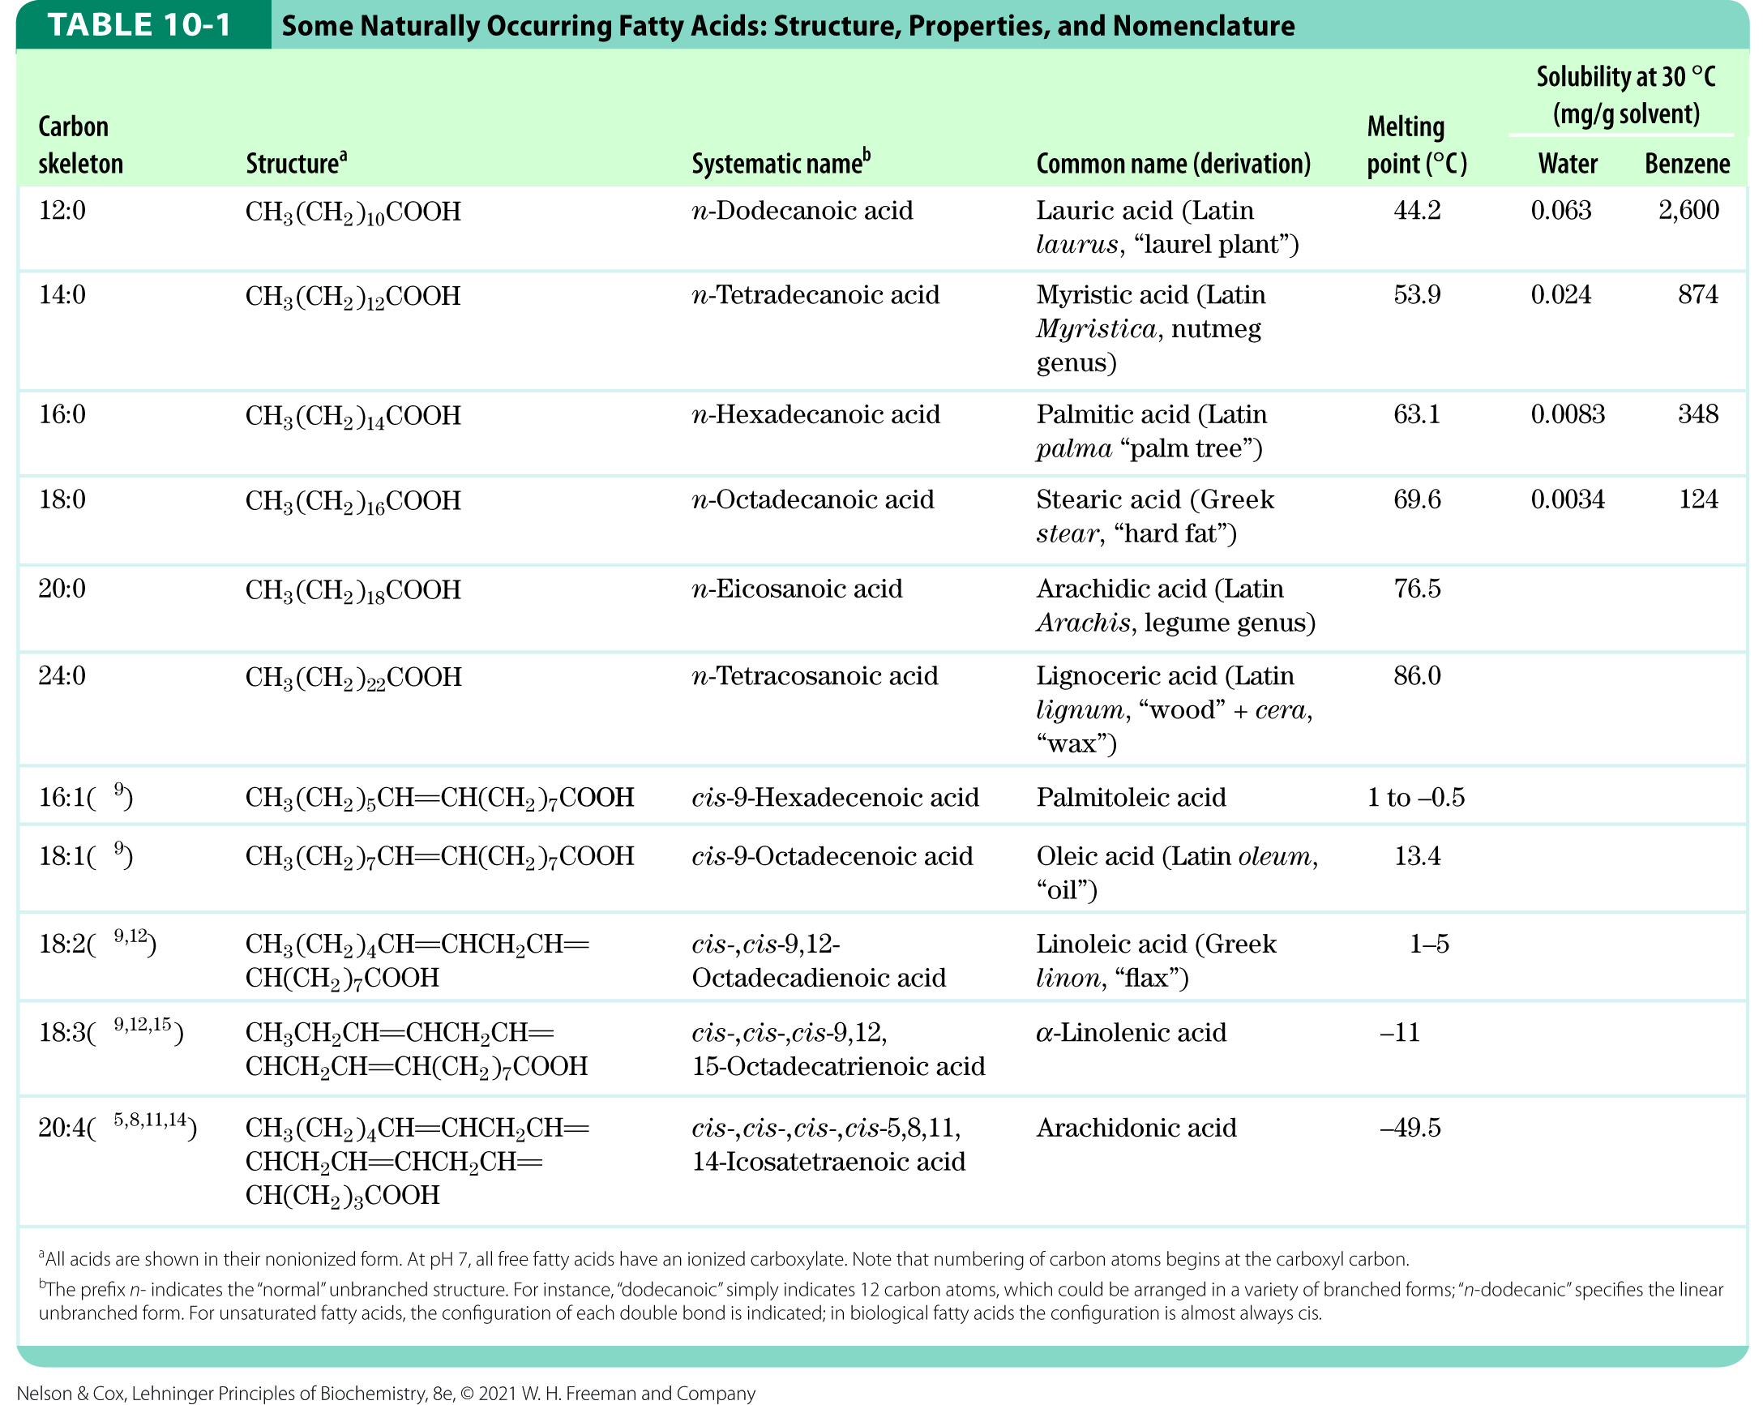
Naturally Occurring Fatty Acids

Slide 5
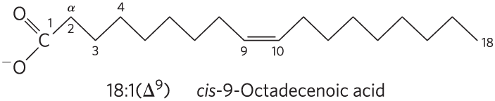
Nomenclature for Unbranched Fatty Acids
the chain length and number of bonds, separated by a colon
numbering begins at the carboxyl carbon
positions of double bonds are indicated by ∆ and a superscript number

Slide 6
Common Patterns in Fatty Acids
most common fatty acids have even numbers of carbon atoms in an unbranched chain of 12 to 24 carbons
in monounsaturated fatty acids, the double bond is usually between C-9 and C-10 (∆⁹)
in polyunsaturated fatty acids:
  the double bonds are usually ∆¹² and ∆¹⁵
  double bonds are usually separated by a methylene group
double bonds are usually in the cis configuration

Slide 7
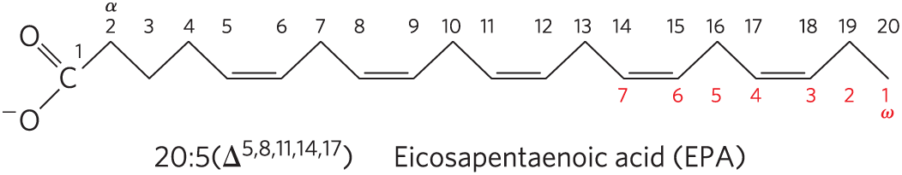
Polyunsaturated Fatty Acids (PUFAs)
polyunsaturated fatty acids (PUFAs) = contain more than one double bond in their backbone
  omega-3 (ω-3) fatty acids = double bond between C-3 and C-4 relative to the most distant carbon (ω)
  omega-6 (ω-6) fatty acids = double bond between C-6 and C-7 relative to ω
omega-3 (ω-3) fatty acid

Slide 8
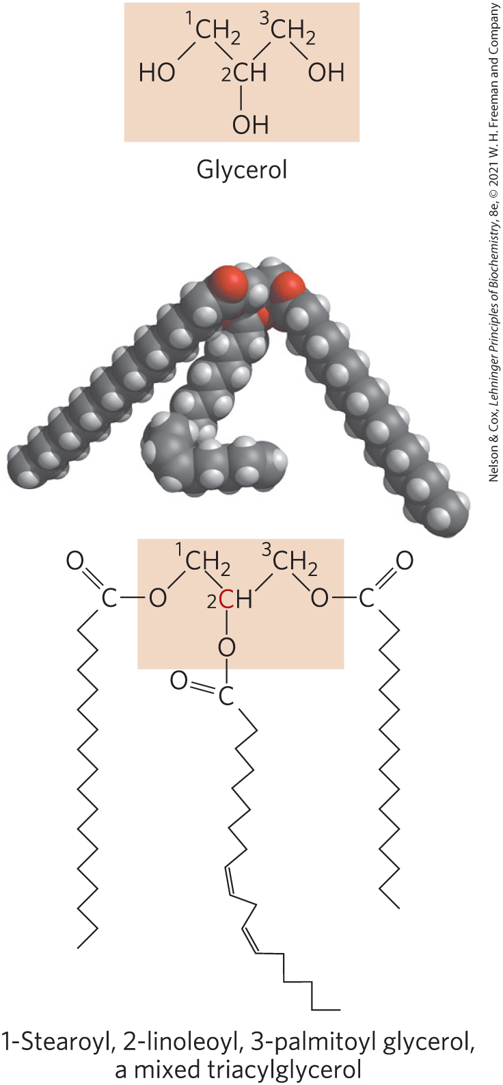
Triacylglycerols Are Fatty Acid Esters of Glycerol
triacylglycerols = simplest lipids constructed from fatty acids
  composed of three fatty acids, each in ester linkage with a single glycerol
  can be simple (one kind of fatty acid) or mixed (two or three different fatty acids)
  non-polar, hydrophobic

Slide 9
Solubility of Fatty Acids
poor solubility in water due to the nonpolar hydrocarbon chain
  increased chain length decreases solubility
  decreased double bond number decreases solubility
carboxylic acid group is polar and ionized at neutral pH

Slide 10
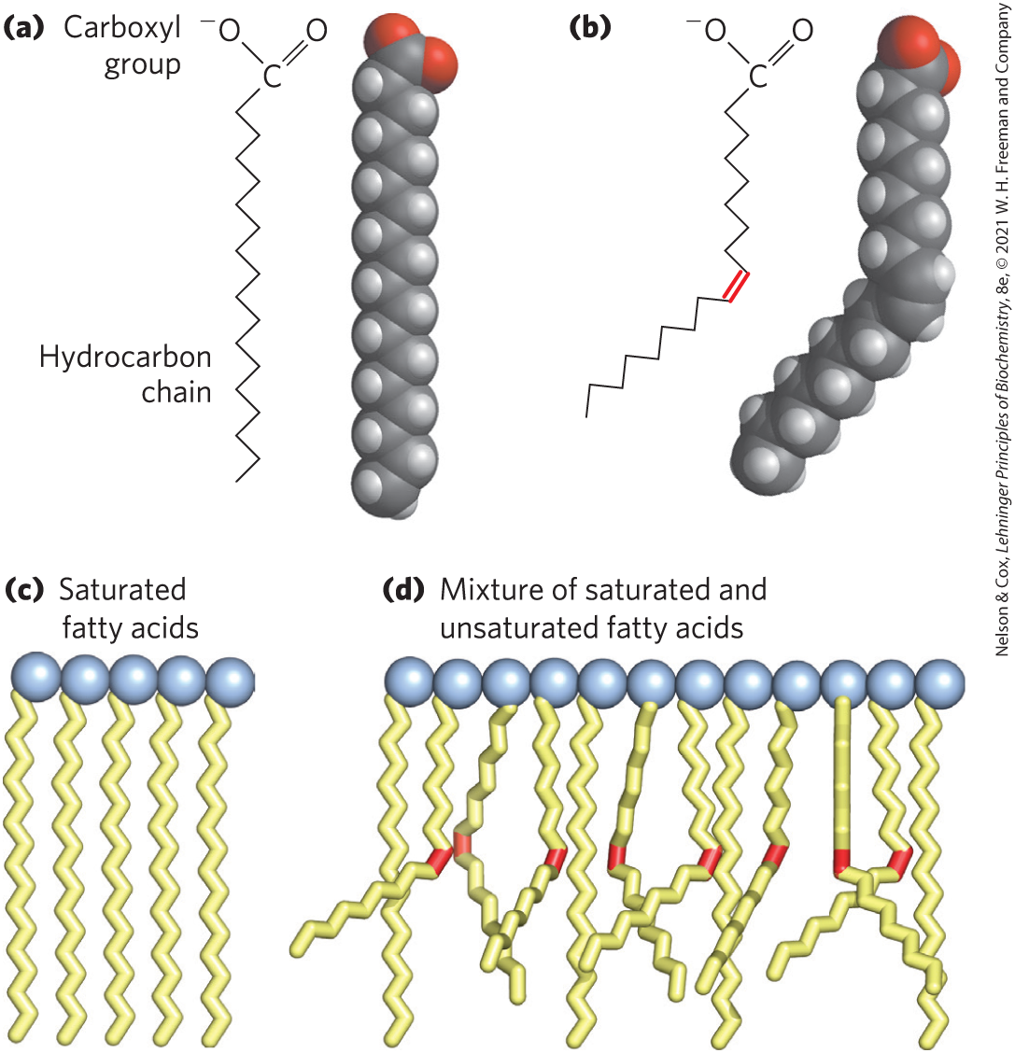
Melting Points of Fatty Acids
at room temperature:
  saturated fatty acids have a waxy consistency
  unsaturated fatty acids are oily liquids
extent of packing depends on degree of saturation

Slide 11
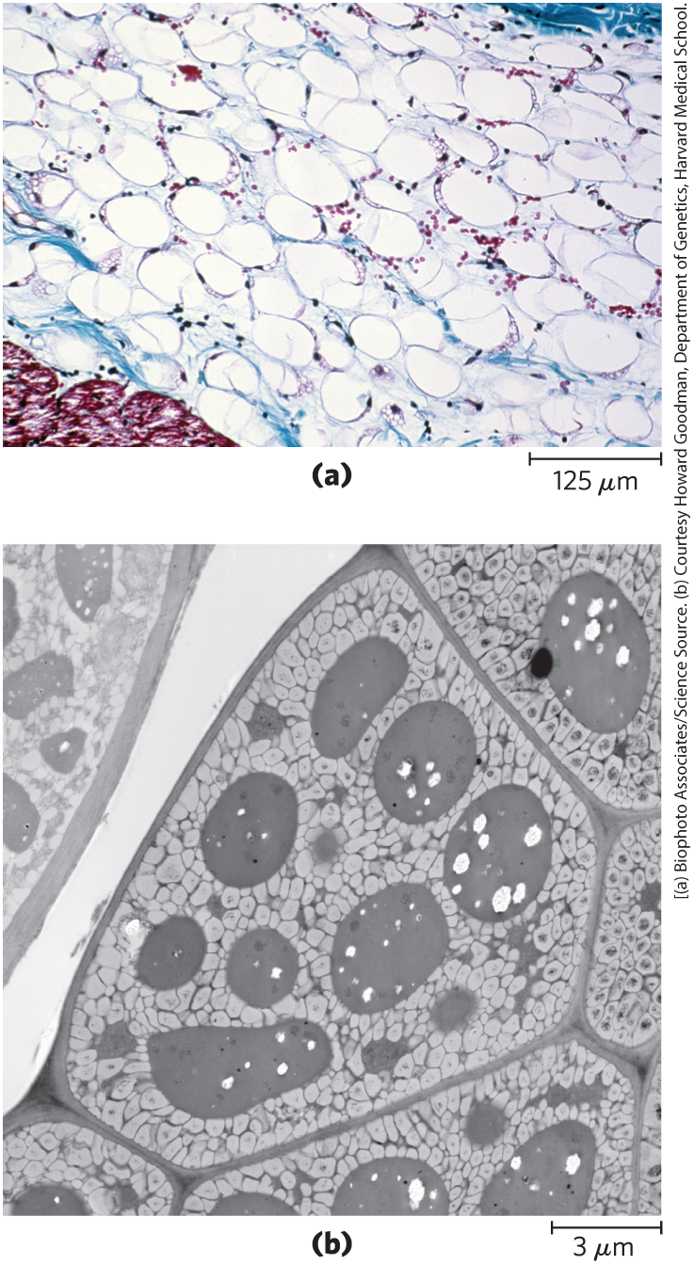
Triacylglycerols Provide Stored Energy and Insulation
vertebrates store triacylglycerols as lipid droplets in adipocytes (fat cells)
plants store triacylglycerols in the seeds

Slide 12
Lipases
lipases = enzymes that catalyze the hydrolysis of stored triacylglycerols, releasing fatty acids for export to sites where they are required as fuel
  adipocytes and germinating seeds contain lipases

Slide 13
Advantages to Using Triacylglycerols as Stored Fuels
two significant advantages:
  because carbon atoms of fatty acids are more reduced than those of sugars, oxidation of fatty acids yields more energy
  because triacylglycerols are hydrophobic and unhydrated, the organism does not have to carry the extra weight of water hydration that is associated with stored polysaccharides

Slide 14
Triacylglycerols Provide Insulation
seals, walruses, penguins, and other warm-blooded polar animals are amply padded with triacylglycerols
  provides insulation against low temperatures
hibernating animals (e.g. bears) accumulate huge fat reserves before hibernation
  provides insulation and energy storage

Slide 15
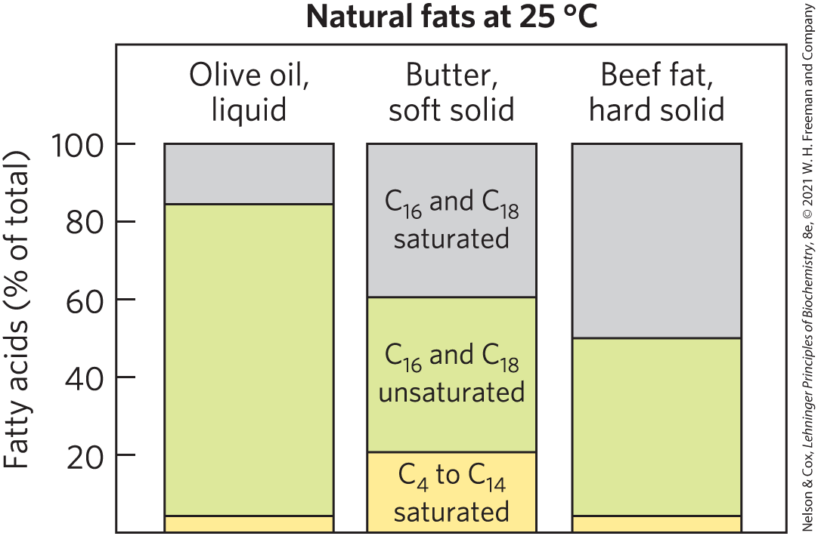
Partial Hydrogenation of Cooking Oils Improves Their Stability but Creates Fatty Acids with Harmful Health Effects
natural fats are complex mixtures of simple and mixed triacylglycerols

Slide 16
Partial Hydrogenation
oxidative cleavage of double bonds in unsaturated fatty acids to aldehydes and carboxylic acids causes lipid-rich food to become rancid
partial hydrogenation = process that converts many of the cis double bonds in the fatty acids to single bonds
  improves shelf life and increases stability
  increases the melting temperature
  converts some cis double bonds to trans double bonds

Slide 17
Trans Fatty Acids (“Trans Fats”)
dietary intake of trans fatty acids is linked to a higher incidence of cardiovascular disease
trans fatty acids:
  raise the level of triacylglycerols in the blood
  raise the level of LDL (“bad”) cholesterol in the blood
  lower the level of HDL (“good”) cholesterol
  increase the body’s inflammatory response

Slide 18
Biological Membranes
biological membranes = double layer of lipids that acts as a barrier to polar molecules and ions
membrane lipids:
  amphipathic = one end of the molecule is hydrophobic, the other hydrophilic
  hydrophobic regions associate with each other
  hydrophilic regions associate with water

Slide 19
Four General Types of Membrane Lipids
phospholipids = have hydrophobic regions composed of two fatty acids joined to glycerol or sphingosine
glycolipids = contain a simple sugar or a complex oligosaccharide at the polar ends
archaeal tetraether lipids = have two very long alkyl chains ether-linked to glycerol at both ends
sterols = compounds characterized by a rigid system of four fused hydrocarbon rings

Slide 20
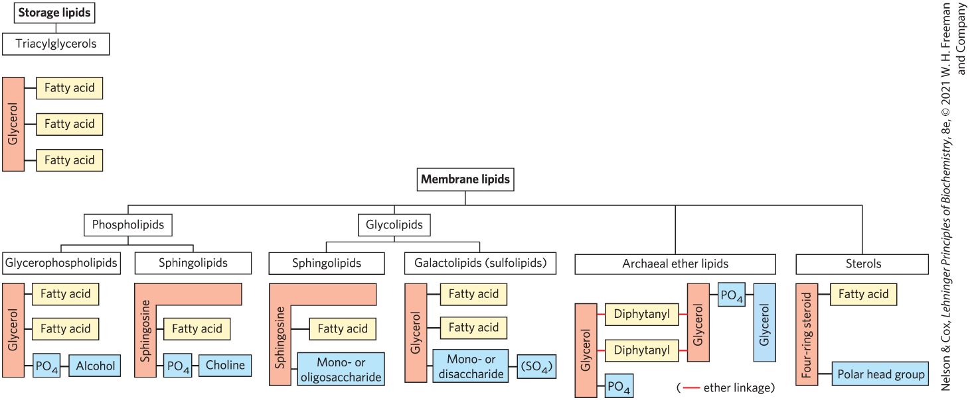
Some Common Types of Storage and Membrane Lipids

Slide 21
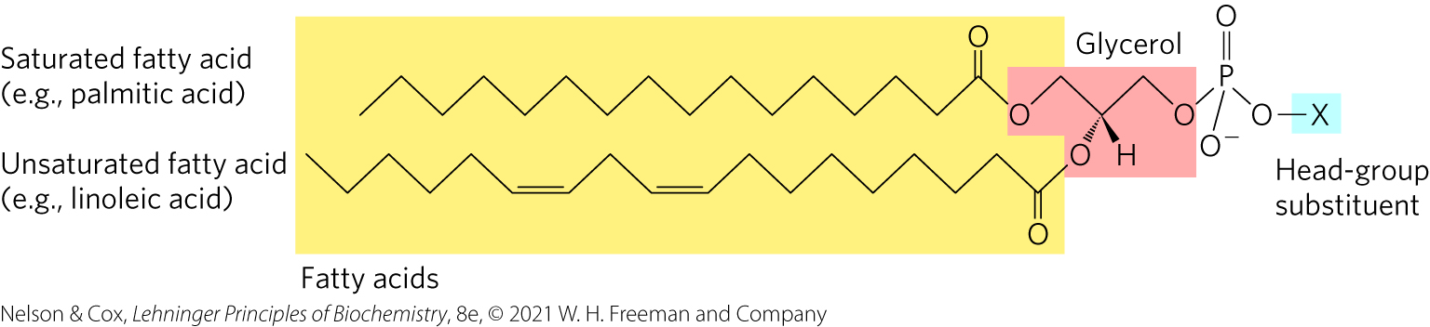
Glycerophospholipids Are Derivatives of Phosphatidic Acid
glycerophospholipids (phosphoglycerides) = membrane lipids in which two fatty acids are attached in ester linkage to the first and second carbons of glycerol, and a highly polar or charged group is attached through a phosphodiester linkage to the third carbon

Slide 22
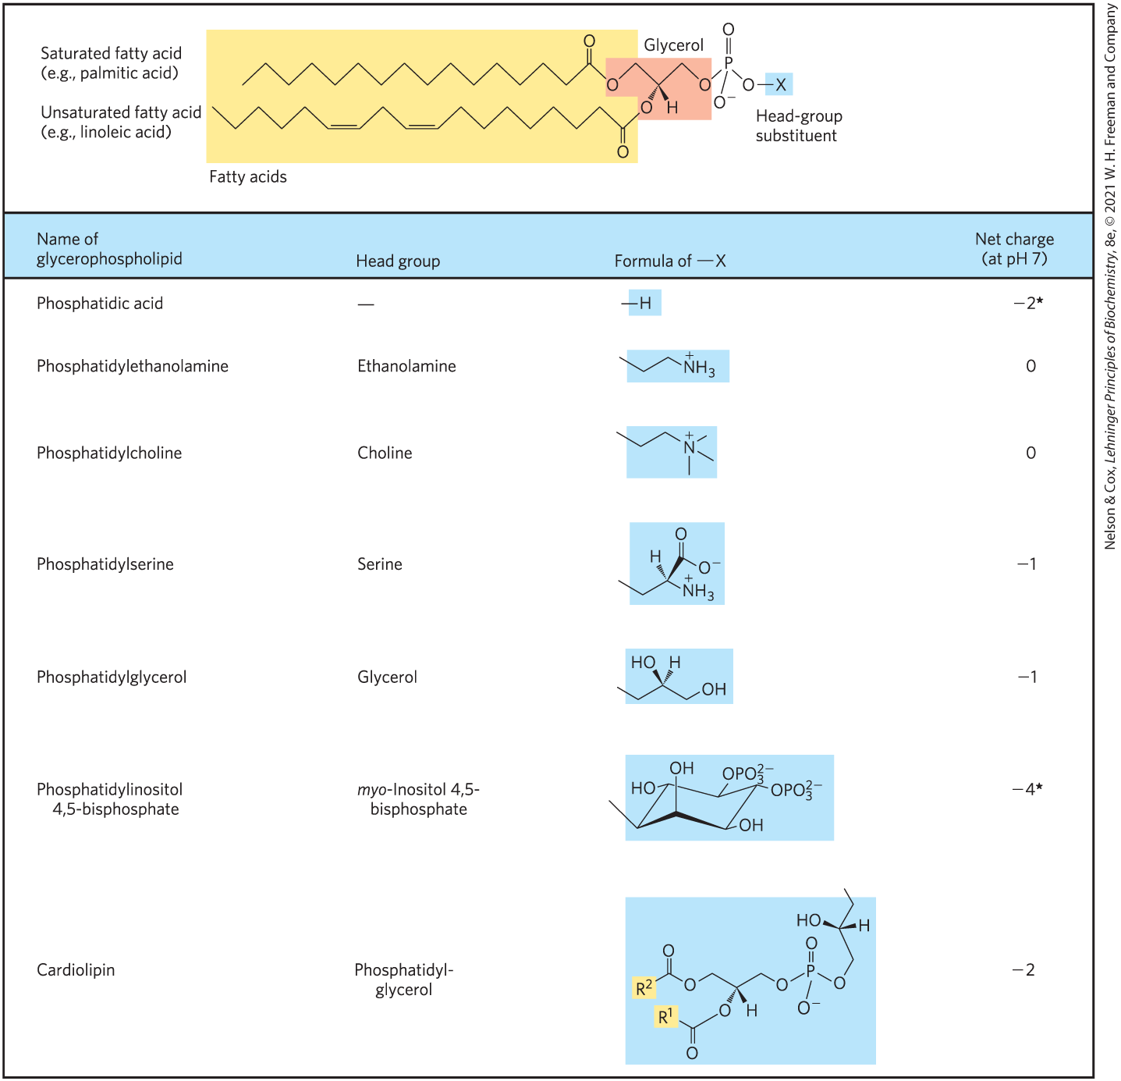
Glycerophospholipids Are Named as Derivatives of Phosphatidic Acid
a phosphodiester bond joins the head group to glycerol
the phosphate group can bear a negative, neutral, or positive charge

Slide 23
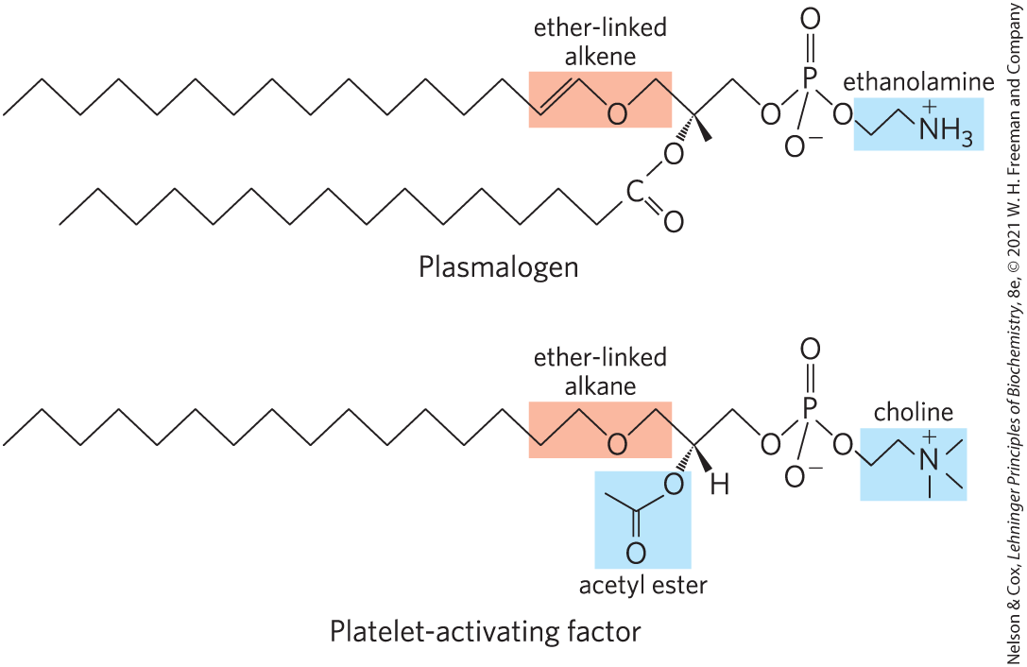
Some Glycerophospholipids Have Ether-Linked Fatty Acids
ether lipids = one of the two acyl chains is attached to glycerol in ether, rather than ester, linkage
  chain may be saturated
  chain may contain a double bond between C-1 and C-2 as in plasmalogens

Slide 24
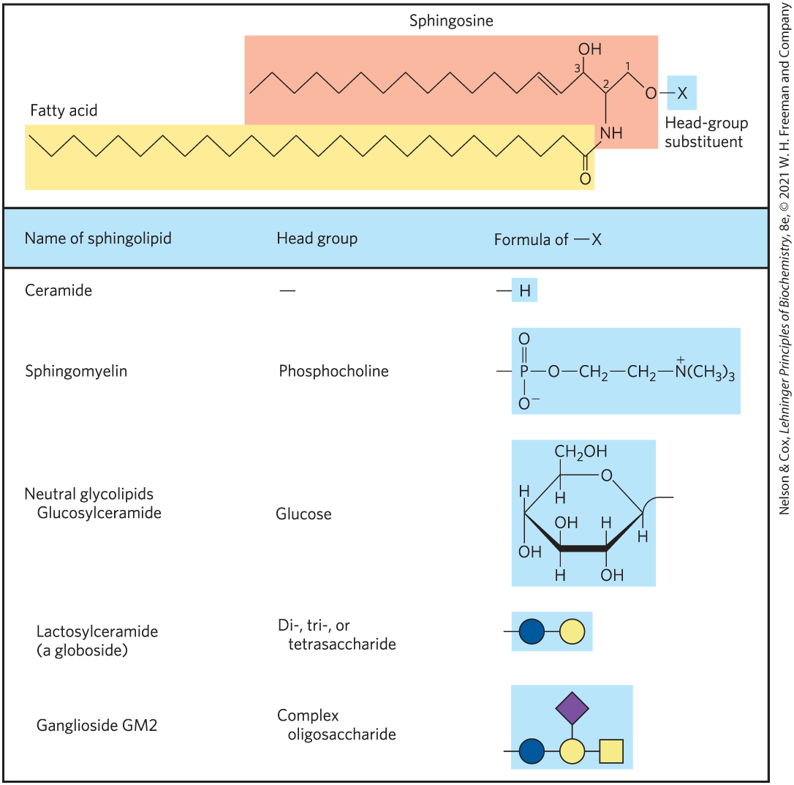
Sphingolipids Are Derivatives of Sphingosine
sphingolipids = large class of membrane phospholipids and glycolipids
  have a polar head group and two nonpolar tails
  contain no glycerol
  contain one molecule of the long-chain amino alcohol sphingosine or one of its derivatives

Slide 25
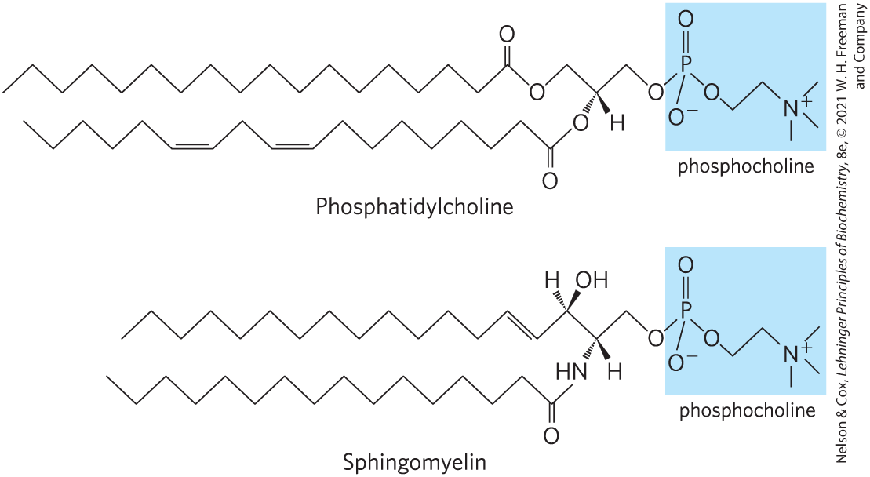
Sphingomyelins
sphingomyelins = subclass of sphingolipids that contains phosphocholine or phosphoethanolamine as their polar head group

Slide 26
Glycosphingolipids
glycosphingolipids = have head groups with 1+ sugars connected directly to the –OH at C-1 of the ceramide moiety
  do not contain phosphate
  occur largely in the outer face of plasma membranes

Slide 27
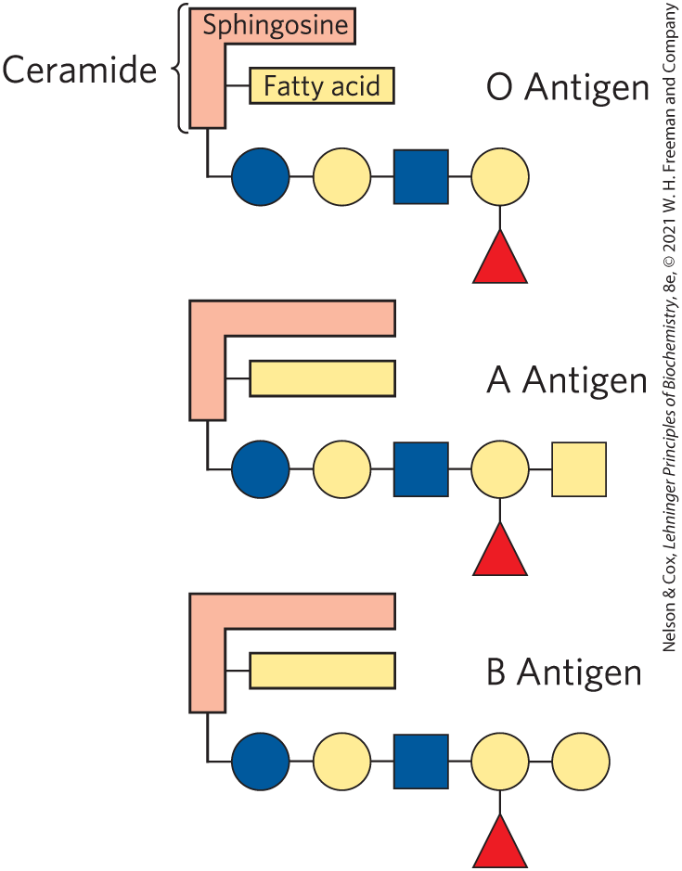
Sphingolipids at Cell Surfaces Are Sites of Biological Recognition
prominent in the plasma membranes of neurons
human blood groups (O, A, B) are determined in part by the oligosaccharide head groups of these glycosphingolipids

Slide 28
Sterols Have Four Fused Carbon Rings
sterols = structural lipids present in the membranes of most eukaryotic cells
steroid nucleus:
  consists of four fused rings
  almost planar
  relatively rigid

Slide 29
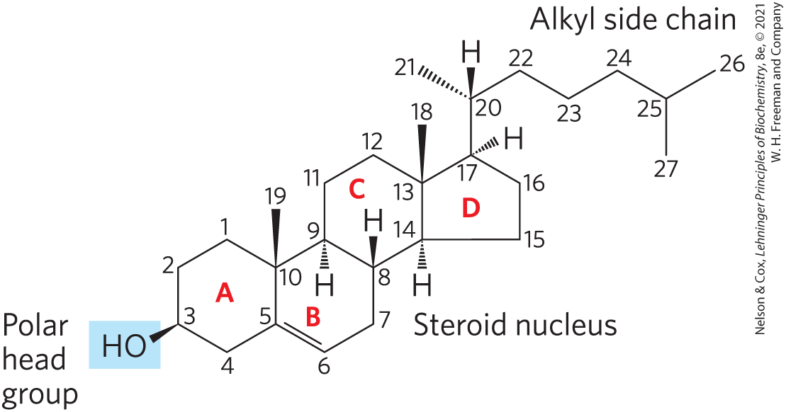
Cholesterol
cholesterol = major sterol in animal tissues
  amphipathic
  polar head group
  nonpolar hydrocarbon body
  membrane constituents
  similar to stigmasterol in plants and ergosterol in fungi

Slide 30
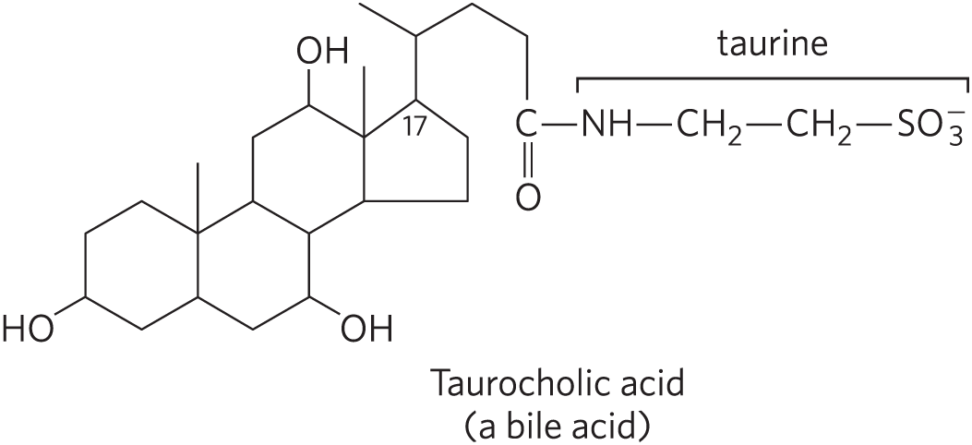
Sterols Serve as Precursors for Products with Specific Biological Activities
steroid hormones regulate gene expression
bile acids = polar derivatives of cholesterol that emulsify dietary fats in the intestine to make them more readily accessible to digestive lipases

Slide 31
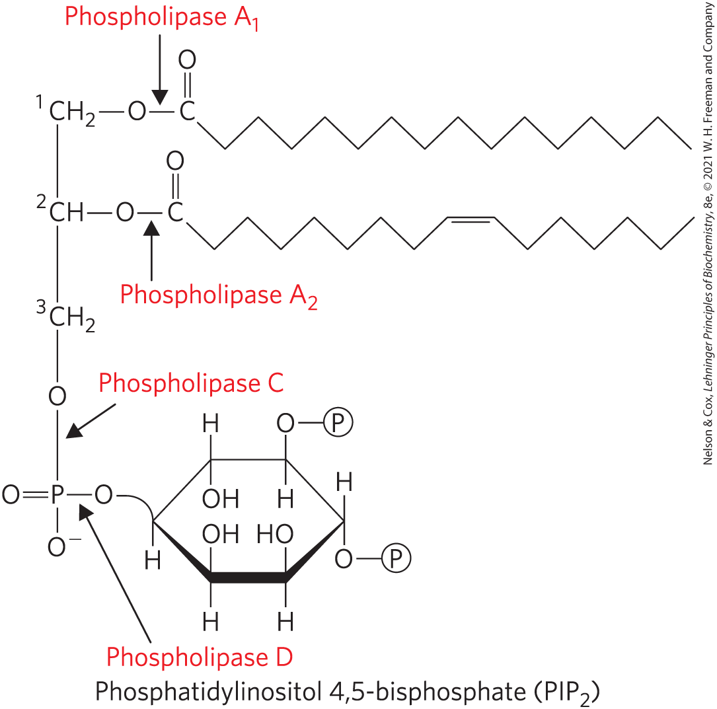
Phosphatidylinositol 4,5-Bisphosphate (PIP₂)
in the cytoplasmic face of plasma membranes
serves as a reservoir of messenger molecules that are released in response to extracellular signals
  phospholipase C hydrolyzes PIP₂ to IP₃ and diacylglycerol (intracellular messengers)

