Slide 1

8 Nucleotides and Nucleic Acids
© 2021 Macmillan Learning

Slide 2
Nucleotides
have a variety of roles in cellular metabolism:
  energy currency in metabolic transactions
  essential chemical links in the response of cells to hormones and other extracellular stimuli
  structural components of an array of enzyme cofactors and metabolic intermediates
  constituents of nucleic acids: deoxyribonucleic acid (DNA) and ribonucleic acid (RNA)

Slide 3

Principle 1 (1 of 6)
Nucleic acids are both repositories and functional expressions of biological information. Biological information is one of the required conditions for life, a blueprint for each species transmitted from one generation to the next. RNA can be a functional expression of that information, directing the synthesis of proteins or, in some cases, acting directly as a signal or a reaction catalyst.

Slide 4

Principle 2 (1 of 4)
The transmission of biological information relies on molecular complementarity. Chromosomes are the largest molecules in any cell. They are polymers composed of a small set of common nucleotides, with information embedded in the nucleotide sequence. The common nucleotides in RNA and DNA are organized so that two strands of nucleic acid can maintain a complementary and uniform structure over vast molecular distances. This extended potential for both variable sequence and complementarity, and thus information storage and transmission, is a property shared by no other class of biological molecule.

Slide 5

Principle 3 (1 of 3)
Biological information is subject to natural damage and change. DNA damage is a constant, and it results in occasional mutation — the raw material for evolution.

Slide 6

Principle 4 (1 of 4)
Biological information can be accessed, interpreted, and altered in the laboratory. The information embedded in nucleic acids
is of singular importance to biochemistry and molecular biology. The techniques for sequencing, synthesizing, and altering nucleic acids are continually advancing.

Slide 7

Principle 5 (1 of 3)
Nucleoside triphosphates occupy a central role in cellular metabolism, serving as an energy currency and as important regulatory signals. ATP is the ultimate product of catabolic pathways, providing fuel for anabolic pathways.

Slide 8
8.1 Some Basic Definitions and Conventions

Slide 9
The Functions of DNA
gene = a segment of a DNA molecule that contains the information required for the synthesis of a functional biological product, whether protein or RNA
only known functions of DNA:
  storage of biological information
  transmission of that information to the next generation

Slide 10
The Functions of RNA
several classes of RNA:
  ribosomal RNAs (rRNAs) = components of ribosomes
  messenger RNAs (mRNAs) = intermediates in protein synthesis
  transfer RNAs (tRNAs) = adapter molecules that translate the information in mRNA into a specific amino acid sequence
  noncoding RNAs (ncRNAs) = wide variety of functions

Slide 11
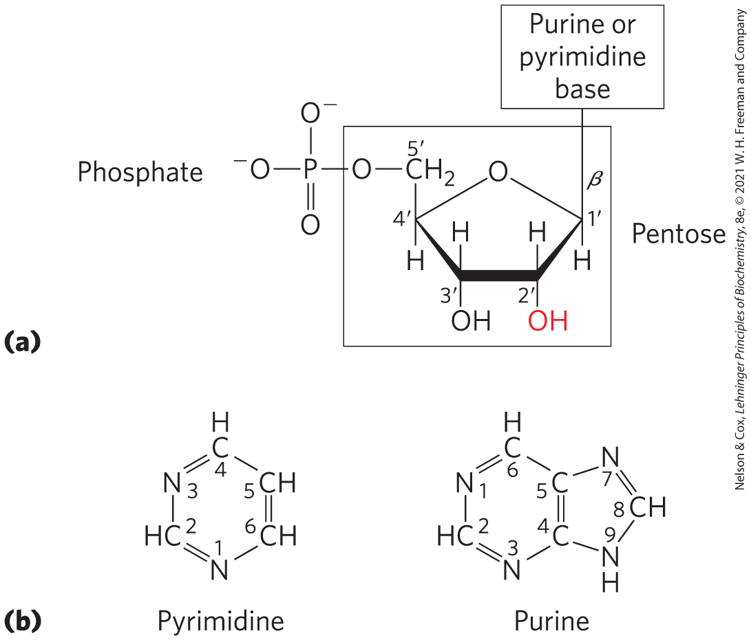
Nucleotides and Nucleic Acids Have Characteristic Bases and Pentoses
nucleotides have three components:
  a nitrogenous base (pyrimidine or purine)
  a pentose
  1+ phosphates
nucleoside = the molecule without a phosphate group

Slide 12
Nucleotide Bonds
N-β-glycosyl bond = covalently joins the 1′ carbon of the pentose to the base (at N-1 of pyrimidines and N-9 of purines)
  formed by removal of the elements of water
the phosphate is esterified to the 5′ carbon

Slide 13
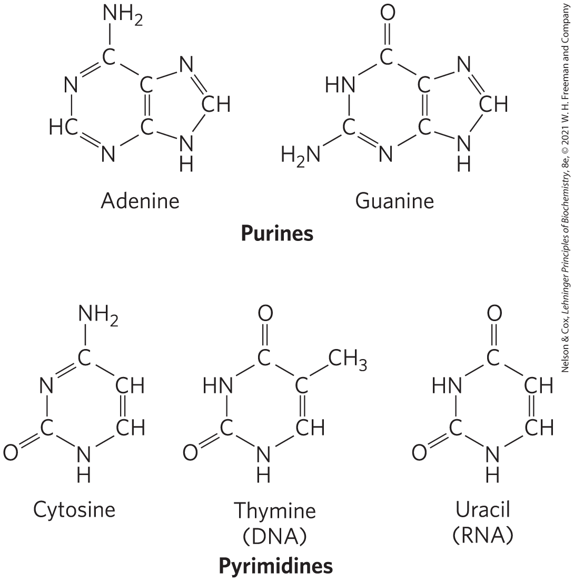
Nucleotide Nitrogenous Bases
major purine bases:
  adenine (A) = in DNA and RNA
  guanine (G) = in DNA and RNA
major pyrimidine bases:
  cytosine (C) = in DNA and RNA
  thymine (T) = only in DNA
  uracil (U) = only in RNA

Slide 14
Nucleotide and Nucleic Acid Nomenclature
Table 8-1 Nucleotide and Nucleic Acid Nomenclature
Base | Nucleoside | Nucleotide | Nucleic Acid
Purines: Adenine | Adenosine Deoxyadenosine | Adenylate Deoxyadenylate | RNA DNA
Purines: Guanine | Guanosine Deoxyguanosine | Guanylate Deoxyguanylate | RNA DNA
Pyrimidines: Cytosine | Cytidine Deoxycytidine | Cytidylate Deoxycytidylate | RNA DNA
Pyrimidines: Thymine | Thymidine or deoxythymidine | Thymidylate or deoxythymidylate | DNA
Pyrimidines: Uracil | Uridine | Uridylate | RNA

Slide 15
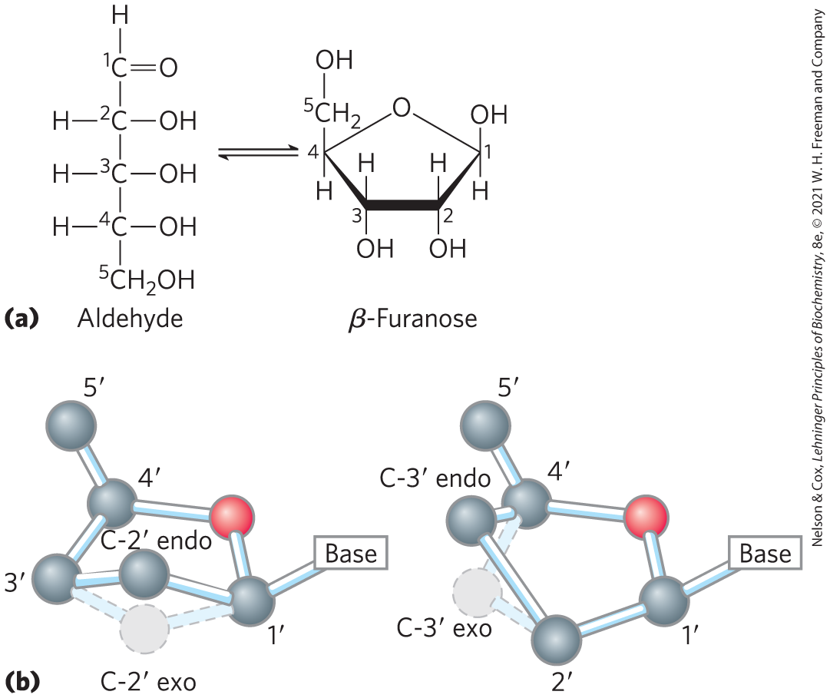
Nucleotide Pentoses
two kinds of pentoses:
  2′-deoxy-d-ribose = in DNA
  D-ribose = in RNA
both are in their β-furanose (closed five-membered ring) form

Slide 16
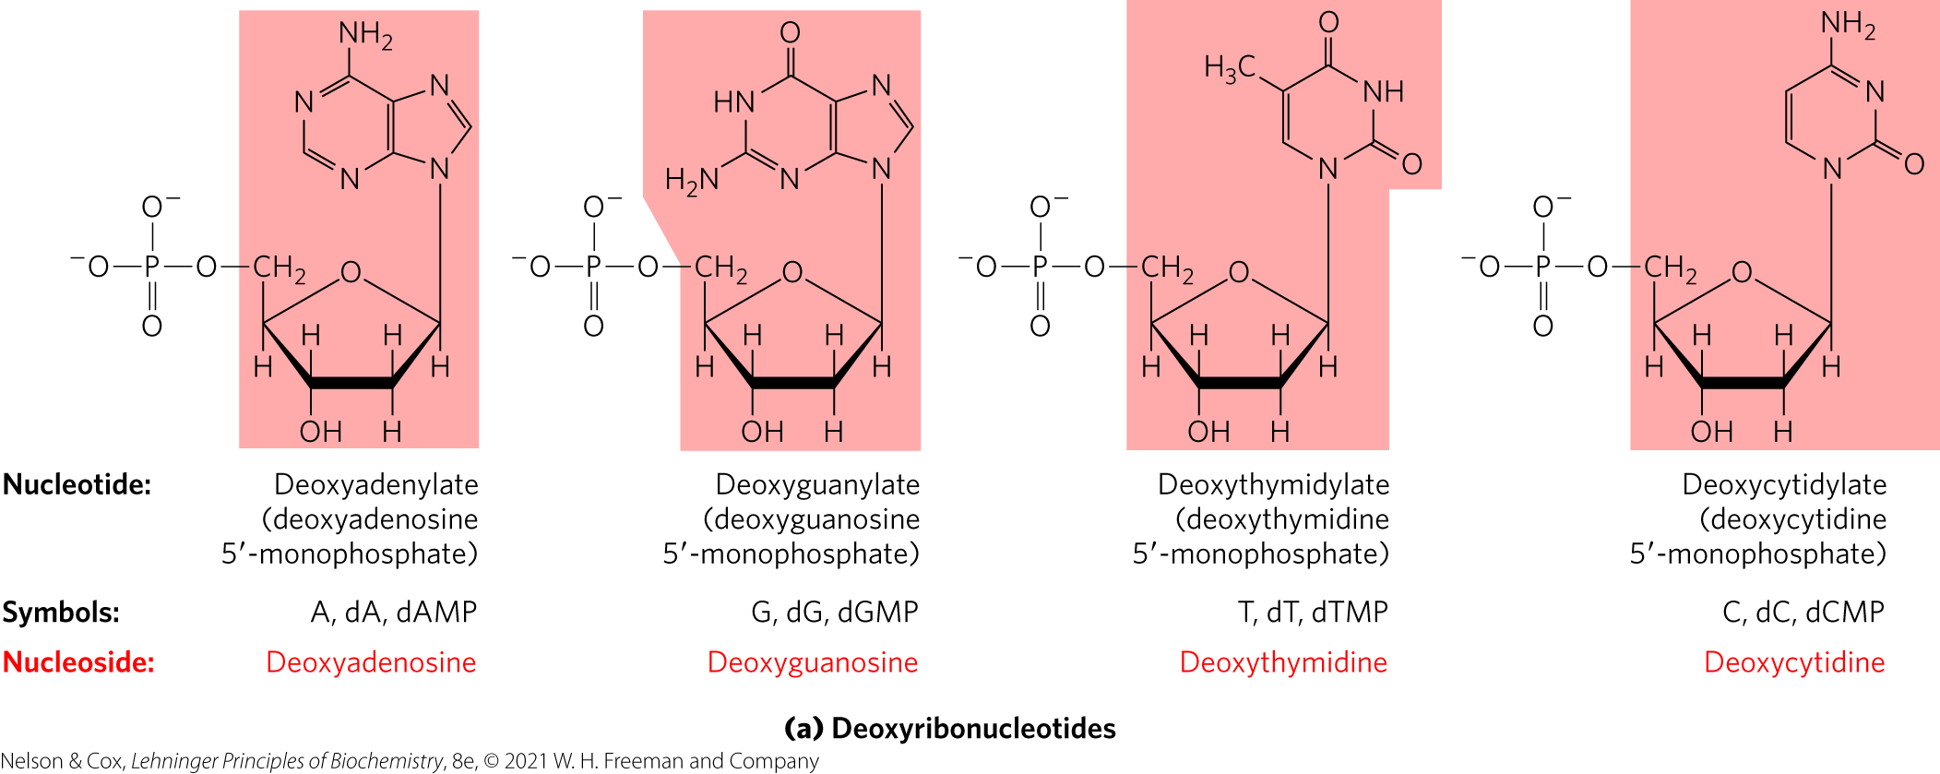
Structure and Names of The Four Major Deoxyribonucleotides
deoxyribonucleotides = structural units of DNA
  also called deoxyribonucleoside 5′-monophosphates, deoxynucleotides, and deoxynucleoside triphosphates

Slide 17
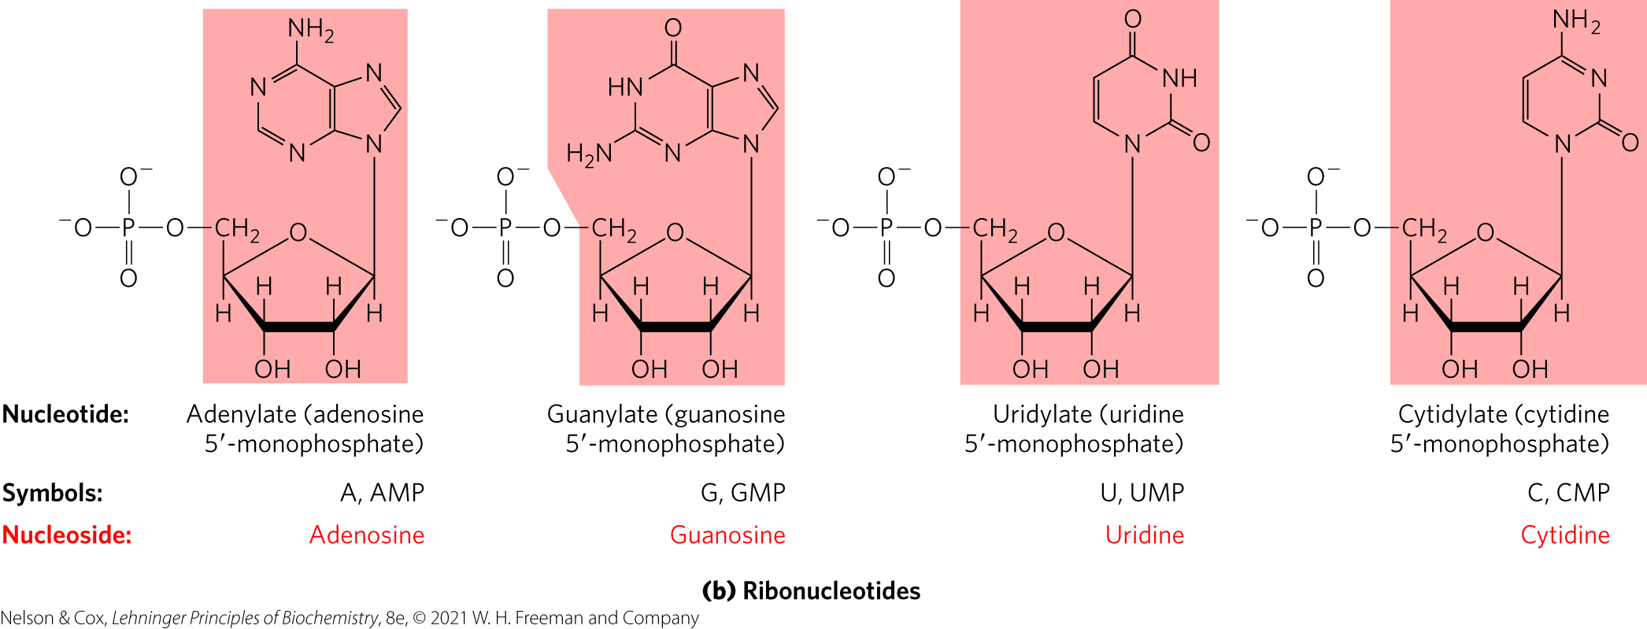
Structure and Names of The Four Major Ribonucleotides
ribonucleotides = structural units of RNA
  also called ribonucleoside 5′-monophosphates

Slide 18
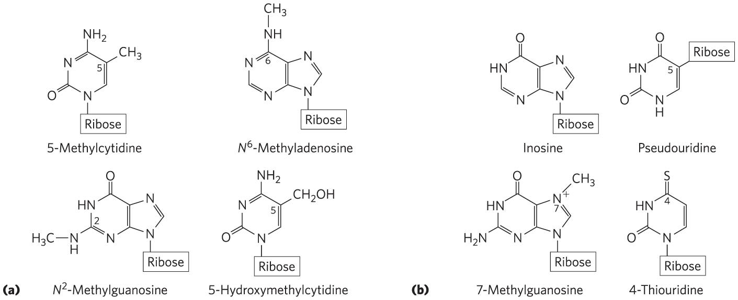
Minor Purine and Pyrimidine Bases
methylated forms – most common in DNA

Slide 19
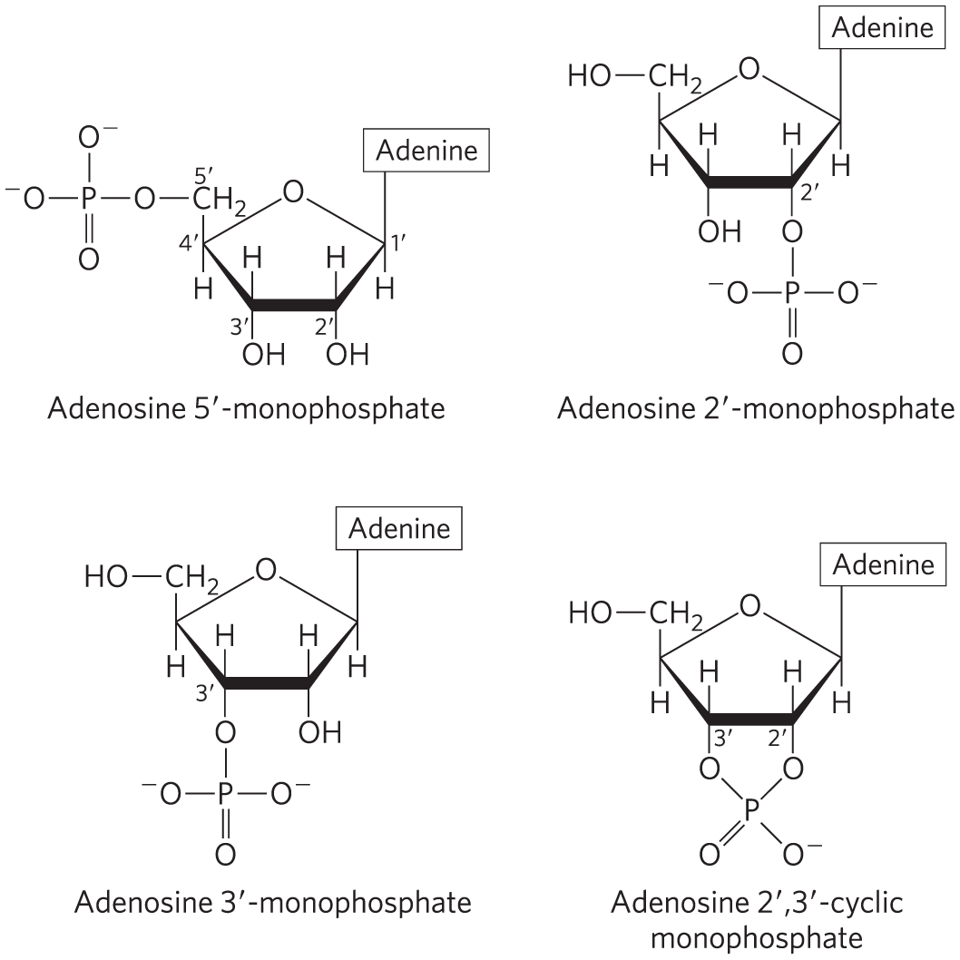
Nucleotides with Phosphate Groups in Different Positions
ribonucleoside 2′,3′-cyclic monophosphates = isolatable intermediates
ribonucleoside 3′-monophosphates = end products of RNA hydrolysis
adenosine 3′,5′-cyclic monophosphate (cAMP)
guanosine 3′,5′-cyclic monophosphate (cGMP)

Slide 20
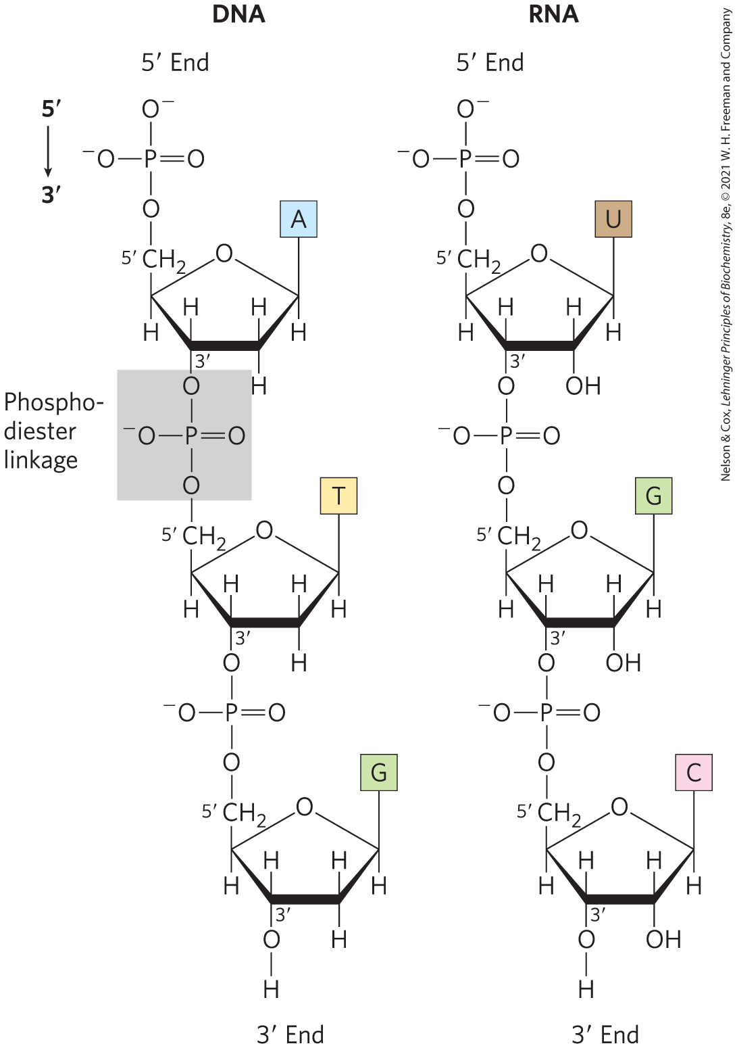
Phosphodiester Bonds Link Successive Nucleotides in Nucleic Acids
phosphodiester linkage = covalent bond that joins successive nucleotides of both DNA and RNA
  between the 5′-phosphate group of one nucleotide unit and the 3′-hydroxyl group of the next nucleotide

Slide 21
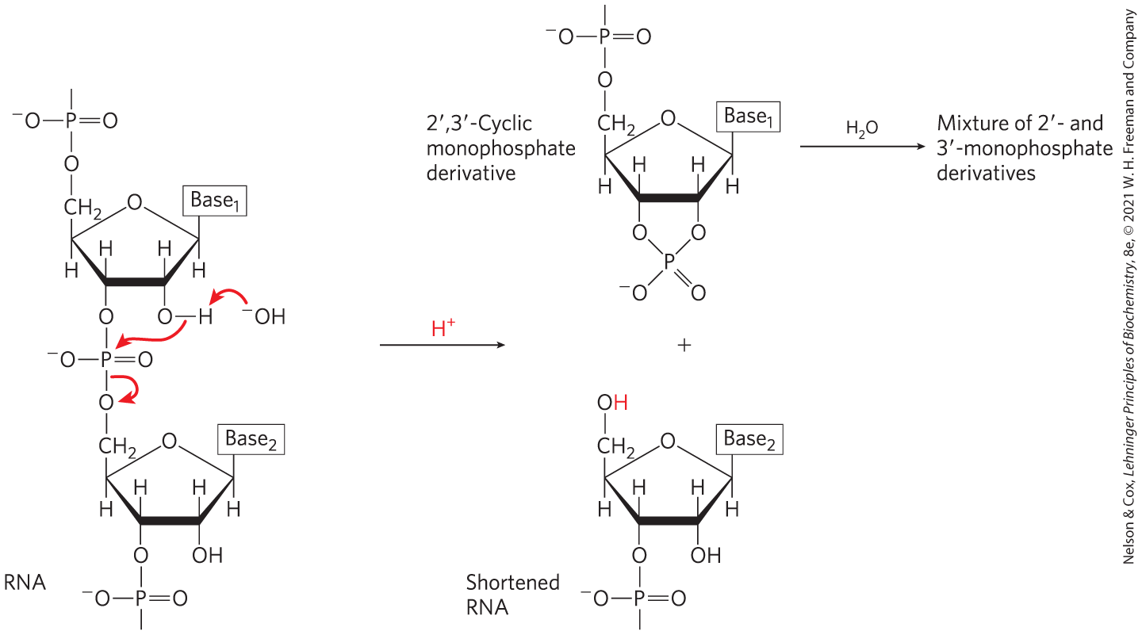
Hydrolysis of DNA and RNA
under alkaline conditions:
  RNA is rapidly hydrolyzed due to the presence of 2′-hydroxyl groups
  DNA is not rapidly hydrolyzed

Slide 22
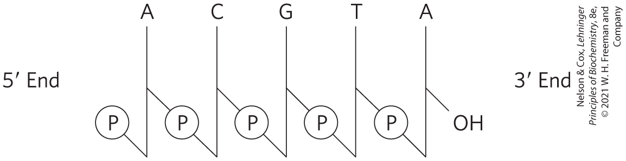
Schematic Representation of Nucleotide Sequences
phosphate groups symbolized by ℗
deoxyribose symbolized by a vertical line, from C-1′ at the top to C-5′ at the bottom
lines connecting nucleotides drawn diagonally from C-3′ to C-5′

Slide 23
Simpler Representations of Nucleotide Sequences
can also be written as:
  pA-C-G-T-A_{OH}
  pApCpGpTpA
  pACGTA

Slide 24
Oligonucleotides and Polynucleotides
oligonucleotide = short (typically < 50 nucleotides) nucleic acid
polynucleotide = longer nucleic acid

Slide 25
The Properties of Nucleotide Bases Affect the Three-Dimensional Structure of Nucleic Acids
weakly basic compounds
aromatic molecules
because most bonds in the ring have partial double-bond character:
  pyrimidines are planar
  purines have a slight pucker

Slide 26
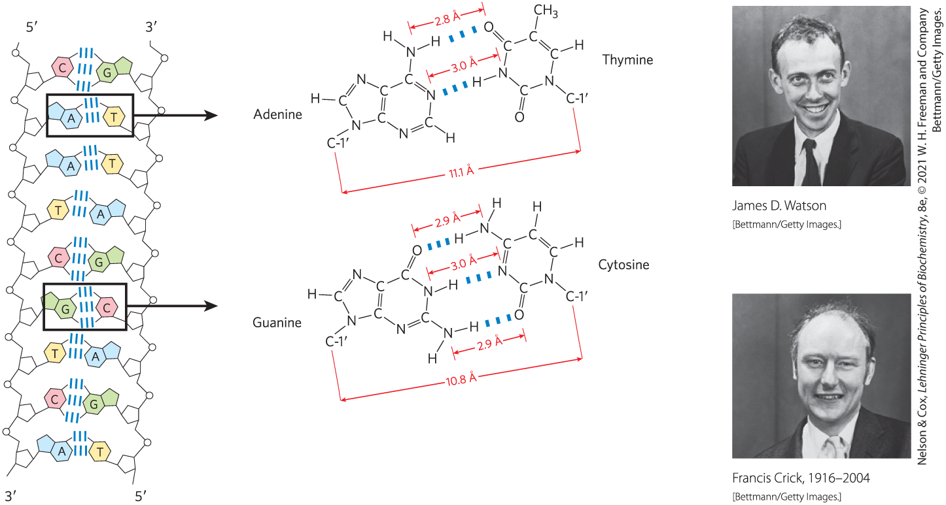
Base Pairing Permits the Duplication of Genetic Information
base pairs = hydrogen-bonding patterns between complementary strands of nucleic acids
  A bonds specifically to T (or U)
  G bonds specifically to C

Slide 27
8.2 Nucleic Acid Structure

Slide 28
Hierarchical Levels of Nucleic Acid Structure
primary structure = covalent structure and nucleotide sequence
secondary structure = regular, stable structure taken up by some or all the nucleotides
tertiary structure = complex folding of large chromosomes or the elaborate folding of tRNA or rRNA structures

Slide 29
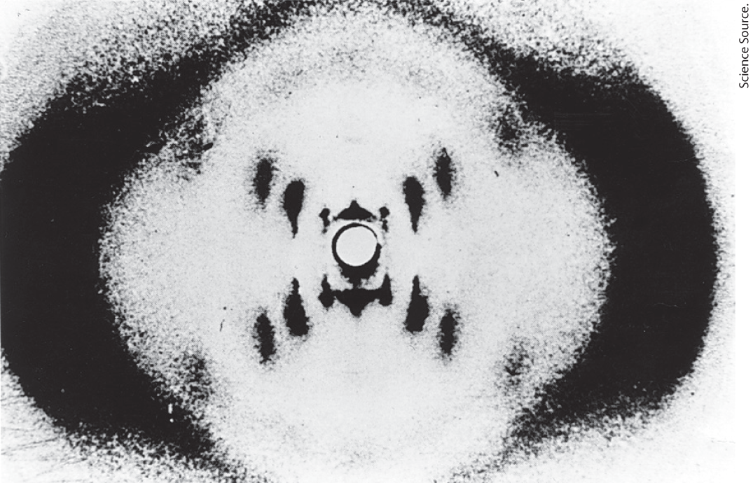
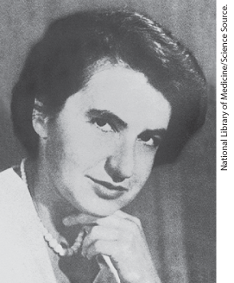
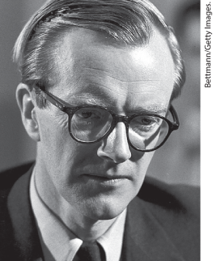
DNA Is a Double Helix that Stores Genetic Information
x-ray diffraction pattern revealed DNA molecules are helical

Slide 30
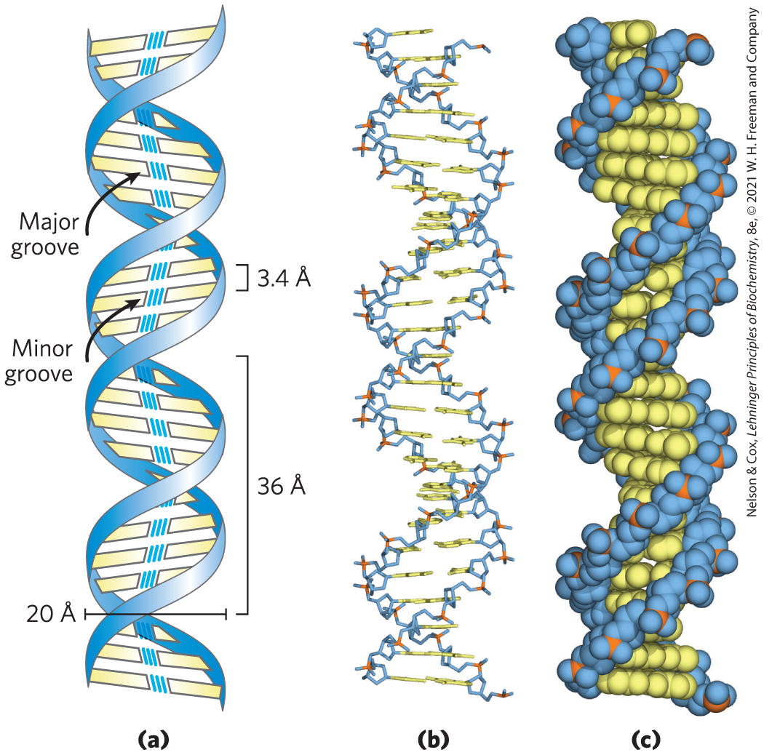
Watson-Crick Model for the Structure of DNA
offset pairing of the two strands creates a major groove and a minor groove
3 hydrogen bonds form between G and C
2 hydrogen bonds form between A and T

Slide 31
DNA Strands Are Antiparallel
parallel = 3′ ,5′ -phosphodiester bonds run in the same direction
antiparallel = 3′ ,5′ -phosphodiester bonds run in opposite directions
  ultimately confirmed by x-ray analysis

Slide 32
The Double Helix Has 10.5 Base Pairs Per Helical Turn
per helical turn:
  10.5 bp
  36 Å (3.6 nm)

Slide 33
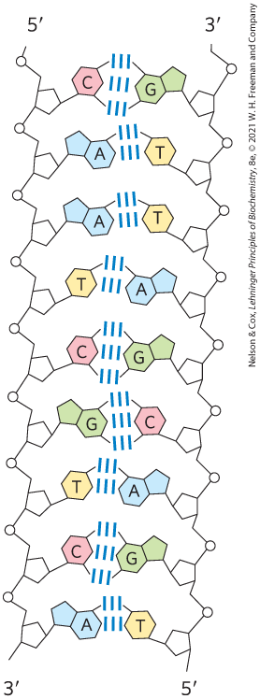
Antiparallel Polynucleotides Chains Are Complementary
double-helical DNA strands are complementary:
  when A occurs in one chain, T is found in the other
  when G occurs in one chain, C is found in the other
hydrogen bonding does not contribute significantly to stability of the structure

Slide 34
Stabilization of the DNA
Double Helix
the double helix is stabilized by:
  metal cations that shield the negative charges of backbone phosphates
  base stacking interactions between successive base pairs
    successive G≡C or C≡G are stronger than successive A=T or T=A
    duplexes with higher G≡C context are more stable

Slide 35
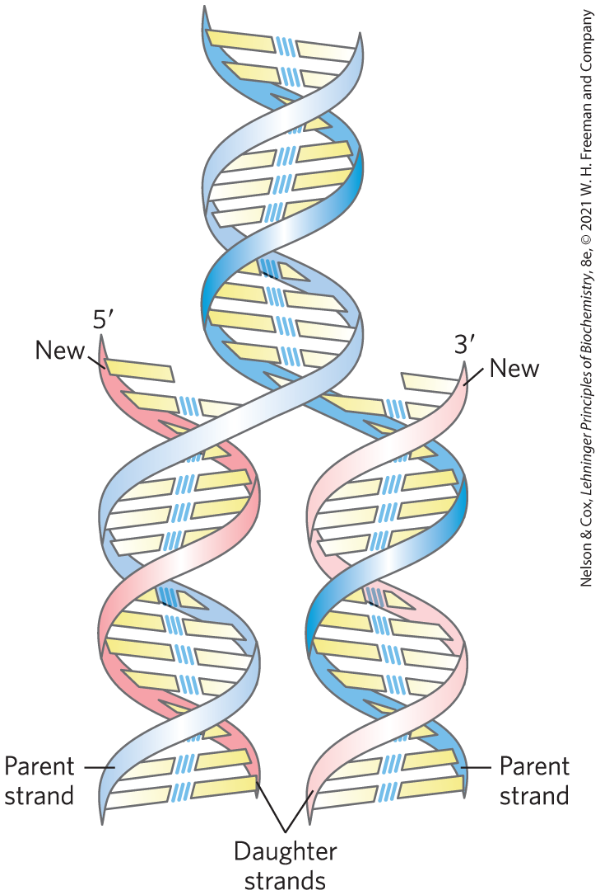
Replication of DNA
Step 1: preexisting or “parent” strands become separated
Step 2: each “parent” strand serves as a template for the biosynthesis of a complementary “daughter strand”

Slide 36
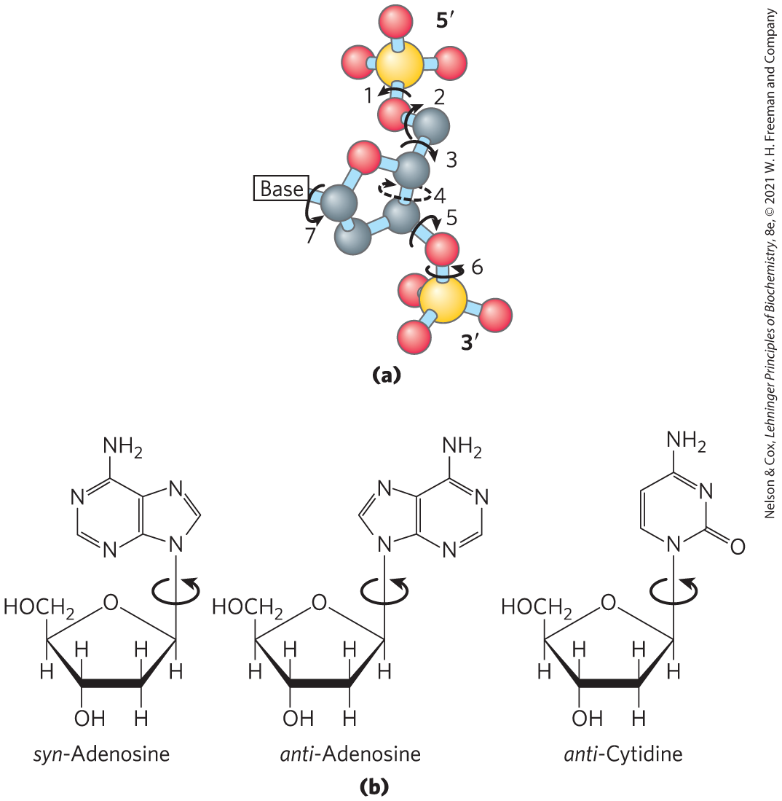
DNA Can Occur in Different Three-Dimensional Forms
structural variation in DNA reflects:
  different possible conformations of the deoxyribose
  rotation about the contiguous bonds making up the phosphodeoxyribose backbone
  free rotation about the C-1′–N-glycosyl bond

Slide 37
The Three Forms of DNA
B-form DNA = the Watson-Crick structure
  most stable for a random-sequence DNA molecule under physiological conditions
A-form DNA = right-handed double helix with a wider helix, 11 bp/turn, and a tilted plane
  favored in solutions devoid of water
Z-form DNA = left-handed helix with 12 bp/turn and a backbone with a zig-zag appearance
  appears more slender and elongated

Slide 38
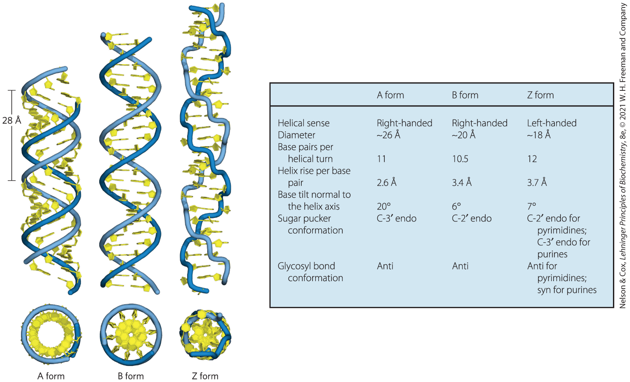
A, B, and Z Forms of DNA

Slide 39
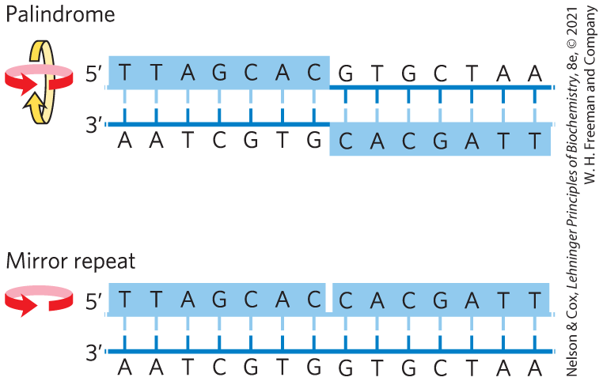
Certain DNA Sequences Adopt Unusual Structures
palindrome = region of DNA that is identical when read either forward or backward
  applied to regions of DNA with inverted repeats
mirror repeat = sequence when the inverted repeat occurs within each individual strand

Slide 40
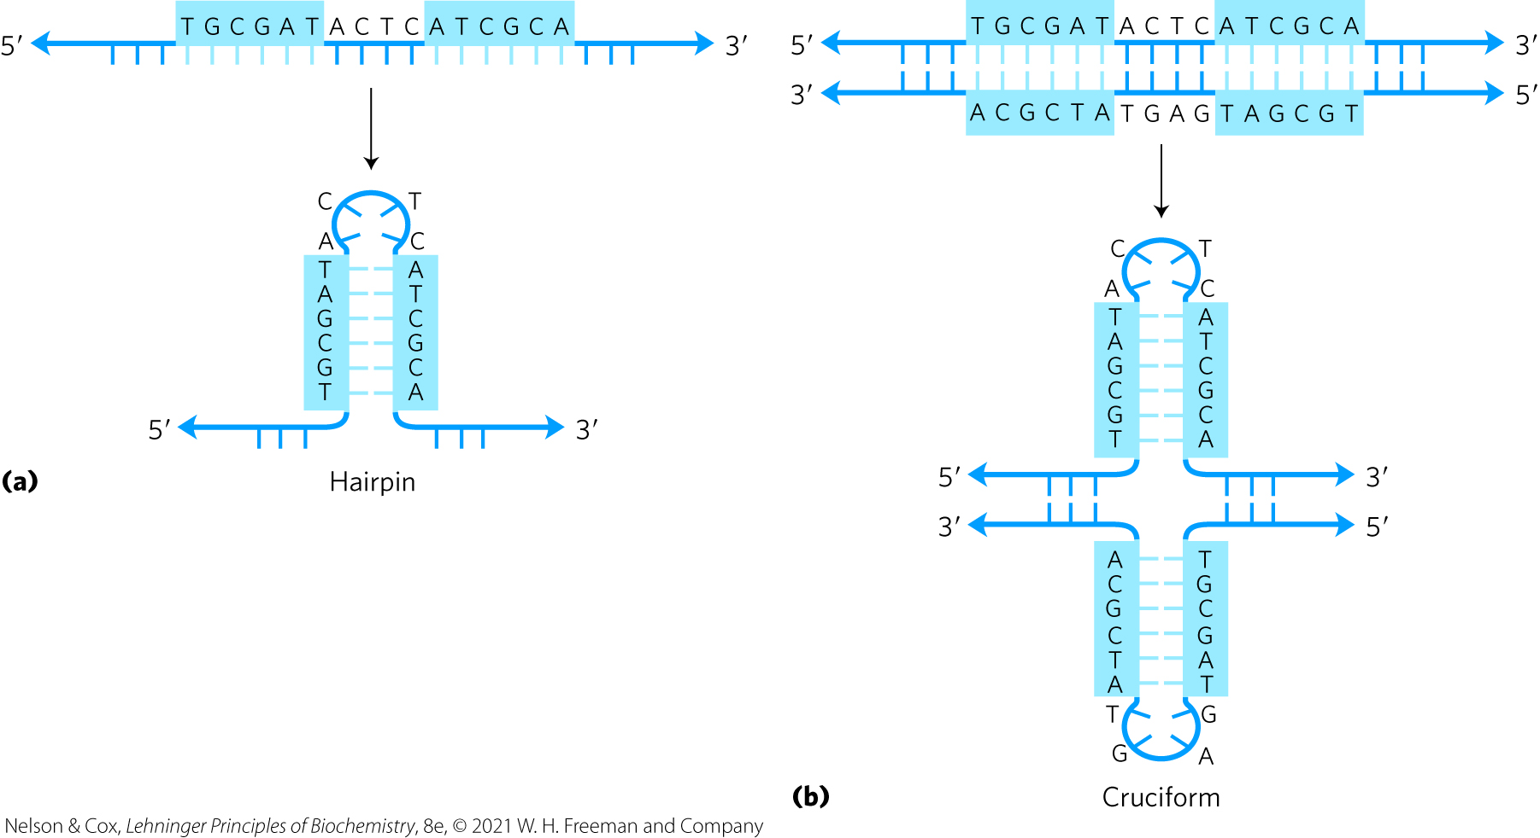
Hairpin and Cruciform Structures
hairpin and cruciform structures = form from the self-complementarity within each strand

Slide 41
Messenger RNAs Code for Polypeptide Chains
“messenger RNA” (mRNA) = portion of cellular RNA carrying the genetic information from DNA to the ribosome
transcription = process by which mRNAs are formed on a DNA template

Slide 42
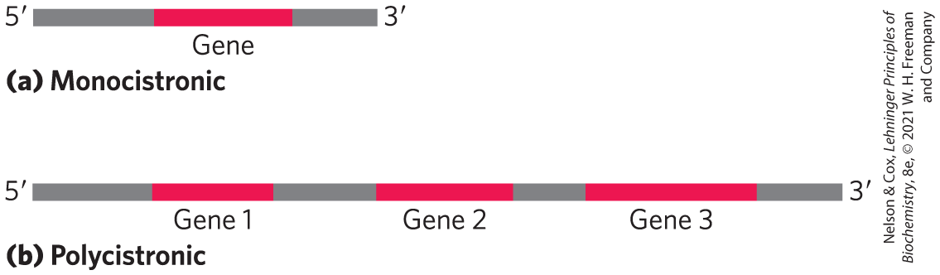
mRNA Can Be Monocistronic or Polycistronic
monocistronic = codes for only one polypeptide
  most mRNAs in eukaryotes
polycistronic = codes for 2+ different polypeptides
  occurs in bacteria and archaea
noncoding RNA

Slide 43
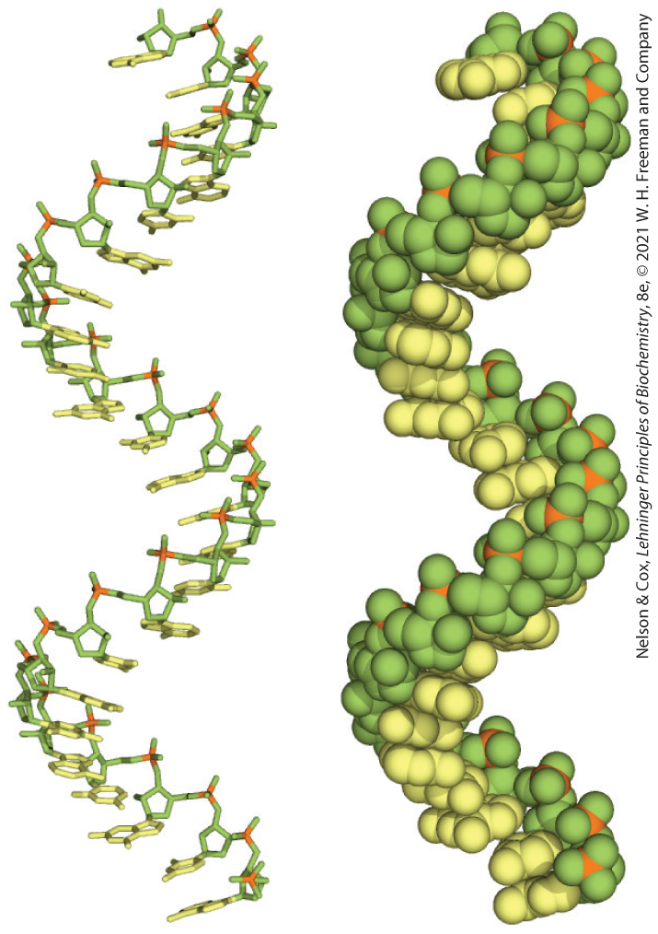
Many RNAs Have More Complex Three-Dimensional Structures
mRNA is always single-stranded
  right-handed helical conformation
  dominated by base-stacking interactions
    strongest between two purines
  can base pair with complementary regions of DNA or RNA
    paired strands are antiparallel

Slide 44
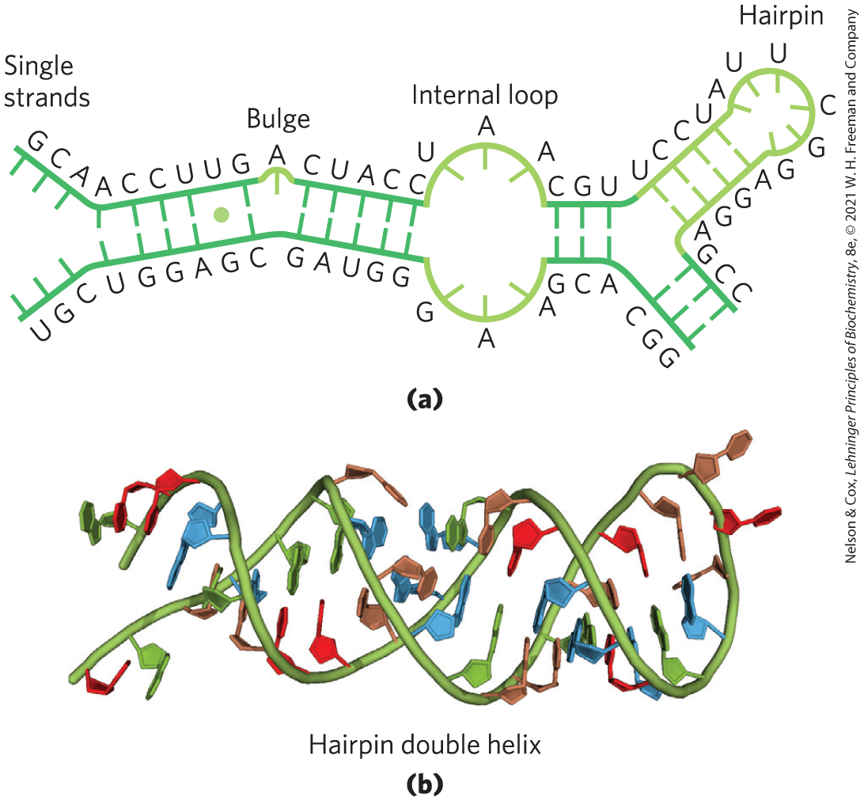
Secondary Structure of RNAs
structure of complementary RNA strands is an A-form right-handed double helix
breaks caused by mismatched or unmatched bases result in bulges or internal loops
internal loops form between palindromic sequences

Slide 45
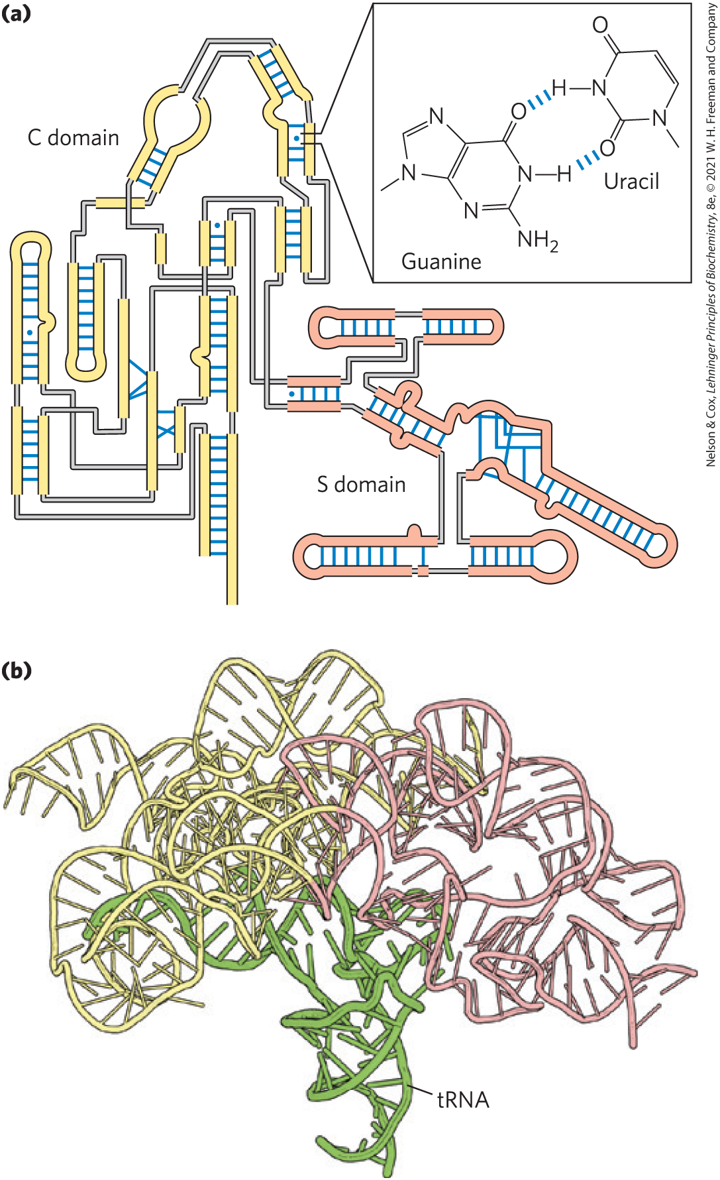
Base-Paired Helical Structures
In RNA
extensive base-paired helical segments form in RNAs
hairpins are the most common type of secondary structure

Slide 46
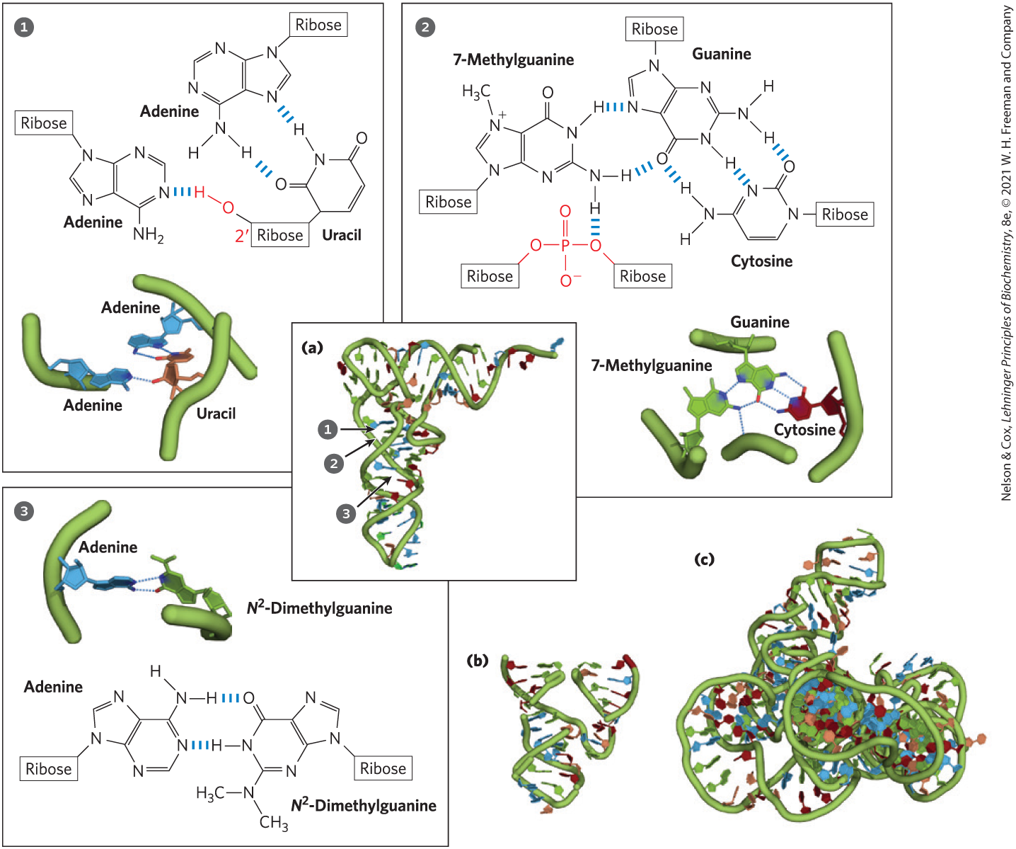
Three-Dimensional Structure in RNA

Slide 47
8.3 Nucleic Acid Chemistry

Slide 48
The Role of DNA as a Repository of Genetic Information
depends in part on its inherent stability
chemical transformations are generally very slow in the absence of enzyme catalysts
carcinogenesis and aging may be linked to slowly accumulating, irreversible DNA alternations

Slide 49
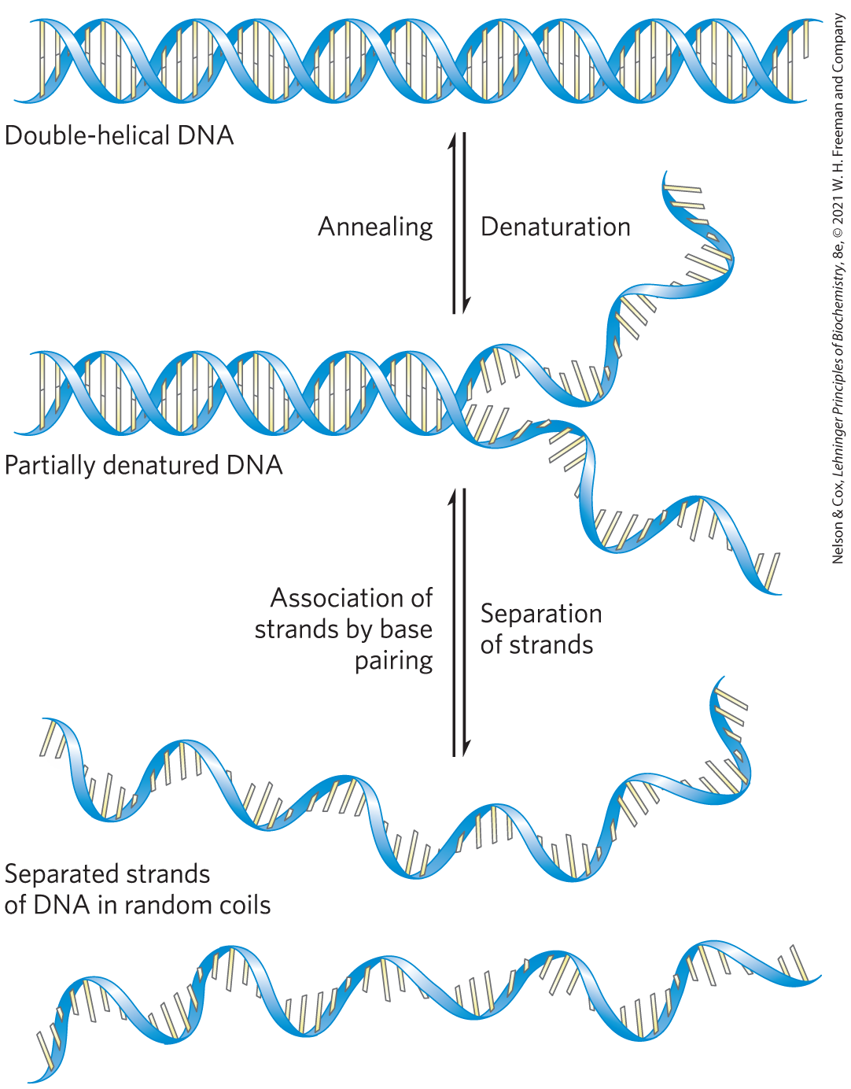
Double-Helical DNA and RNA Can Be Denatured
denaturation, or melting, of the double helix:
  due to pH extremes or high temperatures
  disrupts hydrogen bonds and base-stacking interactions

Slide 50
Double-Helical DNA and RNA Can Anneal
anneal = process by which two strands spontaneously rewind when temperature or pH is returned to its normal range
  two-step process

Slide 51
The Hypochromic and Hyperchromic Effects
hypochromic effect = the observed decrease in the absorption of UV light when complementary strands are paired
hyperchromic effect = the observed increase in the absorption of UV light when a double-stranded nucleic acid is denatured
monitoring UV absorption at 260 nm can detect the transition from double-stranded to single-stranded DNA

Slide 52
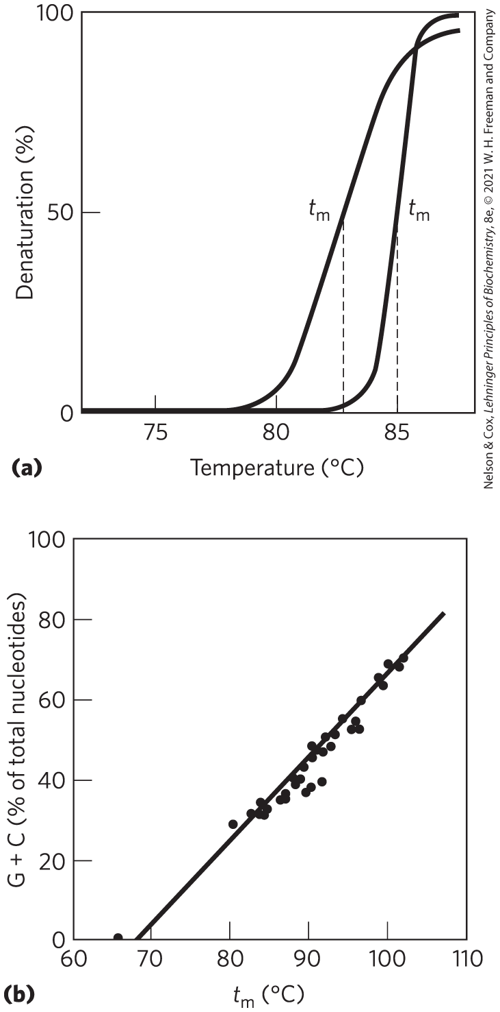
Heat Denaturation of DNA
denaturation temperature, t_{m} = temperature at which ½ of DNA is present as separated single strands
  increases with content of G≡C base pairs

Slide 53
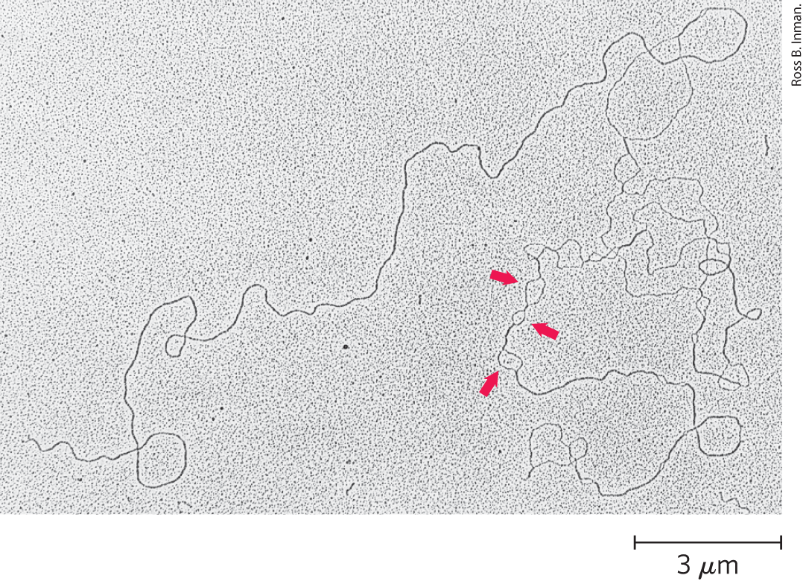
Partially Denatured DNA
denatured regions form bubbles
often rich in A=T base pairs

Slide 54
Denaturation of Double-Stranded RNA and RNA-DNA Hybrids
RNA duplexes are more stable to heat denaturation than DNA duplexes
RNA-DNA hybrid stability is generally intermediate

Slide 55
Nucleotides and Nucleic Acids Undergo Nonenzymatic Transformations
mutations = alterations in DNA structure that produce permanent changes in the genetic information encoded
  linked to aging and carcinogenesis

Slide 56
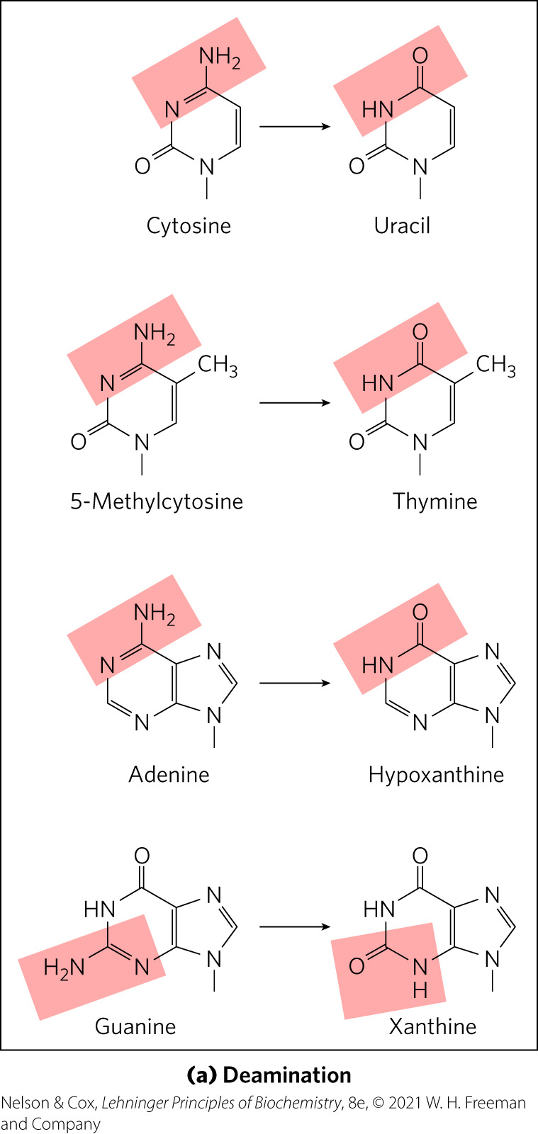
Deamination Reactions
deamination = spontaneous loss of exocyclic amino groups
deamination of cytosine to uracil = ~100 events/day
  recognized as foreign in DNA and removed
  almost certainly why DNA contains thymine rather than uracil

Slide 57
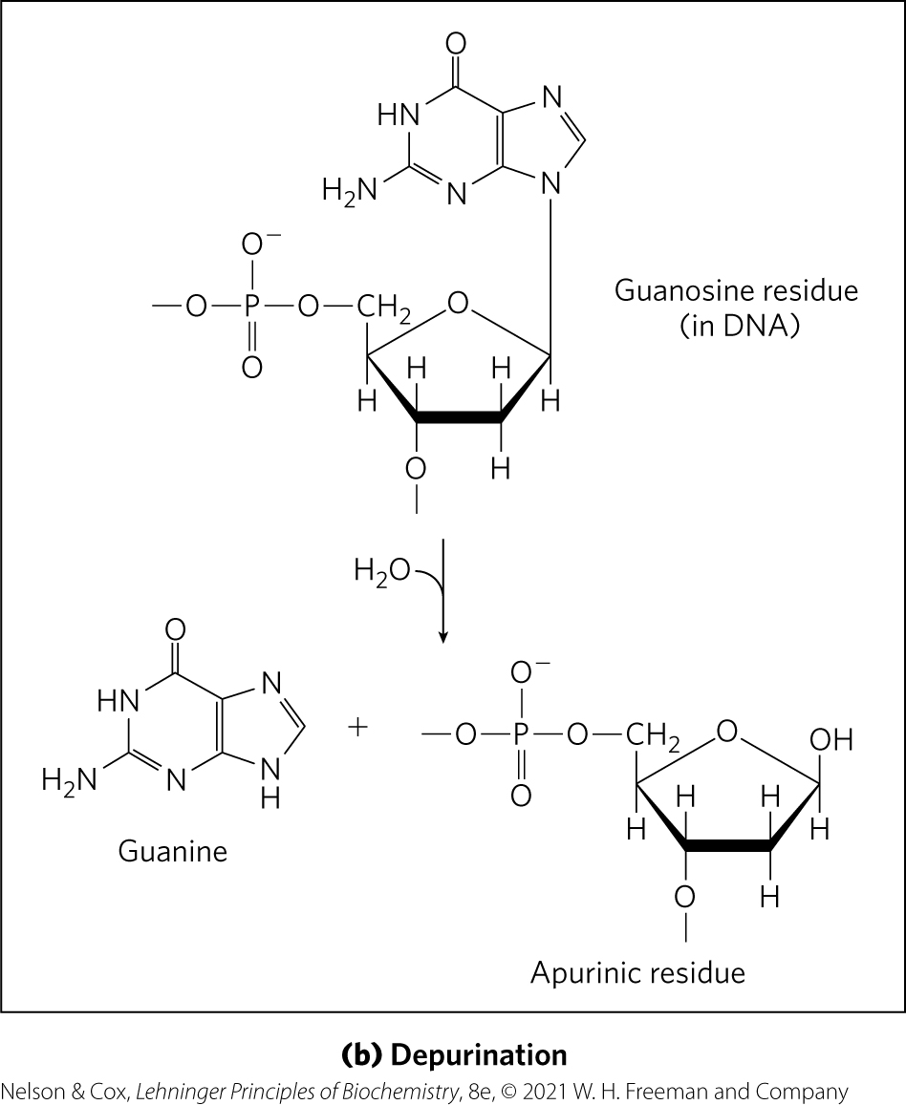
Depurination Reactions
depurination = hydrolysis of the N-β-glycosyl bond between the base and the pentose
  creates an AP (apurinic, apyrimidinic) site or abasic site
  more common with purines

Slide 58
Reactions Promoted by Radiation
UV light causes:
  cyclobutane pyrimidine dimers
  6-4 photoproduct
ionizing radiation (x-rays and gamma rays) causes:
  ring opening
  base fragmentation
  breaks in the covalent backbone of nucleic acids

Slide 59
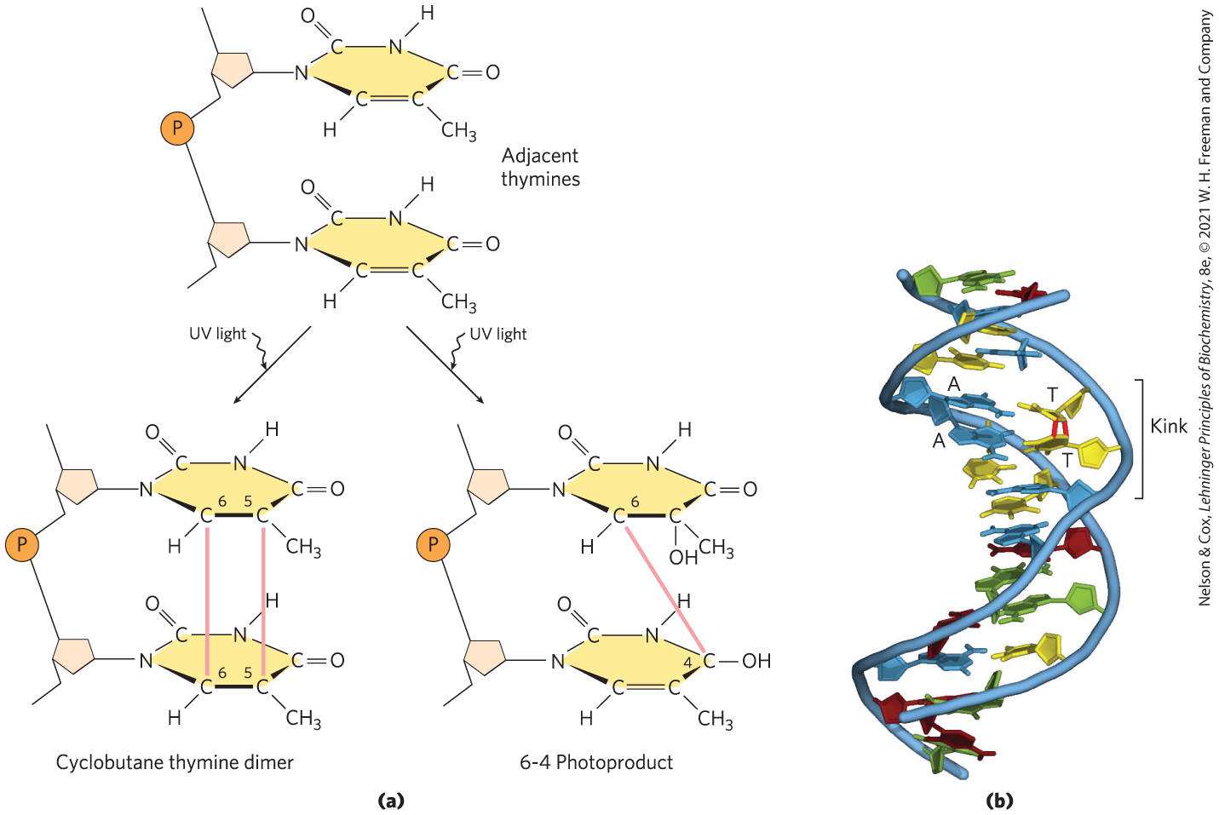
Formation of Pyrimidine Dimers by UV Light

Slide 60
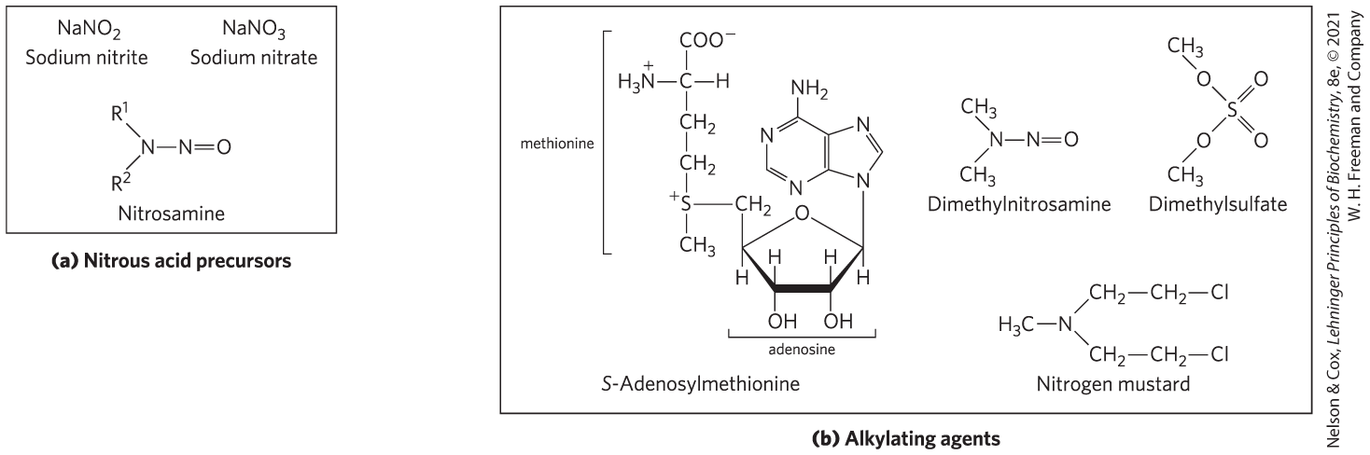
DNA Damage by Reactive Chemicals
nitrous acid precursors = deaminating agents
alkylating agents = generate modified nucleotides nonenzymatically

Slide 61
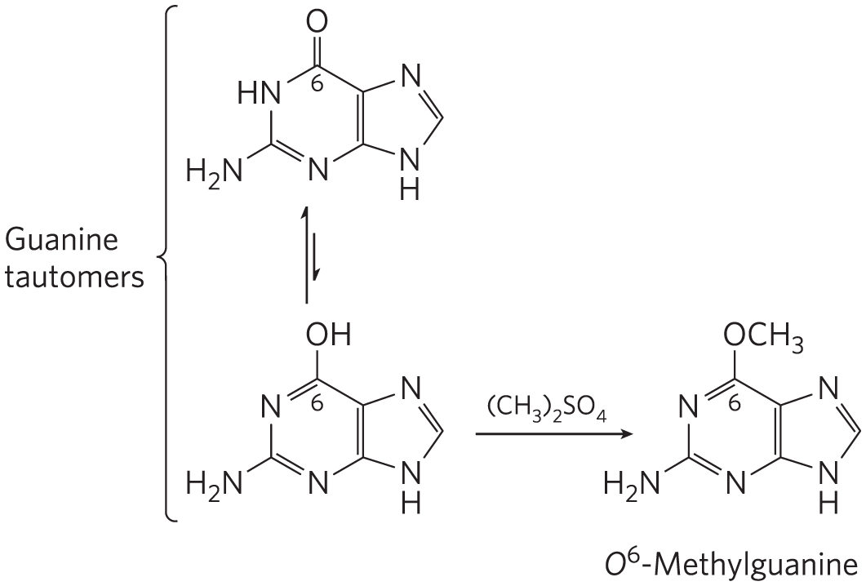
Alkylating Agents Can Alter Certain Bases of DNA
can methylate guanine to O⁶-methyl-guanine, which cannot base-pair with cytosine

Slide 62
DNA Damage by Oxidative Damage
reactive oxygen species (hydrogen peroxide, hydroxyl radicals, superoxide radical) damage DNA
hydroxyl radicals are responsible for most oxidative DNA damage
cells have an elaborate defense system to destroy reactive oxygen species

Slide 63
Some Bases of DNA Are Methylated
A and C are methylated more frequently than G and T
all known DNA methylases use S-adenosylmethionine as a methyl group donor
In eukaryotes, 5% of cytidine residues are methylated
  affects DNA metabolism and gene expression

Slide 64
8.4 Other Functions of Nucleotides

Slide 65
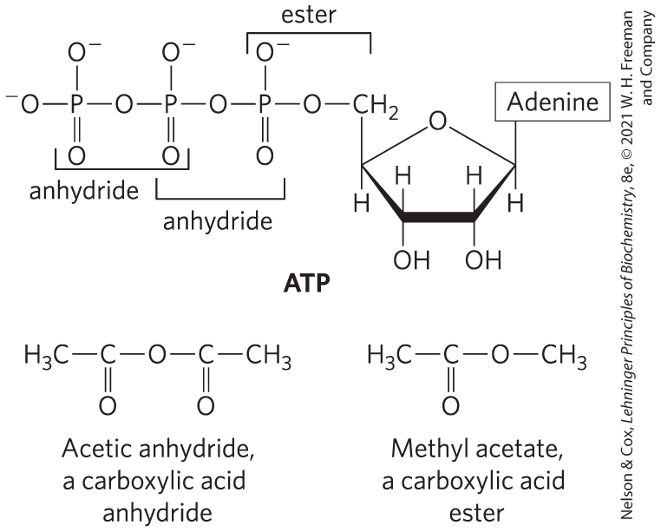
Nucleotides Carry Chemical Energy in Cells
hydrolysis of nucleoside triphosphates provides chemical energy
  ATP is the most widely used

Slide 66
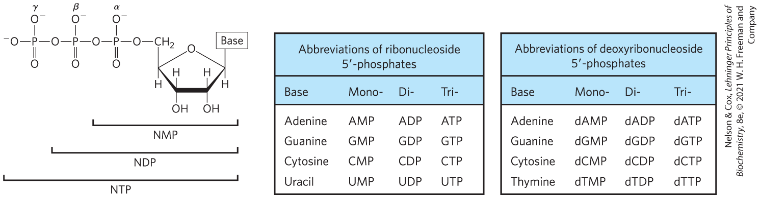
Hydrolysis of Nucleoside Phosphates
when coupled to a reaction with a positive free-energy change, ATP hydrolysis shifts the equilibrium to favor product formation
  hydrolysis of the ester linkage yields ~14 kJ/mol (under standard conditions)
  hydrolysis of each anhydride bond yields ~30 kJ/mol

Slide 67
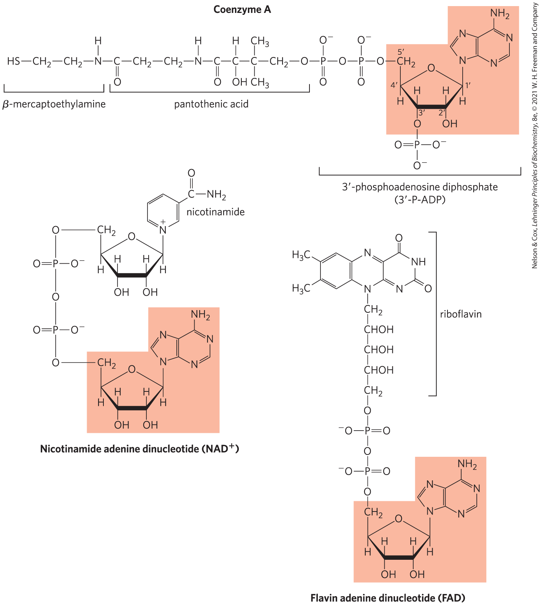
Adenine Nucleotides Are Components of Many Enzyme Cofactors
adenosine does not participate directly in the primary function, but its removal reduces cofactor activities
nucleotide-binding fold = single protein domain that binds adenosine

Slide 68
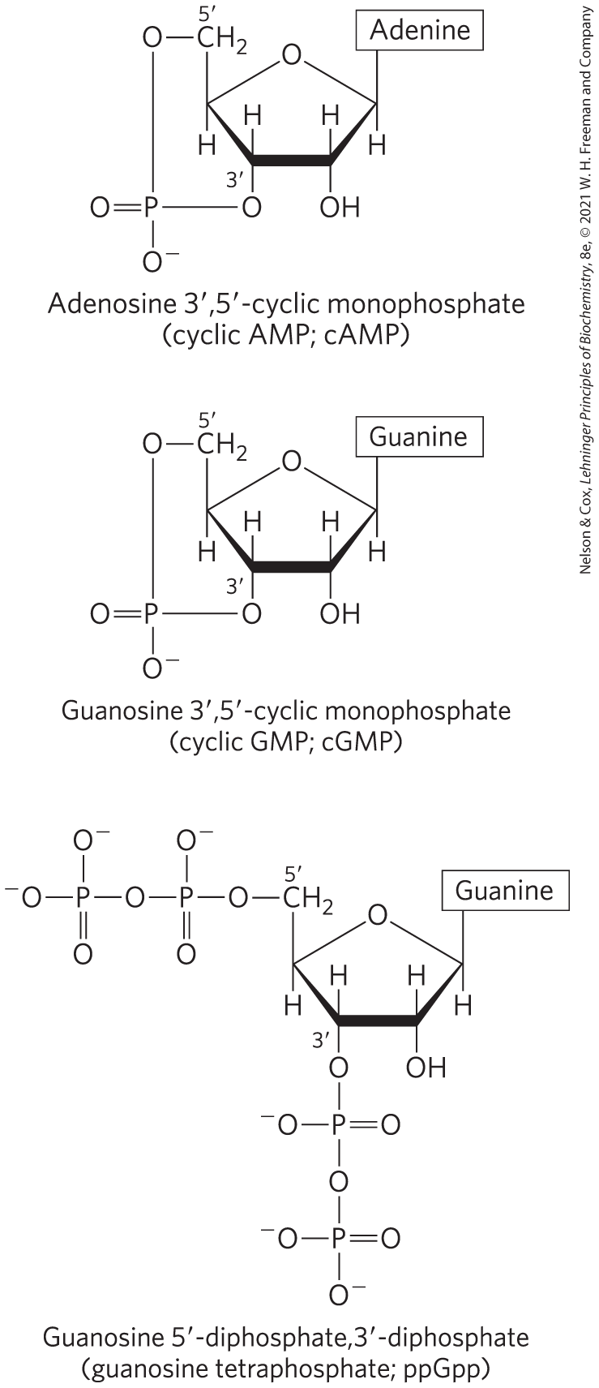
Some Nucleotides Are Regulatory Molecules
second messengers = compounds produced inside the cell following the interaction of extracellular chemical signals with receptors
  often a nucleotide, like adenosine 3′,5′-cyclic monophosphate (cyclic AMP, or cAMP)
ppGpp = produced in bacteria during amino acid starvation to inhibit the synthesis of the rRNA and tRNA molecules

Slide 69
Adenine Nucleotides Also Serve as Signals
ATP and ADP serve as:
  neurotransmitters in a variety of signaling pathways
  signals for receptors that mediate pain sensation
  blood clotting signals

