Slide 1

7 Carbohydrates and Glycobiology
© 2021 Macmillan Learning

Slide 2
Carbohydrates
carbohydrates = aldehydes or ketones with at least two hydroxyl groups, or substances that yield such compounds on hydrolysis
many carbohydrates have the empirical formula (CH₂O)_{n}

Slide 3
Classes of Carbohydrates
monosaccharides = simple sugars, consist of a single polyhydroxy aldehyde or ketone unit
  example: D-glucose
oligosaccharides = short chains of monosaccharide units, or residues, joined by glycosidic bonds

Slide 4
Classes of Carbohydrates, Continued
disaccharides = oligosaccharides with two monosaccharide units
  example: sucrose (D-glucose and D-fructose)
polysaccharides = sugar polymers with 10+ monosaccharide units
  examples: cellulose (linear), glycogen (branched)

Slide 5

Principle 1 (1 of 4)
Carbohydrates can have multiple chiral carbons; the configuration of groups around each carbon atom determines how the compound interacts with other biomolecules. As we saw for L-amino acids in proteins, with rare exceptions, biological evolution selected one stereochemical series (D-series) for sugars.

Slide 6

Principle 2 (1 of 3)
Monomeric subunits, monosaccharides, serve as the building blocks of large carbohydrate polymers. The specific sugar, the way the units are linked, and whether the polymer is branched determine its properties and thus its function.

Slide 7

Principle 3 (1 of 2)
Storage of low molecular weight metabolites in polymeric form avoids the very high osmolarity that would result from storing them as individual monomers. If the glucose in liver glycogen were monomeric, the glucose concentration in liver would be so high that cells would swell and lyse from the entry of water by osmosis.

Slide 8
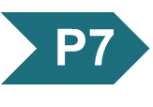
Principle 7 (1 of 3)
An almost infinite variety of discrete structures can be built from a small number of monomeric subunits. Even short polymers, when arranged in different sequences, joined through different linkages, and branched to specific degrees, present unique faces recognized by their molecular partners.

Slide 9
7.1 Monosaccharides and Disaccharides

Slide 10
Stereoisomerism in Sugars
sugar stereoisomers arise because many of the carbon atoms to which the hydroxyl groups are attached are chiral centers
enzymes that act on sugars are stereospecific

Slide 11
The Two Families of Monosaccharides Are Aldoses and Ketoses
backbones of monosaccharides:
  unbranched carbon chains with single bonds linking all carbon atoms
  one of the carbon atoms is double-bonded to an oxygen atom to form a carbonyl group
  other carbon atoms are bonded to a hydroxyl group

Slide 12
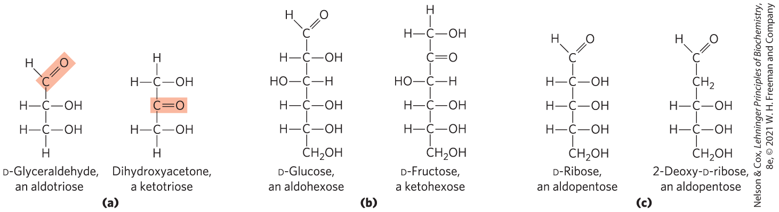
Aldoses and Ketoses
aldose = carbonyl group is at an end of the carbon chain (in an aldehyde group)
ketose = carbonyl group is at any other position (in a ketone group)

Slide 13
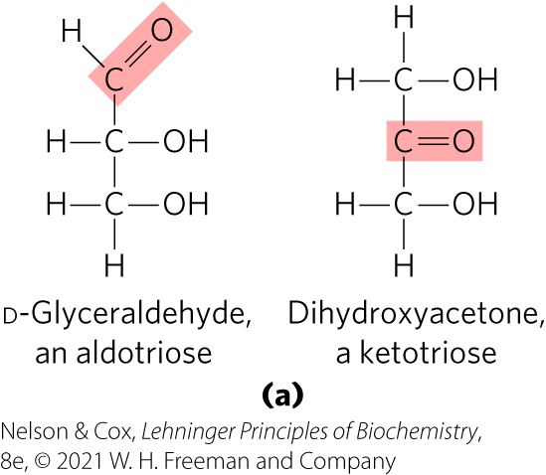
Trioses
trioses = simplest monosaccharides, three carbon backbone

Slide 14
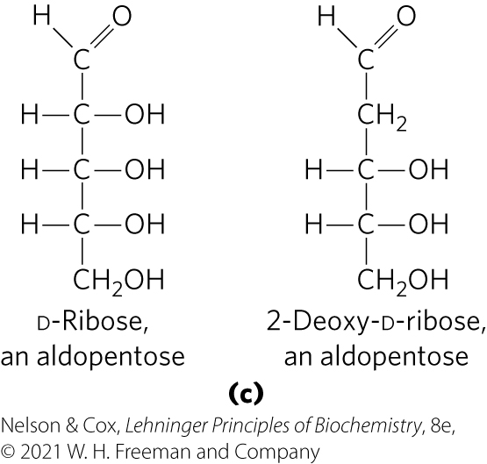
Tetroses and Pentoses
tetroses = four carbon backbone
pentoses = five carbon backbone
  component of RNA
  component of DNA

Slide 15
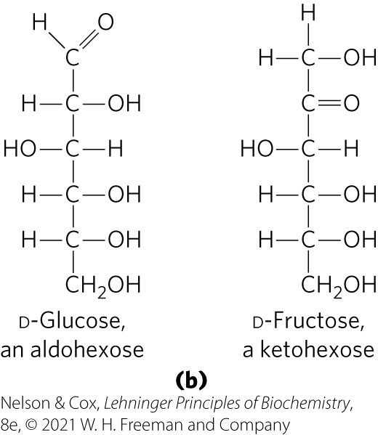
Hexoses and Heptoses
hexoses = six carbon backbone
heptoses = seven carbon backbone

Slide 16
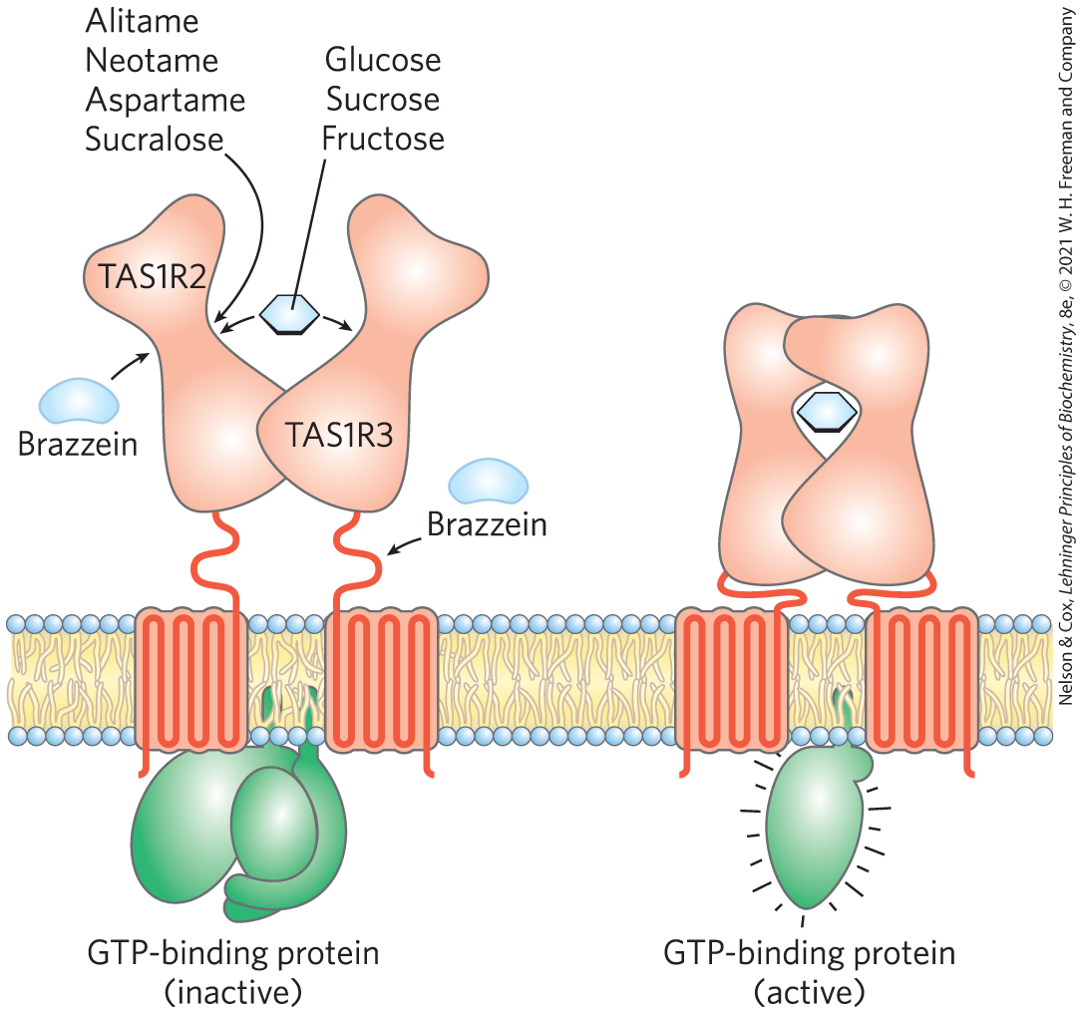
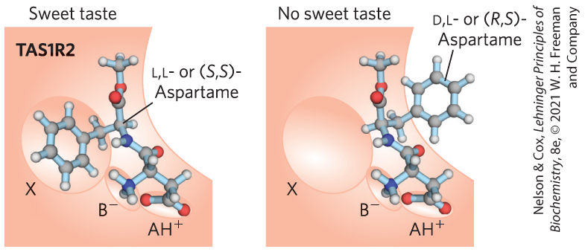
What Makes Sugar Sweet?
TAS1R2 and TAS1R3 encode sweet-taste receptors
binding of a compatible molecule generates a “sweet” electrical signal in the brain
  requires a steric match

Slide 17
Monosaccharides Have Asymmetric Centers
all monosaccharides (except dihydroxyacetone) contain 1+ chiral carbon atom
  occur in optically active isomeric forms
enantiomers = two different optical isomers that are mirror images
in general, a molecule with n chiral centers can have 2^{n} stereoisomers

Slide 18
D Isomers and L Isomers
reference carbon = chiral center most distant from the carbonyl carbon
two groups of stereoisomers:
  D isomers = configuration at reference carbon is the same as D-glyceraldehyde
    on the right (dextro) in a projection formula
    most hexoses of living organisms
  L isomers = configuration at reference carbon is the same as L-glyceraldehyde
    on the left (levo) in a projection formula

Slide 19
Numbering Carbons of a Sugar
carbons are numbered beginning at the end of the chain near the carbonyl group

Slide 20
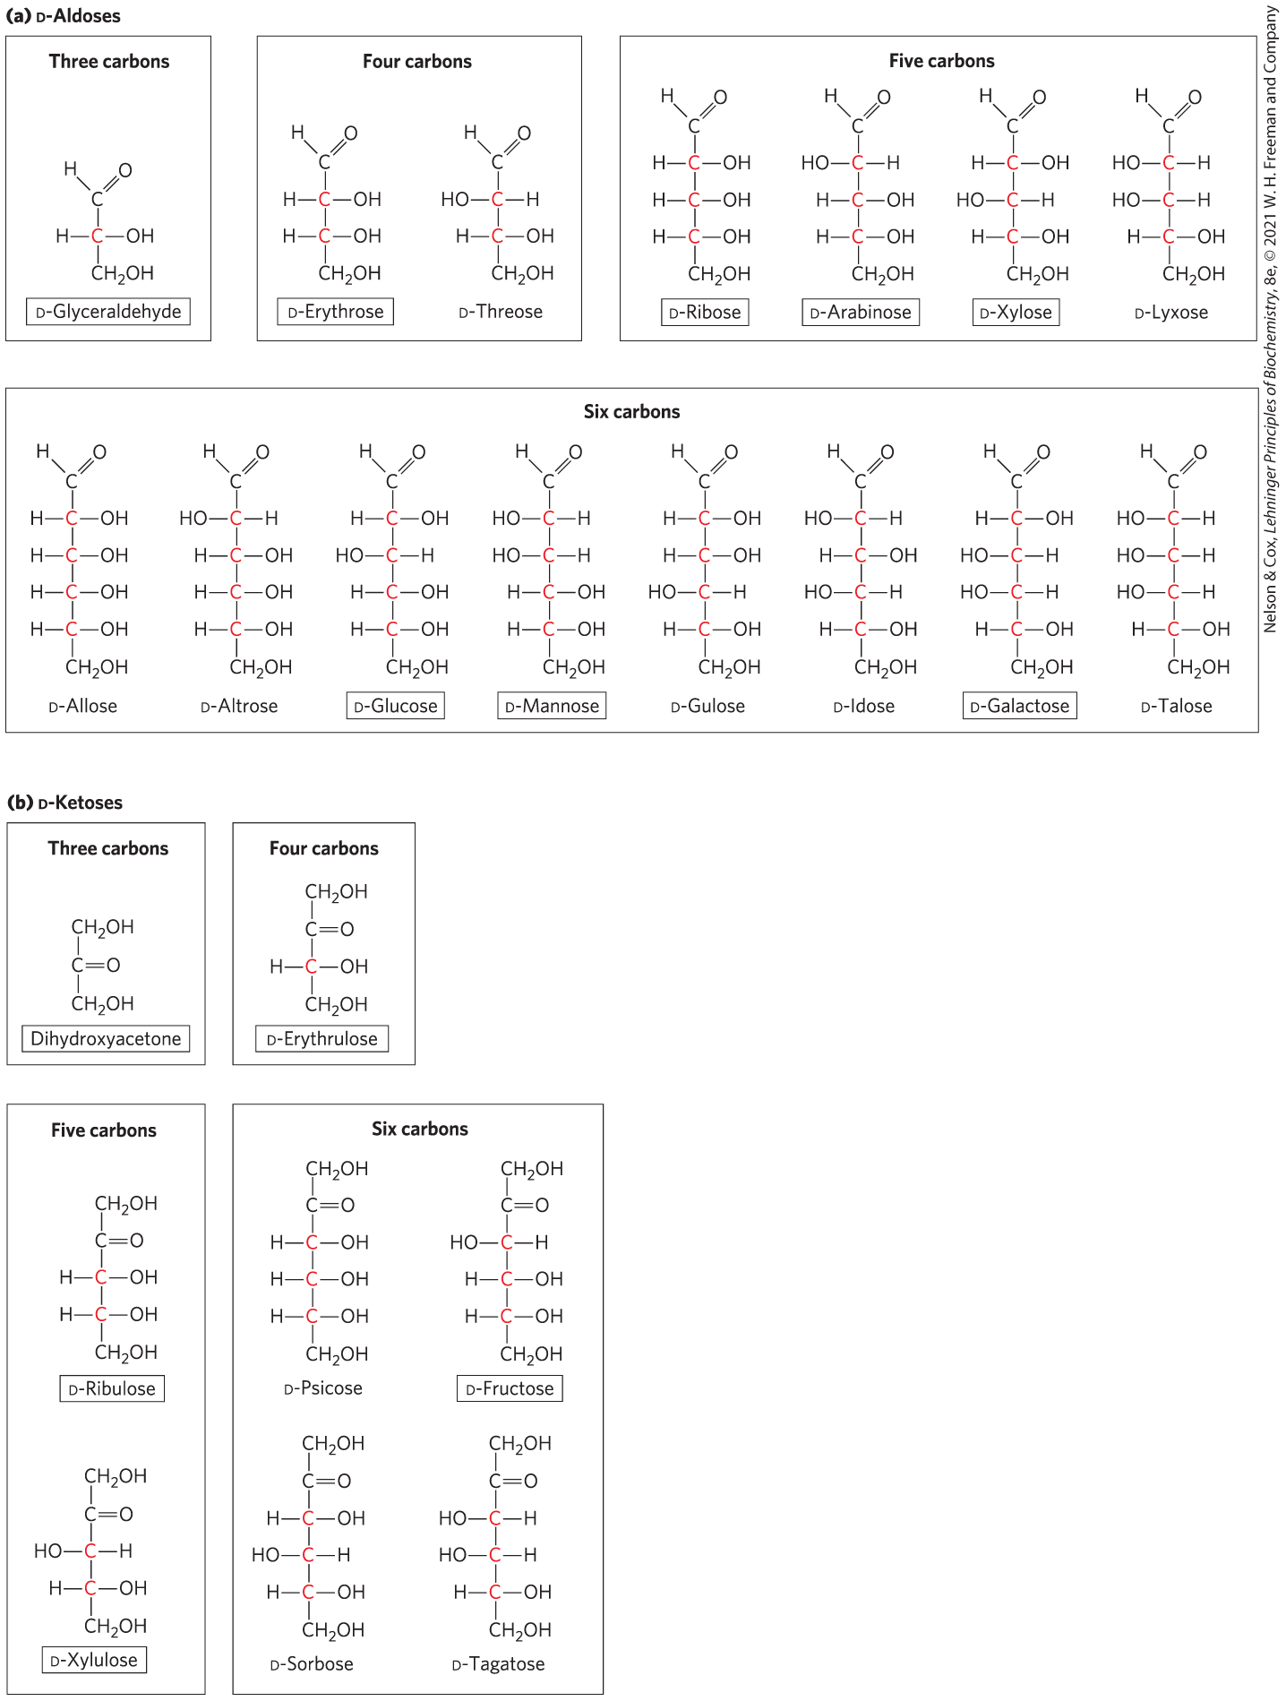
D-Aldoses

Slide 21
D-Ketoses

Slide 22
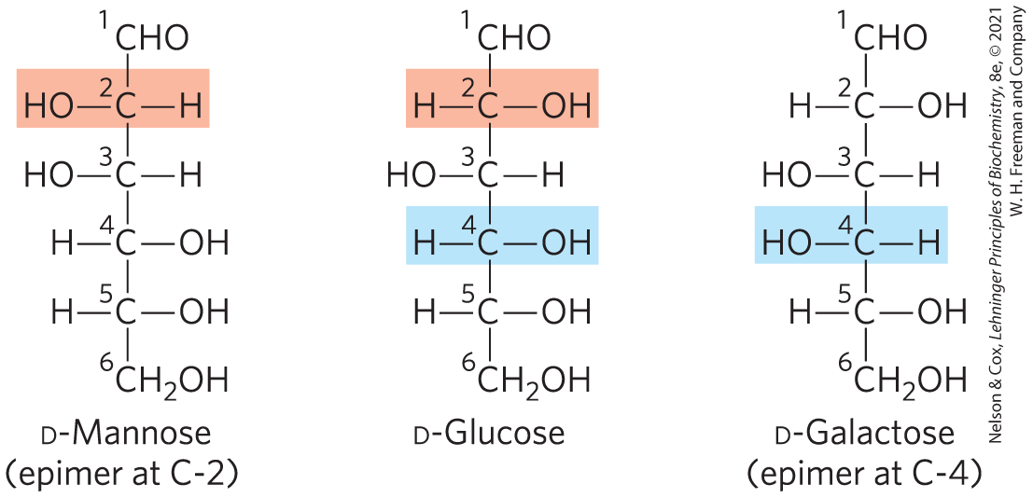
Epimers
epimers = two sugars that differ only in the configuration around one carbon atom

Slide 23
The Common Monosaccharides Have Cyclic Structures
in aqueous solution, aldotetroses and all monosaccharides with 5+ backbone carbon atoms occur as cyclic structures
  covalent bond between the carbonyl group and the oxygen of a hydroxyl group

Slide 24
Hemiacetals and Hemiketals
hemiacetals or hemiketals = derivatives formed by a general reaction between alcohols and aldehydes or ketones
  product of the first alcohol molecule addition
  a five- or six-membered ring forms if the —OH and carbonyl groups are on the same molecule
acetal or ketal = product of the second alcohol molecule addition
  forms a glycosidic bond

Slide 25
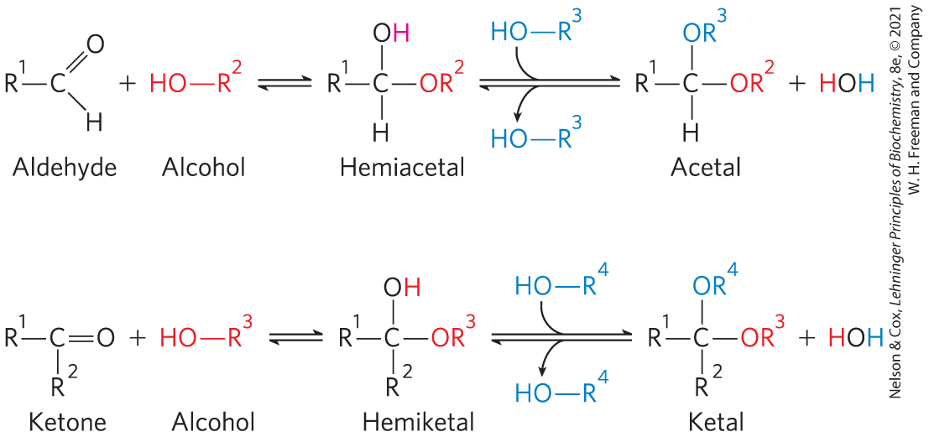
Formation of Hemiacetals and Hemiketals

Slide 26
α and β Stereoisomeric Configurations
reaction with the first alcohol molecule creates an additional chiral center (the carbonyl carbon)
produces either of two stereoisomeric configurations: α and β
anomers = isomeric forms of monosaccharides that differ only in their configuration about the hemiacetal or hemiketal carbon atom
anomeric carbon = the carbonyl carbon atom

Slide 27
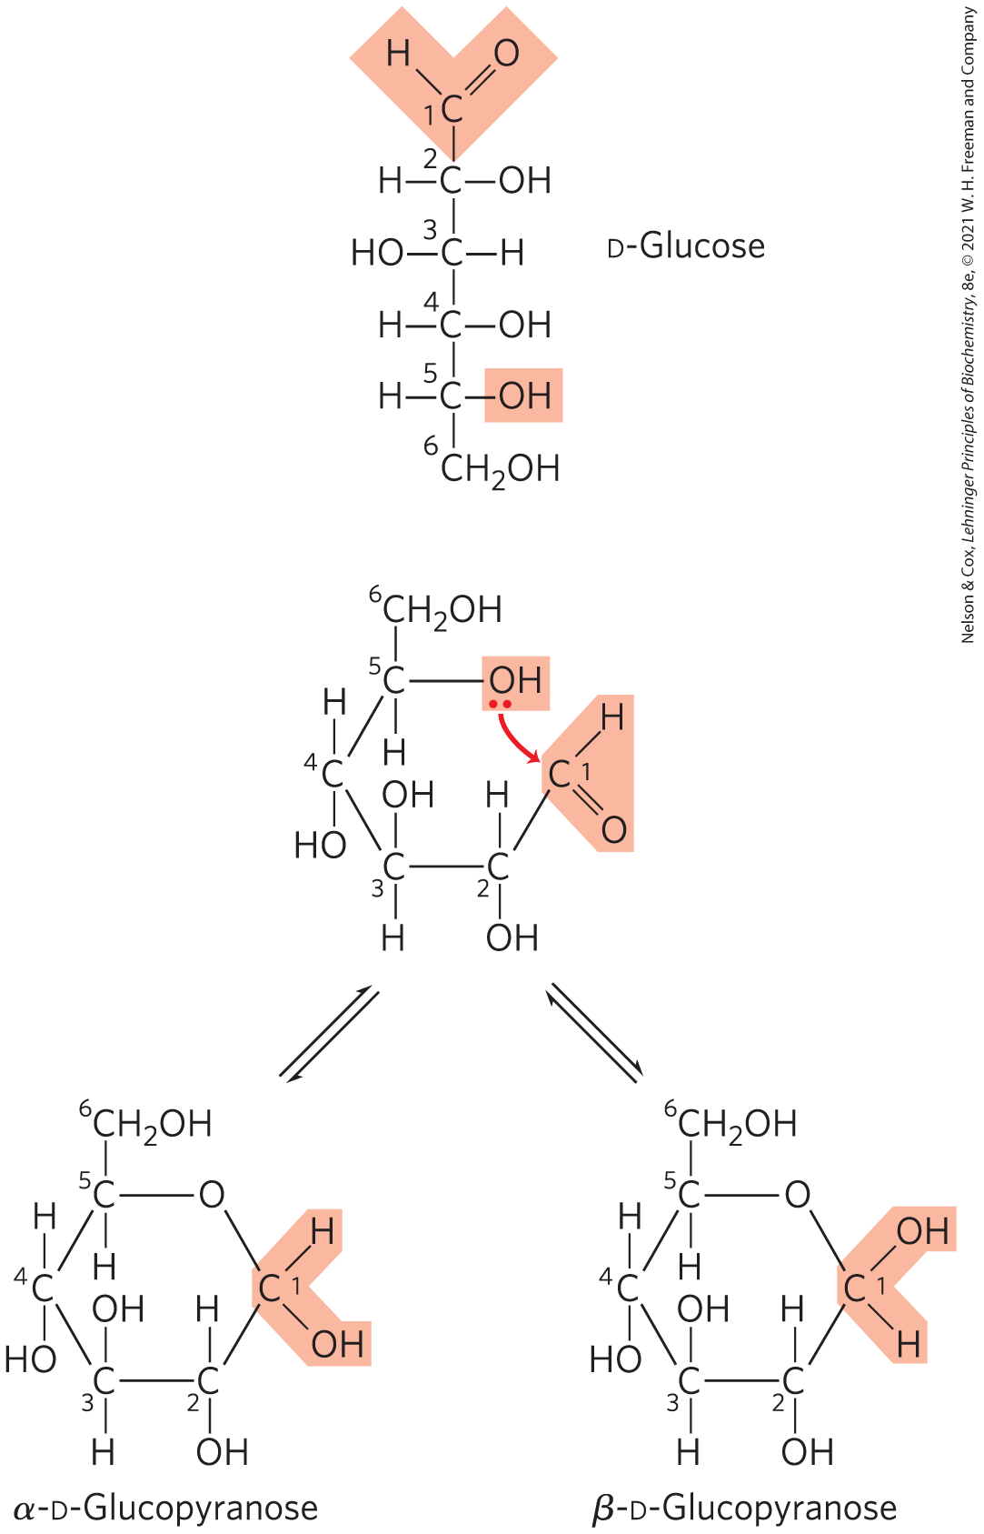
Formation of the Two Cyclic Forms of D-Glucose
reaction between the aldehyde group at C-1 and the hydroxyl group at C-5 forms a hemiacetal linkage
mutarotation = the interconversion of α and β anomers

Slide 28
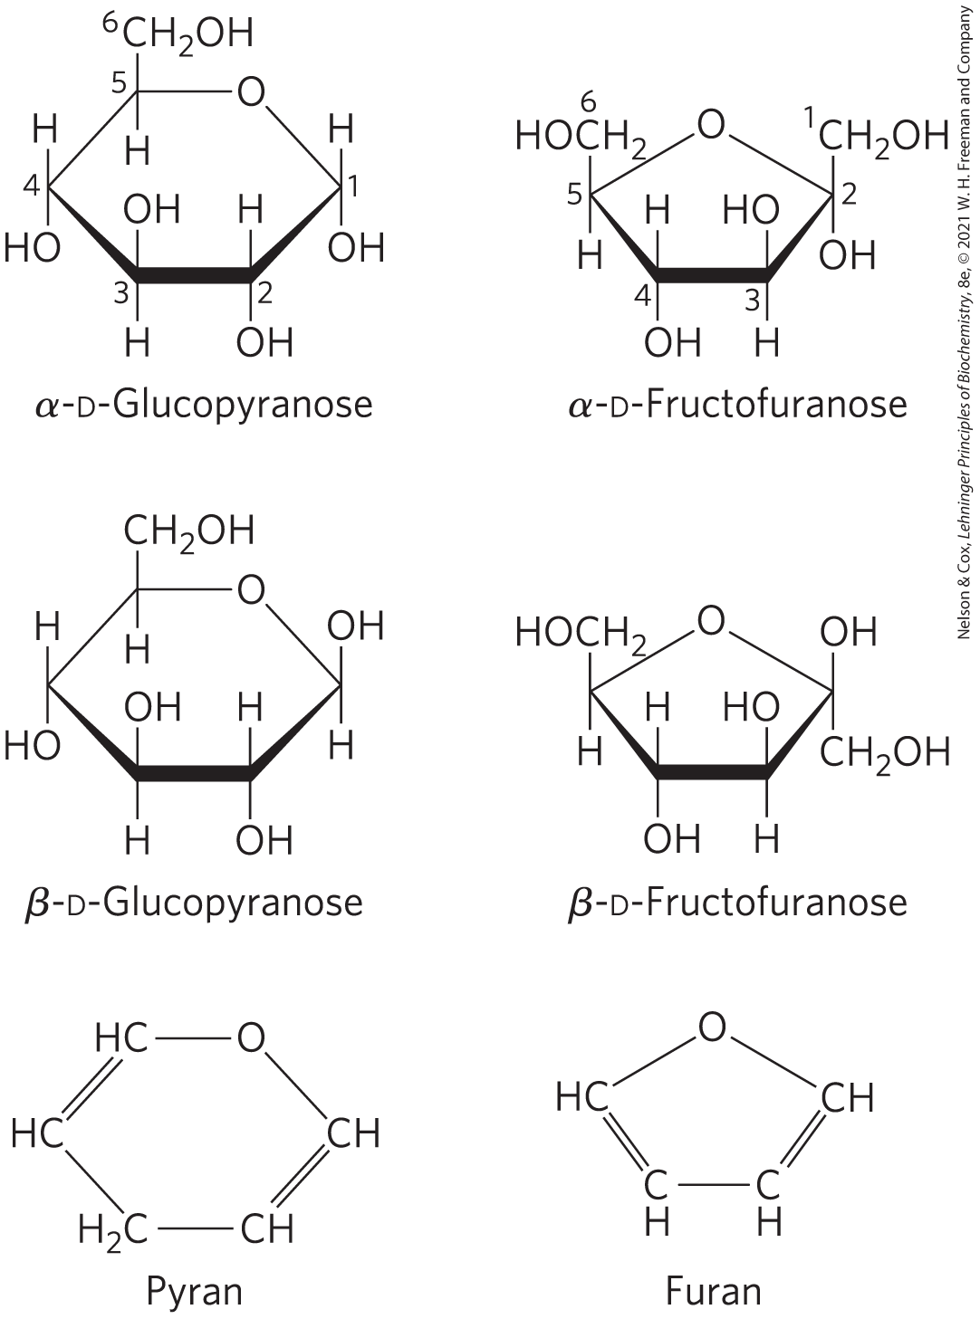
Pyranoses and Furanoses
pyranoses = six-membered ring compounds
  form when the hydroxyl group at C-6 reacts with the keto group at C-2
furanoses = five-membered ring compounds
  form when the hydroxyl group at C-5 reacts with the keto group at C-2

Slide 29
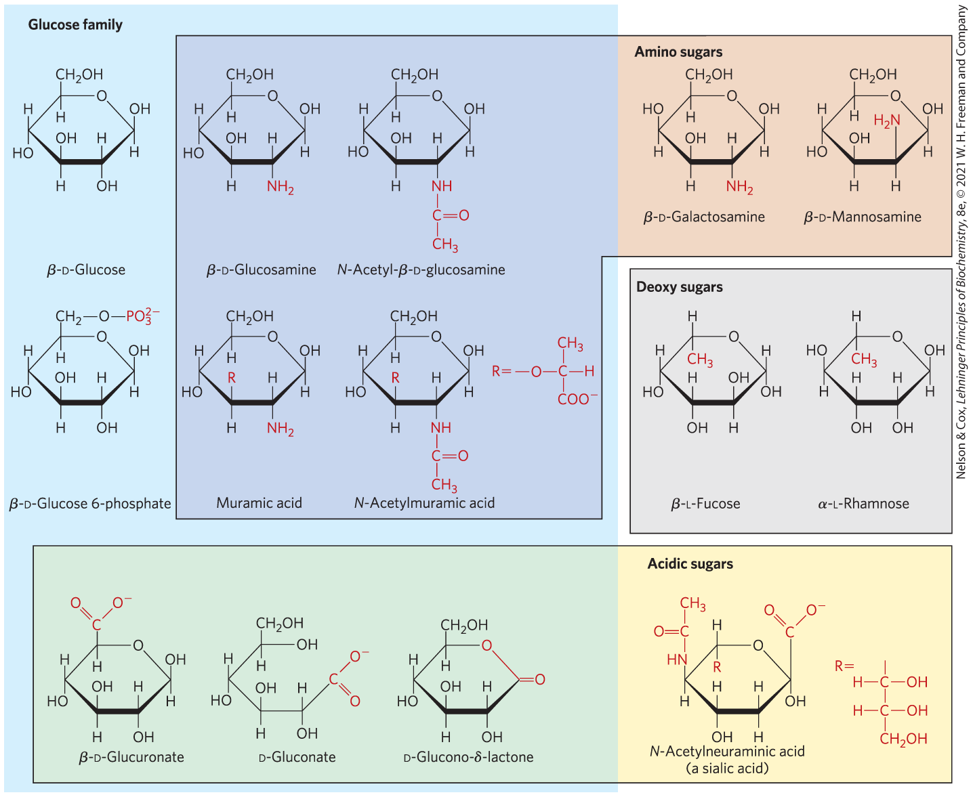
Organisms Contain a Variety of Hexose Derivatives

Slide 30
Phosphorylated Derivatives
some sugar intermediates are phosphate esters
  example: glucose 6-phosphate
stable at neutral pH and bear a negative charge
functions to trap sugar inside the cell because most cells do not have membrane transporters for phosphorylated sugars

Slide 31
Sugars That Are, or Can Form, Aldehydes Are Reducing Sugars
reducing sugars = undergo a characteristic redox reaction where free aldehyde groups react with Cu²⁺ under alkaline condition
  reduction of Cu²⁺ to Cu⁺ forms a brick-red precipitate
ketoses that can tautomerize to form aldehydes are also reducing sugars

Slide 32
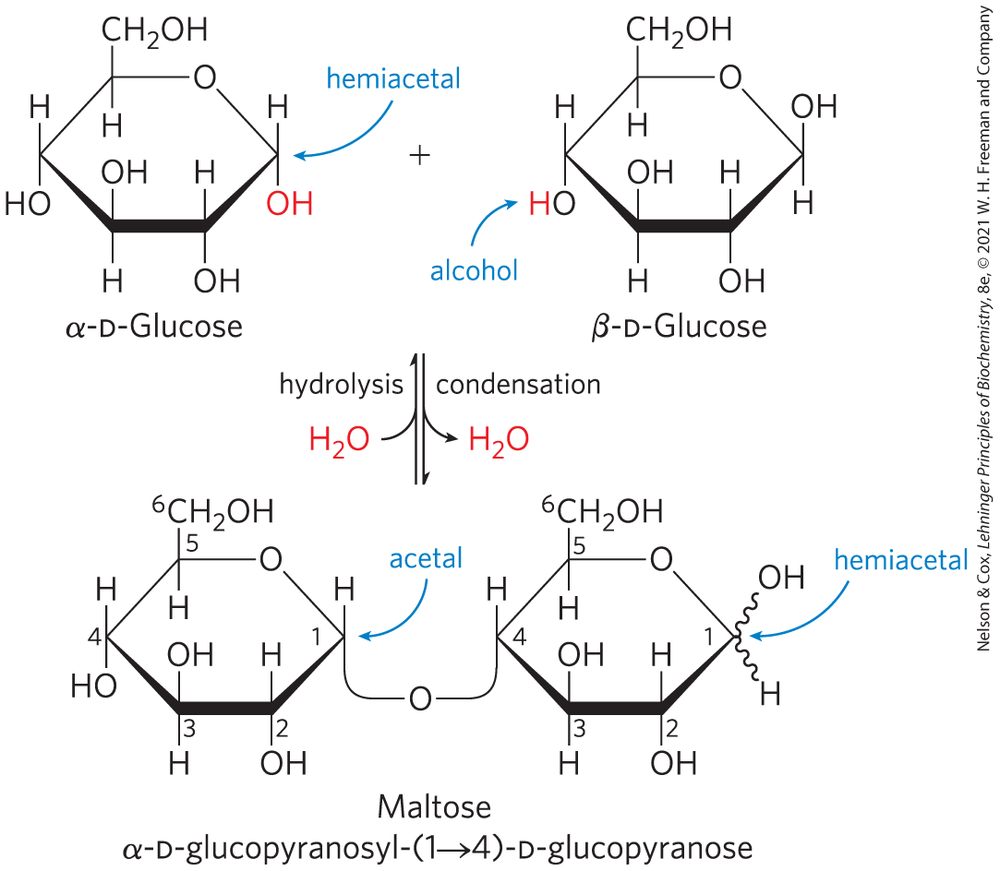
O-Glycosidic Bonds
O-glycosidic bond = covalent linkage joining two monosaccharides
  formed when a hydroxyl group of one sugar molecule reacts with the anomeric carbon of the other
  readily hydrolyzed by acid

Slide 33
The Reducing End
formation of a glycosidic bond renders a sugar nonreducing
reducing end = the end of a disaccharide or polysaccharide chain with a free anomeric carbon
Free anomeric carbon

Slide 34
Naming Reducing Oligosaccharides
step 1: with the nonreducing end on the left, give the configuration (α or β) at the anomeric carbon joining the first unit to the second
step 2: name the nonreducing residue using “furano” or “pyrano”
step 3: indicate in parentheses the two carbon atoms joined by the glycosidic bond, with an arrow connecting the two numbers
step 4: name the second residue and repeat for additional residues

Slide 35
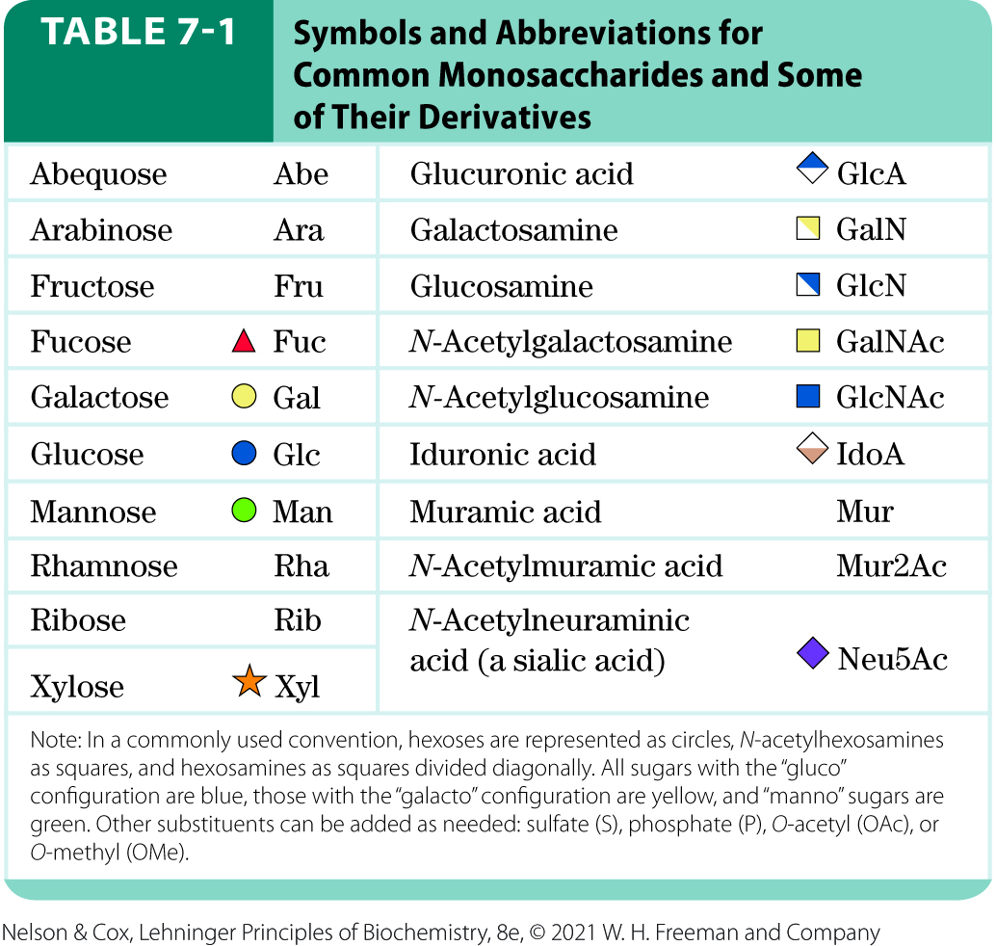
Symbols and Abbreviations for Monosaccharides and Derivatives

Slide 36
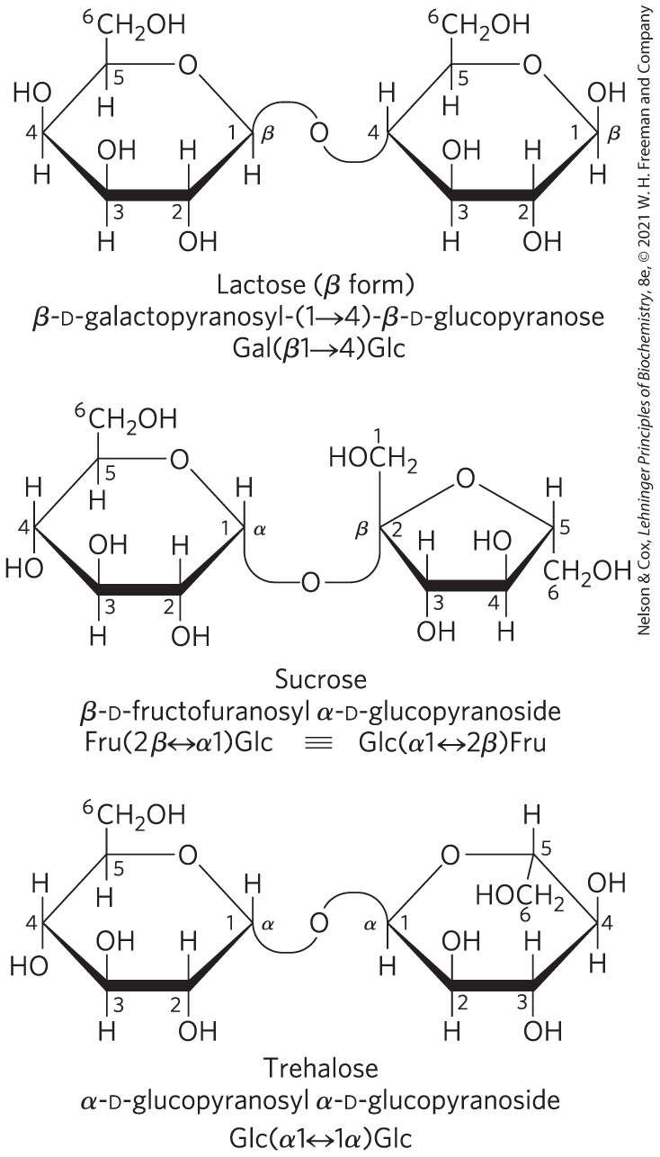
Three Common Disaccharides
lactose is a reducing disaccharide
sucrose and trehalose are nonreducing sugars

Slide 37
7.2 Polysaccharides

Slide 38
Polysaccharides
most carbohydrates in nature occur as polysaccharides (M_{r} > 20,000)
also called glycans

Slide 39
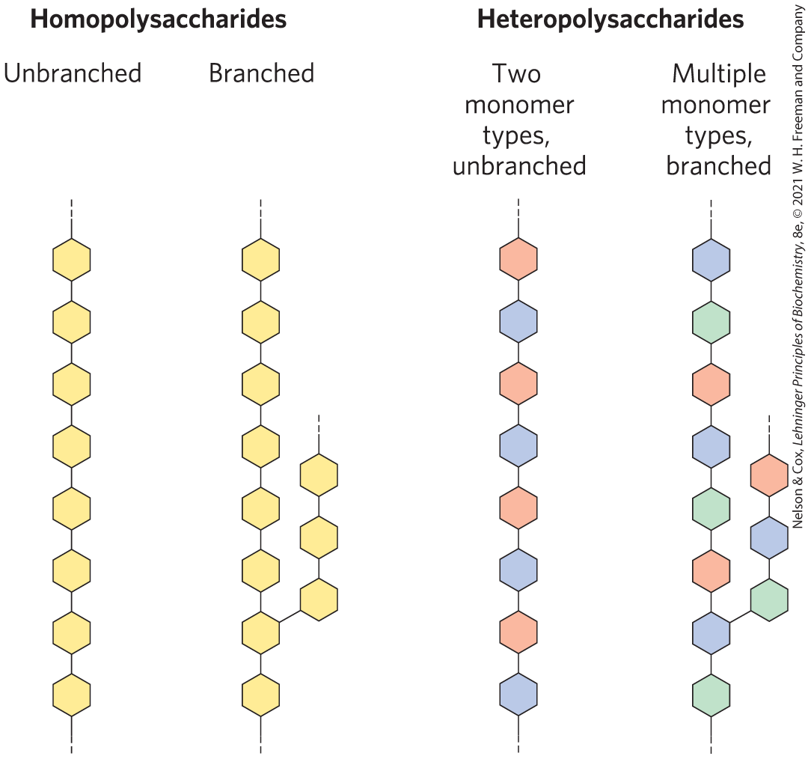
Homopolysaccharides and Heteropolysaccharides
homopolysaccharides = contain only a single monomeric sugar species
  serve as storage forms and structural elements
heteropolysaccharides = contain 2+ kinds of monomers
  provide extracellular support

Slide 40
Some Homopolysaccharides Are Storage Forms of Fuel
storage polysaccharides = starch in plant cells and glycogen in animal cells
starch and glycogen molecules are heavily hydrated because they have many exposed hydroxyl groups available to hydrogen bond

Slide 41
Starch and Glycogen
starch = contains two types of glucose polymer, amylose and amylopectin
  amylose = long, unbranched chains of D-glucose residues connected by (α1→4) linkages
  amylopectin = larger than amylose with (α1→4) linkages between glucose residues and highly branched due to (α1→6) linkages
glycogen = polymer of (α1→4)-linked glucose subunits, with (α1→6)-linked branches
  more extensively branched
  more compact than starch

Slide 42
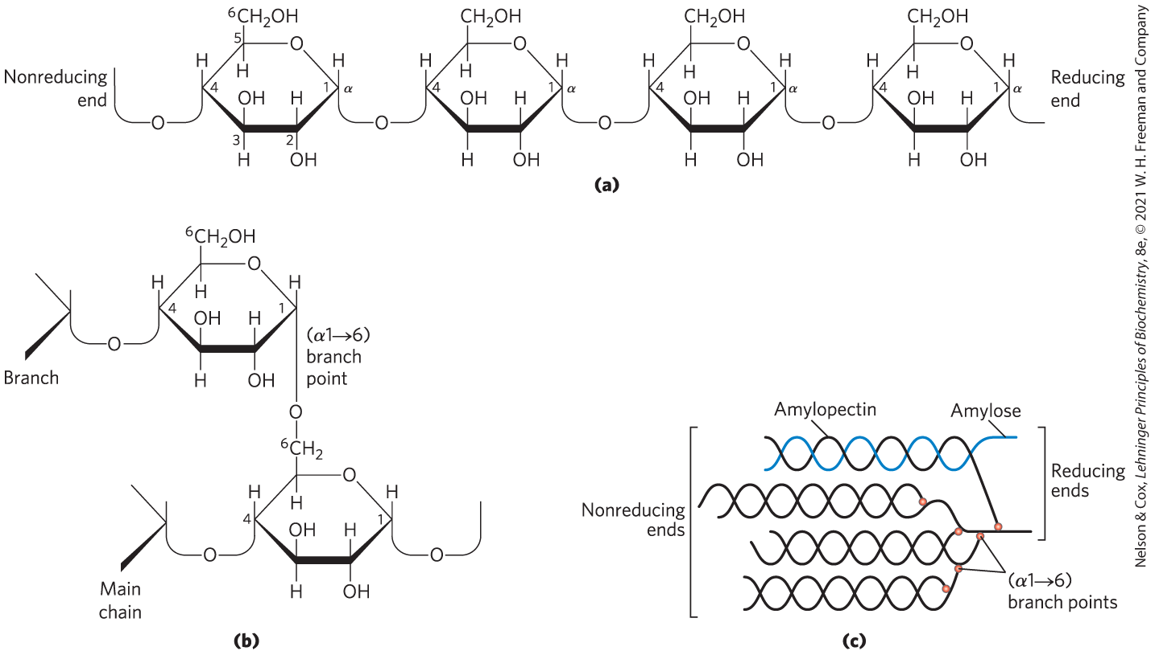
Structure of Starch and Glycogen

Slide 43
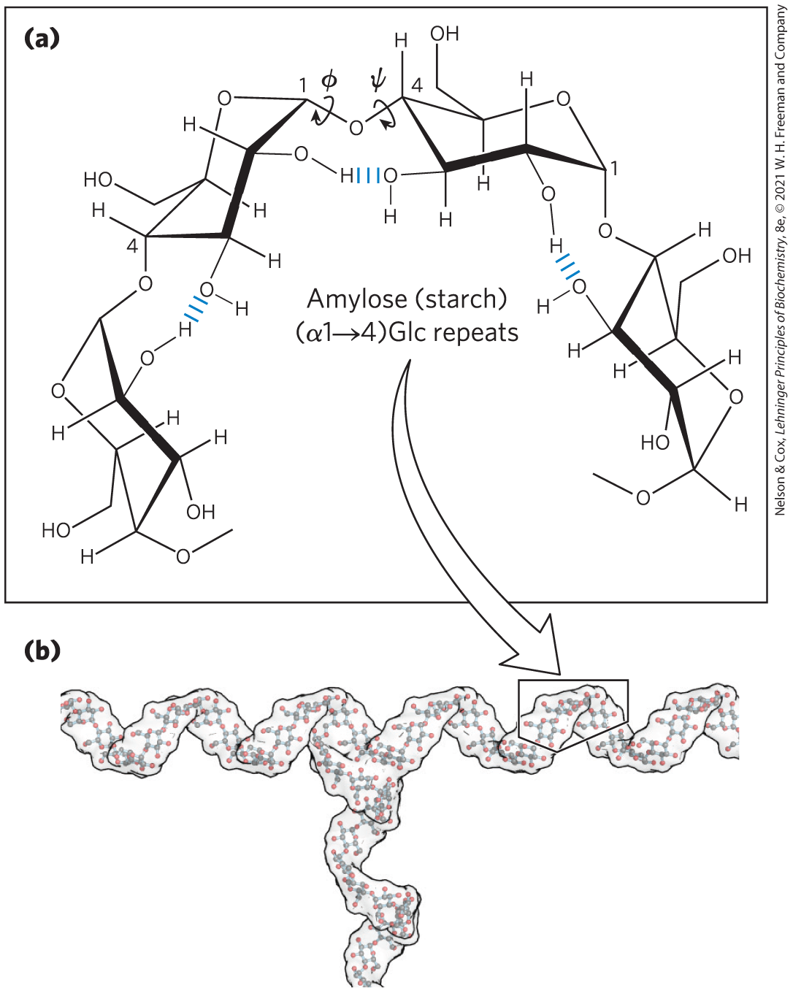
Helical Structure of Starch and Glycogen
most stable three-dimensional structure for the (α1→4)-linked chains of starch and glycogen
  six residues/turn

Slide 44
Structure and Roles of Some Polysaccharides
Table 7-2 Structures and Roles of Some Polysaccharides
Polymer | Type | Repeating unit | Size (number of monosaccharide units) | Roles/significance
Starch: Amylose | Homo- | (𝛼1→4)Glc, linear | 50-5,000 | Energy storage: in plants
Starch: Amylopectin | Homo- | (𝛼1→4)Glc, with (𝛼1→6)Glc branches every 24-30 residues | Up to 10⁶ | Energy storage: in plants
Glycogen | Homo- | (𝛼1→4)Glc, with (𝛼1→6)Glc branches every 8-12 residues | Up to 50,000 | Energy storage: in bacteria and animal cells
Cellulose | Homo- | (𝛽1→4)Glc | Up to 15,000 | Structural: in plants, gives rigidity and strength to cell walls
Chitin | Homo- | (𝛽1→4)GlcNAc | Very large | Structural: in insects, spiders, crustaceans, gives rigidity and strength to exoskeletons
Dextran | Homo- | (𝛼1→6)Glc, with (𝛼1→3) branches | Wide range | Structural: in bacteria, extracellular adhesive
Peptidoglycan | Hetero-; peptides attached | 4)Mur2Ac(𝛽1→4) GlcNAc (𝛽1 | Very large | Structural: in bacteria, gives rigidity and strength to cell envelope
Hyaluronan (a glycosaminoglycan) | Hetero-; acidic | 4)GlcA(𝛽1→3) GlcNAc (𝛽1 | Up to 100,000 | Structural: in vertebrates, extracellular matrix of skin and connective tissue; viscosity and lubrication in joints

Slide 45
7.3 Glycoconjugates: Proteoglycans, Glycoproteins, and Glycolipids

Slide 46
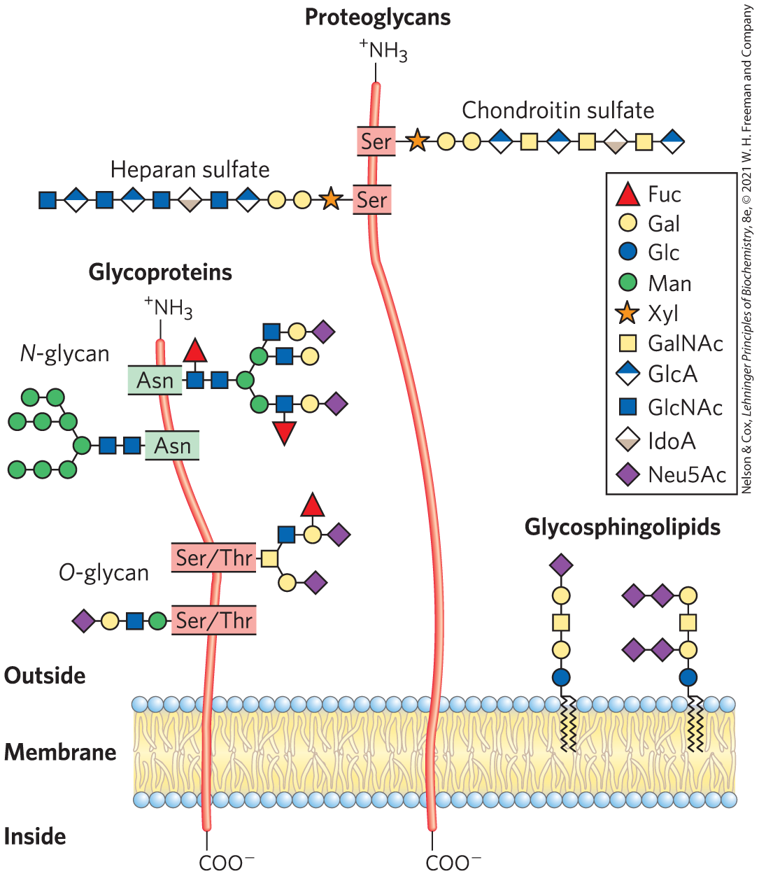
Glycoconjugate
glycoconjugate = biologically active molecule consisting of an informational carbohydrate joined to a protein or lipid

Slide 47
Glycoproteins
glycoproteins = have one or several oligosaccharides joined covalently to a protein
  found on the outer face of the plasma membrane, in ECM, in blood, and in organelles (Golgi complexes, secretory granules, and lysosomes)
  oligosaccharide portions are heterogenous and rich in information

Slide 48
Glycolipids and Glycosphingolipids
glycolipids = plasma membrane components in which the hydrophilic head groups are oligosaccharides
glycosphingolipids = class of glycolipids with specific backbone structure
  neurons are rich in glycosphingolipids
  play a role in signal transduction

Slide 49
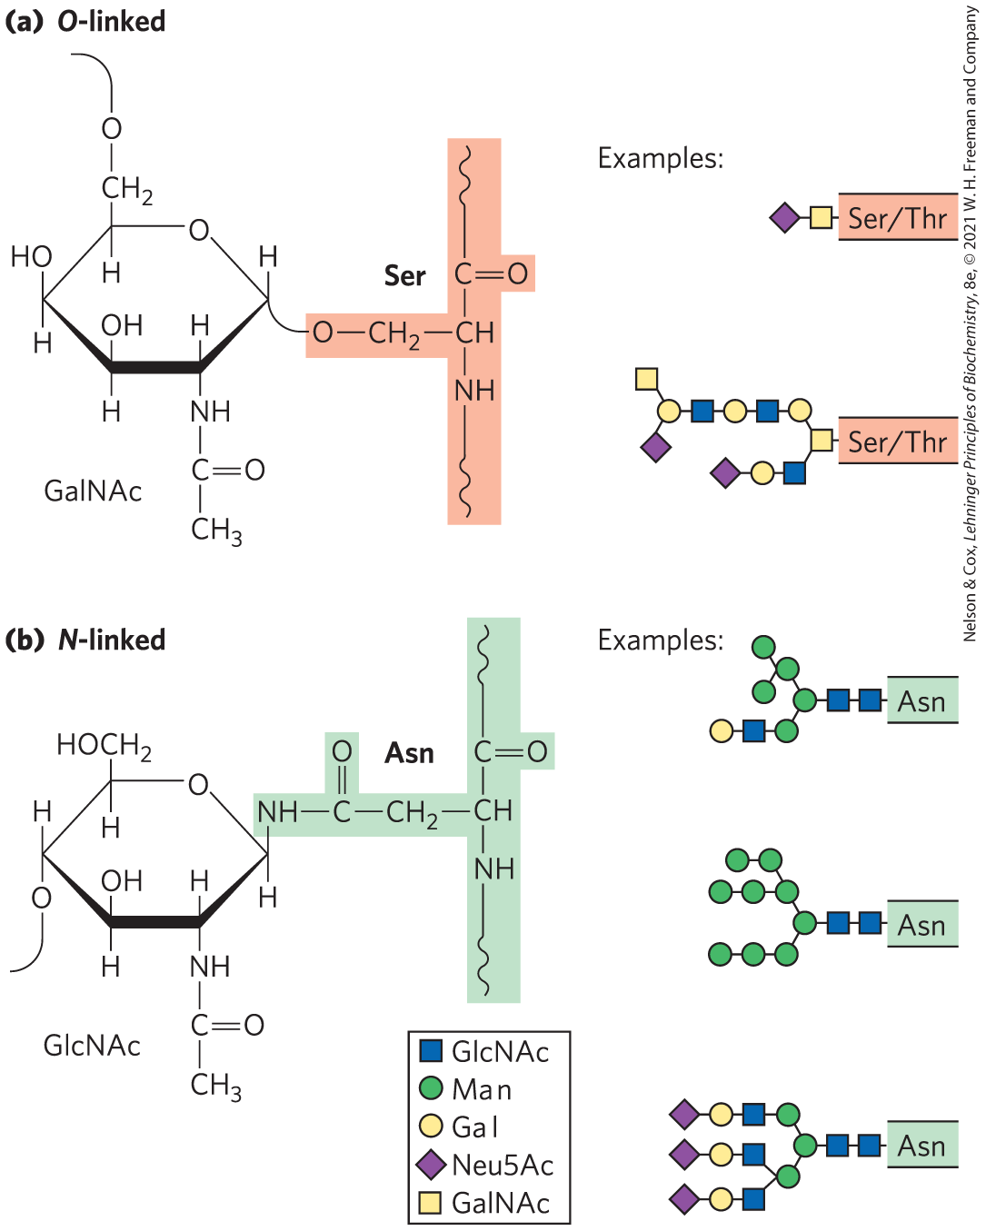
Glycoproteins Have Covalently Attached Oligosaccharides
two types of attachments:
  O-linked = a glycoside bond joins the anomeric carbon of a carbohydrate to the —OH of a Ser or Thr residue
  N-linked = an N-glycosyl bond joins the anomeric carbon of a sugar to the amide nitrogen of an Asn residue

Slide 50
Examples of Glycoproteins
mucins = secreted or membrane glycoproteins
  can contain large numbers of O-linked oligosaccharide chains
  present in most secretions
proteins of the blood
  examples: immunoglobulins (antibodies), follicle-stimulating hormone, luteinizing hormone, and thyroid-stimulating hormone
milk proteins
  example: major whey protein α-lactalbumin

Slide 51
Glycomics
glycomics = the systematic characterization of all carbohydrate components of a given cell or tissue, including those attached to proteins and to lipids

Slide 52
The Biological Advantages of Adding Oligosaccharides to Proteins
covalently attached oligosaccharides:
  influence the folding and stability of the proteins
  provide critical information about the targeting of newly synthesized proteins
  allow specific recognition by other proteins

Slide 53
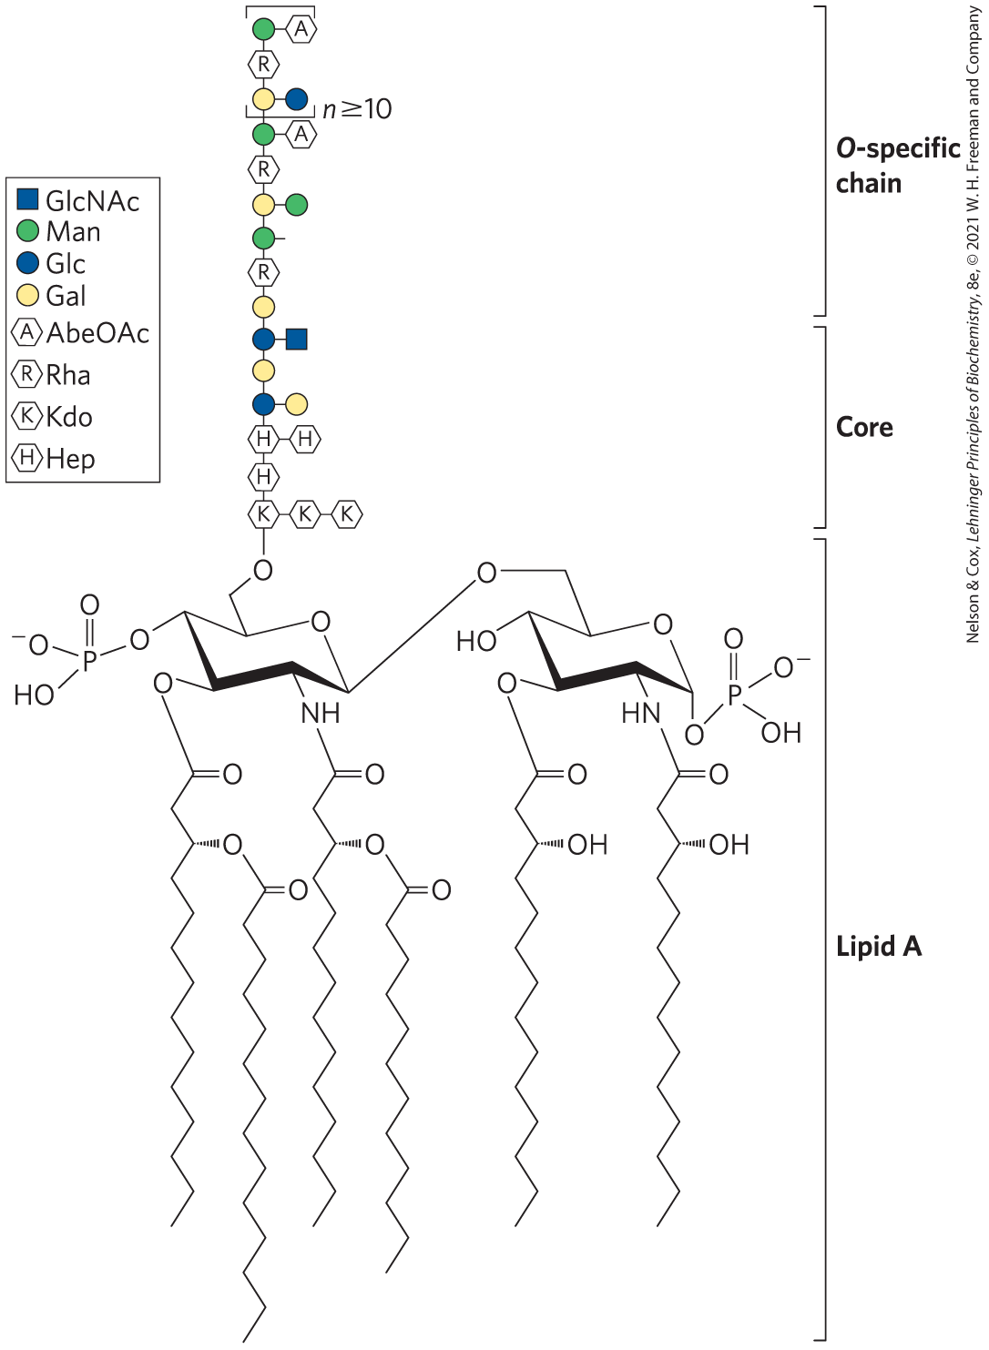
Glycolipids and Lipopolysaccharides Are Membrane Components
gangliosides = membrane lipids of eukaryotic cells in which the polar head group is a complex oligosaccharide containing a sialic acid and other monosaccharide residues
lipopolysaccharides = dominant surface feature of the outer membrane of gram-negative bacteria

Slide 54
7.4 Carbohydrates as Informational Molecules: The Sugar Code

Slide 55
The Challenge of Glycobiology
glycobiology = the study of the structure and function of glycoconjugates
the challenge is to understand how cells use specific oligosaccharides to encode information about:
  intracellular targeting of proteins
  cell-cell interactions
  cell differentiation and tissue development
  extracellular signals

Slide 56
Oligosaccharide Structures Are Information-Dense
branched structures, not found in nucleic acids or proteins, are common in oligosaccharides
almost limitless variety of oligosaccharides due to differences in:
  stereochemistry and position of glycosidic bonds
  type and orientation of substituent groups
  the number and type of branches

