Slide 1

6 Enzymes
© 2021 Macmillan Learning

Slide 2

Principle 1 (1 of 4)
Enzymes are powerful biological catalysts. Rate accelerations by enzymes are often far greater than those by synthetic or inorganic catalysts. Like all catalysts, enzymes increase reaction rates, lowering reaction activation barriers. Enzymes do not affect the equilibria of reactions.

Slide 3

Principle 2 (1 of 3)
Enzymes exhibit a very high degree of specificity. Each enzyme catalyzes only one chemical reaction, or sometimes a few closely related reactions. Reaction activation barriers are thus lowered selectively.

Slide 4

Principle 3 (1 of 3)
Enzymatic reactions occur in specialized pockets called active sites. These pockets are similar to ligand binding sites, except that a reaction occurs there—the conversion of a substrate, a molecule that is acted on by an enzyme, to a product.

Slide 5

Principle 4 (1 of 8)
Two concepts explain the catalytic power of enzymes. First, enzymes bind most tightly to the transition state of the catalyzed reaction, using binding energy to lower the activation barrier. Second, enzyme active sites are organized by evolution to facilitate multiple mechanisms of chemical catalysis simultaneously.

Slide 6
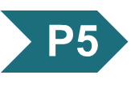
Principle 5 (1 of 3)
Many enzymes are regulated. Regulatory mechanisms include reversible covalent modification, binding of allosteric modulators, proteolytic activation, noncovalent binding to regulatory proteins, and elaborate regulatory cascades. Enzymes are often subject to multiple methods of regulation, which allows for exquisite control of every chemical process that occurs in a cell.

Slide 7
6.1 An Introduction to Enzymes

Slide 8
Enzymes
in 1897, Eduard Buchner:
  demonstrated cell-free yeast extracts could ferment sugar to alcohol
  showed fermentation was promoted by molecules that continued to function when removed from cells
the name enzymes were given to the molecules detected by Buchner

Slide 9
Most Enzymes Are Proteins
catalytic activity depends on the integrity of the native protein conformation
molecular weight = ranges from 12,000 to >1 million
some enzyme require additional chemical components:
  cofactor = 1+ inorganic ions, such as Fe²⁺, Mg²⁺, Mn²⁺, or Zn²⁺
  coenzyme = complex organic or metalloorganic molecule that act as transient carriers of specific functional groups

Slide 10
Inorganic Ions as Cofactors
Table 6-1 Some Inorganic Ions That Serve as Cofactors for Enzymes
Ions | Enzymes
Cu²⁺ | Cytochrome oxidase
Fe²⁺ or Fe³⁺ | Cytochrome oxidase, catalase, peroxidase
K⁺ | Pyruvate kinase
Mg²⁺ | Hexokinase, glucose 6-phosphatase, pyruvate kinase
Mn²⁺ | Arginase, ribonucleotide reductase
Mo | Dinitrogenase
Ni²⁺ | Urease
Zn²⁺ | Carbonic anhydrase, alcohol dehydrogenase, carboxypeptidases A and B

Slide 11
Coenzymes as Transient Carriers of Atoms or Functional Groups
Table 6-2 Some Coenzymes That Serve as Transient Carriers of Specific Atoms or Functional Groups
Coenzyme | Examples of chemical groups transferred | Dietary precursor in mammals
Biocytin | CO₂ | Biotin (vitamin B₇)
Coenzyme A | Acyl groups | Pantothenic acid (vitamin B5) and other compounds
5′-Deoxyadenosylcobalamin (coenzyme B₁₂) | H atoms and alkyl groups | Vitamin B₁₂
Flavin adenine dinucleotide | Electrons | Riboflavin (vitamin B₂)
Lipoate | Electrons and acyl groups | Not required in diet
Nicotinamide adenine dinucleotide | Hydride ion (:H–) | Nicotinic acid (niacin, vitamin B₃)
Pyridoxal phosphate | Amino groups | Pyridoxine (vitamin B₆)
Tetrahydrofolate | One-carbon groups | Folate (vitamin B₉)
Thiamine pyrophosphate | Aldehydes | Thiamine (vitamin B₁)
Notes:
Note on Table 6-2: The structures and modes of action of these coenzymes are described in Part II.

Slide 12
Describing Enzymes and Their Additional Chemical Components
prosthetic group = coenzyme or metal ion that is very tightly or covalently bound to the enzyme protein
holoenzyme = complete catalytically active enzyme together with its bound coenzyme and/or metal ions
apoenzyme or apoprotein = the protein part of a holoenzyme

Slide 13
Enzymes Are Classified by the Reactions They Catalyze
enzymes are divided into seven classes, each with subclasses, based on the type of reaction catalyzed
each enzyme has a four-part Enzyme Commission number (E.C. number) and a systematic name
most enzymes have trivial names
Table 6-3 International Classification of Enzymes
Class number | Class name | Type of reaction catalyzed
1 | Oxidoreductases | Transfer of electrons (hydride ions or H atoms)
2 | Transferases | Group transfer
3 | Hydrolases | Hydrolysis (transfer of functional groups to water)
4 | Lyases | Cleavage of C—C, C—O, C—N, or other bonds by elimination, leaving double bonds or rings, or addition of groups to double bonds
5 | Isomerases | Transfer of groups within molecules to yield isomeric forms
6 | Ligases | Formation of C—C, C—S, C—O, and C—N bonds by condensation reactions coupled to cleavage of ATP or similar cofactor
7 | Translocases | Movement of molecules or ions across membranes or their separation within membranes

Slide 14
6.2 How Enzymes Work

Slide 15
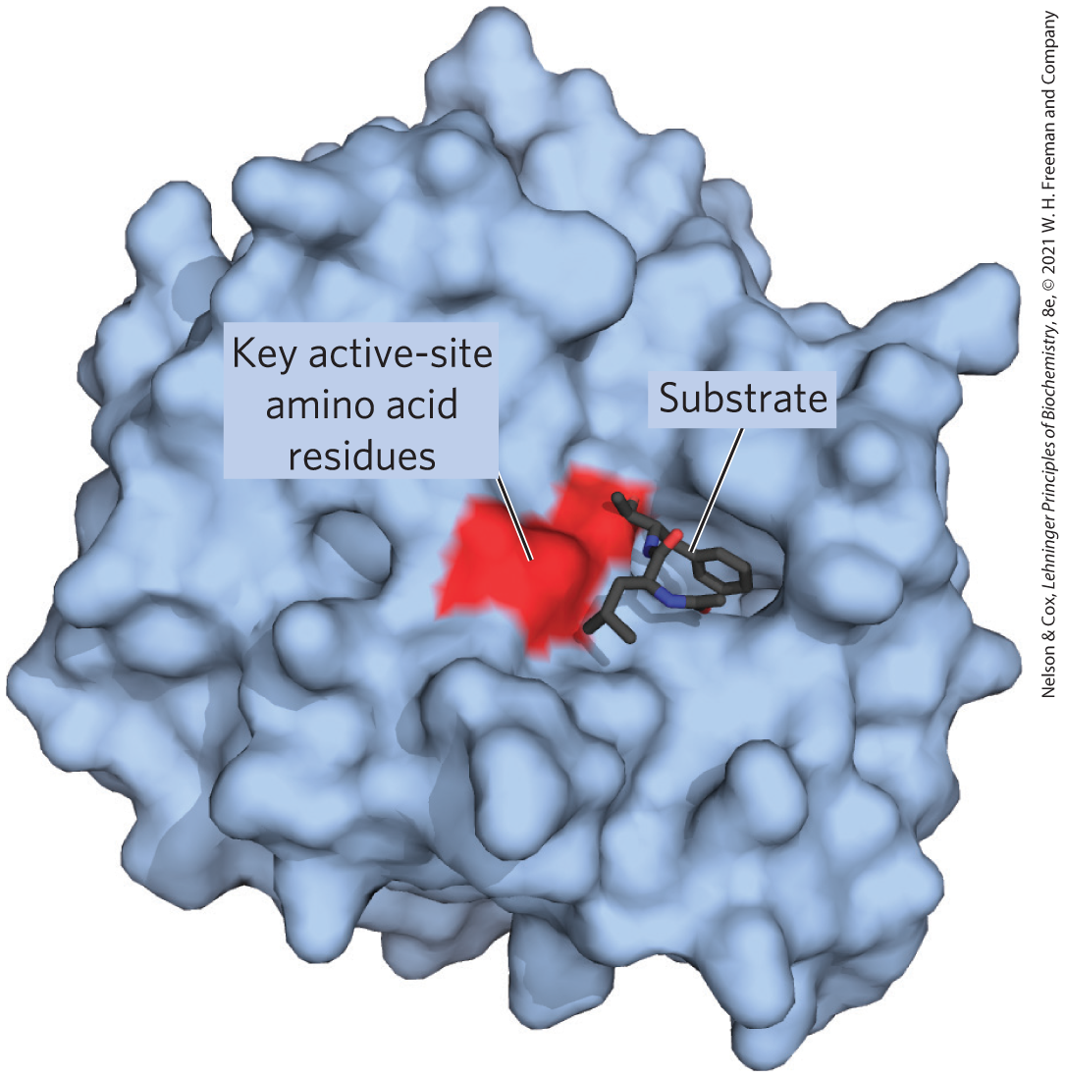
Enzyme-Catalyzed Reactions Take Place within the Active Site
active site = provides a specific environment in which a given reaction can occur more rapidly
substrate = the molecule that is bound to the active site and acted upon by the enzyme

Slide 16
Enzymes Affect Reaction Rates,
Not Equilibria
simple enzymatic reactions can be written as
E + S ⇌ ES ⇌ EP ⇌ E + P
(6-1)
where E, S, and P represent the enzyme, substrate, and product and ES and EP are transient complexes of the enzyme

Slide 17
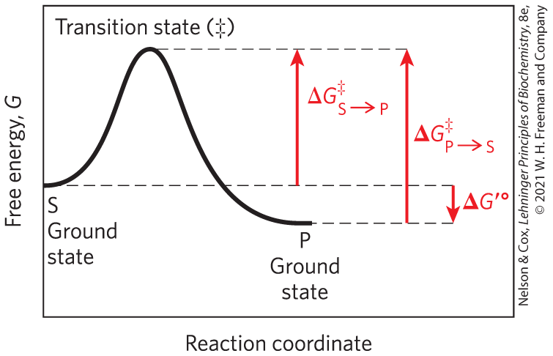
Ground State and Transition State
ground state = starting point for either the forward or reverse reaction
transition state (‡) = the point at which decay to substrate or product are equally likely

Slide 18
Energy Changes in a Reaction Coordinate Diagram
biochemical standard free-energy change = ∆G′° = the standard free-energy change at pH 7.0
activation energy (∆G‡) = difference between the ground state energy level and the transition state energy level

Slide 19
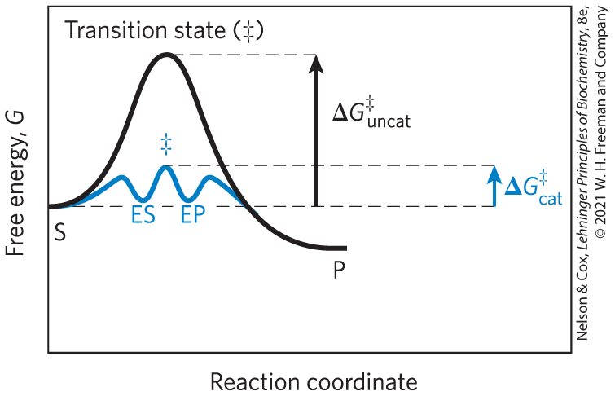
Catalysts Lower the Activation Energy and Increase the Reaction Rate

Slide 20
Catalysts Do Not Affect Reaction Equilibria
any enzyme that catalyzes the reaction S → P also catalyzes the reaction P → S
enzymes accelerate the interconversion of S and P
enzymes are not used up in the process
the equilibrium point is unaffected

Slide 21
Reaction Intermediates
reaction intermediate = any species on the reaction pathway that has a finite chemical lifetime
  example: ES and EP complexes

Slide 22
Rate-Limiting Steps
rate-limiting step = the step in a reaction with the highest activation energy that determines the overall rate of the reaction
activation energies are barriers to chemical reactions

Slide 23
Enzymes Lower Activation Energies Selectively
enzymes have developed to lower activation energies selectively to increase rates for reactions needed for cell survival

Slide 24
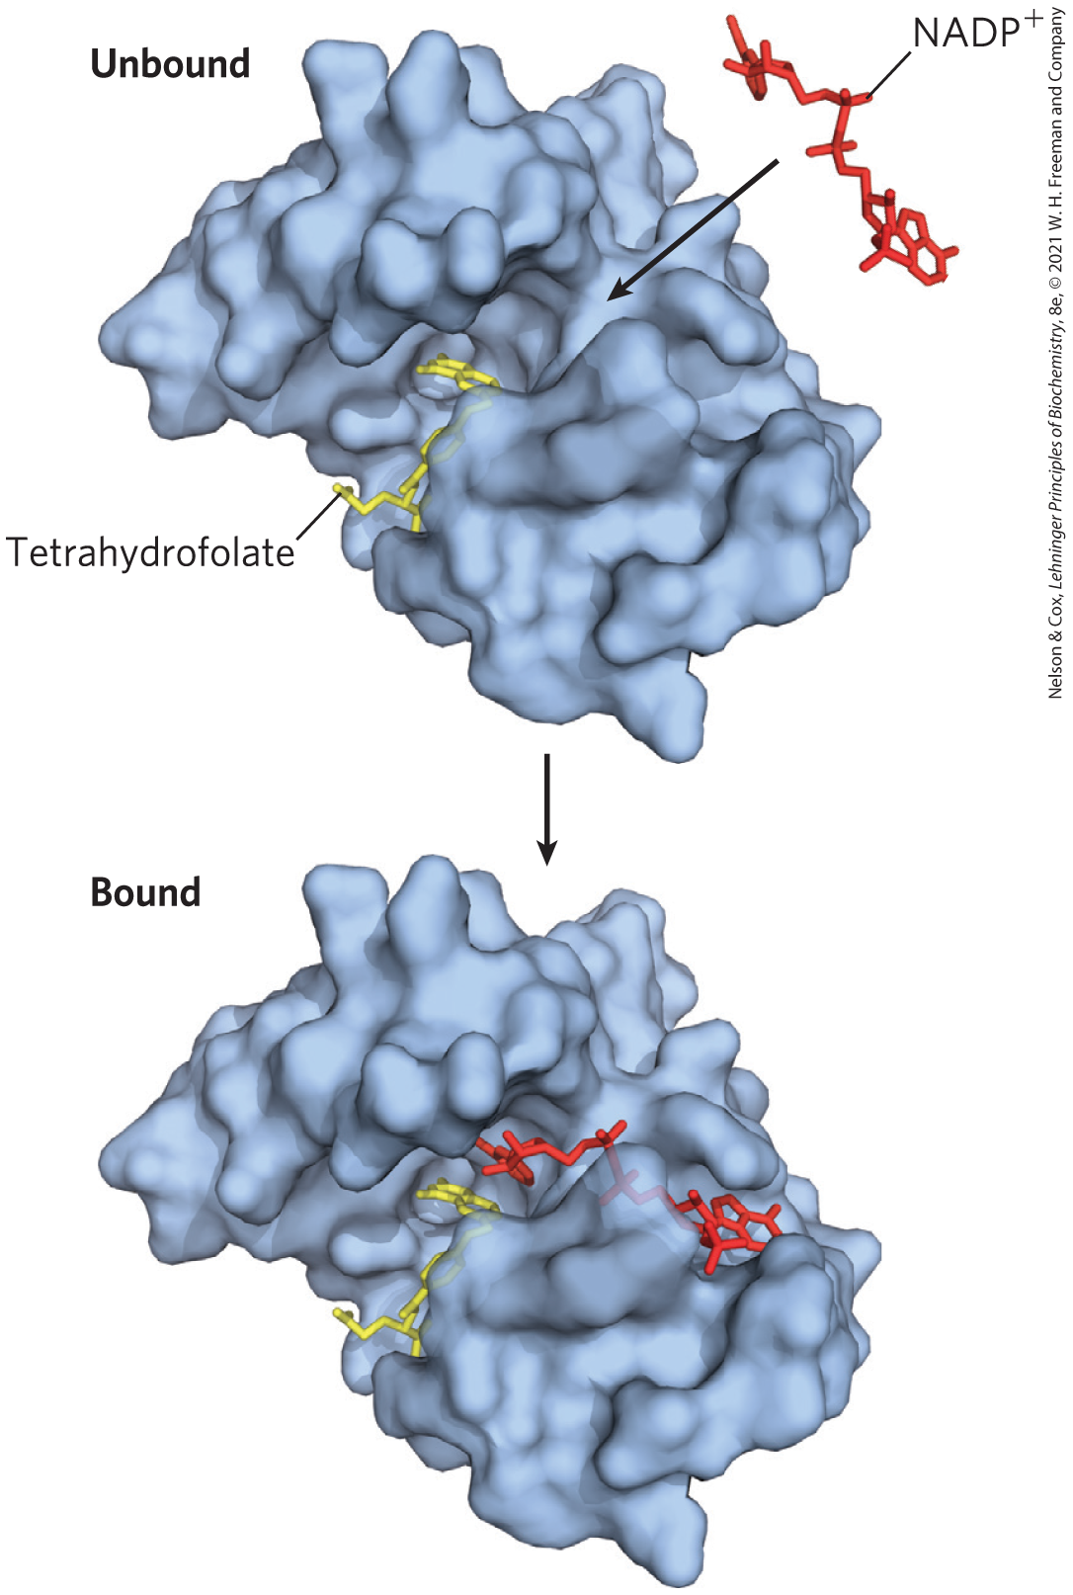
Noncovalent Interactions between Enzyme and Substrate Are Optimized in the Transition State
“lock and key” hypothesis = enzymes are structurally complementary to their substrates
  would make for a poor enzyme

Slide 25
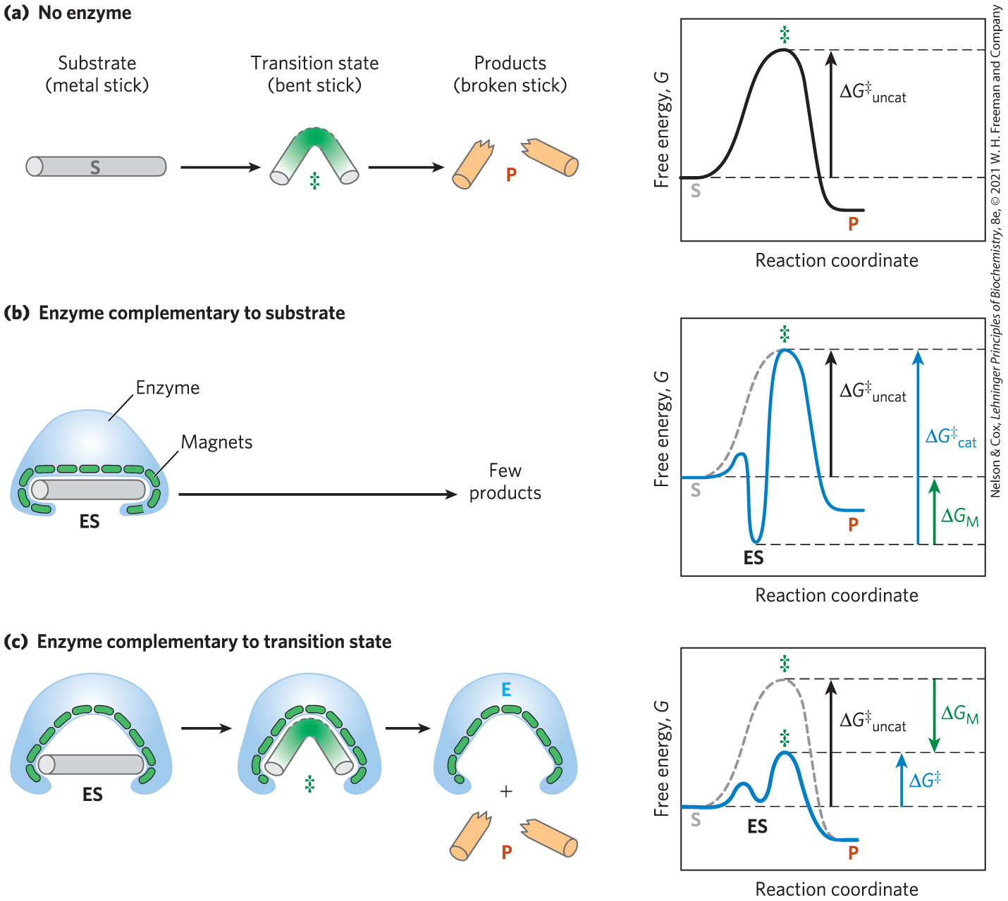
Enzymes Must Be Complementary to the Reaction Transition State
the full complement of interactions between substrate and enzyme is formed only when the substrate reaches the transition state

Slide 26
The Active Site of an Enzyme
optimized binding energy in the transition state is accomplished by positioning a substrate in a cavity (the active site), removed from H₂O

Slide 27
Enzyme Specificity
specificity = ability to discriminate between a substrate and a competing molecule
  given by binding energy

Slide 28
Binding Energy Overcomes the Barrier to Reaction
barrier to reaction, ∆G‡ includes:
  the entropy of molecules in solution
  the solvation shell of hydrogen-bonded water that surrounds and stabilizes most biomolecules in aqueous solution
  the distortion of substrates that must occur in many reactions
  the need for proper alignment of catalytic functional groups on the enzyme

Slide 29
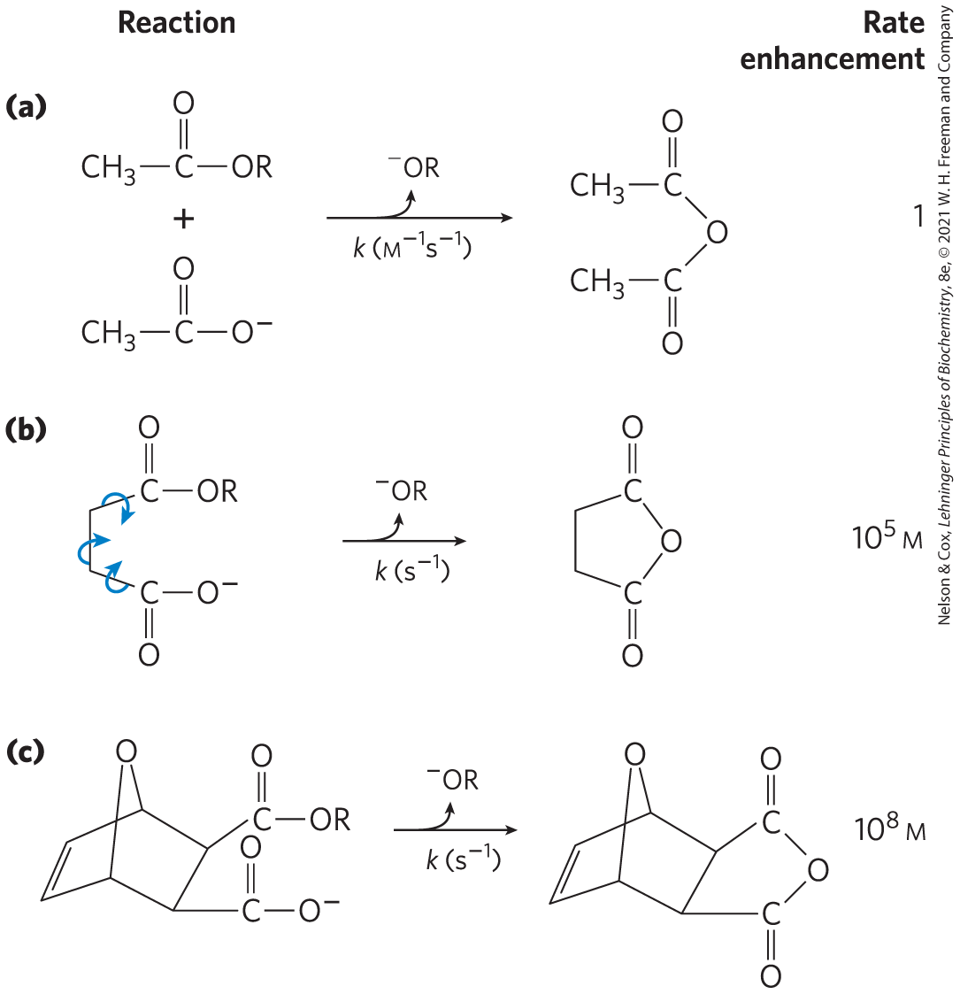
Rate Enhancement by Entropy Reduction
entropy reduction = large restriction in the relative motions of two substrates that are to react
binding energy constrains substrates in the proper orientation to reaction

Slide 30
Desolvation of the Substrate
desolvation = replacement of the solvation shell of structured water around the substrate with weak bonds between substrate and enzyme
  replaces most or all hydrogen bonds between the substrate and H₂O

Slide 31
Distortion of the Substrate
substrate must undergo distortion (electron redistribution) to react
  causes an unfavorable free-energy change
binding energy compensates thermodynamically for this

Slide 32
The Induced Fix Mechanism
induced fit = mechanism by which the enzyme itself undergoes a conformational change when the substrate binds, induced by multiple weak interactions with the substrate
  enhances catalytic properties

Slide 33
6.3 Enzyme Kinetics as an Approach to Understanding Mechanism

Slide 34
Enzyme Kinetics
enzyme kinetics = the discipline focused on determining the rate of a reaction and how it changes in response to changes in experimental parameters

Slide 35
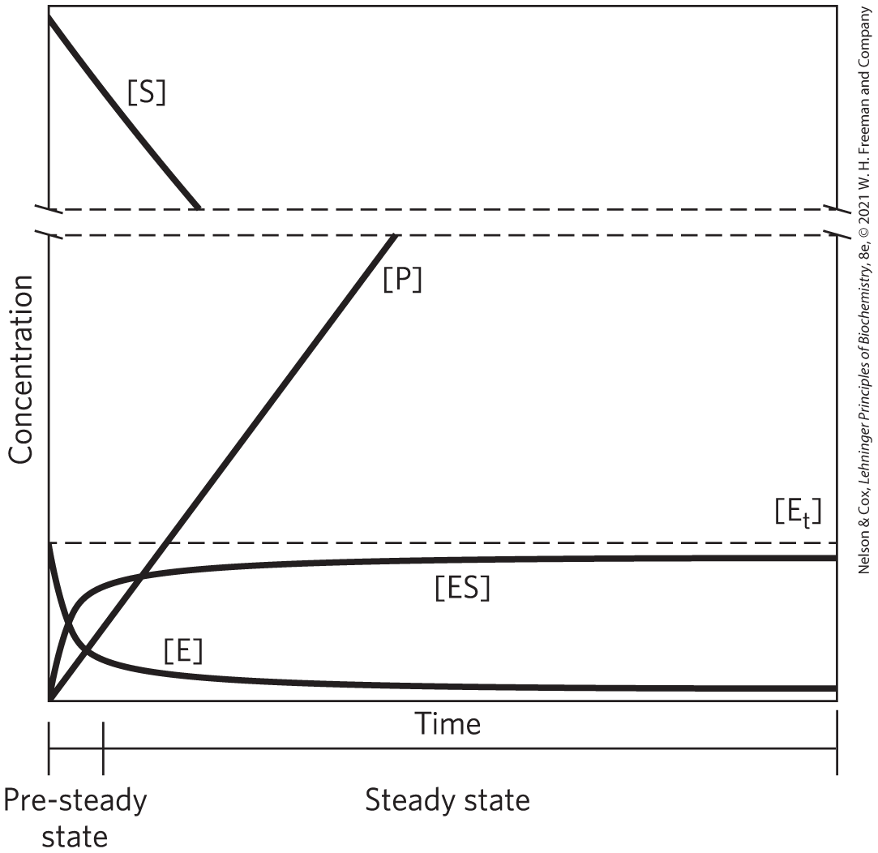
Substrate Concentration Affects the Rate of Enzyme-Catalyzed Reactions
pre–steady state = initial transient period during which ES builds up
steady state = period during which [ES] and other intermediates remain constant
steady-state kinetics = the traditional analysis of reaction rates

Slide 36
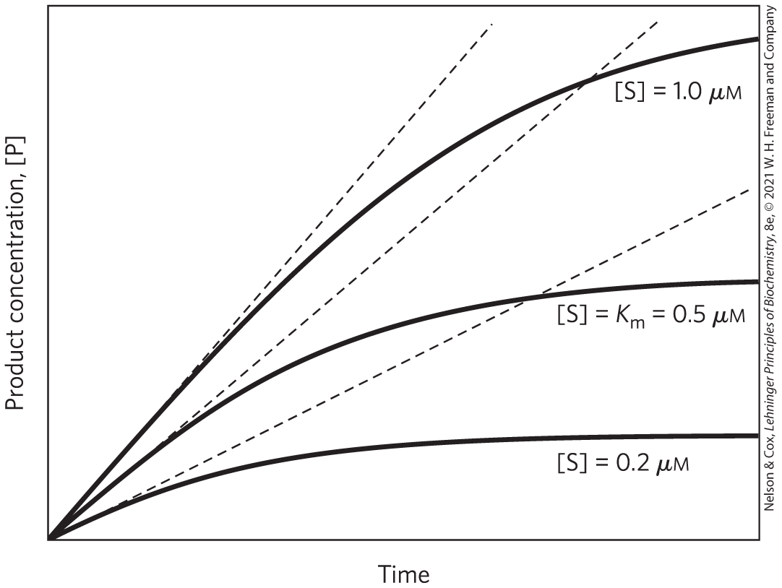
Initial Velocities of Enzyme-Catalyzed Reactions
initial rate (initial velocity), V₀ = tangent to each curve taken at time = 0
  reflects a steady state
at the beginning of the reaction, [S] is regarded as constant

Slide 37
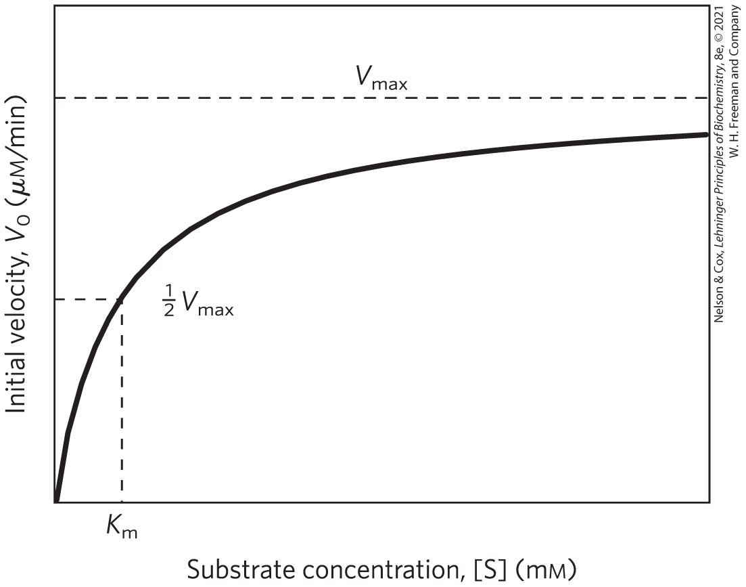
Effect of [S] on the V₀ of an
Enzyme-Catalyzed Reaction
the plateau-like V₀ region is close to the maximum velocity, V_{max}

Slide 38
General Theory of Enzyme Action Proposed by Michaelis and Menten
step 1 – enzyme and substrate combine to form a complex in a reversible, relatively fast step:
(6-7)
step 2 – the complex breaks down to yield the free enzyme and the reaction product in a slower step:
(6-8)
because the second step limits the overall reaction rate, the overall rate is proportional to [ES]

Slide 39
The Saturation Effect
V_{max} is observed when virtually all the enzyme is present as the ES complex
  further increases in [S] have no effect on rate
  responsible for the plateau observed

Slide 40
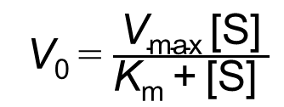
The Relationship between Substrate Concentration and Reaction Rate Can Be Expressed with the Michaelis-Menten Equation
the curve expressing the relationship between [S] and V₀ can be expressed by the Michaelis-Menten equation:
V₀ = $\frac{\text{V}\text{max} \text{[}\text{S}\text{]}}{\text{K}\text{m} \text{+} \text{[}\text{S}\text{] }}$
(6-9)
where V₀ is the initial velocity, V_{max} is the maximum velocity, [S] is the initial substrate concentration, and K_{m} is a constant called the Michaelis constant

Slide 41
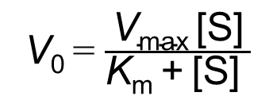
The Michaelis-Menten Equation
the Michaelis-Menten equation is the rate equation for a one-substrate enzyme-catalyzed reaction:
V₀ = $\frac{\text{V}\text{max}\text{ [}\text{S}\text{]}}{\text{K}\text{m}\text{ + [}\text{S}\text{] }}$
(6-9)
V₀, V_{max}, [S], and K_{m} are readily measured experimentally

Slide 42
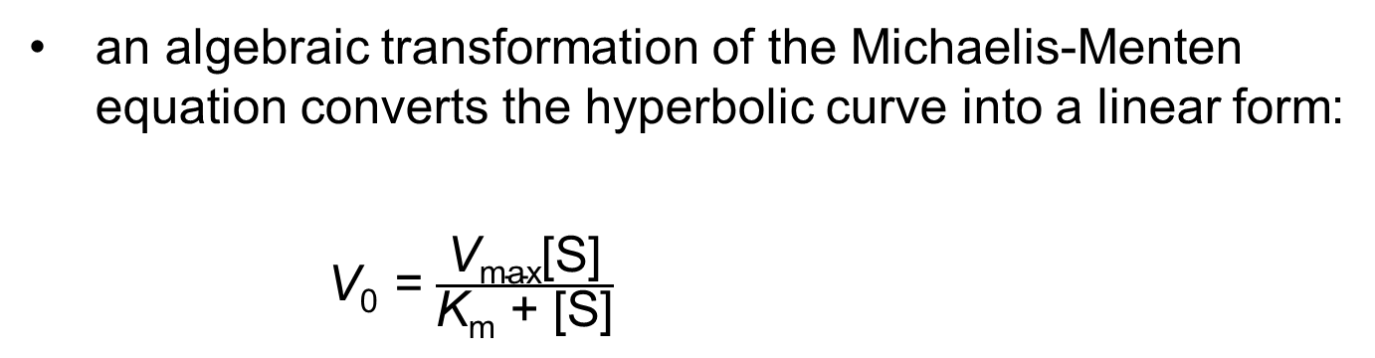
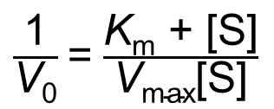
Michaelis-Menten Kinetics Can Be Analyzed Quantitatively
an algebraic transformation of the Michaelis-Menten equation converts the hyperbolic curve into a linear form:
V₀ = $\frac{\text{V}\text{max}\text{[}\text{S}\text{]}}{\text{K}\text{m}\text{ + [}\text{S}\text{]}}$
$\frac{\text{1}}{\text{V}\text{0}}$ = $\frac{\text{K}\text{m}\text{ + [}\text{S}\text{]}}{\text{V}\text{max}\text{[}\text{S}\text{]}}$
(6-24)

Slide 43
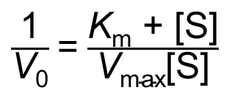
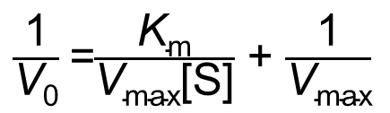
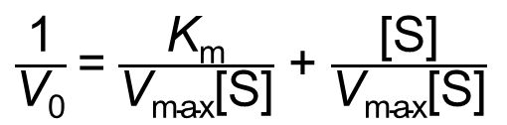
Deriving the Lineweaver-Burk Equation
simplifying this equation gives the Lineweaver-Burk equation:
$\frac{\text{1}}{\text{V}\text{0}}$ = $\frac{\text{K}\text{m}\text{ + [}\text{S}\text{]}}{\text{V}\text{max}\text{[}\text{S}\text{]}}$
(6-24)
$\frac{\text{1}}{\text{V}\text{0}}$ = $\frac{\text{K}\text{m}}{\text{V}\text{max}\text{[}\text{S}\text{]}}$ + $\frac{\text{[}\text{S}\text{]}}{\text{V}\text{max}\text{[}\text{S}\text{]}}$
(6-25)
$\frac{\text{1}}{\text{V}\text{0}}$ =$\frac{\text{K}\text{m}}{\text{V}\text{max}\text{[}\text{S}\text{]}}$ + $\frac{\text{1}}{\text{V}\text{max}}$
(6-26)

Slide 44
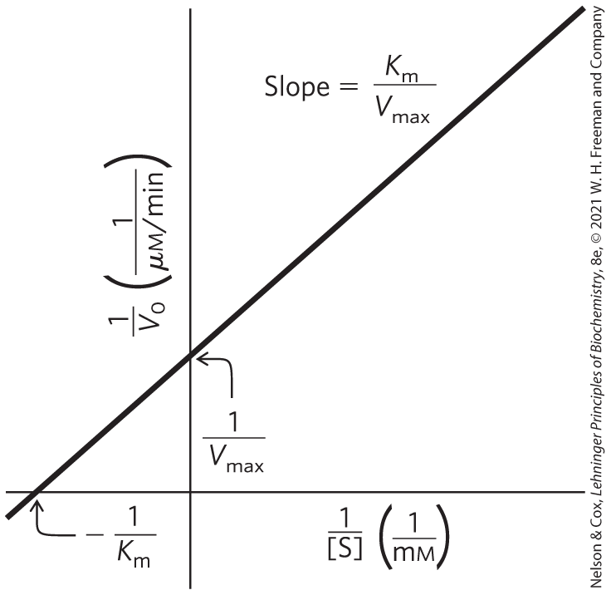
A Double-Reciprocal, or Lineweaver-Burk, Plot
for enzymes obeying the Michaelis-Menten relationship, a plot of 1/V₀ versus 1/[S] yields a straight line

Slide 45
Kinetic Parameters Are Used to Compare Enzyme Activities
all enzymes that exhibit a hyperbolic dependence of V₀ on [S] follow Michaelis-Menten kinetics where:
K_{m} = [S] when V₀ = ½V_{max}
(6-23)

Slide 46
Interpreting K_{m} and V_{max}
K_{m} can vary for different substrates of the same enzyme
Table 6-6 K_{m} for Some Enzymes and Substrates
Enzyme | Substrate | K_{m} (mM)
Hexokinase (brain) | ATP D-Glucose D-Fructose | 0.4 0.05 1.5
Carbonic anhydrase | HCO₃– | 26
Chymotrypsin | Glycyltyrosinylglycine N-Benzoyltyrosinamide | 108 2.5
β-Galactosidase | D-Lactose | 4.0
Threonine dehydratase | L-Threonine | 5.0

Slide 47
Many Enzymes Catalyze Reactions with Two or More Substrates
nearly 2/3 of all enzymatic reactions have 2 substrates and 2 products
example types of reactions:
  a group is transferred from one substrate to the other
  one substrate is oxidized while the other is reduced

Slide 48
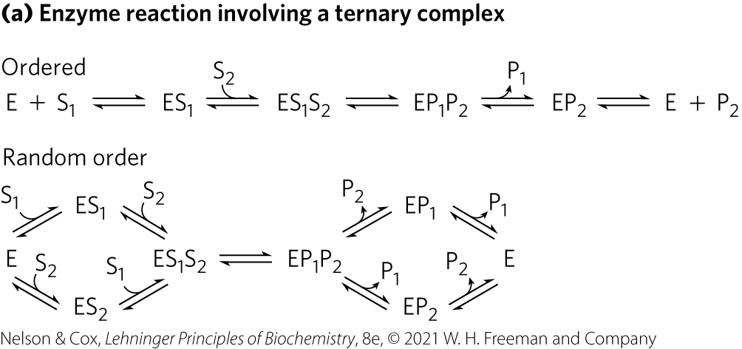
Some Enzyme Reactions Involve a Ternary Complex
substrates can bind in a random sequence or in a specific order

Slide 49
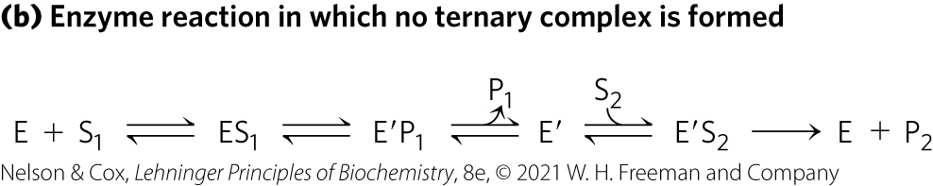
Some Enzyme Reactions Do Not Form a Ternary Complex
the first substrate is converted to product and dissociates before the second substrate binds
  example: Ping-Pong, or double-displacement, mechanism

Slide 50
Enzymes Are Subject to Reversible or Irreversible Inhibition
enzyme inhibitors = molecules that interfere with catalysis, slowing or halting enzymatic reactions
2 classes of enzyme inhibitors:
  reversible
  irreversible

Slide 51
Reversible Inhibition
types of reversible inhibition:
  competitive inhibition
  uncompetitive inhibition
  mixed inhibition
  noncompetitive inhibition

Slide 52
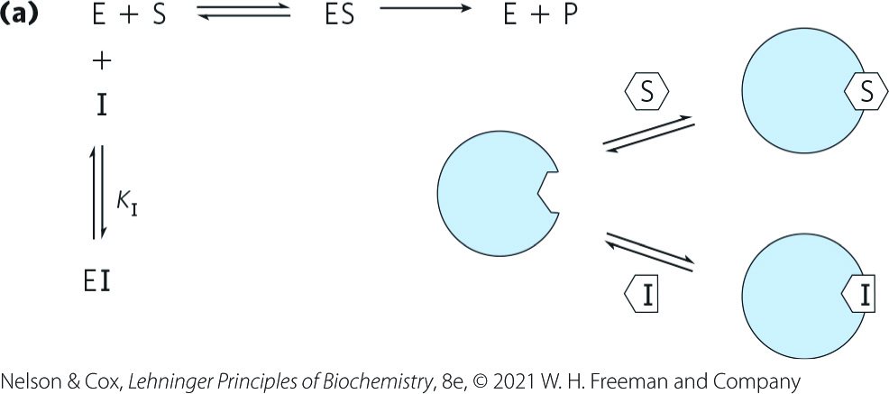
Competitive Inhibition
competitive inhibitor:
  competes with the substrate for the active site of an enzyme
  type of reversible inhibition
  by definition, the value of α′ for a competitive inhibitor is 1

Slide 53
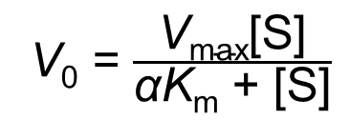
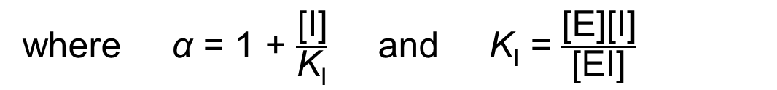
Competitive Inhibitors Alter the Michaelis-Menten Equation
competitive inhibition can be measured by steady-state kinetics
the Michaelis-Menten equation becomes
V₀ = $\frac{\text{V}\text{max}\text{[}\text{S}\text{]}}{\text{α}\text{K}\text{m}\text{ + [}\text{S}\text{]}}$
(6-31)
where $\text{α}$ = 1 + $\frac{\text{[}\text{I}\text{]}}{\text{K}\text{I}}$ and K_{I} = $\frac{\text{[}\text{E}\text{][}\text{I}\text{]}}{\text{[}\text{EI}\text{]}}$

Slide 54
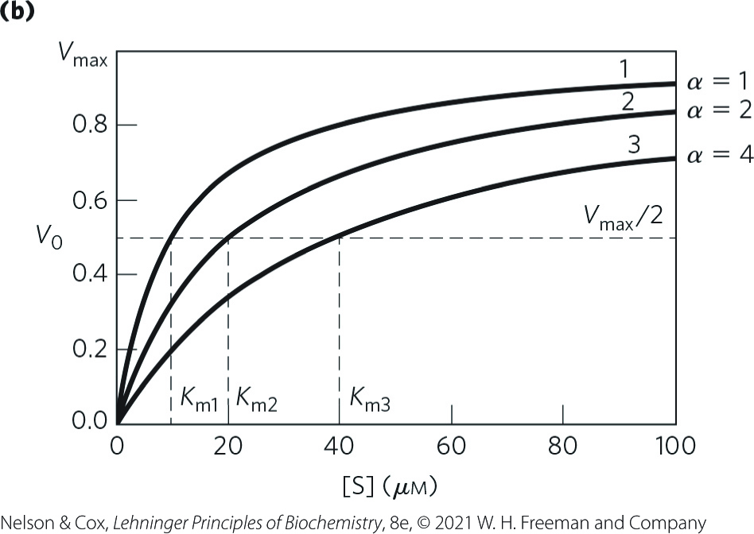
Competitive Inhibitors Affect the Apparent K_{m}, but Not the V_{max}
“apparent” K_{m} = the experimentally determined variable αK_{m}
when [S] >> [I], the reaction exhibits normal V_{max}
in the presence of inhibitor, the [S] at which V₀ = ½V_{max}, the apparent K_{m}, increases by the factor α

Slide 55
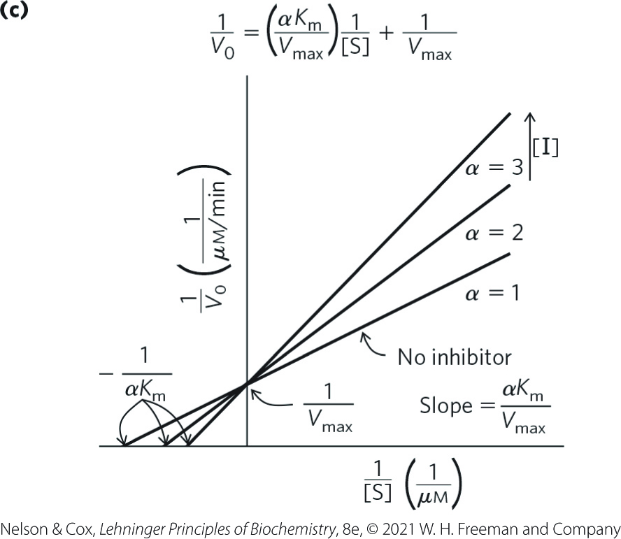
A Lineweaver-Burk Plot Reveals Competitive Inhibition
lines intersect at the y axis

Slide 56
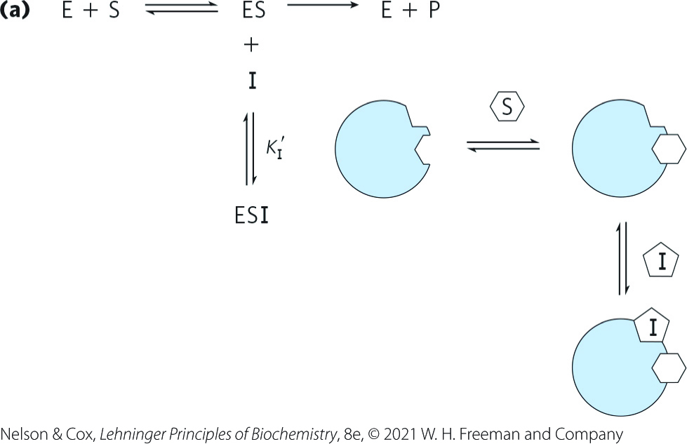
Uncompetitive Inhibition
uncompetitive inhibitor:
  binds at a site distinct from the substrate active site
  unlike a competitive inhibitor, binds only to the ES complex
  type of reversible inhibition

Slide 57
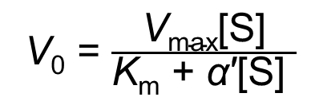
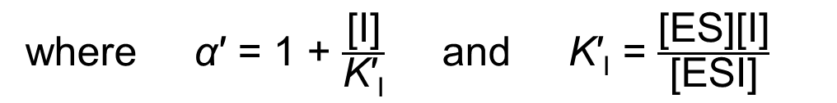
Uncompetitive Inhibitors Alter the Michaelis-Menten Equation
the Michaelis-Menten equation becomes
V₀ = $\frac{\text{V}\text{max}\text{[}\text{S}\text{]}}{\text{K}\text{m}\text{ + }\text{α}\text{′[}\text{S}\text{]} }$
(6-32)
where $\text{α}$′ = 1 + $\frac{\text{[}\text{I}\text{]}}{\text{K}\text{′}\text{I}}$ and K′_{I} = $\frac{\text{[}\text{ES}\text{][}\text{I}\text{]}}{\text{[}\text{ESI}\text{]}}$

Slide 58
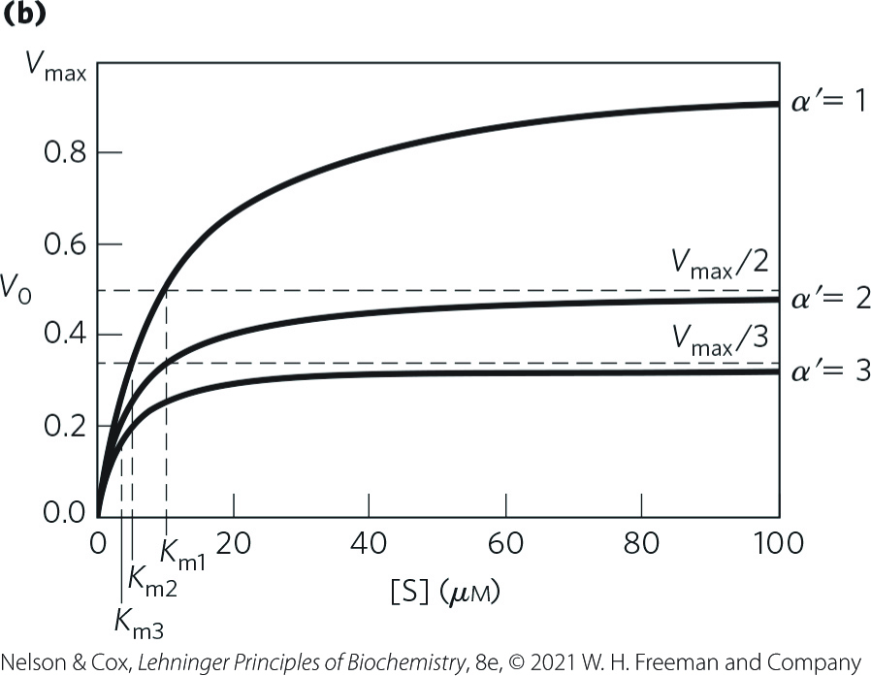
Uncompetitive Inhibitors Affect Both the Apparent K_{m} and the V_{max}
the measured V_{max} decreases because at high [S], V₀ approaches V_{max}/α′
apparent K_{m} decreases because the [S] required to reach ½V_{max} decreases by the factor α′

Slide 59
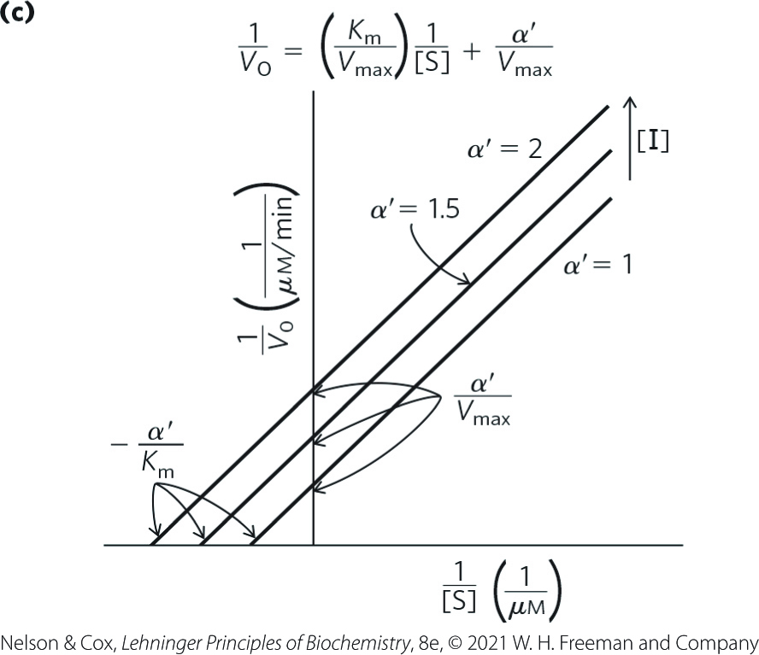
A Lineweaver-Burk Plot Reveals Uncompetitive Inhibition
lines are parallel

Slide 60
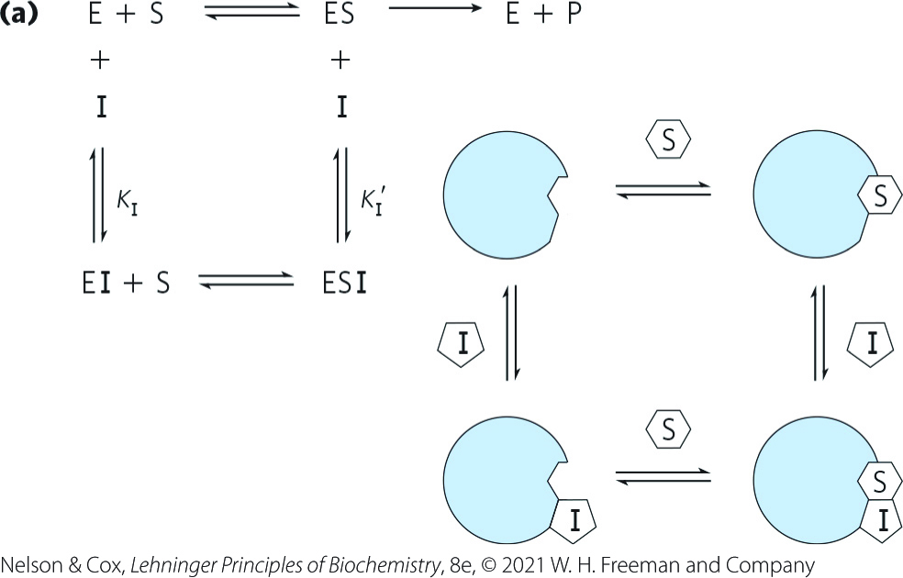
Mixed Inhibition
mixed inhibitor:
  binds at a site distinct from the substrate active site
  binds to either E or the ES complex
  type of reversible inhibition

Slide 61
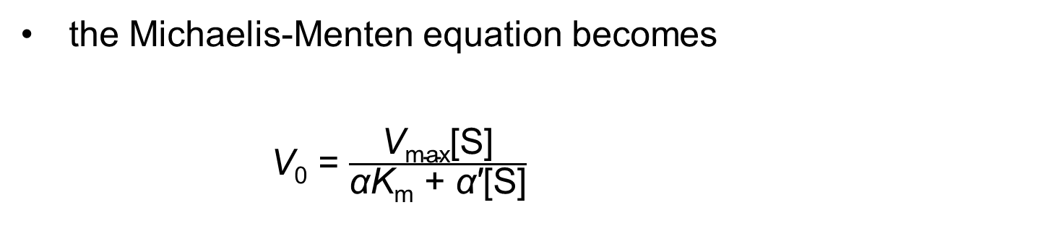
Mixed Inhibitors Alter the Michaelis-Menten Equation
the Michaelis-Menten equation becomes
V₀ = $\frac{\text{V}\text{max}\text{[}\text{S}\text{]}}{\text{α}\text{K}\text{m}\text{ + }\text{α}\text{′[}\text{S}\text{]}}$
(6-33)

Slide 62
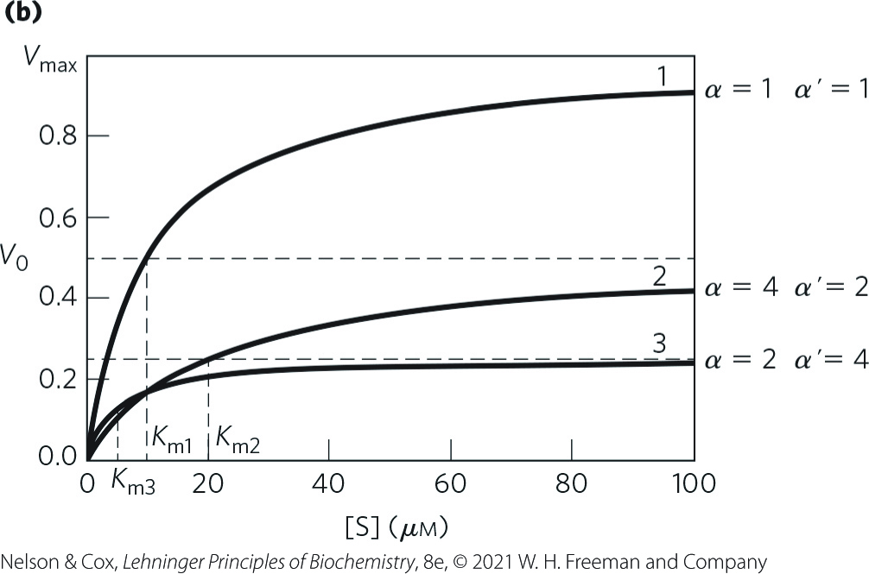
Mixed Inhibitors Usually Affect Both the Apparent K_{m} and the V_{max}
V_{max} is affected because the effective [E] on which V_{max} depends decreases
apparent K_{m} may increase or decrease depending on which enzyme form the inhibitor binds most strongly

Slide 63
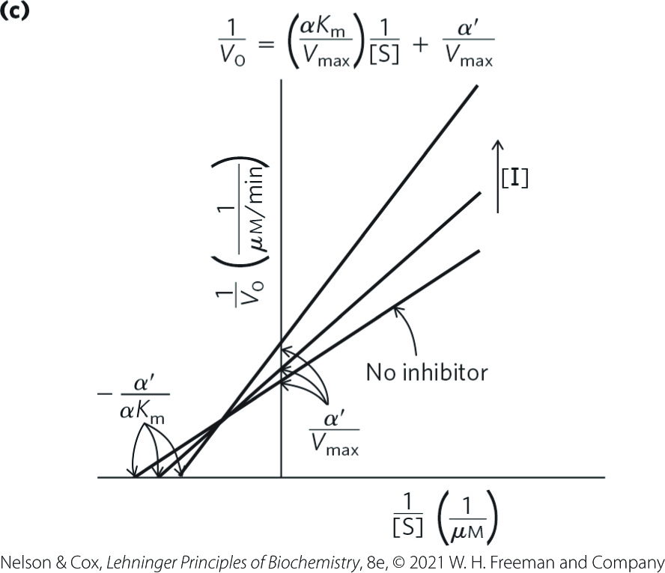
A Lineweaver-Burk Plot Reveals Mixed Inhibition
lines intersect to the left of the y axis

Slide 64
Noncompetitive Inhibition
noncompetitive inhibitor:
  special case of α = α′
  affects the V_{max} but not the K_{m}

Slide 65
Effects of Reversible Inhibitors on Apparent V_{max} and Apparent K_{m}
Table 6-9 Effects of Reversible Inhibitors on Apparent V_{max} and Apparent K_{m}
Inhibitor type | Apparent V_{max} | Apparent K_{m}
None | V_{max} | K_{m}
Competitive | V_{max} | K_{m}
Uncompetitive | V_{max}/α′ | K_{m}/α′
Mixed | V_{max}/α′ | αK_{m}/α′

Slide 66
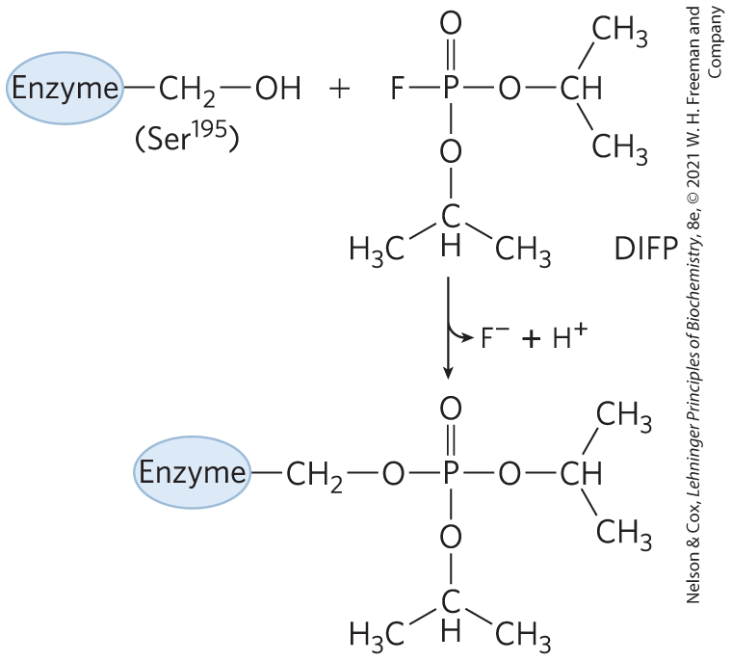
Irreversible Inhibition
irreversible inhibitor = bind covalently with or destroy a functional group on an enzyme that is essential for the enzyme’s activity, or form a highly stable noncovalent association

Slide 67
Suicide Inactivators
suicide inactivator = mechanism-based inactivators = undergo the first few steps until it is converted into a compound that combines irreversibly with the enzyme
  class of irreversible inhibitors

Slide 68
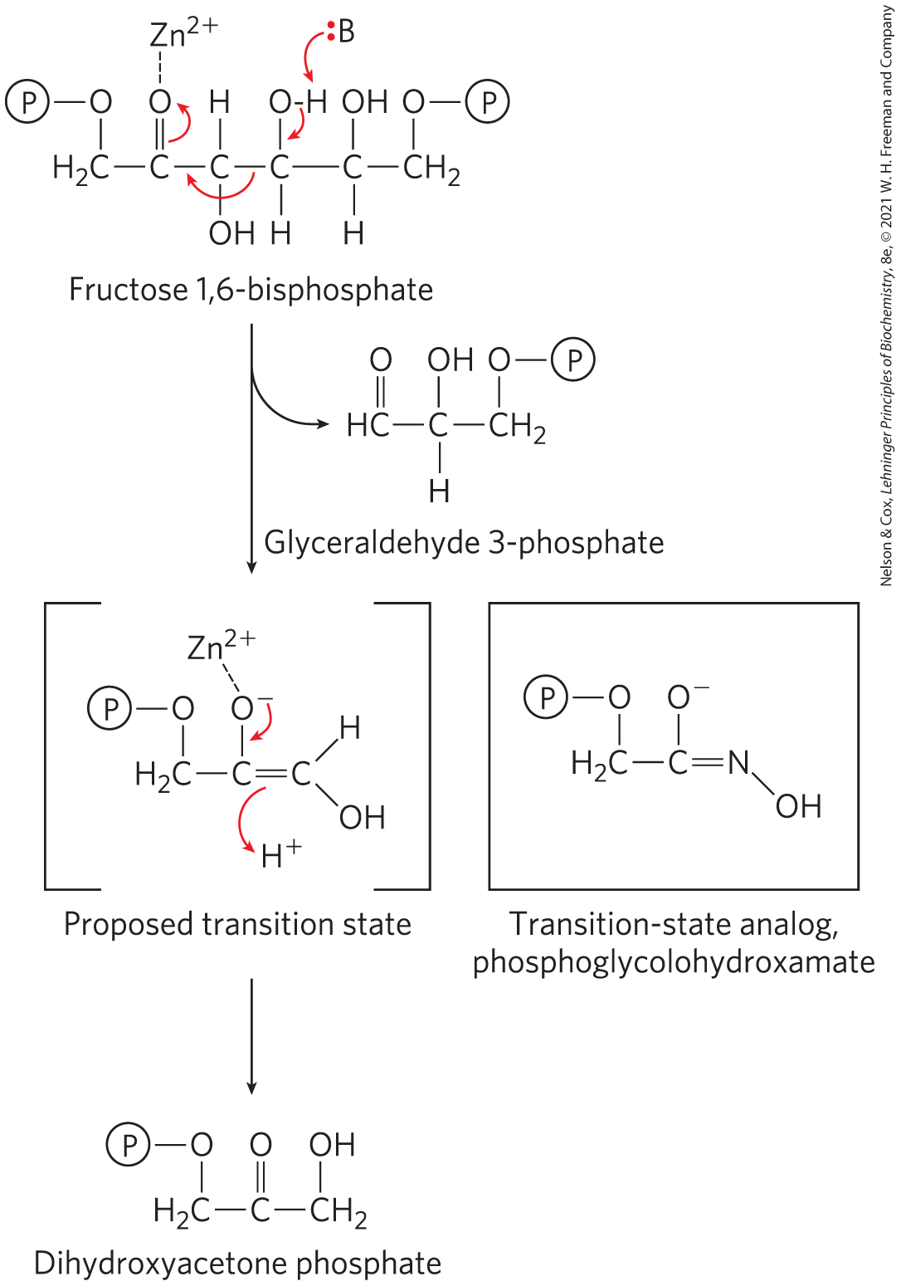
Transition-State Analogs
transition-state analogs = stable molecules designed to resemble transition states
  type of irreversible inhibitors
  bind to an enzyme more tightly than does the substrate in the ES complex

Slide 69
6.4 Examples of Enzymatic Reactions

Slide 70
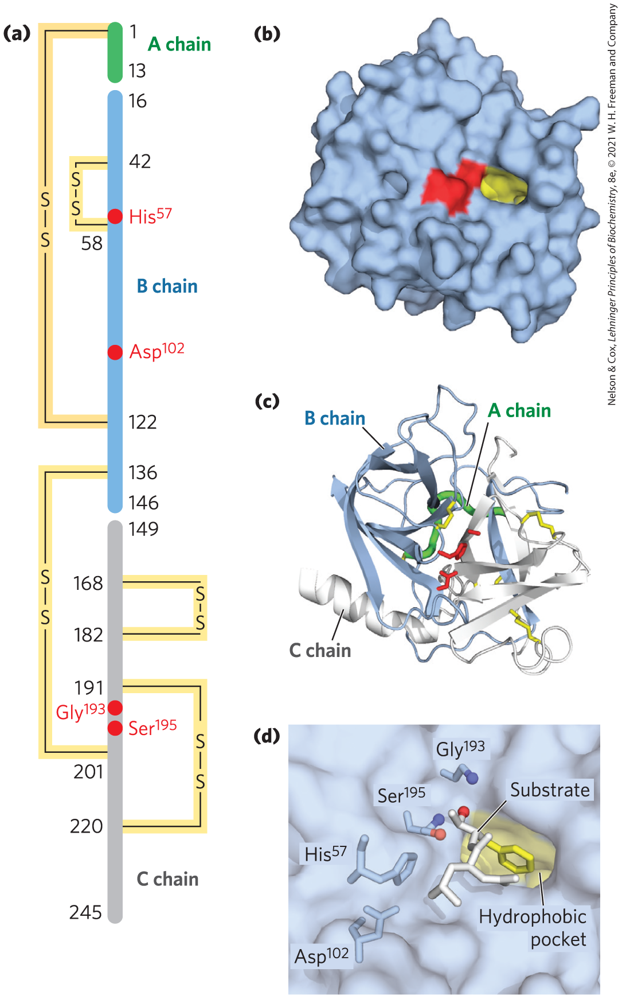
The Chymotrypsin Mechanism Involves Acylation and Deacylation of a Ser Residue
protease = an enzyme that catalyzes the hydrolytic cleavage of peptide bonds
  example = bovine pancreatic chymotrypsin

Slide 71
The Chymotrypsin Mechanism Involves Two Phases
acylation phase = the peptide bond is cleaved and an ester linkage is formed between the peptide carbonyl carbon and the enzyme
deacylation phase = the ester linkage is hydrolyzed and the nonacylated enzyme is regenerated

Slide 72
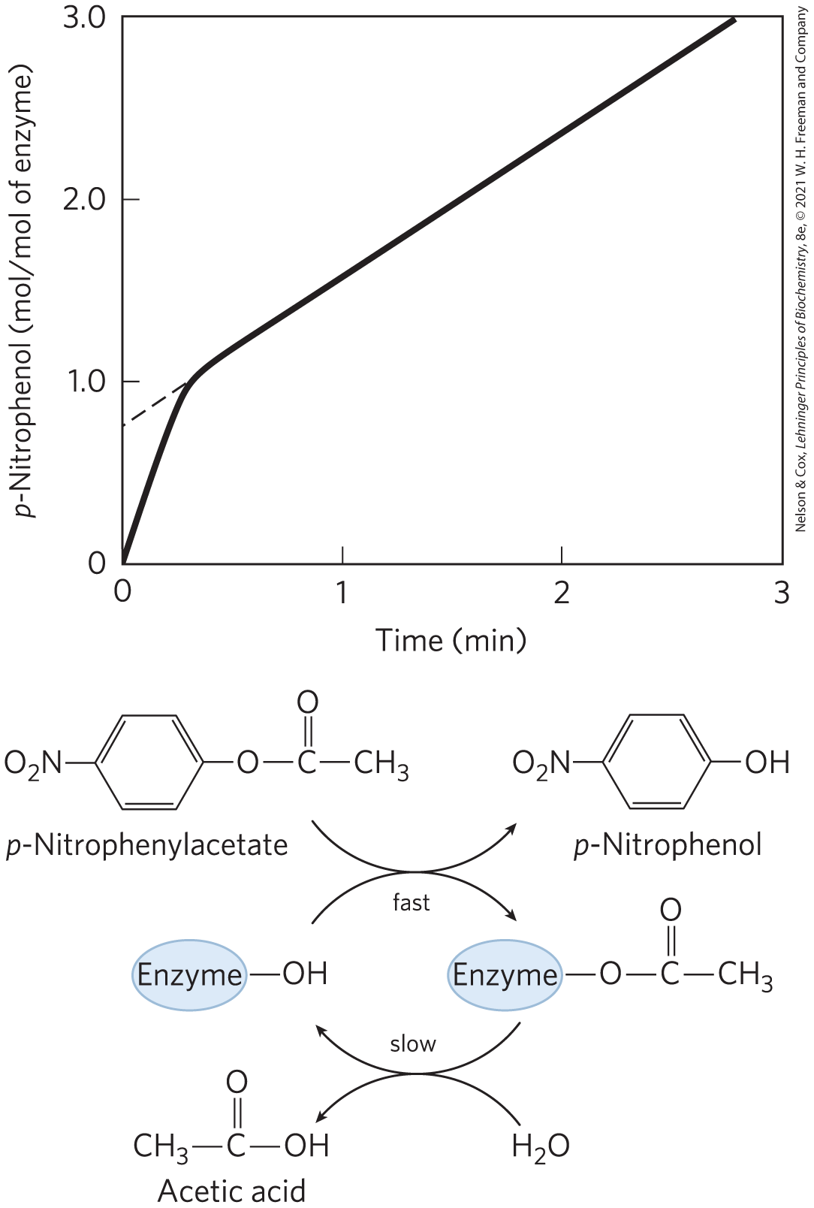
Pre–Steady State Kinetic Evidence for an Acyl-Enzyme Intermediate
presence of a burst suggested that turnover of the enzyme was limited by a subsequent, slower deacylation step

Slide 73
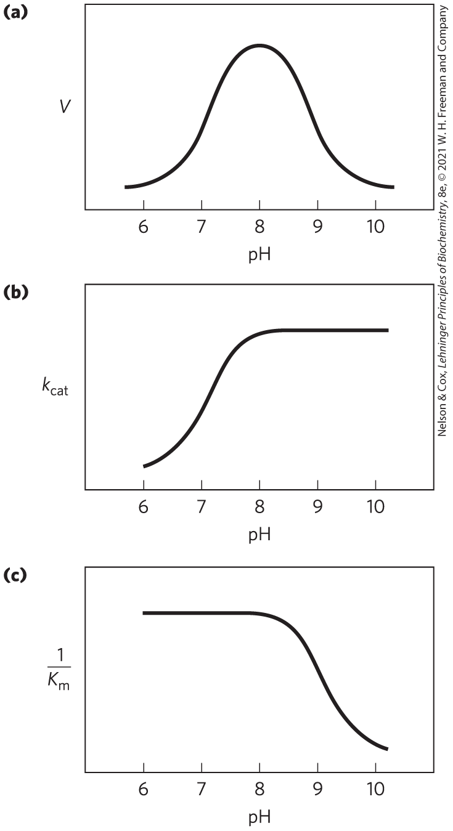
The pH Dependence of Chymotrypsin-Catalyzed Reactions
optimal activity at pH 8
  His⁵⁷ is unprotonated and Ile¹⁶ is protonated
the transition just above pH 7 is due to changes in k_{cat}
  results from protonation of His⁵⁷
the transition above pH 8.5 is due to changes in 1/K_{m}
  results from the ionization of the α-amino group of Ile¹⁶

Slide 74
The Chymotrypsin Reaction
serine proteases = proteases with a Ser residue that acts as the nucleophile
  acylation phase nucleophile is the oxygen of Ser¹⁹⁵
catalytic triad = hydrogen bonding network
  in chymotrypsin, Ser¹⁹⁵ is linked to His⁵⁷ and Asp¹⁰²

Slide 75
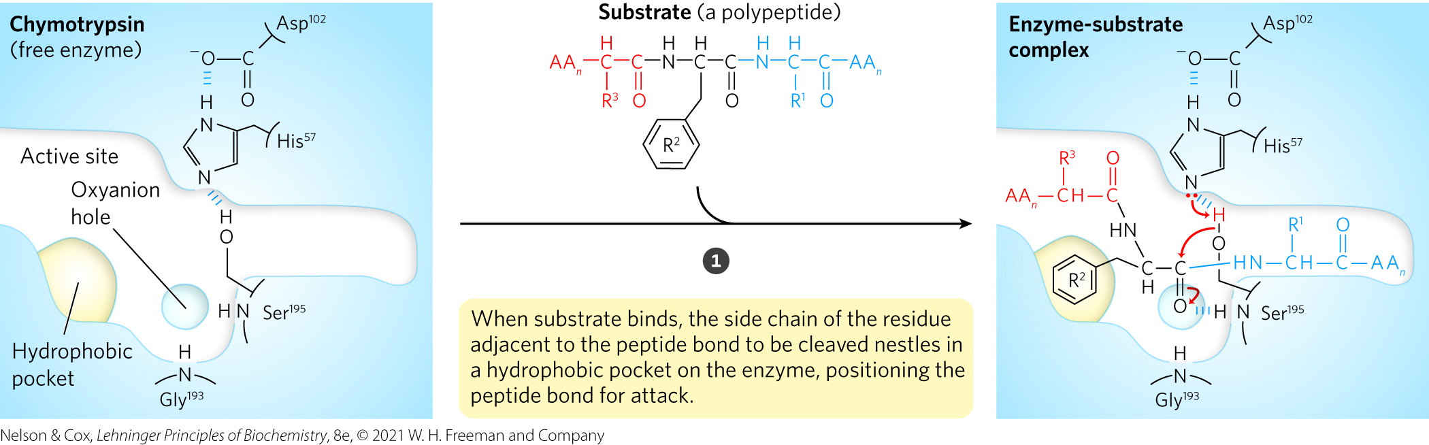
Chymotrypsin Mechanism, Step 1

Slide 76
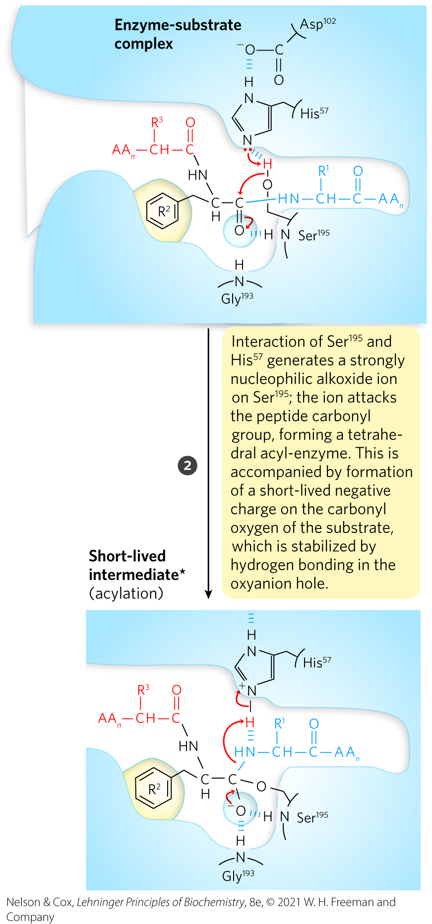
Chymotrypsin Mechanism, Step 2

Slide 77
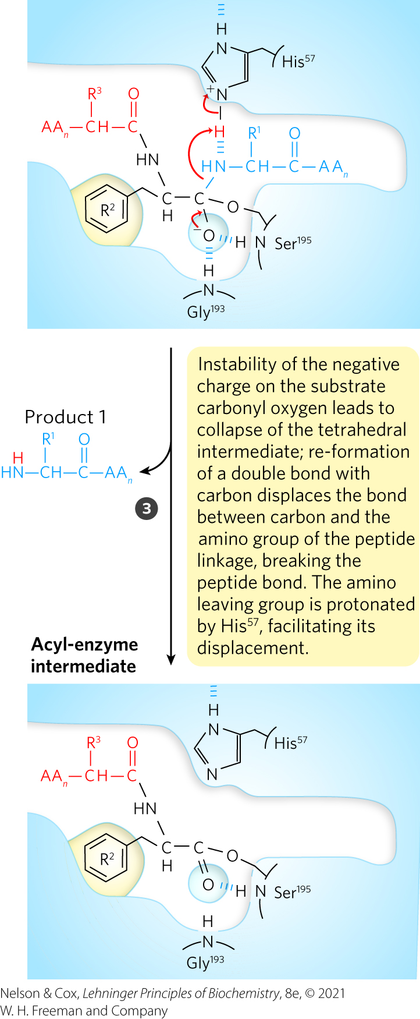
Chymotrypsin Mechanism, Step 3

Slide 78
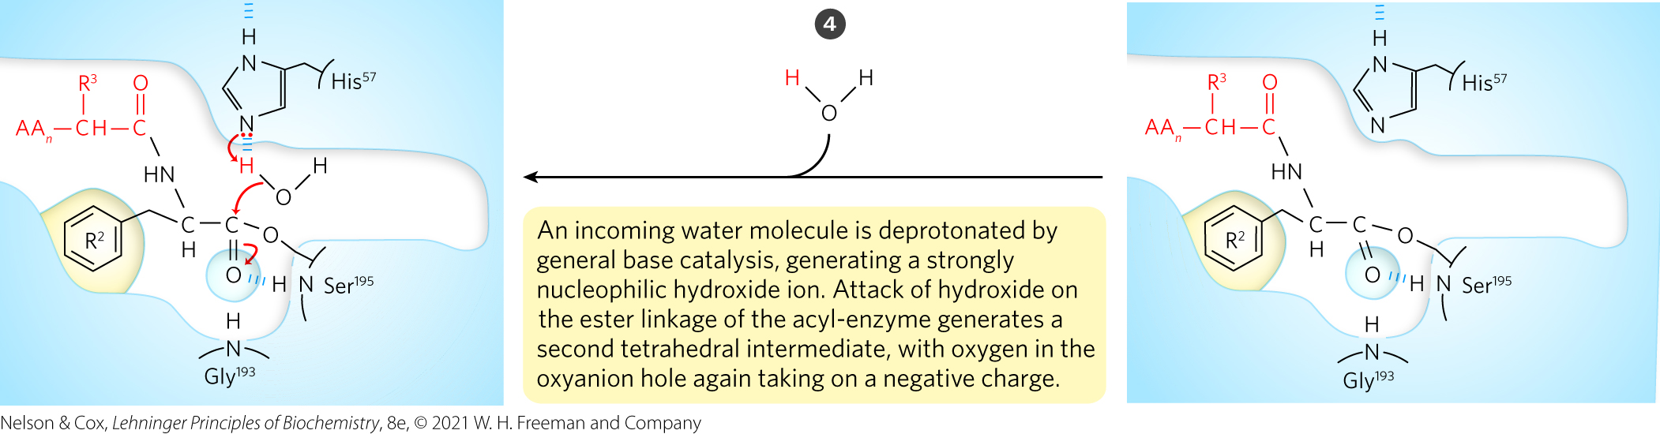
Chymotrypsin Mechanism, Step 4

Slide 79
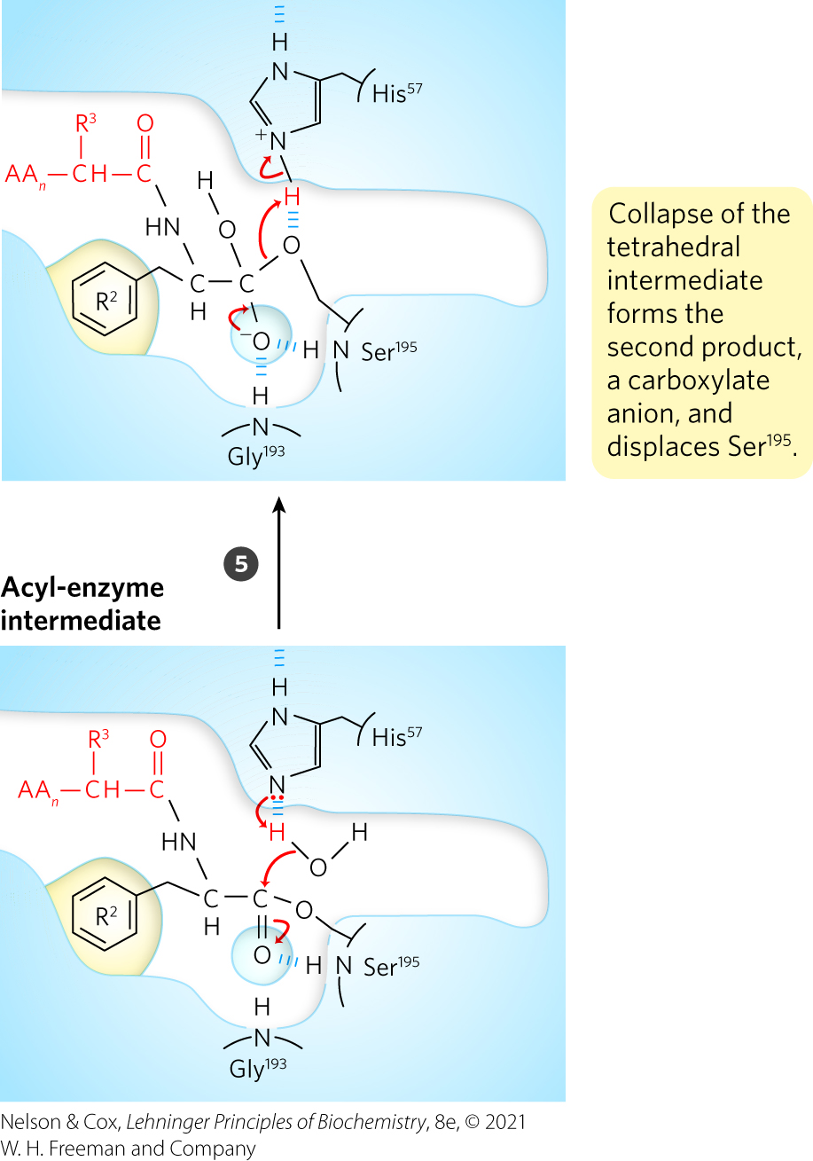
Chymotrypsin Mechanism, Step 5

Slide 80
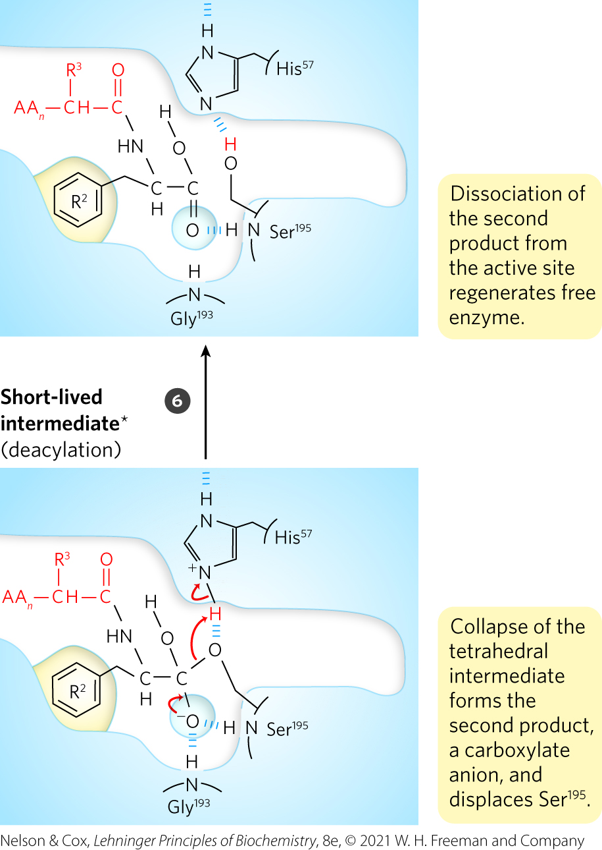
Chymotrypsin Mechanism, Step 6

Slide 81
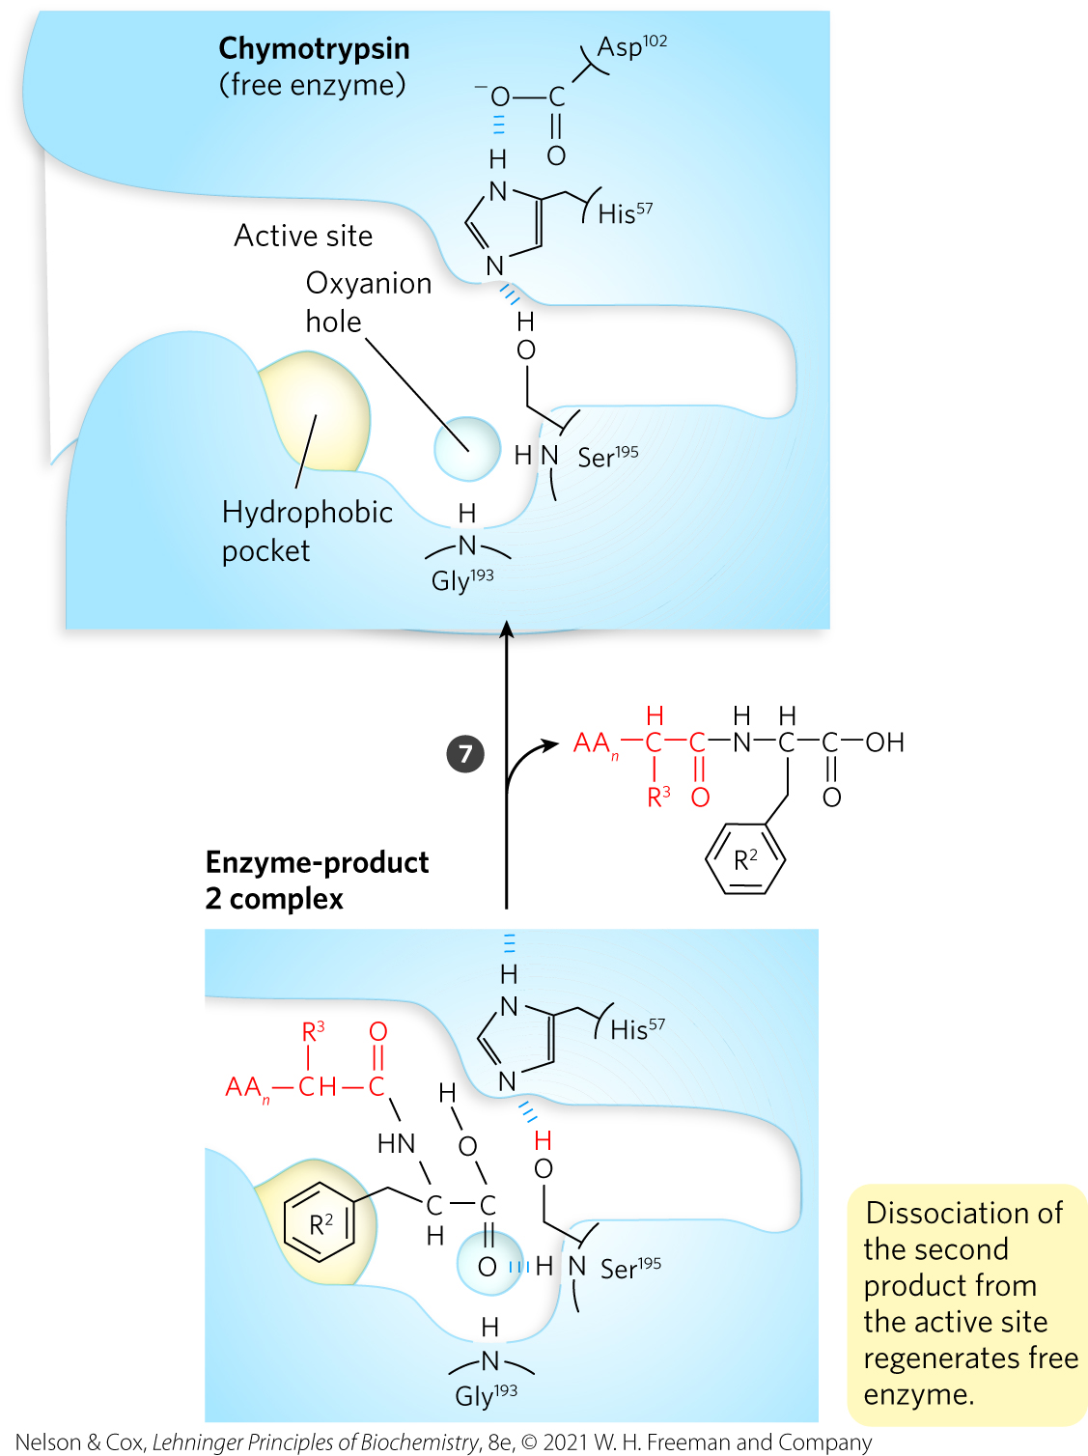
Chymotrypsin Mechanism, Step 7

Slide 82
6.5 Regulatory Enzymes

Slide 83
Regulatory Enzymes
regulatory enzymes = catalytic activity increases or decreases in response to certain signals
  allows the cell to meet changing needs for energy and biomolecules

Slide 84
Modulation of Regulatory Enzymes
activities of regulatory enzymes are modulated in a variety of ways:
  allosteric enzymes = function through reversible, noncovalent binding of regulatory compounds called allosteric modulators or allosteric effectors (small metabolites or cofactors)
  reversible covalent modification
  binding of separate regulatory proteins
  removal of peptide segments by proteolytic cleavage

Slide 85
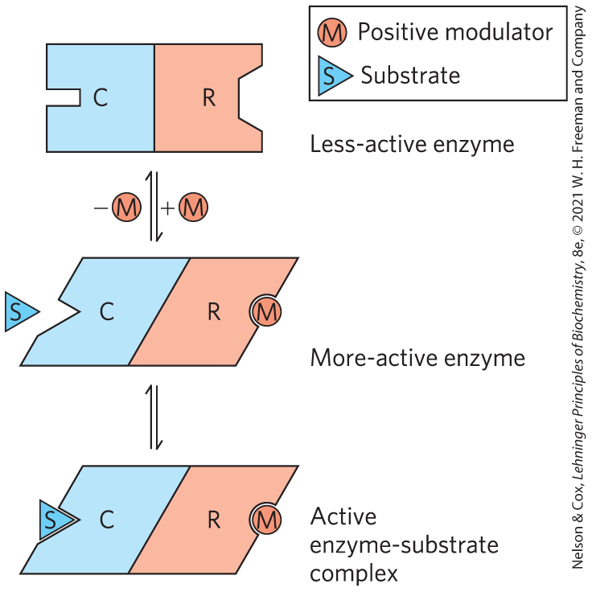
Allosteric Enzymes Undergo Conformational Changes in Response to Modulator Binding
homotrophic = regulation in which the substrate and modulator are identical
heterotropic = regulation in which the modulator is a molecule other than the substrate

Slide 86
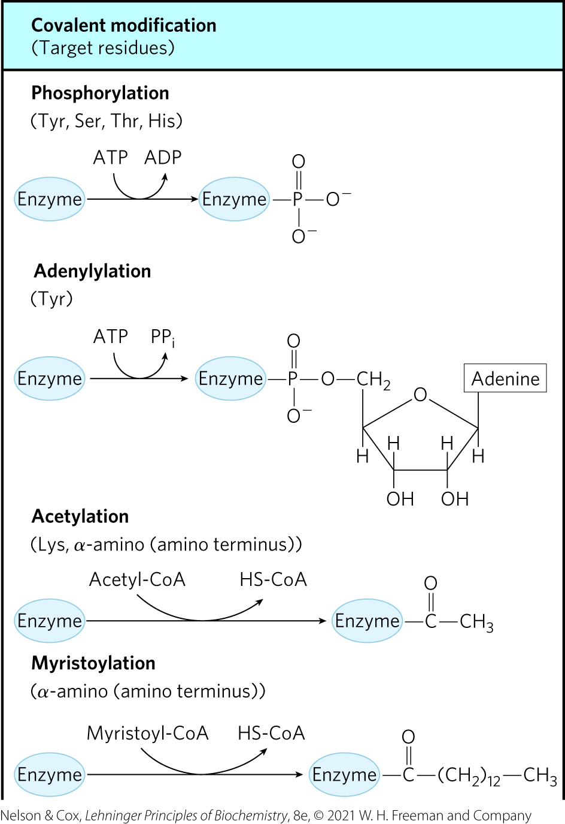
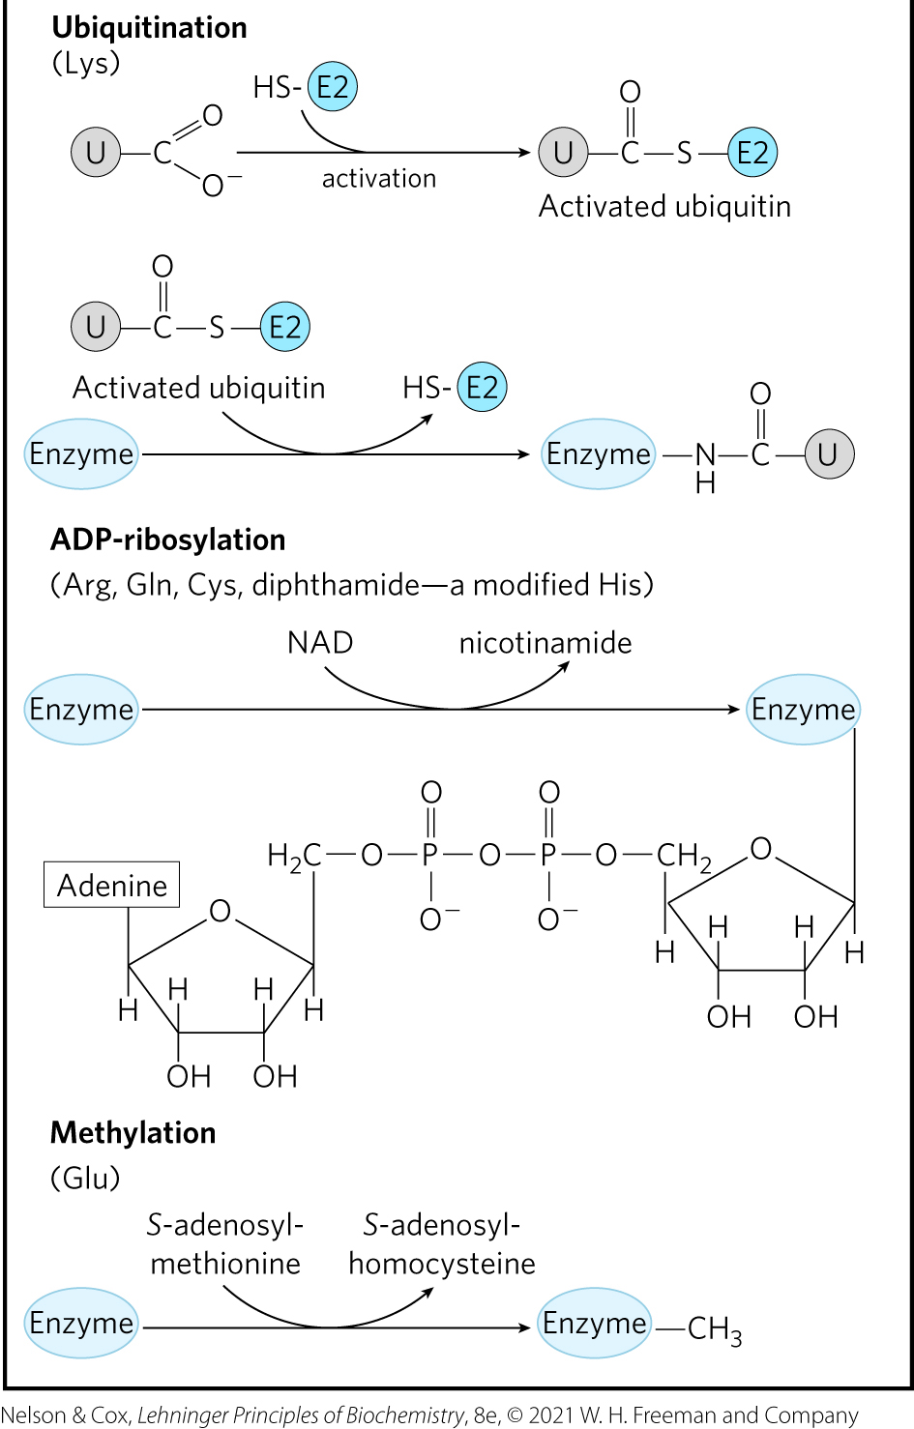
Some Enzymes Are Regulated by Reversible Covalent Modification

Slide 87
Phosphoryl Groups Affect the Structure and Catalytic Activity of Enzymes
protein kinases = catalyze the attachment of phosphoryl groups to specific amino acid residues (Ser, Thr, Tyr, His)
phosphoprotein phosphatases = protein phosphatases = remove phosphoryl groups from the same target proteins

Slide 88
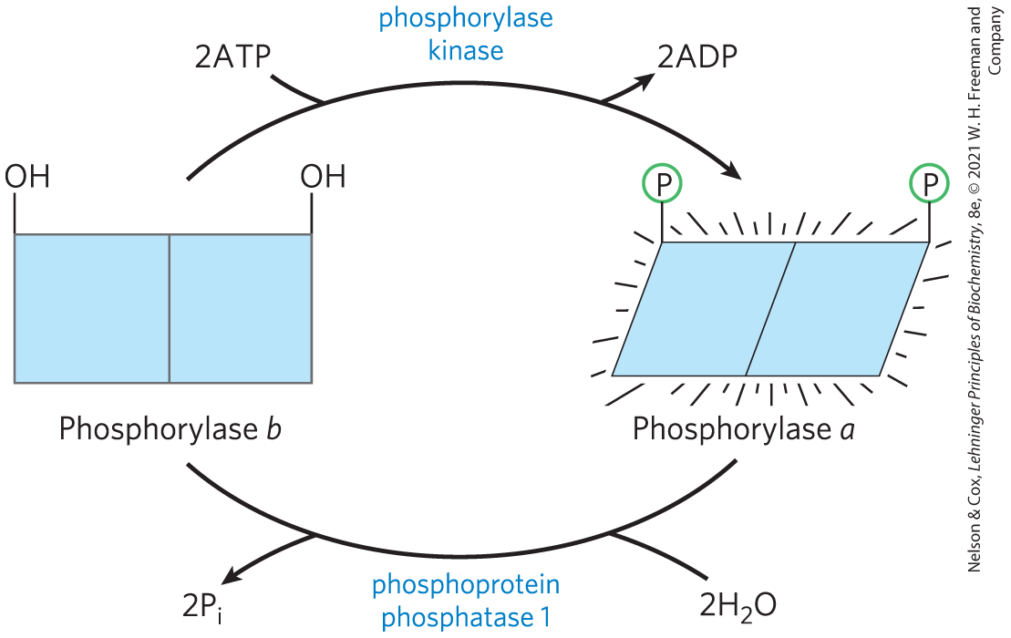

Regulation of Muscle Glycogen Phosphorylase Activity by Phosphorylation

Slide 89

Phosphorylation in Glycogen Phosphorylase Causes a Conformational Change

Slide 90
Multiple Phosphorylations Allow Exquisite Regulatory Control
residues that are typically phosphorylated in regulated proteins occur within common structural motifs (consensus sequences)

Slide 91
Common Recognition Sequences for Protein Kinases
Table 6-10 Consensus Recognition Sequences for a Few Protein Kinases
Protein kinase | Consensus sequence and phosphorylated residue
Protein kinase A | -x-R-[RK]-x-[ST]-B-
Protein kinase G | -x-R-[RK]-x-[ST]-X-
Protein kinase C | -[RK](2)-x-[ST]-B-[RK](2)-
Protein kinase B | R-x-x-R-x-[ST]-x-ψ-
Ca²⁺/calmodulin kinase I | -B-x-R-x(2)-[ST]-x(3)-B-
Ca²⁺/calmodulin kinase II | -B-x-[RK]-x(2)-[ST]-x(2)-
Myosin light chain kinase (smooth muscle) | -K(2)-R-x(2)-S-x-B(2)-
Phosphorylase b kinase | -K-R-K-Q-I-S-V-R-
Extracellular signal-regulated kinase (ERK) | -P-x-[ST]-P(2)
Cyclin-dependent protein kinase (cdc2) | -x-[ST]-P-x-[KR]-
Casein kinase I | -[SpTp]-x(2)-[ST]-B
Casein kinase II | -x-[ST]-x(2)-[ED]-x-
β-Adrenergic receptor kinase | -[DE](n)-[ST]-x(3)
Rhodopsin kinase | -x(2)-[ST]-E(n)-vABL-[YLV]-Y-X₁₋₃-[PF]-
Epidermal growth factor (EGF) receptor kinase | -E(4)-Y-F-E-L-V-
Notes:
See Table 6-10 in text for footnotes.

Slide 92

Multiple Regulatory Phosphorylations
provide the potential for extremely subtle modulation of enzyme activity
sequential phosphorylation processes can be hierarchical

Slide 93

Some Enzymes and Other Proteins Are Regulated by Proteolytic Cleavage of an Enzyme Precursor
zymogen = inactive precursor that is cleaved to form an active protease enzyme
proprotein or proenzyme = precursors that are cleaved to form other proteins

Slide 94
Some Regulatory Enzymes Use Several Regulatory Mechanisms
when chemical resources are plentiful, cells synthesize and store glucose and other metabolites
when chemical resources are scarce, cells use these stores to fuel cellular metabolism
the availability of specific catalysts allows for the regulation of these reactions

