Slide 1

4 The Three-Dimensional Structure of Proteins
© 2021 Macmillan Learning

Slide 2

Principle 1 (1 of 2)
Protein structures are stabilized by noncovalent interactions and forces. Formation of a thermodynamically favorable structure depends on the influences of the hydrophobic effect, hydrogen bonds, ionic interactions, and van der Waals forces. Natural protein structures are constrained by peptide bonds, whose configurations can be described by the dihedral angles φ and ψ.

Slide 3

Principle 2 (1 of 2)
Protein segments can adopt regular secondary structures such as the α helix and the β conformation. These structures are defined by particular values of φ and ψ and their formation is impacted by the amino acid composition of the segment. All of the φ and ψ values for a given protein structure can be visualized using a Ramachandran plot.

Slide 4

Principle 3 (1 of 2)
Tertiary structure describes the well-defined, three-dimensional fold adopted by a protein. Protein structures are often built by combinatorial use of common protein folds or motifs. Quaternary structure describes the interactions between components of a multisubunit assembly.

Slide 5

Principle 4 (1 of 2)
Tertiary structure is determined by amino acid sequence. Even though protein folding is complex, some denatured proteins can spontaneously refold into their active conformation based only on the chemical properties of their constituent amino acids. Cellular proteostasis involves numerous pathways that regulate the folding, unfolding, and degradation of proteins. Many human diseases arise from protein misfolding and defects in proteostasis.

Slide 6

Principle 5 (1 of 2)
The three-dimensional structures of proteins can be defined. Structural biologists use a variety of instruments and computational methods to solve biomolecular structures. The choice of method may depend on factors such as the size of the protein being studied, its properties, or the desired resolution of the final structure.

Slide 7
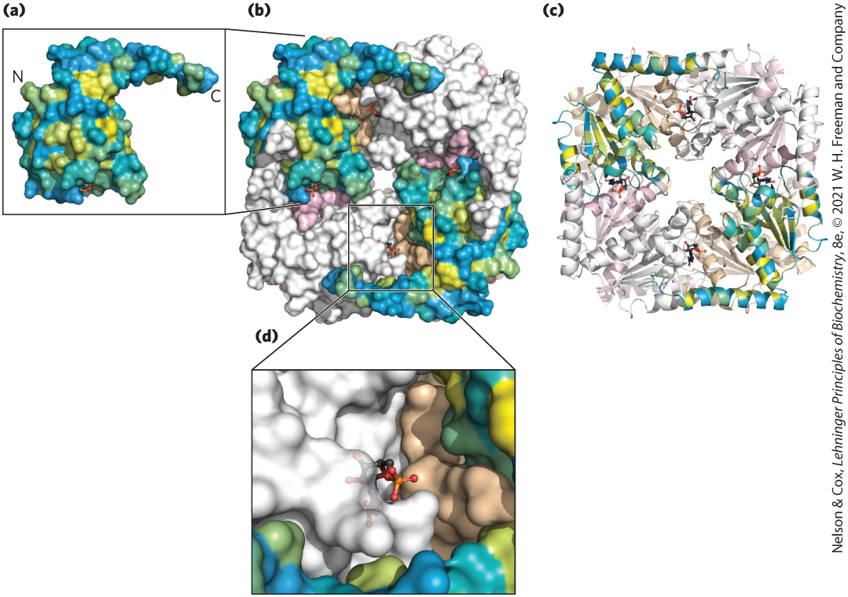
The Relationship between Protein Structure and Function
in principle, proteins can assume an uncountable number of special arrangements, or conformations
chemical or structural functions relate to unique three-dimensional structures

Slide 8
4.1 Overview of Protein Structure

Slide 9
Principle 1 (2 of 2)
Protein structures are stabilized by noncovalent interactions and forces. Formation of a thermodynamically favorable structure depends on the influences of the hydrophobic effect, hydrogen bonds, ionic interactions, and van der Waals forces. Natural protein structures are constrained by peptide bonds, whose configurations can be described by the dihedral angles φ and ψ.

Slide 10
Protein Conformations
limited number of conformations predominate under biological conditions
conformations = thermodynamically the most stable, that is, lowest free energy (G)
native = proteins in any functional, folded conformations

Slide 11
A Protein’s Conformation Is Stabilized Largely by Weak Interactions
stability = tendency of a protein to maintain a native conformation
unfolded proteins have high conformational entropy
chemical interactions stabilize native conformations:
  strong disulfide (covalent) bonds are uncommon
  weak (noncovalent) interactions and forces are numerous
    hydrogen bonds
    hydrophobic effect
    ionic interactions

Slide 12
Packing of Hydrophobic Amino Acids Away from Water Favors Protein Folding
hydrophobic effect = predominating weak interaction
solvation layer = highly structured shell of H₂O around a hydrophobic molecule
  decreases when nonpolar groups cluster together
  decrease causes a favorable increase in net entropy
hydrophobic R chains form a hydrophobic protein core

Slide 13
Polar Groups Contribute Hydrogen Bonds and Ion Pairs to Protein Folding
repeating secondary structures (α helices and β sheets) optimize hydrogen bonding
interaction of oppositely charged groups = ion pair = salt bridge
  strength increases in an environment of lower dielectric constant, ε
    polar aqueous solvent: ε ~ 80
    nonpolar protein interior: ε ~ 4

Slide 14
Individual van der Waals Interactions Are Weak but Combine to Promote Folding
van der Waals interactions = dipole-dipole interactions over short distances
individual interactions contribute little to overall protein stability
high number of interactions can be substantial

Slide 15
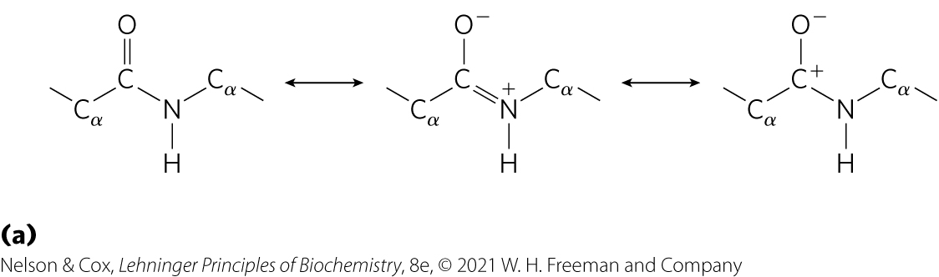
The Peptide Bond Is Rigid and Planar
3 covalent bonds separate the α carbons of adjacent amino acid residues: C_{α} —C—N—C_{α}
resonance between the carbonyl oxygen and the amide nitrogen
partial negative charge and partial positive charge sets up a small electric dipole

Slide 16
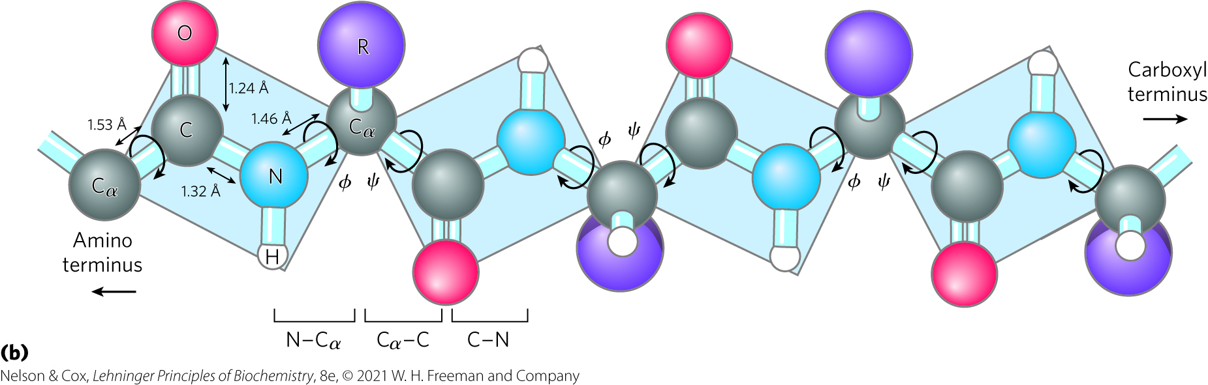
Peptide C—N Bonds Cannot
Rotate Freely
6 atoms of the peptide group lie in a single plane
partial double-bond character of C—N peptide bond prevents rotation, limiting range of conformations

Slide 17
4.2 Protein Secondary Structure

Slide 18
Principle 2 (2 of 2)
Protein segments can adopt regular secondary structures such as the α helix and the β conformation. These structures are defined by particular values of φ and ψ and their formation is impacted by the amino acid composition of the segment. All of the φ and ψ values for a given protein structure can be visualized using a Ramachandran plot.

Slide 19
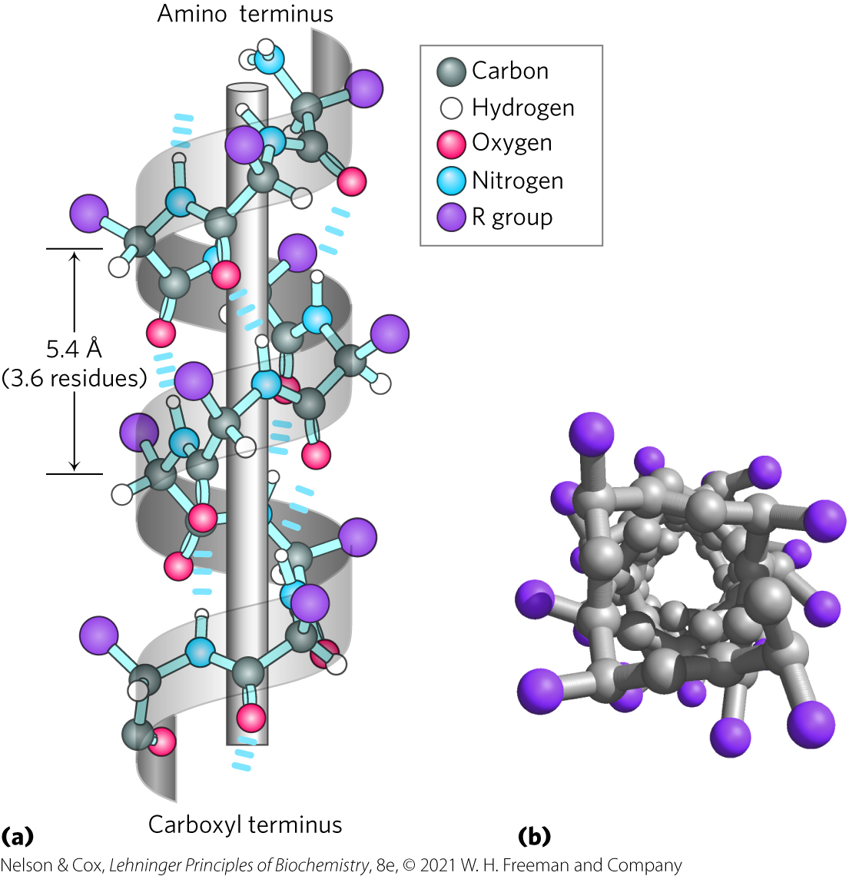
The α Helix Is a Common Protein Secondary Structure
α helix = simplest arrangement, maximum number of hydrogen bonds
  backbone wound around an imaginary longitudinal axis
  R groups protrude out from the backbone
  each helical turn = 3.6 residues, ∼5.4 Å

Slide 20
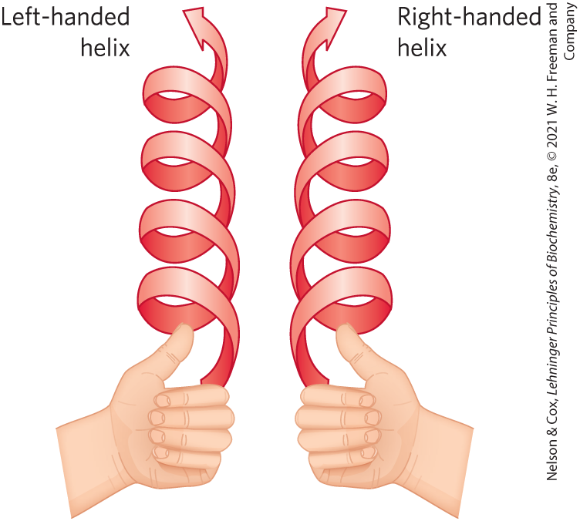
Handedness of the α Helix
right-handed:
  R groups protruding away from the helical backbone
  most common
extended left-handed: theoretically less stable, not observed in proteins

Slide 21
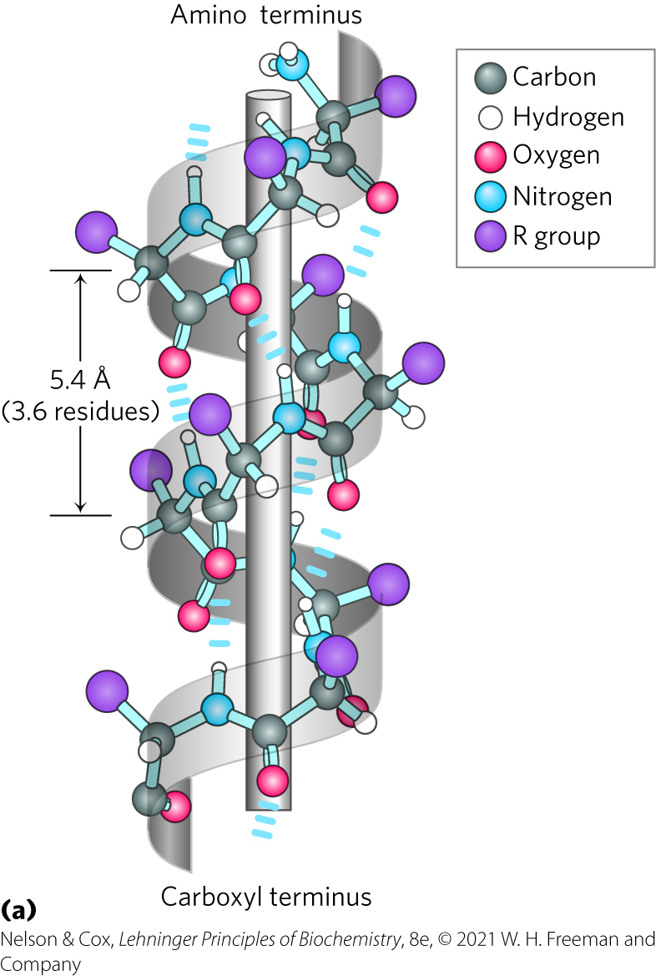
Intrahelical Hydrogen Bonds
between hydrogen atom attached to the electronegative nitrogen atom of residue n and the electronegative carbonyl oxygen atom of residue n + 4
confers significant stability
n + 4
n
Notes:
Helical backbone is held together by hydrogen bonds between the backbone amides of an n and n + 4 amino acids.

Slide 22
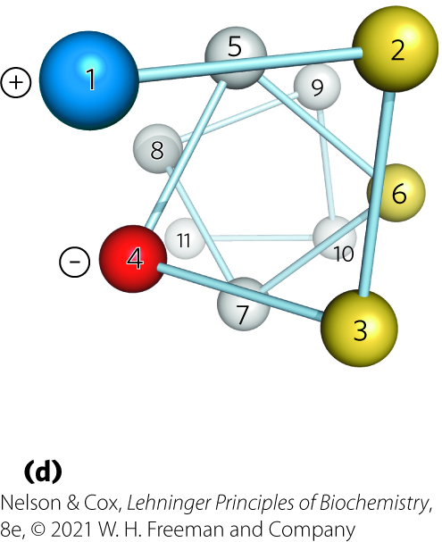
Amino Acid Sequence Affects Stability of the α Helix
amino acid residues have an intrinsic propensity to form an α helix
interactions between R chains spaced 3–4 residues apart can stabilize or destabilize α helix
  charge, size, and shape of R chains can destabilize
  formation of ion pairs and hydrophobic effect can stabilize
Helical wheel

Slide 23
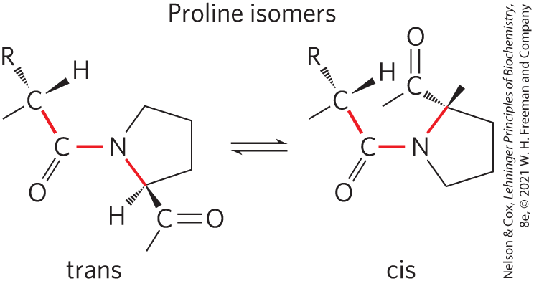
Proline and Glycine Occur Infrequently in an α Helix
proline = introduces destabilizing kink in helix
  nitrogen atom is part of rigid ring
  rotation about N—C_{α} bond not possible
glycine = high conformational flexibility, take up coiled structures

Slide 24
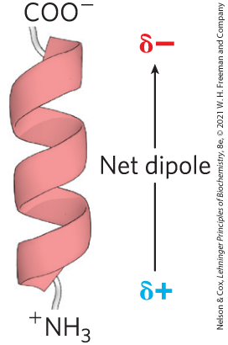
Amino Acid Residues Near the End of the α Helix Segment Affect Stability
small electric dipoles in each peptide bond align through hydrogen bonds
negatively charged amino acids often found near the NH₃⁺ terminus
positively charged amino acids often found near the COO– terminus

Slide 25
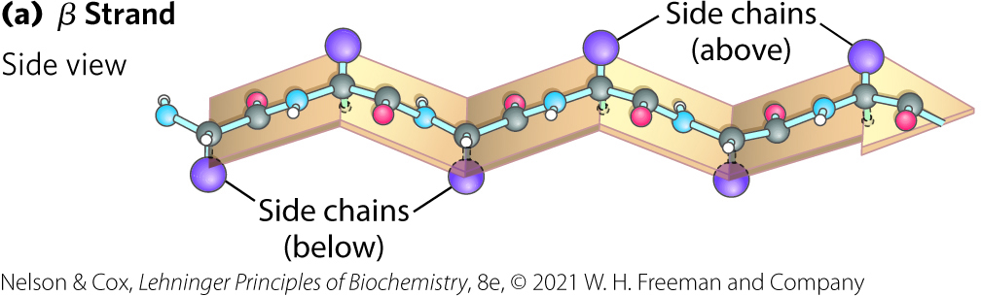
The β Conformation Organizes Polypeptide Chains into Sheets
β conformation = backbone extends into a zigzag
  β strand = single protein segment
  β sheet = several strands in β conformation side by side

Slide 26
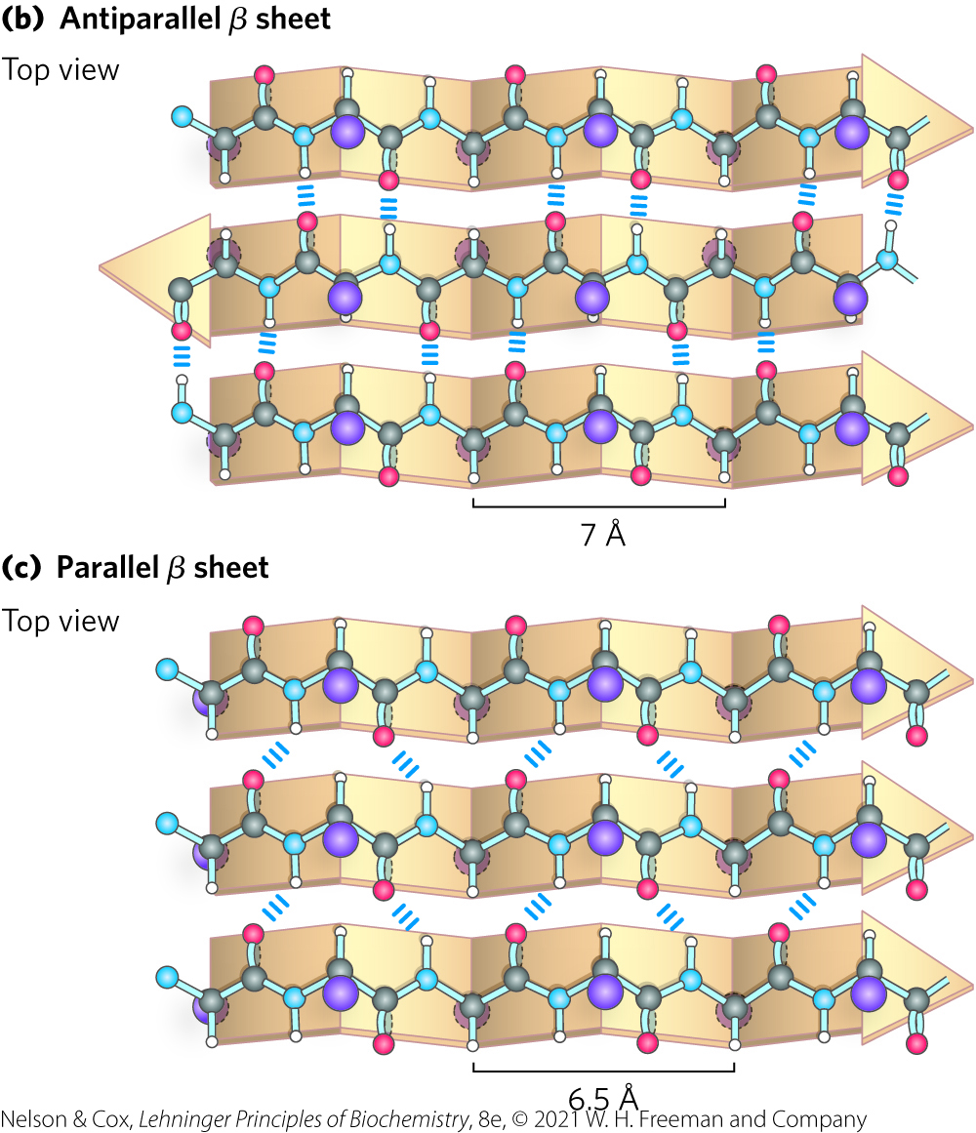
Adjacent Polypeptide Chains in a β Sheet Can Be Antiparallel or Parallel
antiparallel = opposite orientation
  occur more frequently
parallel = same orientation
H bonds form between backbone atoms of adjacent segments

Slide 27
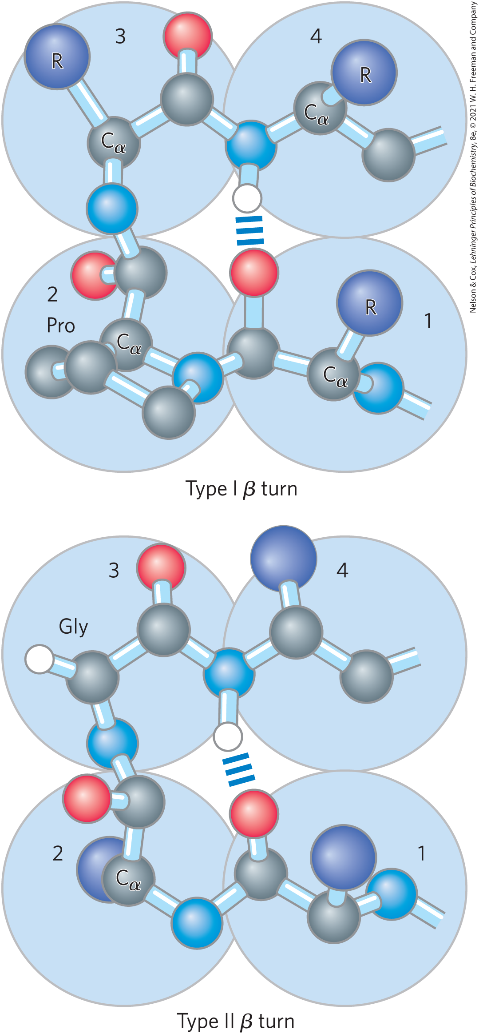
β Turns Are Common in Proteins
β turns = connect ends of two adjacent segments of an antiparallel β sheet
  180° turn
  involves 4 residues
  hydrogen bond forms between first and fourth residue
  Gly (residue 2) and Pro (residue 3) often occur in β turns

Slide 28
4.3 Protein Tertiary and Quaternary Structures

Slide 29
Principle 3 (2 of 2)
Tertiary structure describes the well-defined, three-dimensional fold adopted by a protein. Protein structures are often built by combinatorial use of common protein folds or motifs. Quaternary structure describes the interactions between components of a multisubunit assembly.

Slide 30
Protein Tertiary and Quaternary Structure
tertiary structure = overall three-dimensional arrangement of all the atoms in a protein
  weak interactions and covalent bonds hold interacting segments in position
quaternary structure = arrangement of 2+ separate polypeptide chains in three-dimensional complexes

Slide 31
Classifying Proteins
four major types of protein groups based on polypeptide chains:
  fibrous proteins = arranged in long strands or sheets
  globular proteins = folded into a spherical or globular shape
  membrane proteins = embedded in hydrophobic lipid membranes
  intrinsically disordered proteins = lacking stable tertiary structures

Slide 32
Fibrous Proteins Are Adapted for a Structural Function
give strength and/or flexibility to structures
simple repeating element of secondary structure
H₂O insoluble due to high concentrations of hydrophobic residues
Table 4-2 Secondary Structures and Properties of Some Fibrous Proteins
Structure | Characteristics | Examples of occurrence
α Helix, cross-linked by disulfide bonds | Tough, insoluble protective structures of varying hardness and flexibility | α-Keratin of hair, feathers, nails
β Conformation | Soft, flexible filaments | Silk fibron
Collagen triple helix | High tensile strength, without stretch | Collagen of tendons, bone matrix

Slide 33
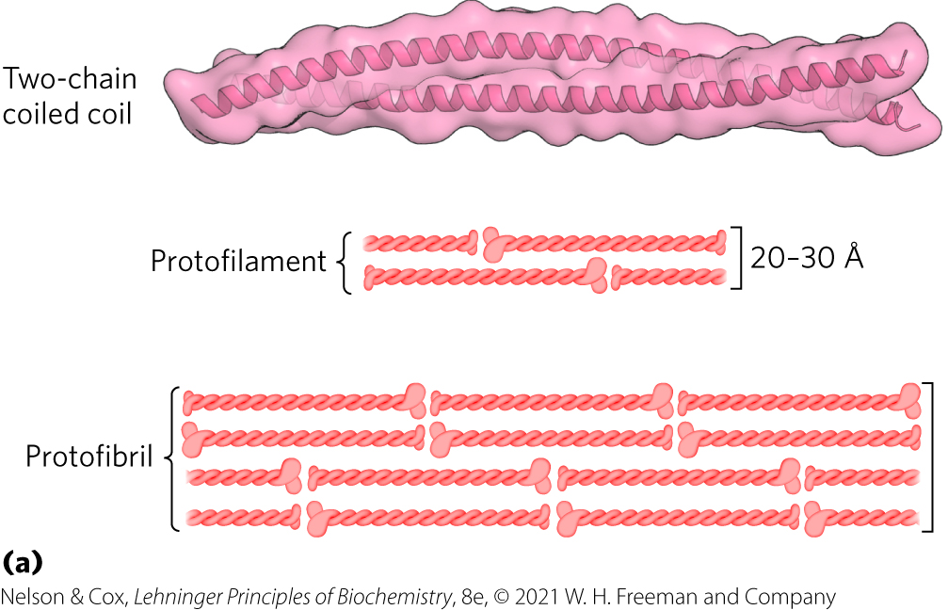
The Structure of α-Keratin in Hair
α-keratin helix is a right-handed α helix
two strands of α-keratin, oriented in parallel, wrap about each other to form a supertwisted coiled coil
  supertwisted helical path is left-handed

Slide 34
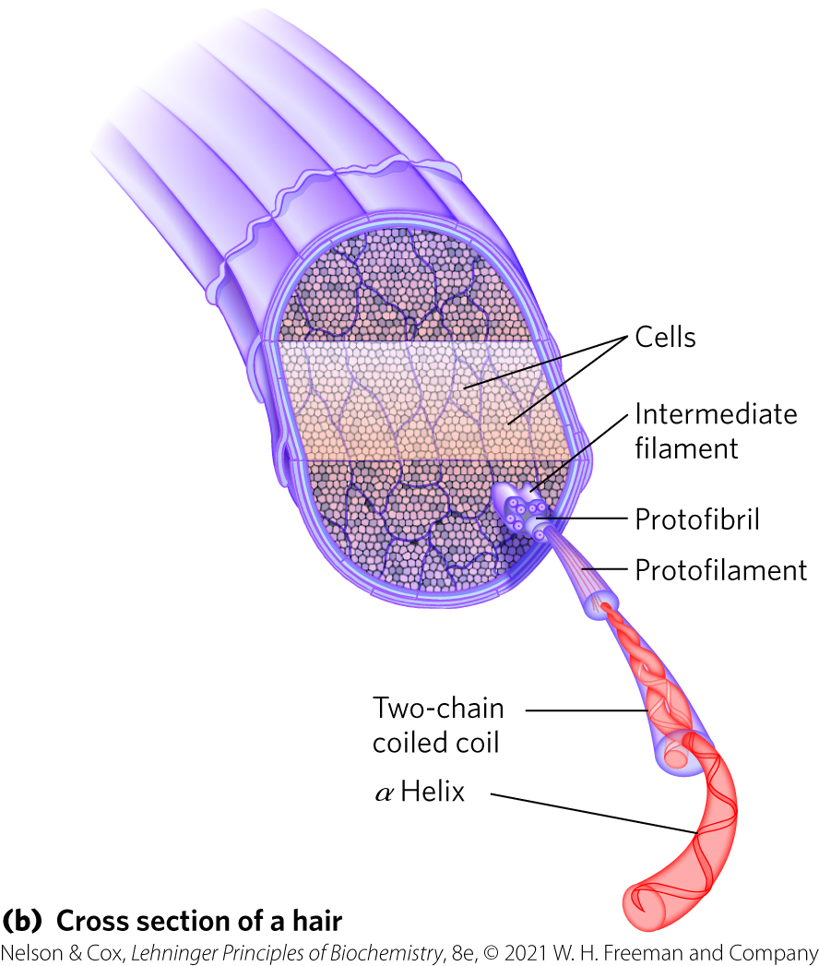
Hair Contains Many α-Keratin Filaments
rich in hydrophobic residues: Ala, Val, Leu, Ile, Met, Phe
cross-links stabilized by disulfide bonds

Slide 35
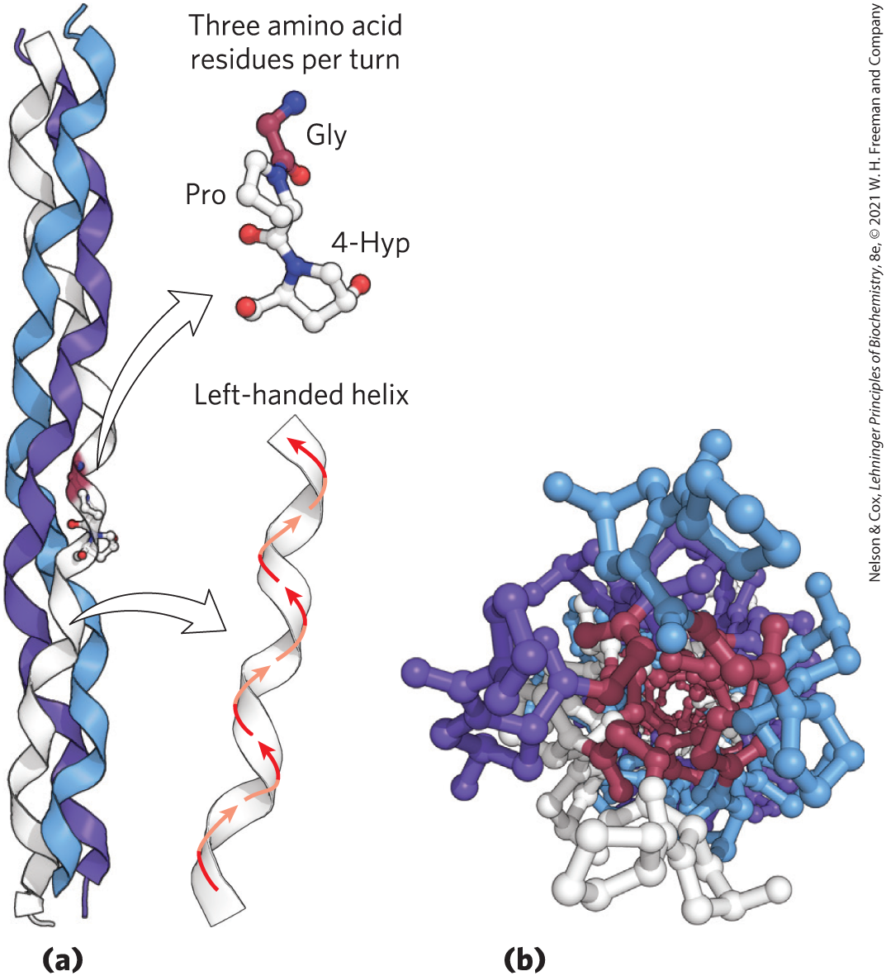
The Structure of Collagen
collagen = found in connective tissue
  secondary structure = left-handed, repeating tripeptide unit Gly–X–Y, where X is often Pro and Y is often 4-Hyp
  tertiary and quaternary structure = right-handed twisting of 3 separate polypeptides

Slide 36
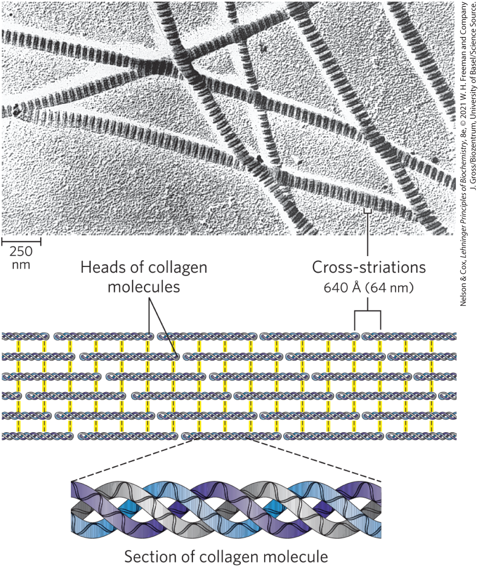
The Structure of Collagen Fibrils

Slide 37
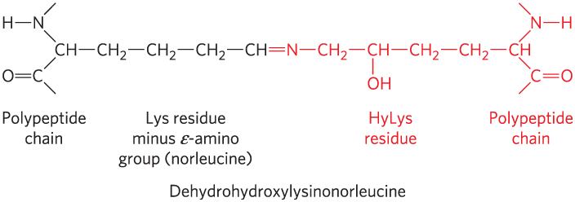
Covalent Cross-Links in
Collagen Fibrils
cross-linked by covalent bonds involving Lys, HyLys (5-hydroxylysine), or His
  links create uncommon amino acid residues

Slide 38
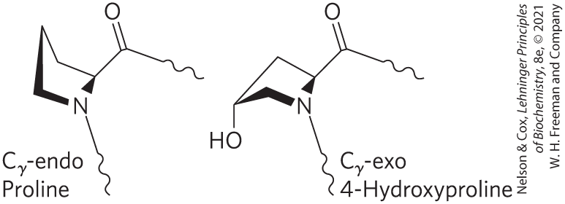
Scurvy, Vitamin C, and Collagen Formation
scurvy is caused by a lack of vitamin C
  characterized by general degeneration of connective tissue
vitamin C is required for the hydroxylation of proline and lysine in collagen

Slide 39
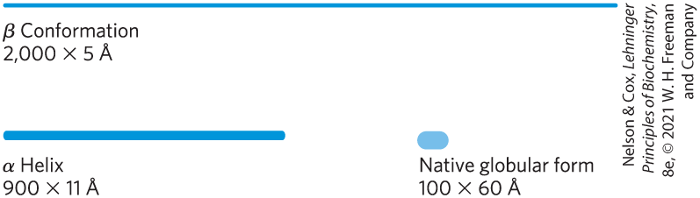
Structural Diversity Reflects Functional Diversity in Globular Proteins
globular proteins:
  fold back on each other
  more compact than fibrous proteins
  enzymes, transport proteins, motor proteins, regulatory proteins, immunoglobulins

Slide 40
The Protein Data Bank
The Protein Data Bank (PDB): www.rcsb.org
  archive of experimentally determined three-dimensional structures
  structures assigned an identifier called the PDB ID
  PDB data files describe:
    the spatial coordinates of each atom
    information on how the structure was determined
    information on its accuracy
  structure visualization software can convert atomic coordinates to an image of the molecule

Slide 41
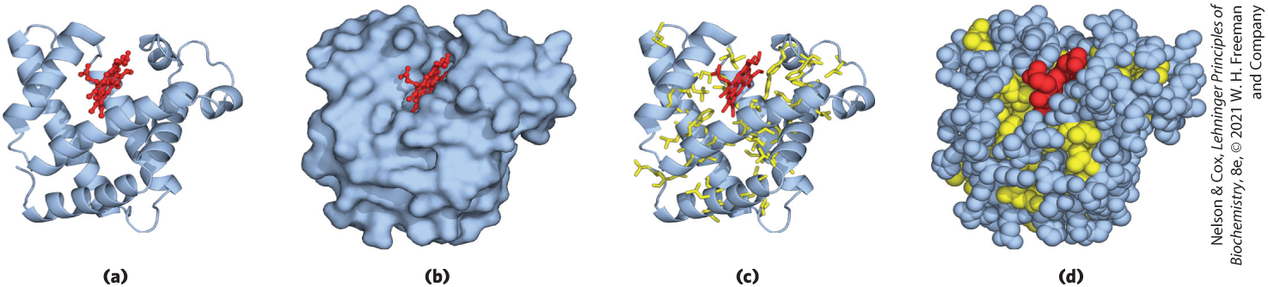
Myoglobin Provided Early Clues about the Complexity of Globular Protein Structure
several structural representations of myoglobin’s tertiary structure:
Binding pocket
α-Helical regions
Hydrophobic R chains

Slide 42
Globular Proteins Have a Variety of Tertiary Structures
Table 4-3 Approximate Proportion of α Helix and β Conformation in Some Single-Chain Proteins
each globular protein has a distinct structure, adapted for its biological function
Protein (total residues) | Residues (%): α Helix | Residues (%): β Conformation
Chymotrypsin (247) | 14 | 45
Ribonuclease (124) | 26 | 35
Carboxypeptidase (307) | 38 | 17
Cytochrome c (104) | 39 | 0
Lysozyme (129) | 40 | 12
Myoglobin (153) | 78 | 0
Notes:
See Table 4-3 in text for footnotes.

Slide 43
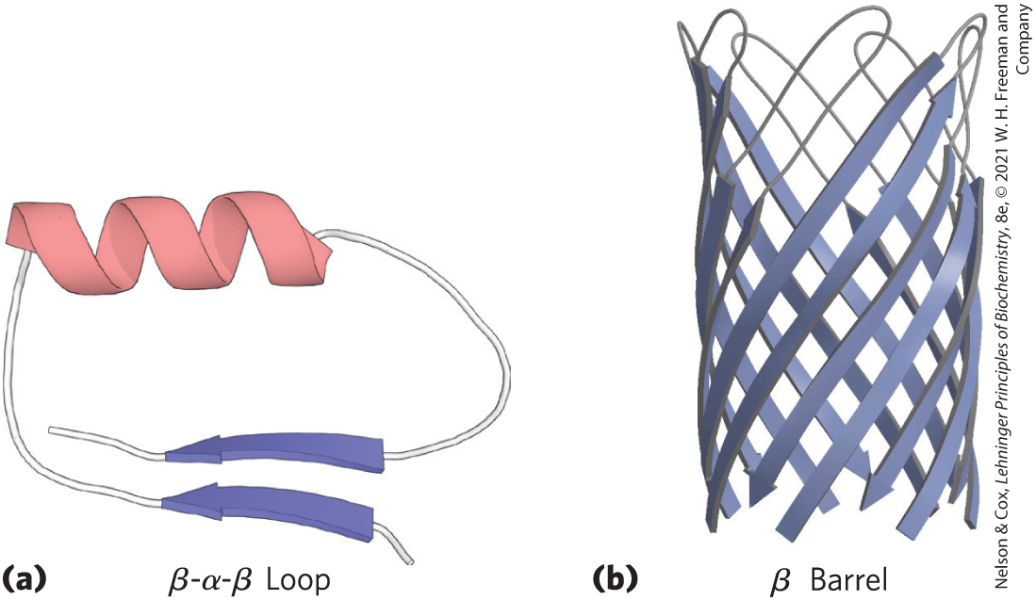
Folding Patterns of Proteins
motif = fold = recognizable folding pattern involving 2+ elements of secondary structures and the connection(s)
  can be simple, such as in a β-α-β loop
  can be elaborate, such as in a β barrel

Slide 44
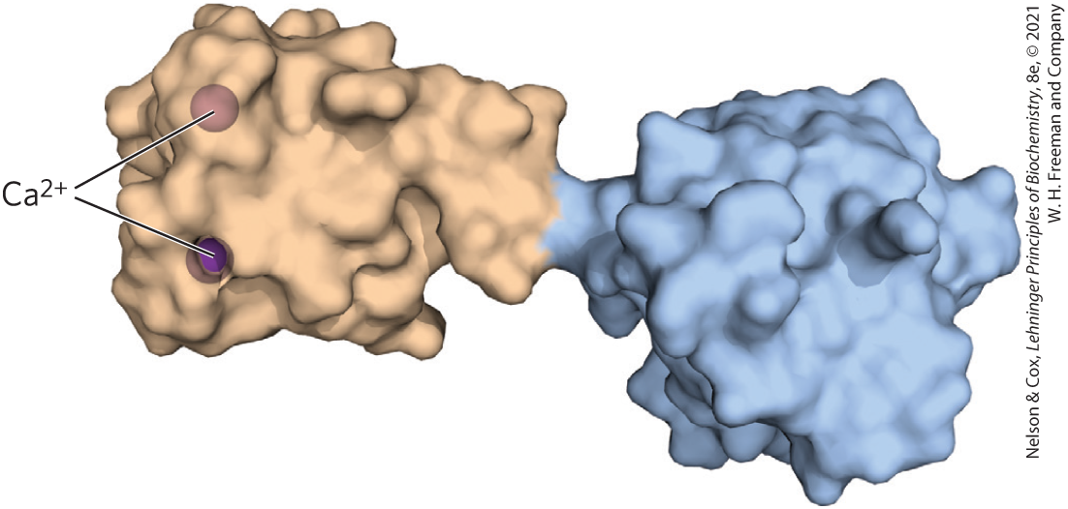
Protein Domains
domain = part of a polypeptide chain that is independently stable or could undergo movements as a single entity
  domains may appear as distinct or be difficult to discern
  small proteins usually have only one domain

Slide 45
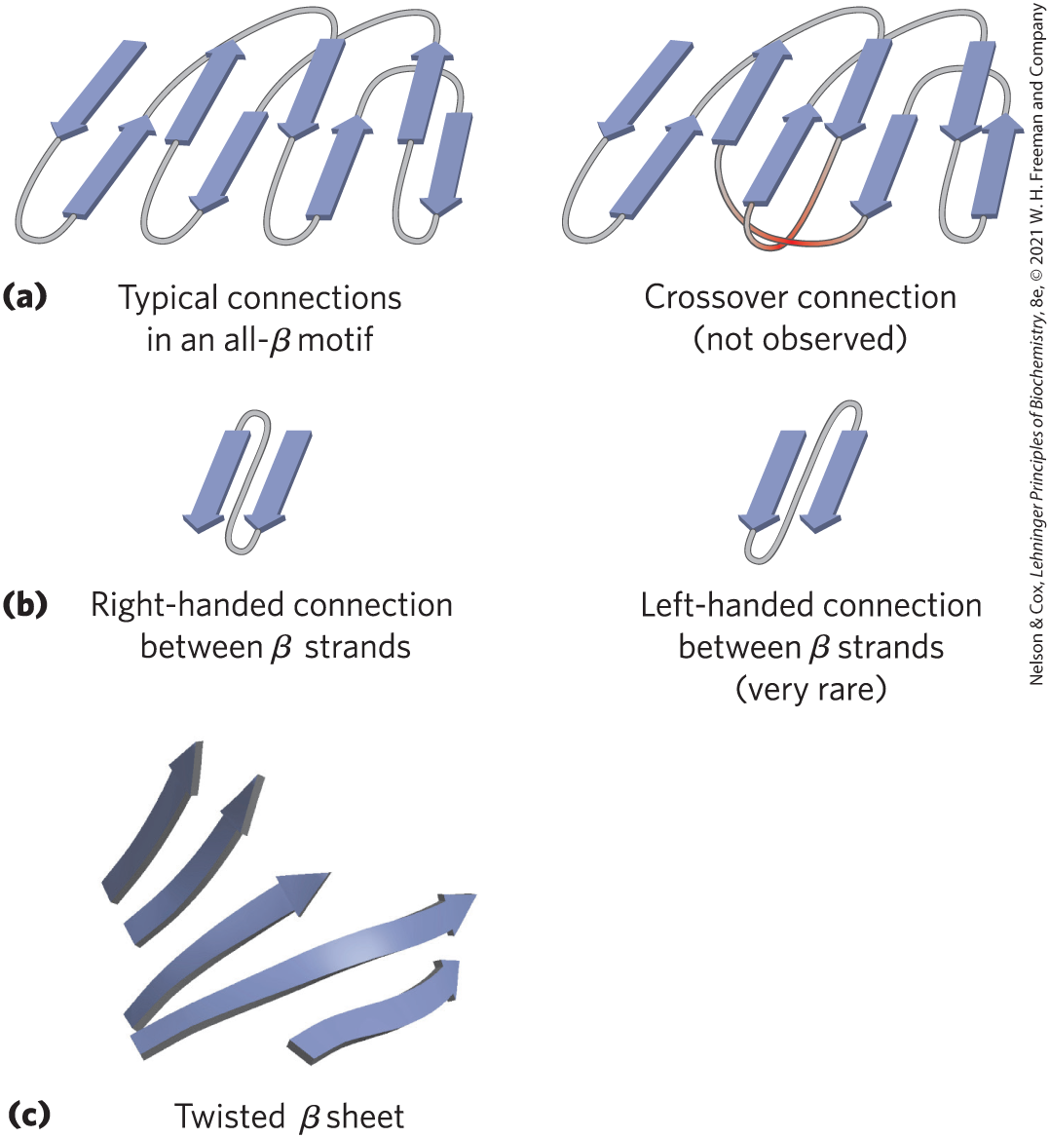
Protein-Folding Rules
burial of hydrophobic R groups requires 2+ layers of secondary structure
α helices and β sheets are found in different layers
adjacent amino acid segments are usually stacked adjacent
the β conformation is most stable with right-handed connections

Slide 46
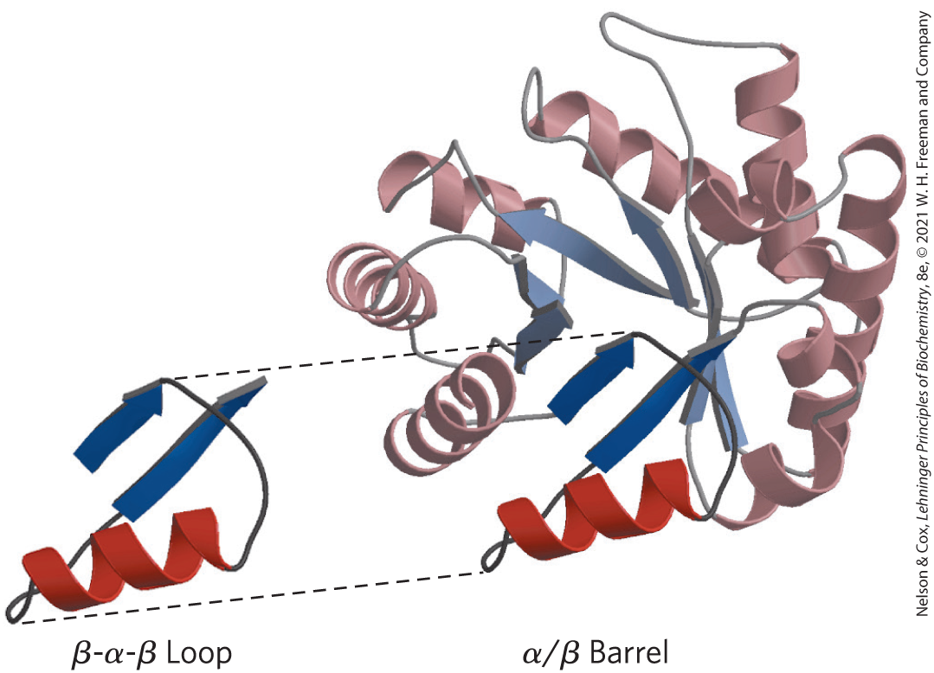
Complex Motifs Are Built from Simple Motifs
α/β barrel = series of β-α-β loops arranged such that the β strands form a barrel

Slide 47
Some Proteins or Protein Segments Are Intrinsically Disordered
intrinsically disordered proteins:
  lack definable structure
  often lack a hydrophobic core
  high densities of charged residues (Lys, Arg, Glu) and Pro
  facilitates a protein to interact with multiple binding partners

Slide 48
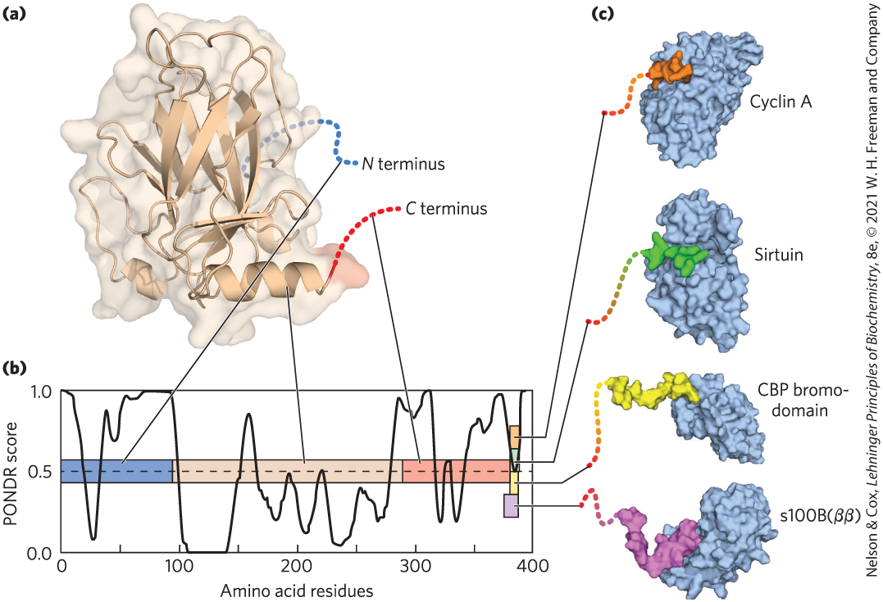
Intrinsically Disordered Segments Can Assume Different Structures

Slide 49
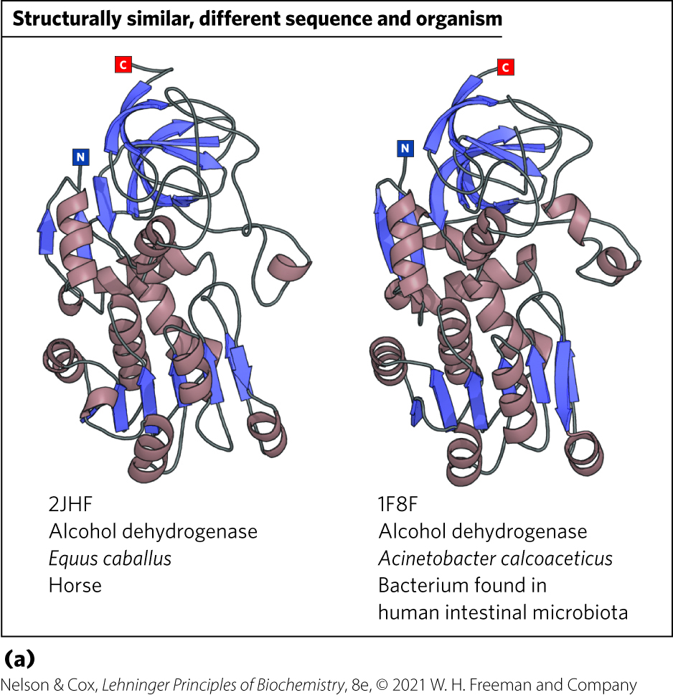
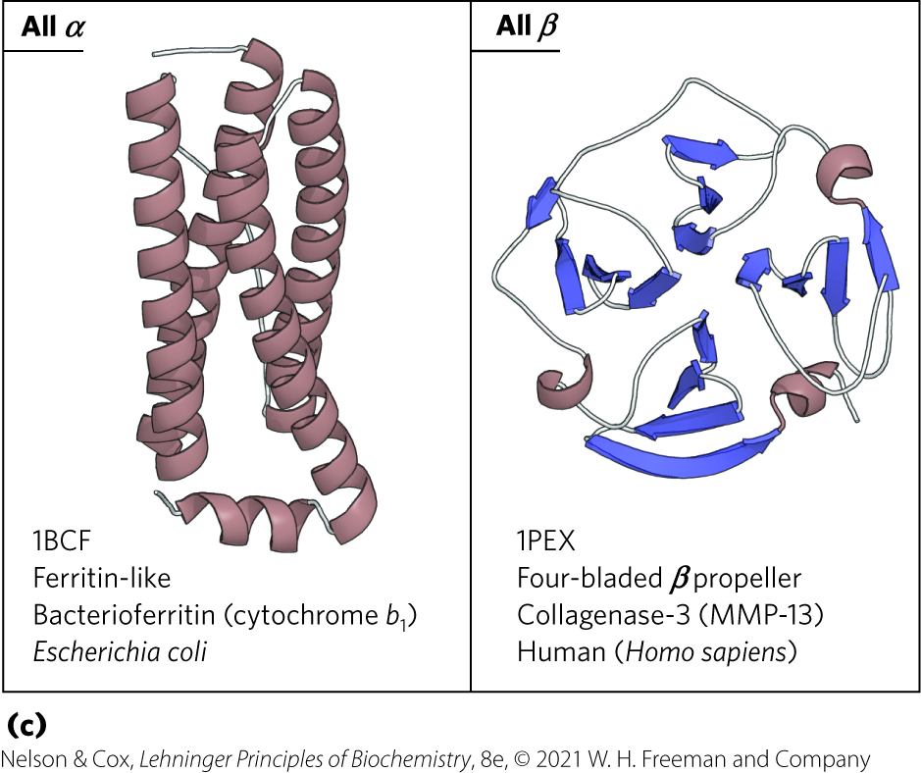
Protein Motifs Are the Basis for Protein Structural Classification
Protein Data Bank (PDB) = 150,000+ structures archived
Structural Classification of Proteins database (SCOP2) = searches protein information in the PDB

Slide 50
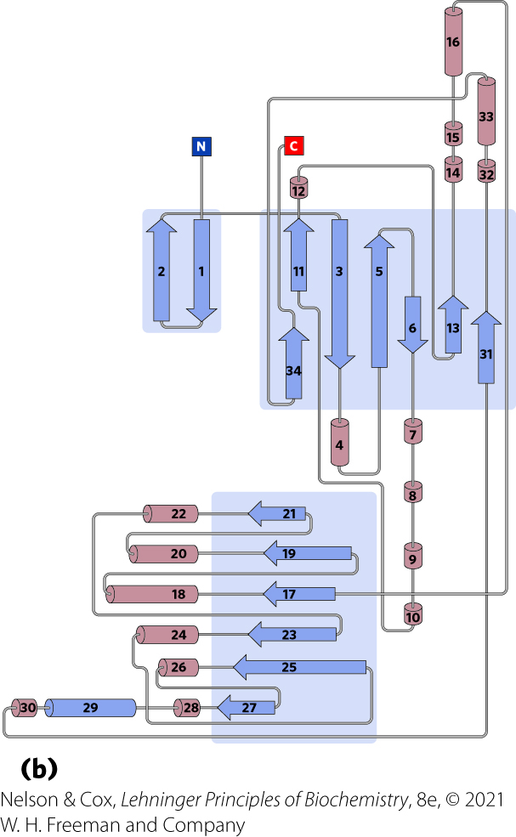
Topology Diagrams
topology diagram = represent elements of secondary structure and the relationships among segments of secondary structure in a protein

Slide 51
Protein Families and Superfamilies
proteins with significant similarity in primary structure and/or tertiary structure and function are in the same protein family
  ~4,000 different protein families in the PDB
  strong evolutionary relationship within a family
superfamilies = 2+ families that have little sequence similarity, but the same major structural motif and have functional similarities
  evolutionary relationship is probable

Slide 52
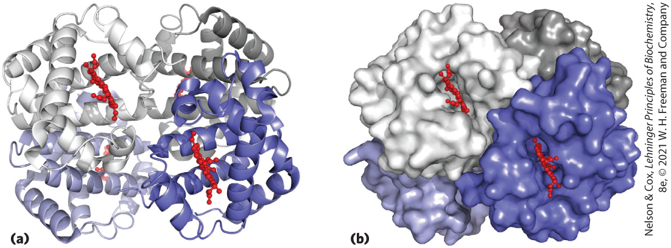
Protein Quaternary Structures Range from Simple Dimers to Large Complexes
quaternary structure = assembly of multiple peptide subunits
oligomer = multimer = multisubunit protein
  repeating structural unit = protomer

Slide 53
4.4 Protein Denaturation and Folding

Slide 54
Principle 4 (2 of 2)
Tertiary structure is determined by amino acid sequence. Even though protein folding is complex, some denatured proteins can spontaneously refold into their active conformation based only on the chemical properties of their constituent amino acids. Cellular proteostasis involves numerous pathways that regulate the folding, unfolding, and degradation of proteins. Many human diseases arise from protein misfolding and defects in proteostasis.

Slide 55
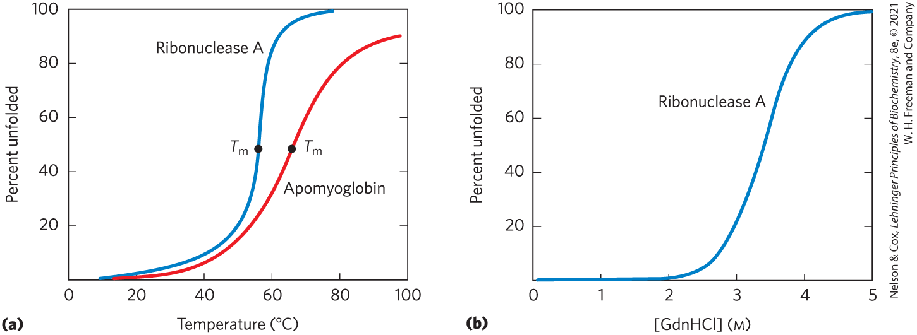
Loss of Protein Structure Results in Loss of Function
denaturation = loss of three-dimensional structure sufficient to cause loss of function
  can occur by heat, pH extremes, miscible organic solvents, certain solutes, detergents
  often leads to protein precipitation

Slide 56
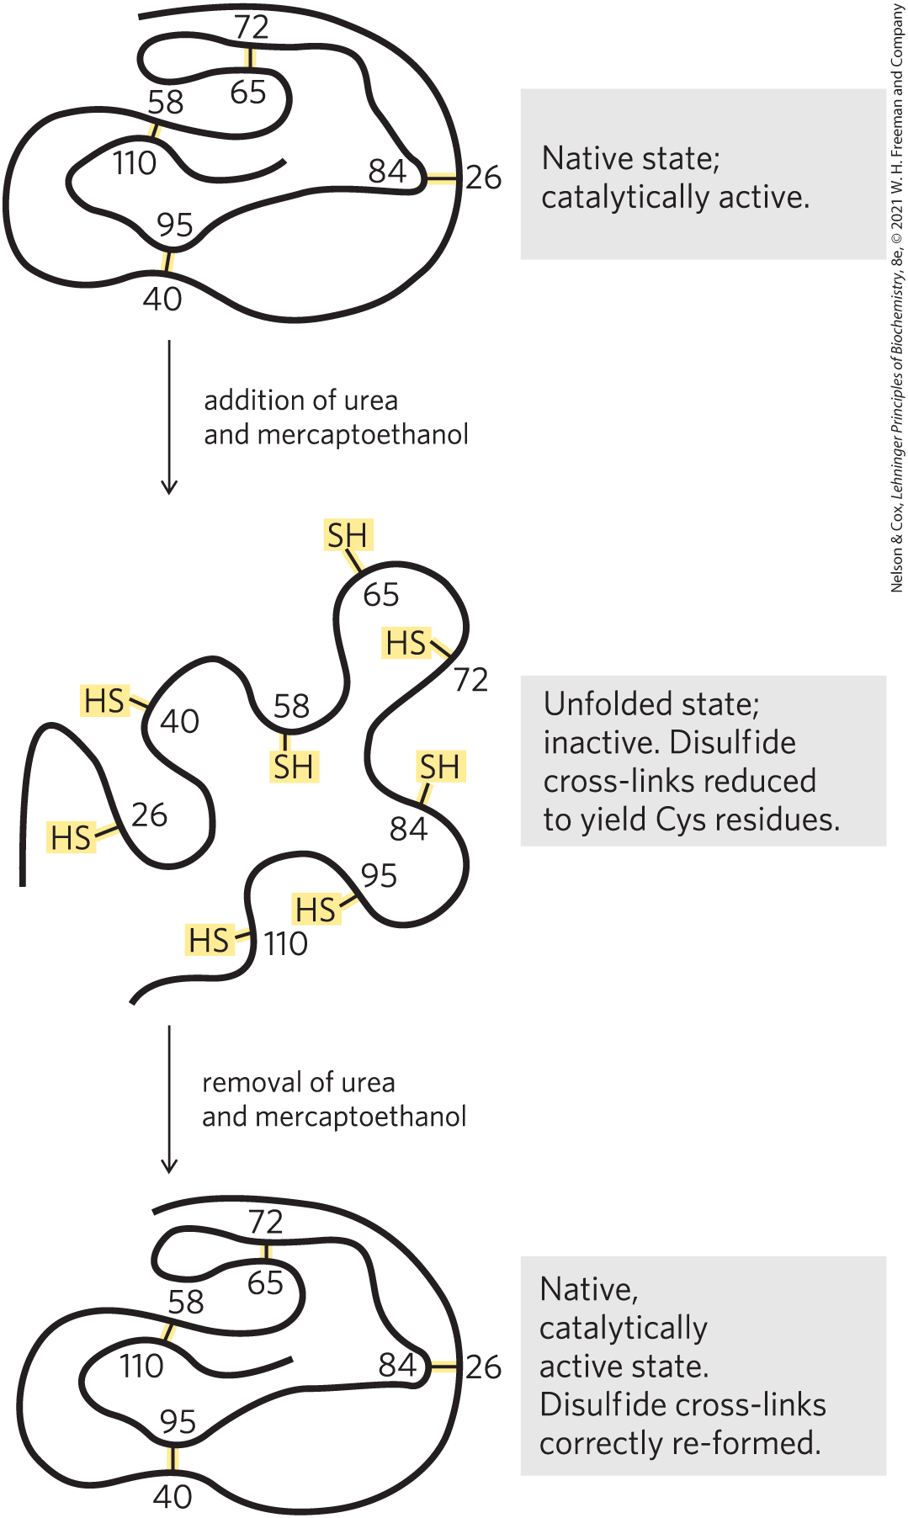
Amino Acid Sequence Determines Tertiary Structure
renaturation = process by which certain denatured globular proteins regain their native structure and biological activity
Anfinsen experiment showed the amino acid sequence contains all the information required to fold the chain

Slide 57
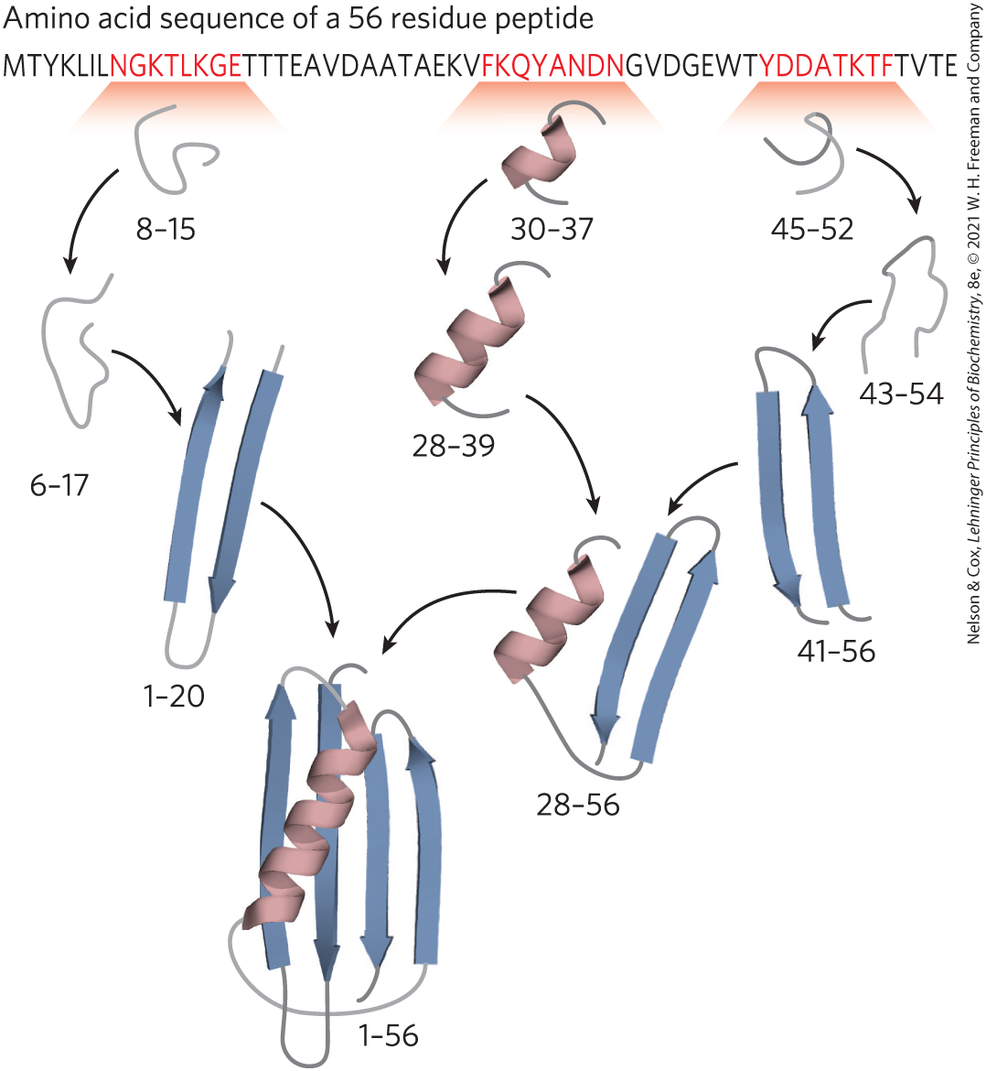
Polypeptides Fold Rapidly by a Stepwise Process
local secondary structures fold first
  ionic interactions play an important role
longer range interactions follow
  hydrophobic effect plays a significant role
process continues until the entire polypeptide folds

Slide 58
Defects in Protein Folding Are the Molecular Basis for Many Human Genetic Disorders
amyloid fiber = protein secreted in a misfolded state and converted to an insoluble extracellular fiber
amyloidose diseases: type 2 diabetes, Alzheimer disease, Huntington disease, and Parkinson disease

Slide 59
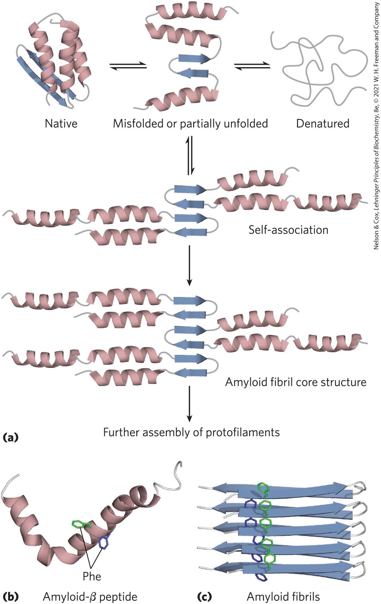
Formation of Disease-Causing Amyloid Fibrils
native = high degree of β-sheet structure
misfolded β amyloid promotes aggregation, forming an amyloid fibril

Slide 60
Neurodegenerative Conditions
Alzheimer disease = associated with extracellular amyloid deposition by neurons, involving the amyloid-β peptide
Parkinson disease = misfolded form α-synuclein aggregates into spherical filamentous masses called Lewy bodies
Huntington disease = involves the intracellular aggregation of huntingtin, a protein with long polyglutamine repeat

Slide 61
Cystic Fibrosis
cystic fibrosis = caused by defects in the membrane-bound protein cystic fibrosis transmembrane conductance regulator (CFTR)
  deletion of a Phe residue causes improper protein folding

Slide 62
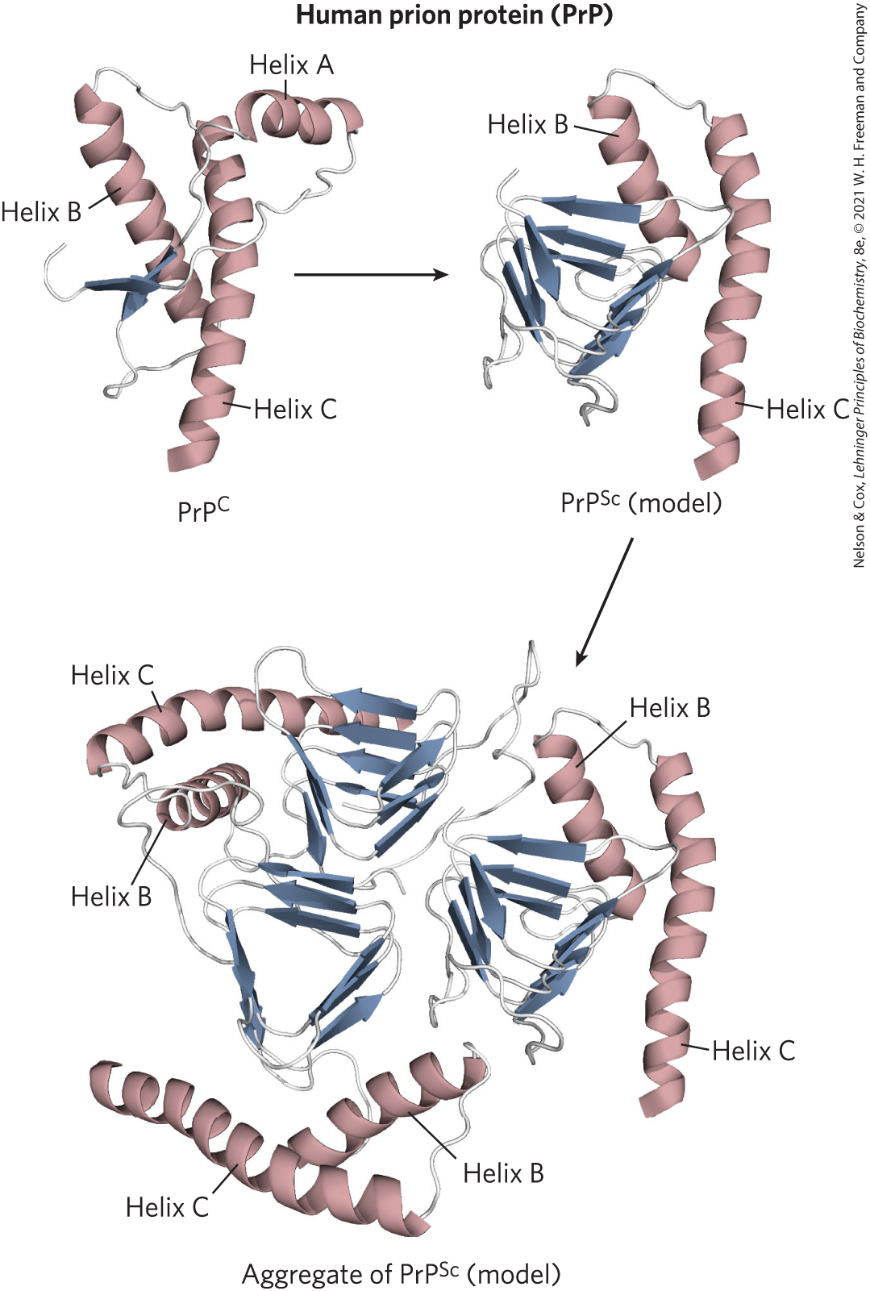
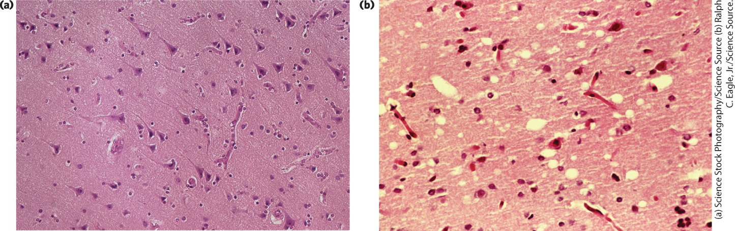
Death by Misfolding: The Prion Diseases
prion protein (PrP) = misfolded brain protein
Pyramidal cells in the human cerebral cortex
Comparable section from a patient with Creutzfeldt-Jakob disease

