Slide 1

3 Amino Acids, Peptides, and Proteins
© 2021 Macmillan Learning

Slide 2

Principle 1 (1 of 2)
In every living organism, proteins are constructed from a common set of 20 amino acids. Each amino acid has a side chain with distinctive chemical properties. Amino acids may be regarded as the alphabet in which the language of protein structure is written.

Slide 3

Principle 2 (1 of 3)
In proteins, amino acids are joined in characteristic linear sequences through a common amide linkage, the peptide bond. The amino acid sequence of a protein constitutes its primary structure, a first level we will introduce within the broader complexities of protein structure.

Slide 4

Principle 3 (1 of 2)
For study, individual proteins can be separated from the thousands of other proteins present in a cell, based on differences in their chemical and functional properties arising from their distinct amino acid sequences. As proteins are central to biochemistry, the purification of individual proteins for study is a quintessential biochemical endeavor.

Slide 5
3.1 Amino Acids

Slide 6
Principle 1 (2 of 2)
In every living organism, proteins are constructed from a common set of 20 amino acids. Each amino acid has a side chain with distinctive chemical properties. Amino acids may be regarded as the alphabet in which the language of protein structure is written.

Slide 7
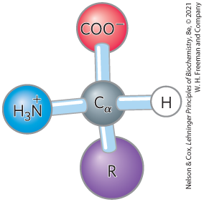
Amino Acids Share
Common Structural Features
α carbon and four substituents
α carbon is the chiral center
tetrahedral

Slide 8
Amino Acid Substituents
four substituents:
  a carboxyl group
  an amino group
  a hydrogen atom
  an R group (a side chain unique to each amino acid)
    glycine has a second hydrogen atom instead of an R group

Slide 9
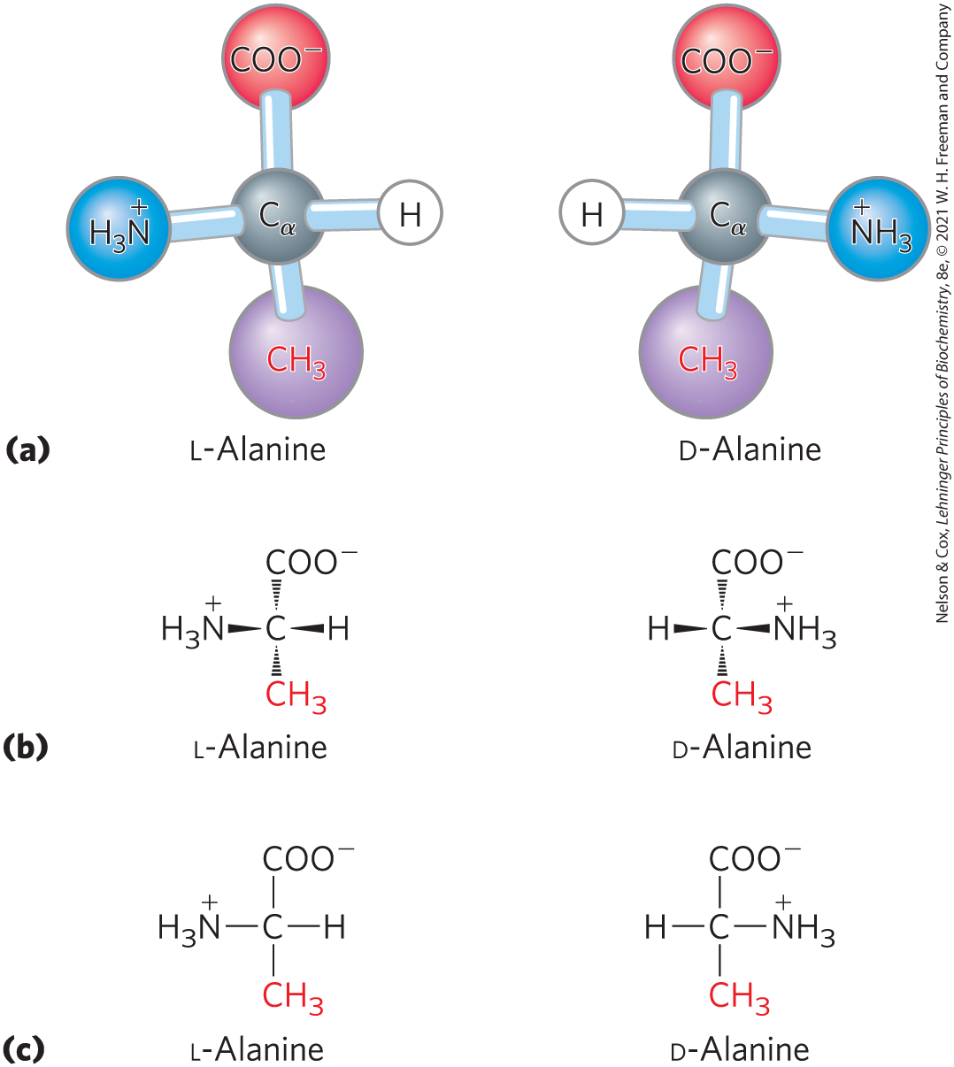
The Amino Acid Residues in
Proteins are L Stereoisomers
two possible stereoisomers = enantiomers
optically active
D, L system specifies absolute configuration

Slide 10
Amino Acids Can Be Classified by
R Group
five main classes:
  nonpolar, aliphatic (7)
  aromatic (3)
  polar, uncharged (5)
  positively charged (3)
  negatively charged (2)

Slide 11
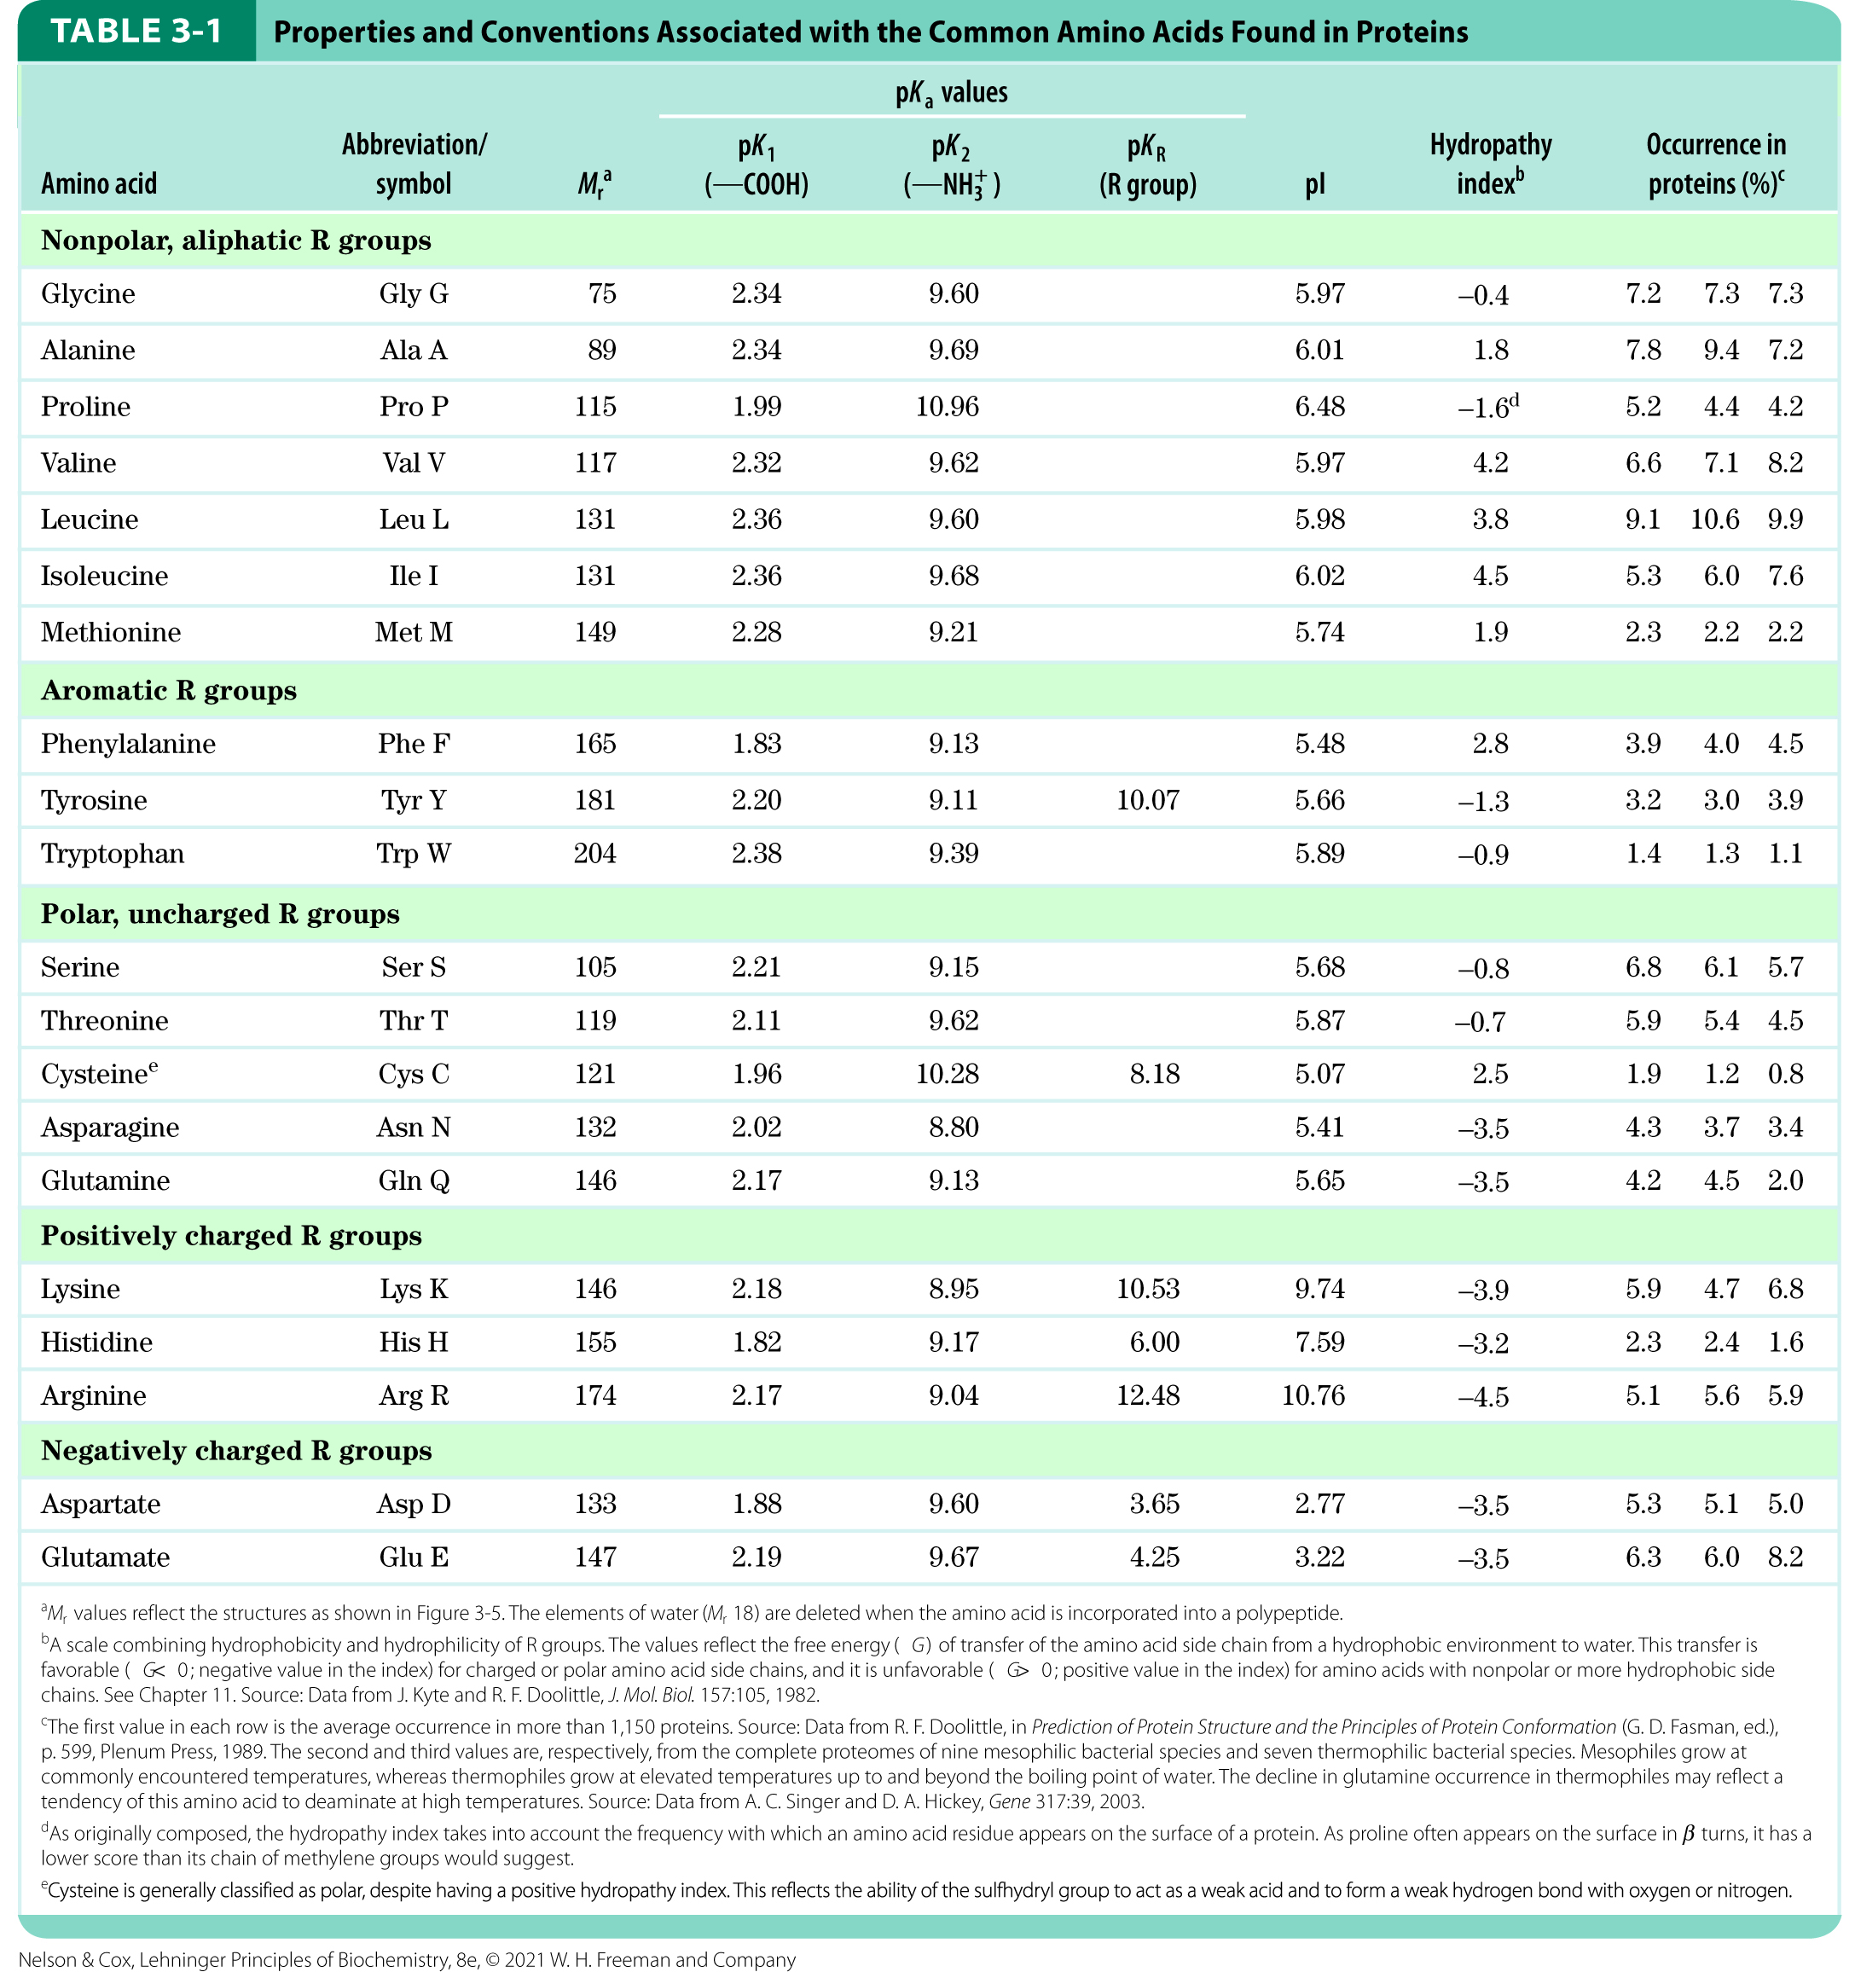
Table 3-1

Slide 12
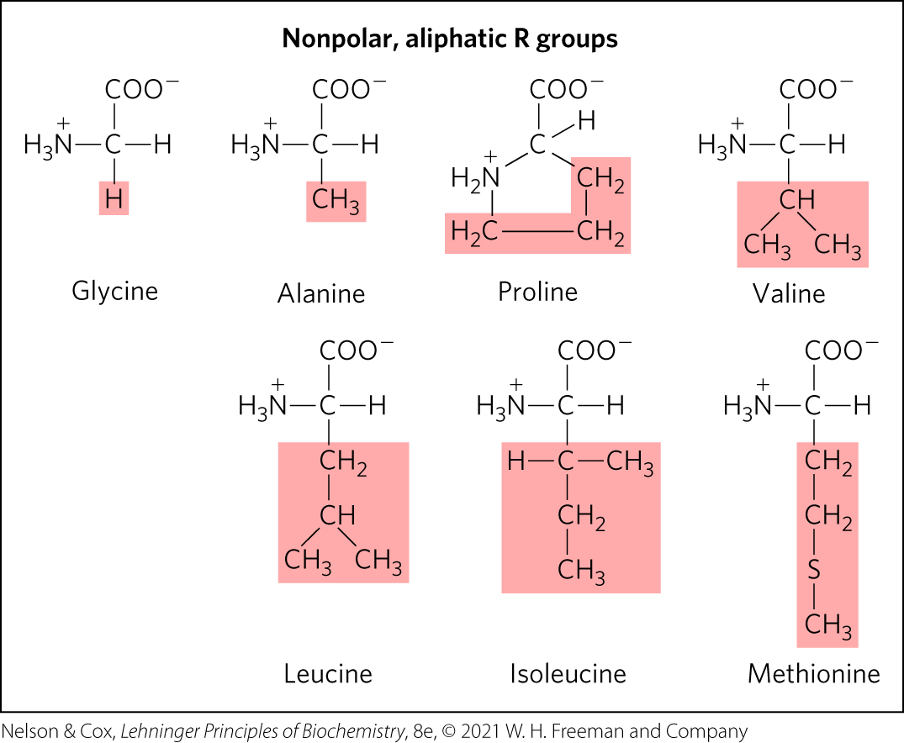
Nonpolar, aliphatic R groups
the hydrophobic effect stabilizes protein structure

Slide 13
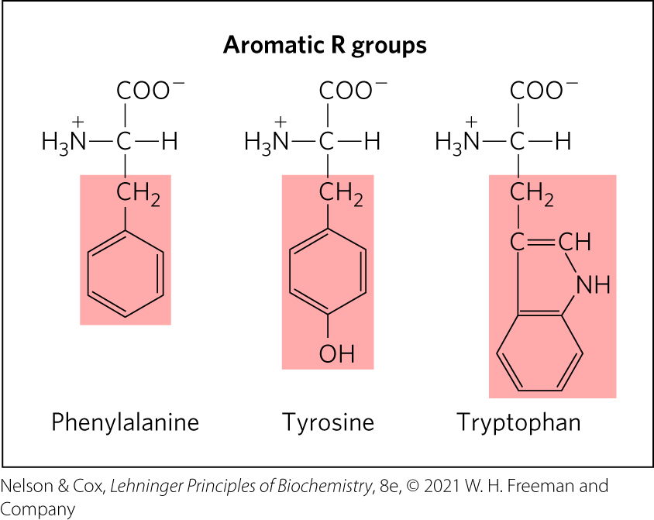
Aromatic R Groups
R groups absorb UV light at 270–280 nm
can contribute to the hydrophobic effect

Slide 14
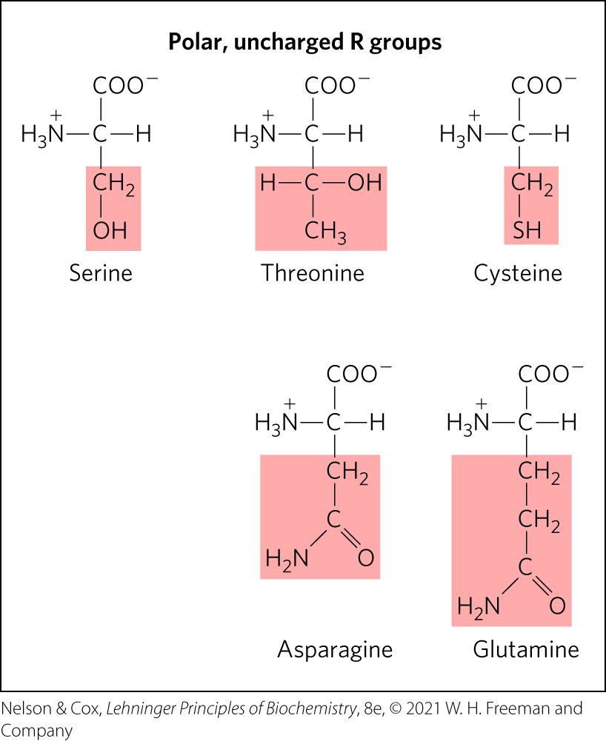
Polar, Uncharged R Groups
R groups can form hydrogen bonds
cysteine can form disulfide bonds

Slide 15
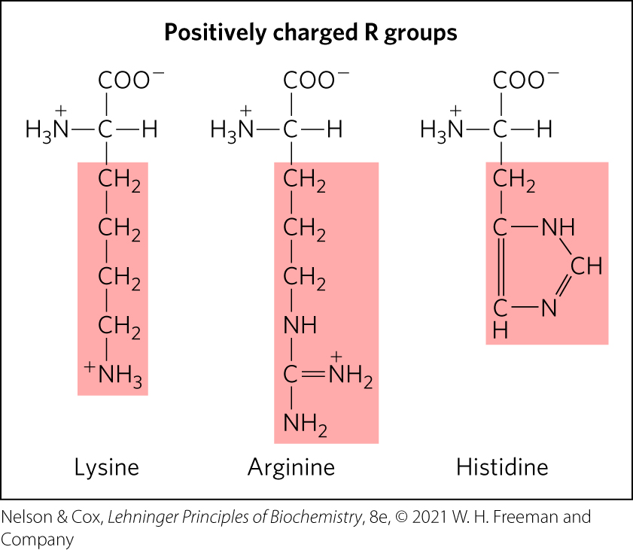
Positively Charged R Groups
have significant positive charge at pH 7.0

Slide 16
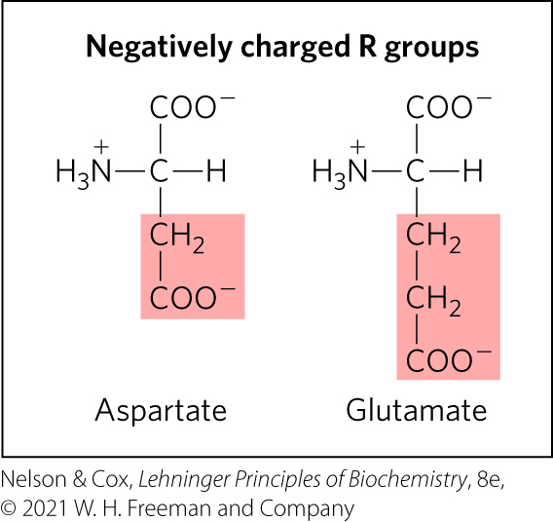
Negatively Charged R Groups
have a net negative charge at pH 7.0

Slide 17
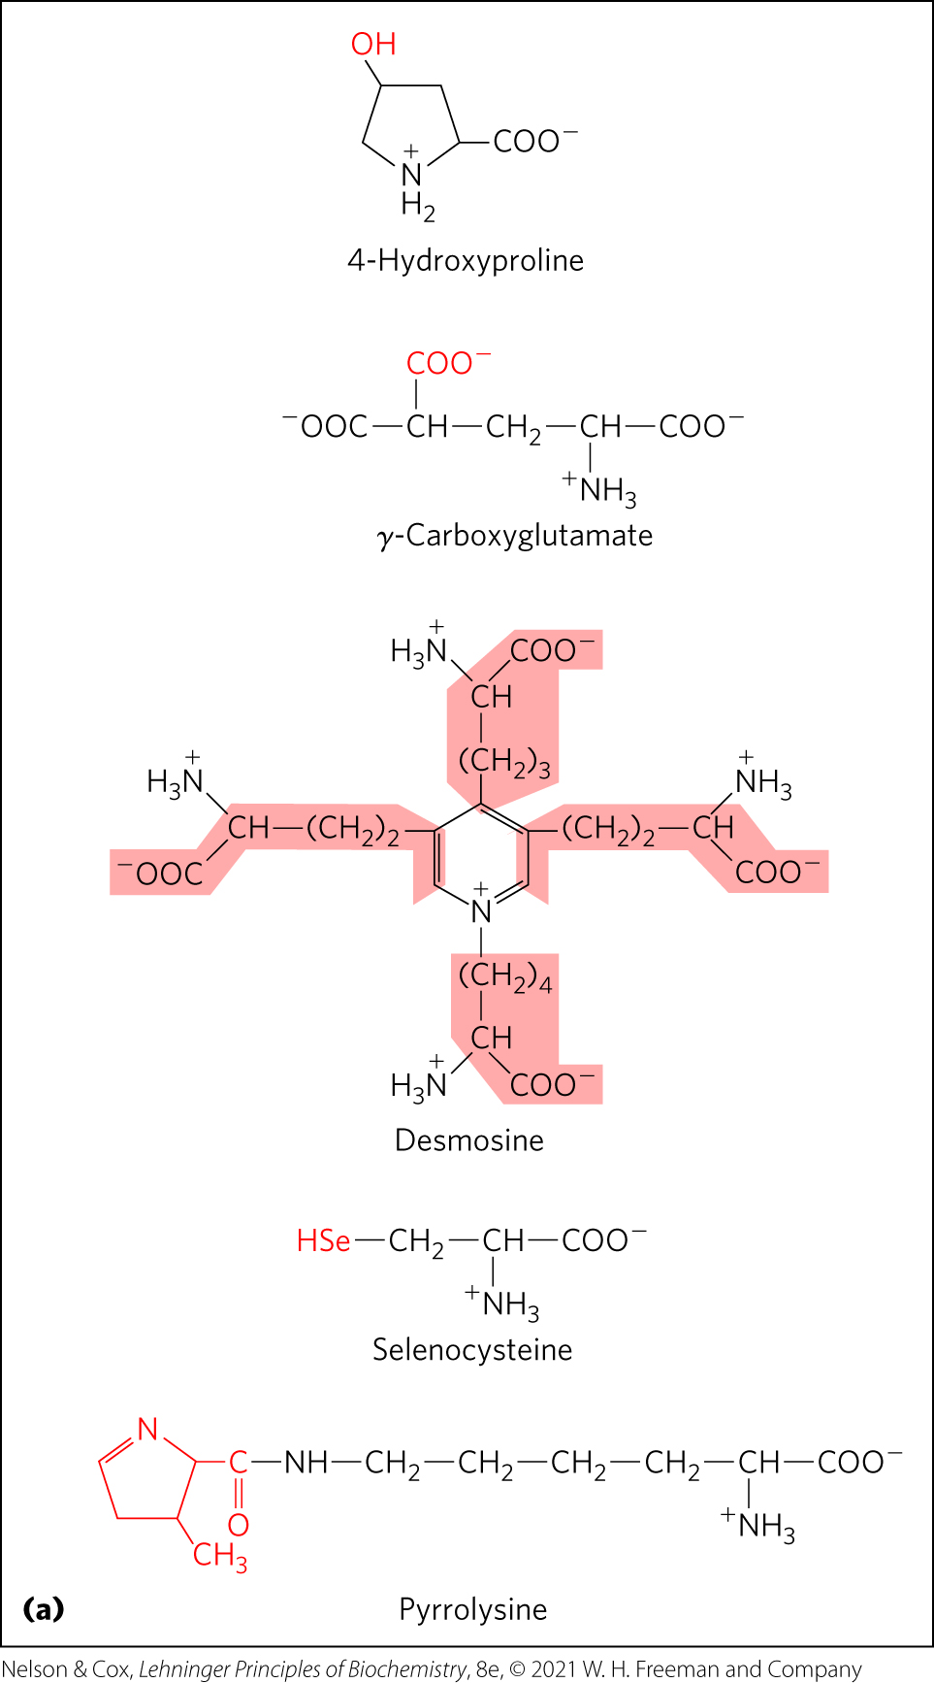
Uncommon Amino Acids Also Have Important Functions
modifications of common amino acids:
  modified after protein synthesis (e.g., 4-hydroxyproline, found in collagen)
  modified during protein synthesis (e.g., pyrrolysine, contributes to methane biosynthesis)
  modified transiently to change protein’s function (e.g., phosphorylation)
free metabolites (e.g., ornithine, intermediate in arginine biosynthesis)

Slide 18
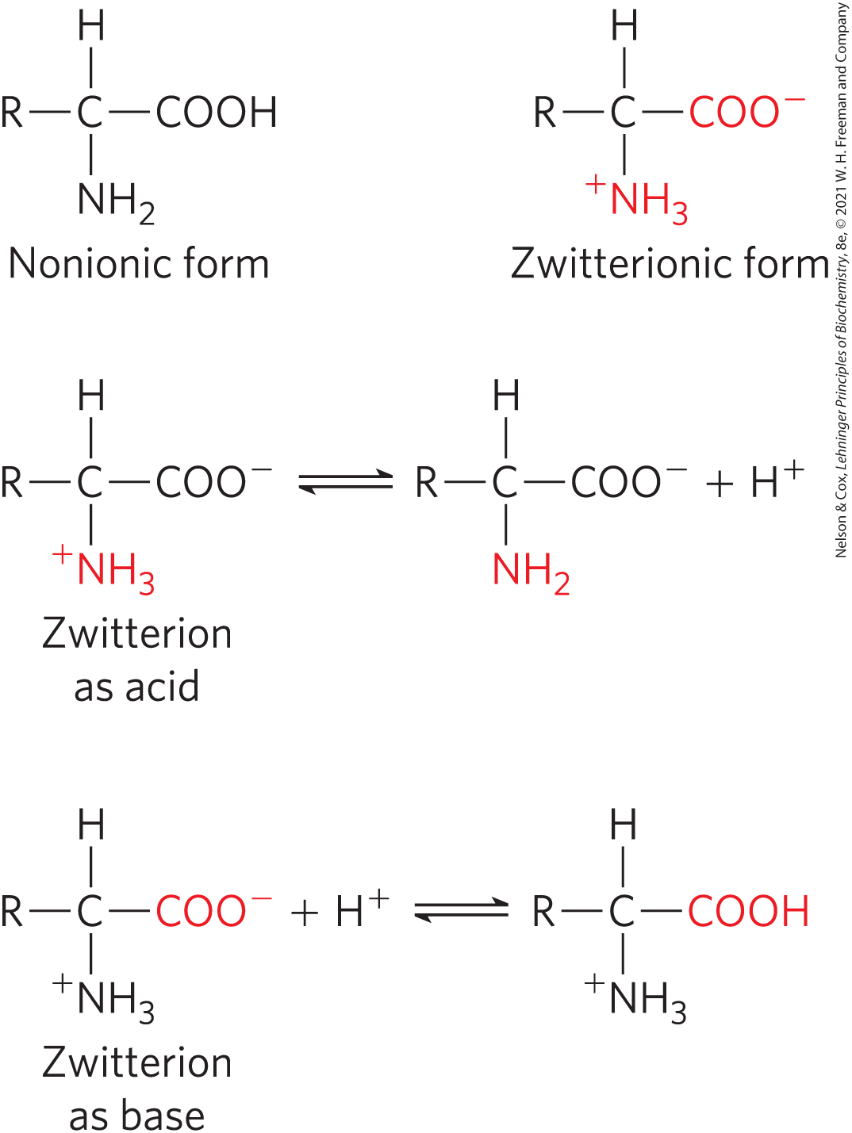
Amino Acids Can Act as Acids or Bases
amino groups, carboxyl groups, and ionizable R groups = weak acids and bases
zwitterion occurs at neutral pH

Slide 19
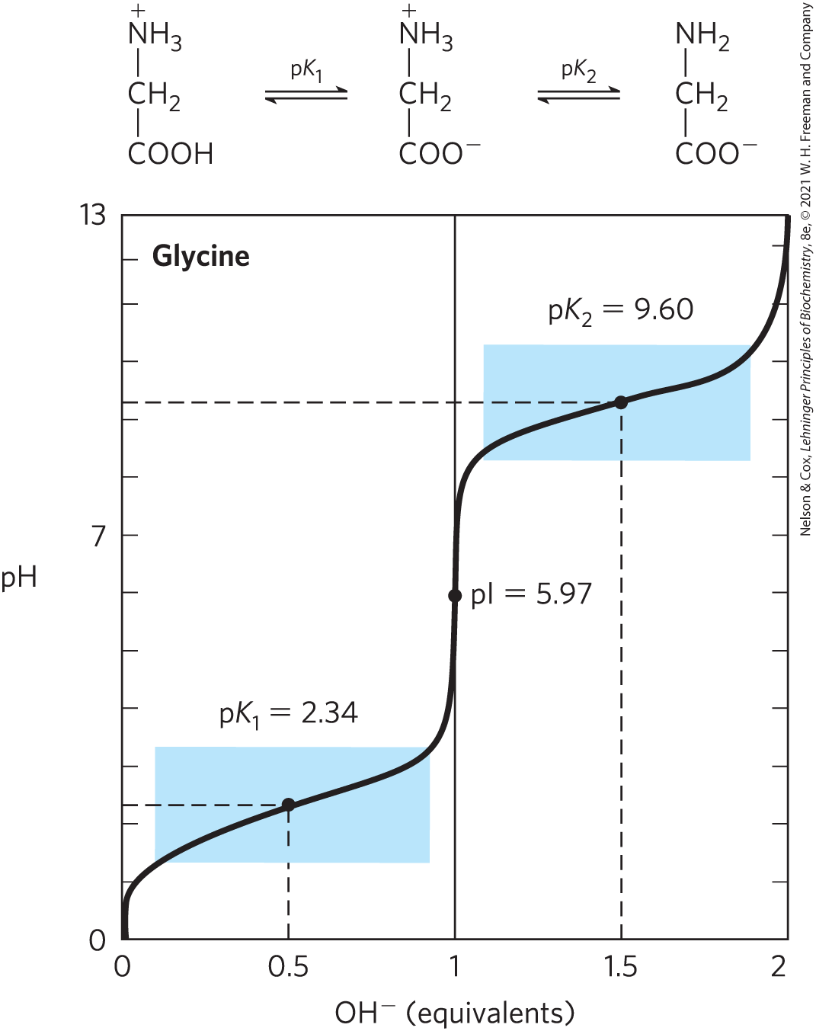
Titration of Amino Acids
cation ⇌ zwitterion ⇌ anion
—COOH has an acidic pK_{a} (pK₁)
—NH₃⁺ has a basic pK_{a} (pK₂)
the pH at which the net electric charge is zero is the isoelectric point (pI)

Slide 20
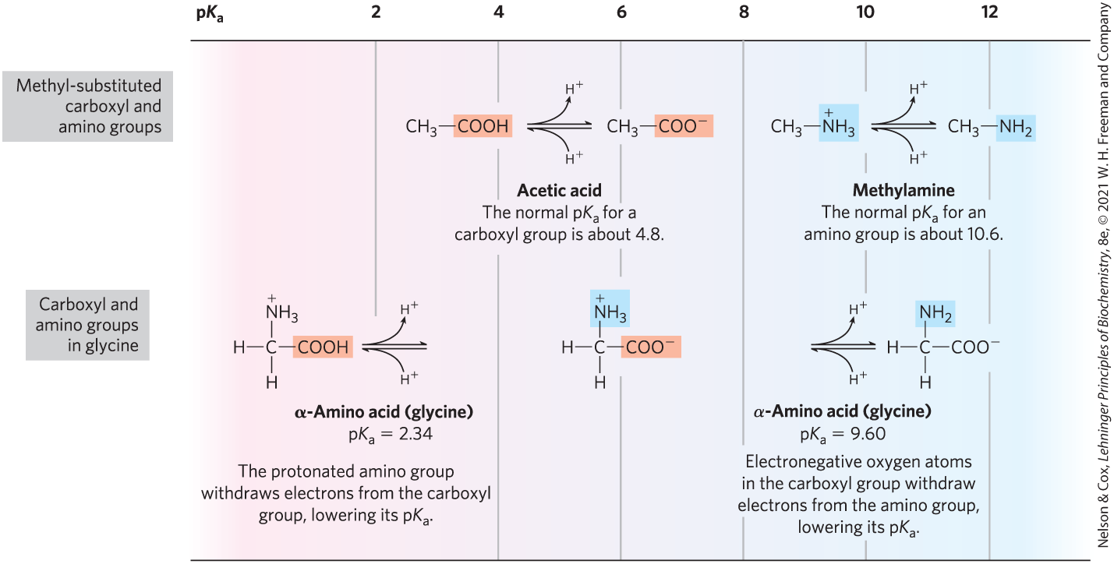
Effect of the Chemical Environment on pK_{a}
α-carboxyl group is more acidic than in carboxylic acids
α-amino group is less basic than in amines

Slide 21
Information from a Titration Curve
quantitative measure of the pK_{a} of each ionizing group
regions of buffering power
relationship between its net charge and the pH of the solution
  isoelectric point, pI

Slide 22
Amino Acids as Buffers
buffers prevent changes in pH close to the pK_{a}
glycine has two buffer regions:
  centered around the pK_{a} of the α-carboxyl group (pK₁ = 2.34)
  centered around the pK_{a} of the α-amino group (pK₂ = 9.6)
buffer
regions

Slide 23
Isoelectric Point, pI
for amino acids without ionizable side chains, the isoelectric point (pI) is:
pH = pI = net charge is zero (amino acid least soluble in water, does not migrate in electric field)
pH > pI = net negative change
pH < pI = net positive charge

Slide 24
Amino Acids Differ in Their Acid-Base Properties
ionizable side chains:
  have a pK_{a} value
  act as buffers
  influence the pI of the amino acid
  can be titrated (titration curve has 3 ionization steps)

Slide 25
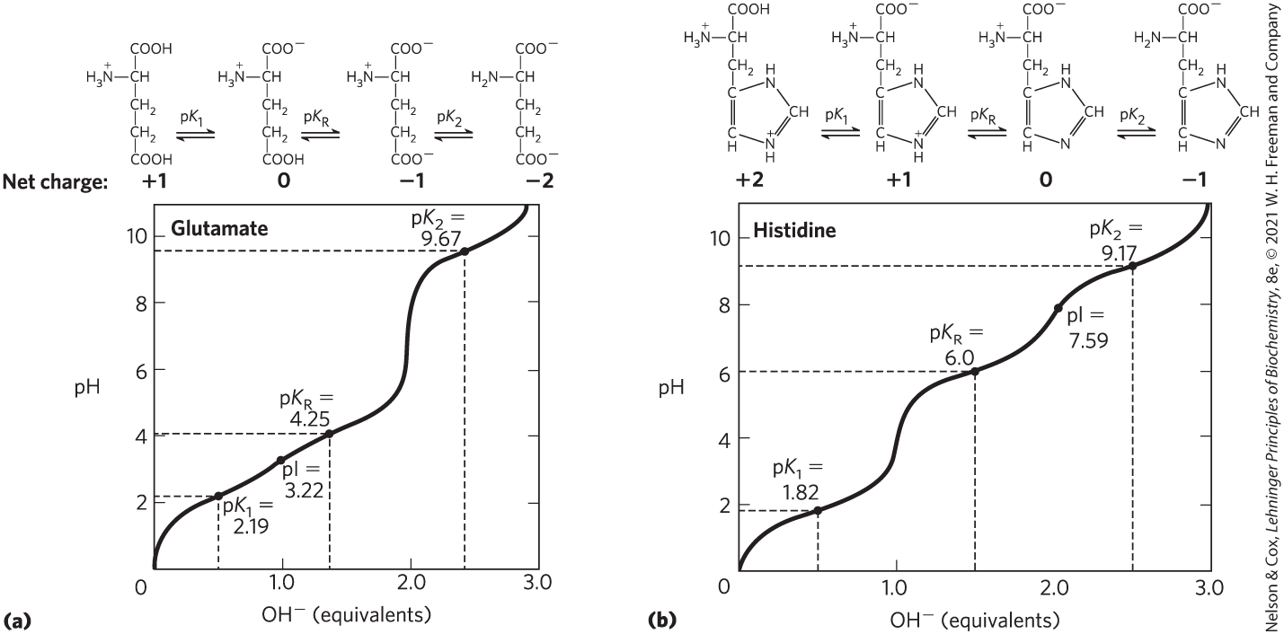
Titration of Amino Acids with an Ionizable R Group

Slide 26
3.2 Peptides and Proteins

Slide 27
Principle 2 (2 of 3)
In proteins, amino acids are joined in characteristic linear sequences through a common amide linkage, the peptide bond. The amino acid sequence of a protein constitutes its primary structure, a first level we will introduce within the broader complexities of protein structure.

Slide 28
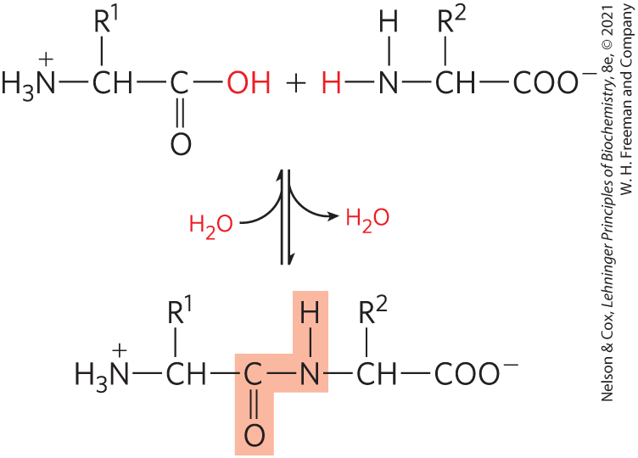
Peptides Are Chains of
Amino Acids
peptide bond:
  covalent
  formed through condensation
  broken through hydrolysis

Slide 29
Peptide Types by the Number
dipeptide = 2 amino acids, 1 peptide bond
tripeptide = 3 amino acids, 2 peptide bonds
oligopeptide = a few amino acids
polypeptide = many amino acids, molecular weight < 10 kDa
protein = thousands of amino acids, molecular weight > 10 kDa

Slide 30
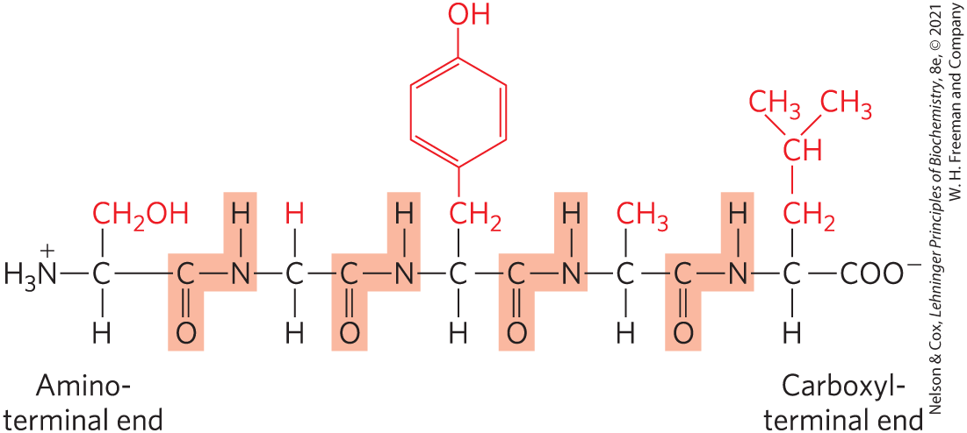
Peptide Terminals
numbering (and naming) starts from the
amino-terminal residue (N-terminal)
N-terminal
C-terminal

Slide 31
Naming Peptides
full amino acid names:
serylglycyltyrosylalanylleucine
three-letter code abbreviations:
Ser–Gly–Tyr–Ala–Leu
one-letter code abbreviation:
SGYAL

Slide 32
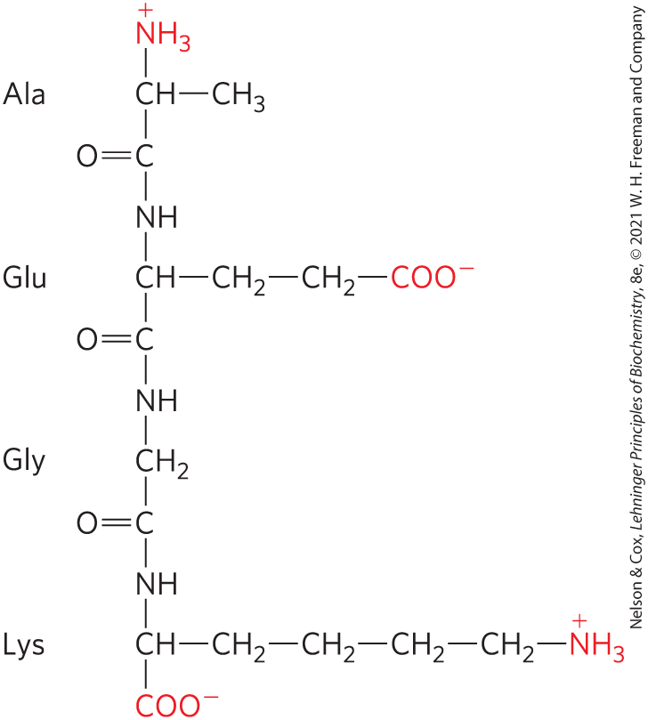
Peptides Can Be Distinguished by Their Ionization Behavior
ionizable groups in peptides:
  one free α-amino group
  one free α-carboxyl group
  some R groups

Slide 33
Biologically Active Peptides and Polypeptides Occur in a Vast Range of Sizes and Compositions
length of naturally occurring peptides = 2 to many thousands of amino acid residues
Table 3-2 Molecular Data on Some Proteins
Protein | Molecular weight | Number of residues | Number of polypeptide chains
Cytochrome c (human) | 12,400 | 104 | 1
Myoglobin (equine heart) | 16,700 | 153 | 1
Chymotrypsin (bovine pancreas) | 25,200 | 241 | 3
Hemoglobin (human) | 64,500 | 574 | 4
Hexokinase (yeast) | 107,900 | 972 | 2
RNS polymerase (E. coli) | 450,00 | 4,158 | 5
Glutamine synthetase (E. coli) | 619,000 | 5,628 | 12
Titin (human) | 2,993,000 | 26,926 | 1

Slide 34
Peptide Subunits
multisubunit protein = 2+ polypeptides associated noncovalently
oligomeric protein = at least 2 identical subunits
  identical units = protomers

Slide 35
Amino Acid Composition of Proteins
Table 3-3 Amino Acid Composition of Two Proteins
amino acid composition is highly variable
Amino Acid | Bovine cytochrome c: Number of residues per molecule | Bovine cytochrome c: percentage of total | Bovine chymotrypsinogen: Number of residues per molecule | Bovine chymotrypsinogen: Percentage of total
Ala | 6 | 6 | 22 | 9
Arg | 2 | 2 | 4 | 1.6
Asn | 5 | 5 | 14 | 5.7
Asp | 3 | 3 | 9 | 3.7
Cys | 2 | 2 | 10 | 4
Gln | 3 | 3 | 10 | 4
Glu | 9 | 9 | 5 | 2
Gly | 14 | 13 | 23 | 9.4
His | 3 | 3 | 2 | 0.8
Ile | 6 | 6 | 10 | 4
Leu | 6 | 6 | 19 | 7.8
Lys | 18 | 17 | 14 | 5.7
Met | 2 | 2 | 2 | 0.8
Phe | 4 | 4 | 6 | 2.4
Pro | 4 | 4 | 9 | 3.7
Ser | 1 | 1 | 28 | 11.4
Thr | 8 | 8 | 23 | 9.4
Trp | 1 | 1 | 8 | 3.3
Tyr | 4 | 4 | 4 | 1.6
Val | 3 | 3 | 23 | 9.4
Total | 104 | 102 | 245 | 99.7
Notes:
See Table 3-3 in the text for footnotes

Slide 36
Estimating the Number of
Amino Acid Residues
number of residues = molecular weight/110
average molecular weight of amino acid = ~128
molecule of water removed to form peptide bond = 18
128 – 18 = 110

Slide 37
Some Proteins Contain Chemical Groups Other Than Amino Acids
conjugated proteins = contain permanently associated chemical components
  non–amino acid part = prosthetic group
lipoproteins contain lipids
glycoproteins contain sugars
metalloproteins contain specific metals
Table 3-4 Conjugated Proteins
Class | Prosthetic group | Example
Lipoproteins | Lipids | β₁-Lipoprotein of blood (Fig. 17-2)
Glycoproteins | Carbohydrates | Immunoglobulin G (Fig. 5-20)
Phosphoproteins | Phosphate groups | Glycogen phosphorylase (Fig. 6-39)
Hemoproteins | Heme (iron porphyrin) | Hemoglobin (Figs 5-8 to 5-11)
Flavoproteins | Flavin nucleotides | Succinate dehydrogenase (Fig. 19-9)
Metallproteins | Iron Zinc Calcium Molybdenum Copper | Ferritin (Box 16-1) Alcohol dehrogenase (Fig. 14-12) Calmodulin (Fig. 12-17) Dinitrogenase (Fig. 22-3) Complex IV (Fig. 19-12)

Slide 38
3.4 The Structure of Proteins: Primary Structure

Slide 39
Principle 2 (3 of 3)
In proteins, amino acids are joined in characteristic linear sequences through a common amide linkage, the peptide bond. The amino acid sequence of a protein constitutes its primary structure, a first level we will introduce within the broader complexities of protein structure.

Slide 40
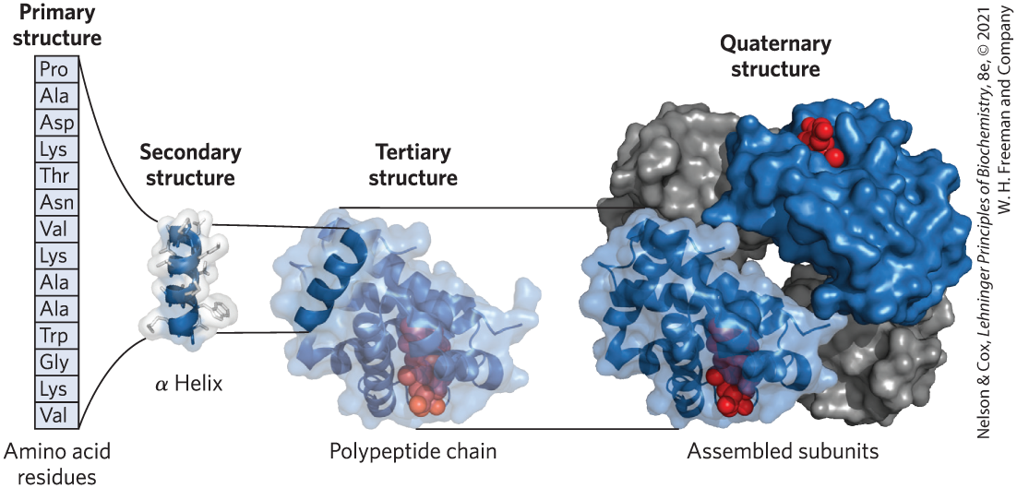
Levels of Structure in Proteins
four levels:
  primary structure = covalent bonds linking amino acid residues in a polypeptide chain
  secondary structure = recurring structural patterns
  tertiary structure = 3D folding of polypeptide
  quaternary structure = 2+ polypeptide subunits

Slide 41
The Function of a Protein Depends on Its Amino Acid Sequence
amino acid sequence confers 3D structure
3D structure confers function
most human proteins = polymorphic = have amino acid sequence variants
Edman degradation = classic method of sequencing amino acids

