Slide 1

2 Water, the Solvent of Life
© 2021 Macmillan Learning

Slide 2

Principle 1 (5 of 5)
The solvent properties of water shaped the evolution of living things. Most small intermediates of metabolism, as well as nucleic acids and proteins, are soluble in water. Lipid bilayers, the likely forerunners of biological membranes, form spontaneously in water and are stabilized by their interaction with it. Although hydrogen bonds, ionic interactions, and the hydrophobic effect are individually weak, their combined effects powerfully influence the three-dimensional shape and stability of biological molecules and structures.

Slide 3

Principle 2 (1 of 3)
The ionization behavior of water and of weak acids and bases dissolved in water can be represented by one or more equilibrium constants. Most biomolecules are ionizable; their structure and function depend on their ionization state, which is characterized by equilibrium constants.

Slide 4

Principle 3 (1 of 5)
An aqueous solution of a weak acid and its salt makes a buffer that resists changes in pH in response to added acid or base. Biological systems are buffered to maintain a narrow pH range, in which their macromolecules retain their functional structure, which depends on their ionization state. Conditions that produce blood pH outside the range of 7.3 to 7.5 are life-threatening in humans.

Slide 5

Principle 4
Enzymes, which catalyze all of the processes inside a cell, have evolved to function optimally at near-neutral (physiological) pH. However, enzymes that function in intracellular compartments of low or high pH show their greatest activity and stability at those pH values.

Slide 6
2.1 Weak Interactions in Aqueous Systems

Slide 7
Principle 1 (1 of 5)
The solvent properties of water shaped the evolution of living things. Most small intermediates of metabolism, as well as nucleic acids and proteins, are soluble in water. Lipid bilayers, the likely forerunners of biological membranes, form spontaneously in water and are stabilized by their interaction with it. Although hydrogen bonds, ionic interactions, and the hydrophobic effect are individually weak, their combined effects powerfully influence the three-dimensional shape and stability of biological molecules and structures.

Slide 8
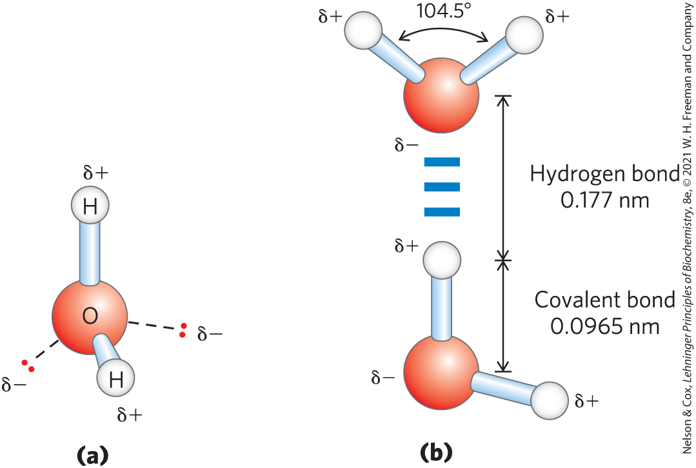
Hydrogen Bonding Gives Water Its Unusual Properties
water has a higher melting point, boiling point, and heat of vaporization than most other common solvents
hydrogen bond = electrostatic attraction between the oxygen atom of one water molecule and the hydrogen of another

Slide 9
Strength of Hydrogen Bonds
hydrogen bonds are relatively weak
  bond dissociation energy = ~23 kJ/mol in liquid H₂O
  10% covalent, 90% electrostatic
hydrogen bonds are fleeting
  lifetime of each hydrogen bond is just 1 to 20 picoseconds in liquid
  when one hydrogen bond breaks, another forms

Slide 10
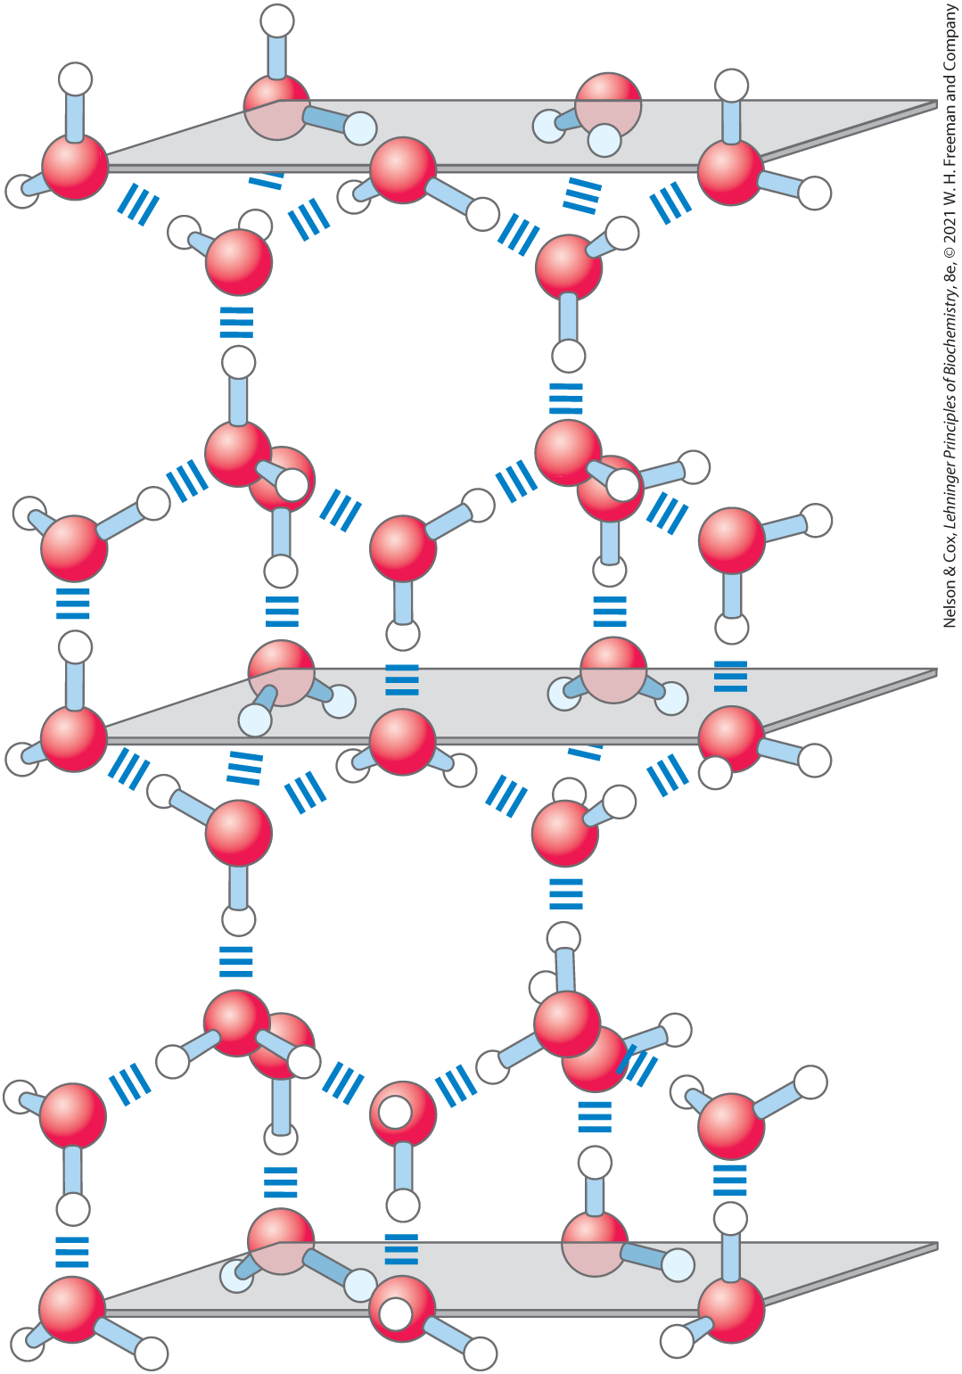
Number of Hydrogen Bonds Formed
in liquid, each H₂O molecule forms hydrogen bonds with an average of 3.4 other molecules
in ice, each H₂O molecule forms 4 hydrogen bonds

Slide 11
Hydrogen Bonds Account for the Relatively High Melting Point of Water
during melting or evaporation, heat is taken up by the system and the entropy of the aqueous system increases:
H₂O(solid) → H₂O(liquid) ∆H = +5.9 kJ/mol
H₂O(liquid) → H₂O(gas) ∆H = +44.0 kJ/mol
at room temperature, melting and evaporation occur spontaneously
  free-energy change (∆G) must be negative
  because ∆H is positive, the increase in ∆S drives these changes

Slide 12
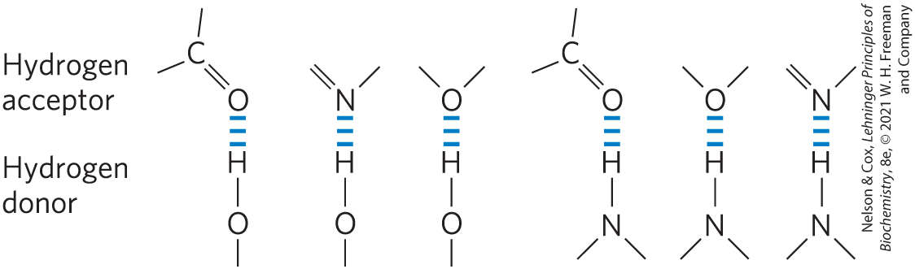
Water Forms Hydrogen Bonds with Polar Solutes
hydrogen bonds readily form between an electronegative atom (the hydrogen acceptor) and a hydrogen atom covalently bonded to another electronegative atom (the hydrogen donor)

Slide 13
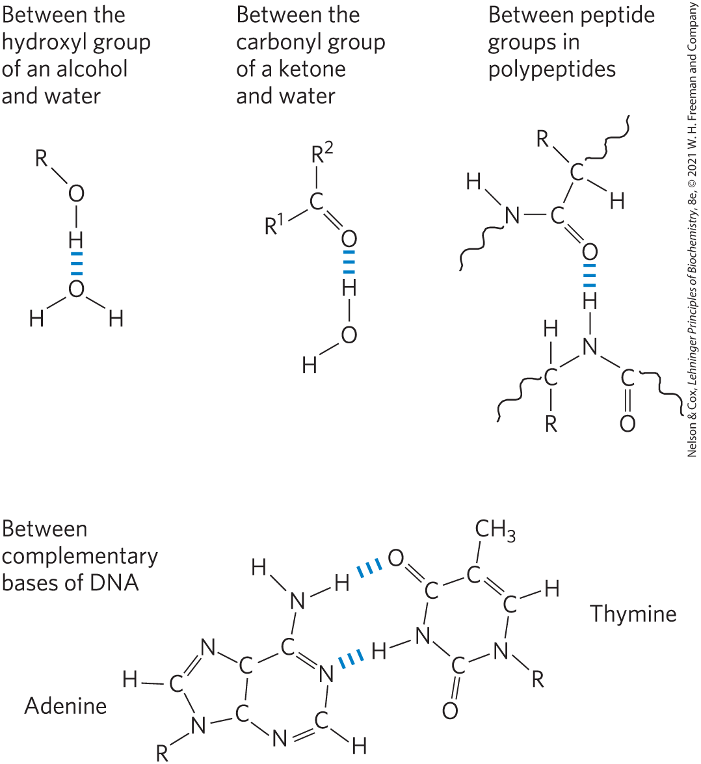
Biologically Important Hydrogen Bonds
hydrogen atoms covalently bonded to carbon atoms do not hydrogen bond
alcohols, aldehydes, ketones, and compounds containing N—H bonds all form hydrogen bonds with water

Slide 14
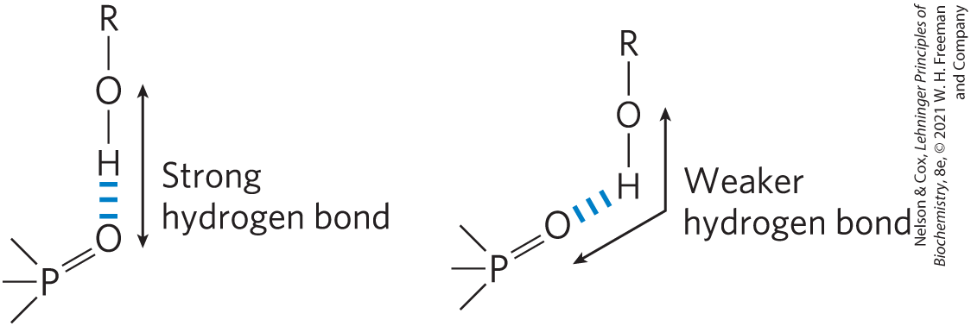
Directionality of the Hydrogen Bond
strongest when the acceptor atom is in line with the covalent bond between the donor atom and H
  maximizes electrostatic interaction

Slide 15
Water Interacts Electrostatically with Charged Solutes
hydrophilic = describes compounds that dissolve easily in H₂O; generally charged or polar compounds
hydrophobic = nonpolar molecules such as lipids and waxes
amphipathic = contain regions that are polar (or charged) and regions that are nonpolar

Slide 16
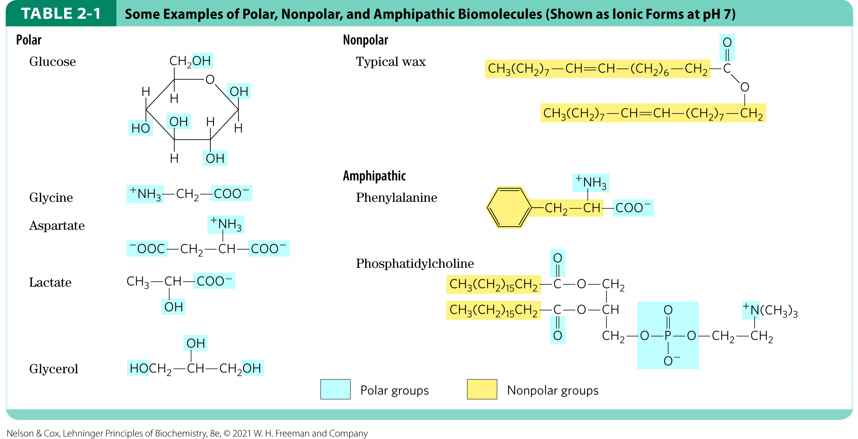
Polar, Nonpolar, and Amphipathic Biomolecules

Slide 17
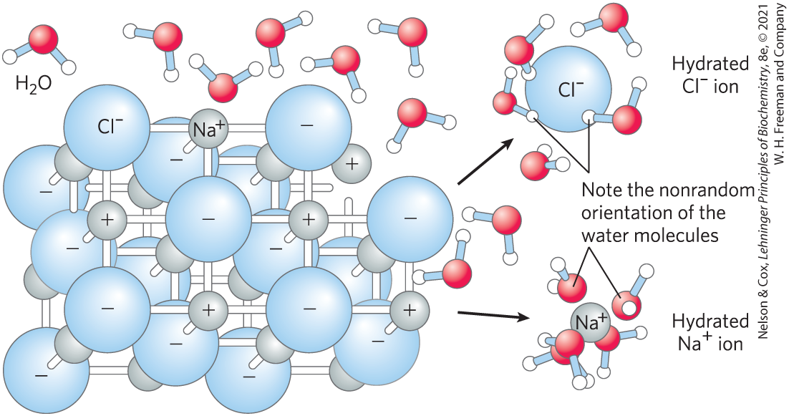
Water as Solvent
H₂O dissolves salts and charged biomolecules by screening electrostatic interactions
the increase in entropy of the system is largely responsible for the ease of dissolving salts in water

Slide 18
Water Has a High Dielectric
Constant
dielectric constant (ε) = a dimensionless physical property that reflects the number of dipoles in a solvent
  for water at 25 °C, ε = 78.5
  for nonpolar benzene at 25 °C, ε = 4.6

Slide 19
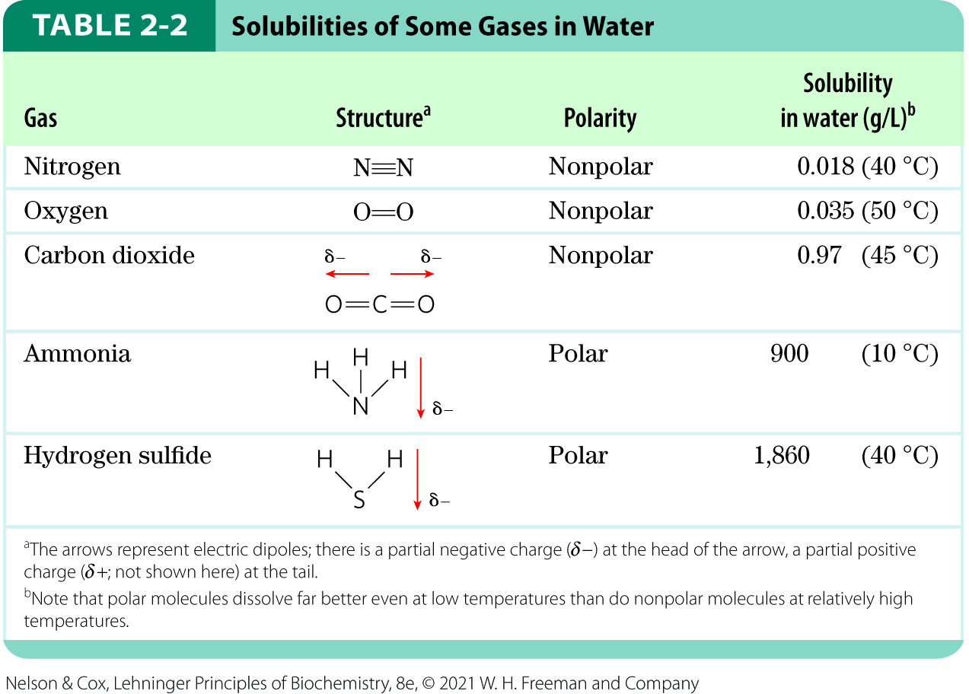
Nonpolar Gases Are Poorly Soluble in Water
biologically important gases CO₂, O₂, N₂ are nonpolar
their movement into aqueous solution decreases entropy by constraining their motion

Slide 20
Nonpolar Compounds Force Energetically Unfavorable Changes in the Structure of Water
nonpolar compounds interfere with the hydrogen bonding among H₂O molecules
  increases enthalpy (∆H) and decreases entropy (∆S)
the free-energy change (∆G = ∆H − T∆S) for dissolving a nonpolar solute in water is unfavorable:
  ∆H has a positive value
  ∆S has a negative value
  ∆G has a positive value

Slide 21
The Ordering of Water Molecules around Nonpolar Solutes
H₂O molecules form a highly ordered, cagelike shell around each solute molecule
  maximizes solvent-solvent hydrogen bonding
  H₂O molecules are not as highly oriented as those in clathrates (crystalline compounds of nonpolar solutes and water)

Slide 22
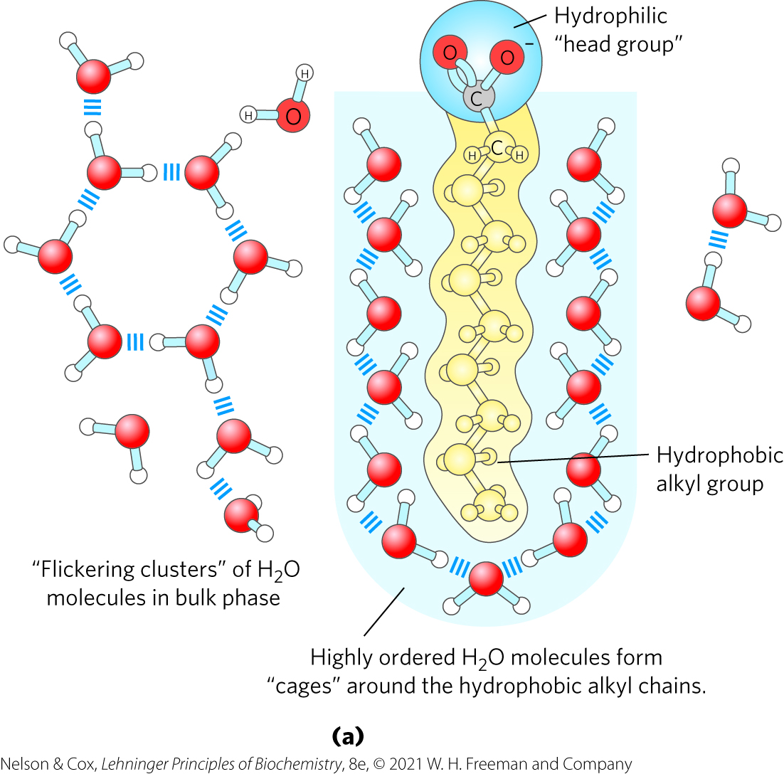
Amphipathic Compounds in Aqueous Solutions
polar, hydrophilic region interacts favorably with H₂O and tends to dissolve
nonpolar, hydrophobic region tends to avoid contact with H₂O and cluster together

Slide 23
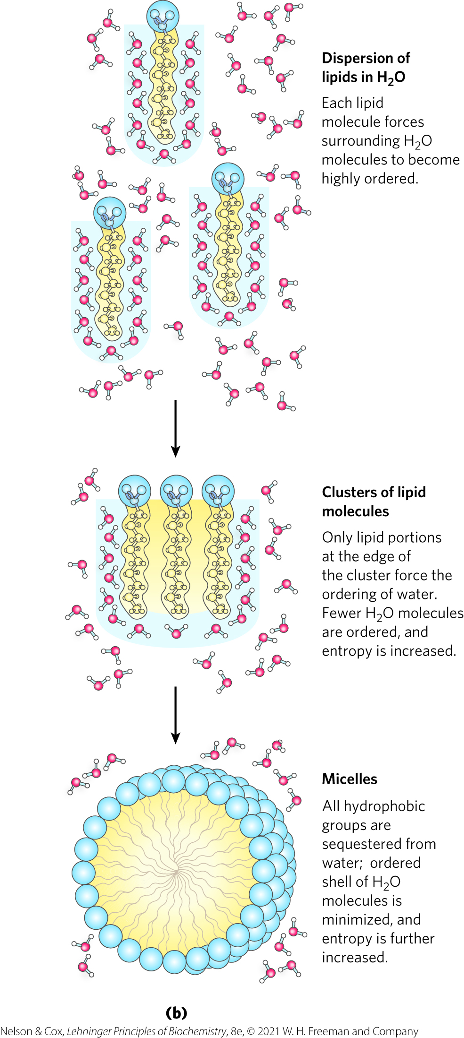
The Hydrophobic Effect
hydrophobic effect =
  nonpolar regions cluster together
  polar regions arrange to maximize interactions with each other and with the solvent
micelles = thermodynamically stable structures of amphipathic compounds in water

Slide 24
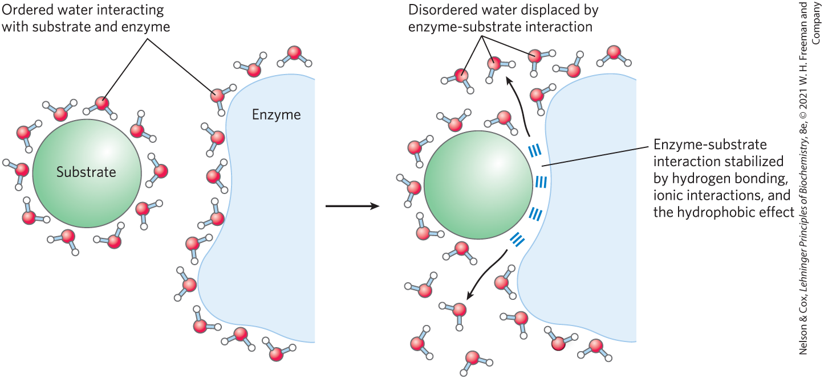
Release of Ordered Water Favors Formation of an Enzyme-Substrate Complex

Slide 25
van der Waals Interactions Are Weak Interatomic Attractions
Table 2-3: van der Waals Radii and Covalent (Single-Bond) Radii of Some Elements
van der Waals interactions (London dispersion forces) = distance-dependent weak attractions and repulsions between transient dipoles
van der Waals radius = measure of how close an atom will allow another to approach
Element | van der Waals radius (nm) | Covalent radius for single bond (nm)
H | 0.11 | 0.030
O | 0.15 | 0.066
N | 0.15 | 0.070
C | 0.17 | 0.077
S | 0.18 | 0.104
P | 0.19 | 0.110
I | 0.21 | 0.133
Sources: For van der Waals radii, R. Chauvin, J. Phys. Chem. 96:9194, 1992. For covalent radii, L. Pauling, Nature of the Chemical Bond, 3rd edn, Cornell University Press, 1960.
Note: van der Waals radii describe the space-filling dimensions of atoms. When two atoms are joined covalently, the atomic radii at the point of the bonding are shorter than the van der Waals radii, because the joined atoms are pulled together by the shared electron pair. The distance between nuclei in a van der Waals interaction or a covalent bond is about equal to the sum of the van der Waals or covalent radii, respectively, for the two atoms. Thus, the length of a carbon-carbon single bond is about 0.077 nm + 0.077 nm = 0.154 nm.

Slide 26
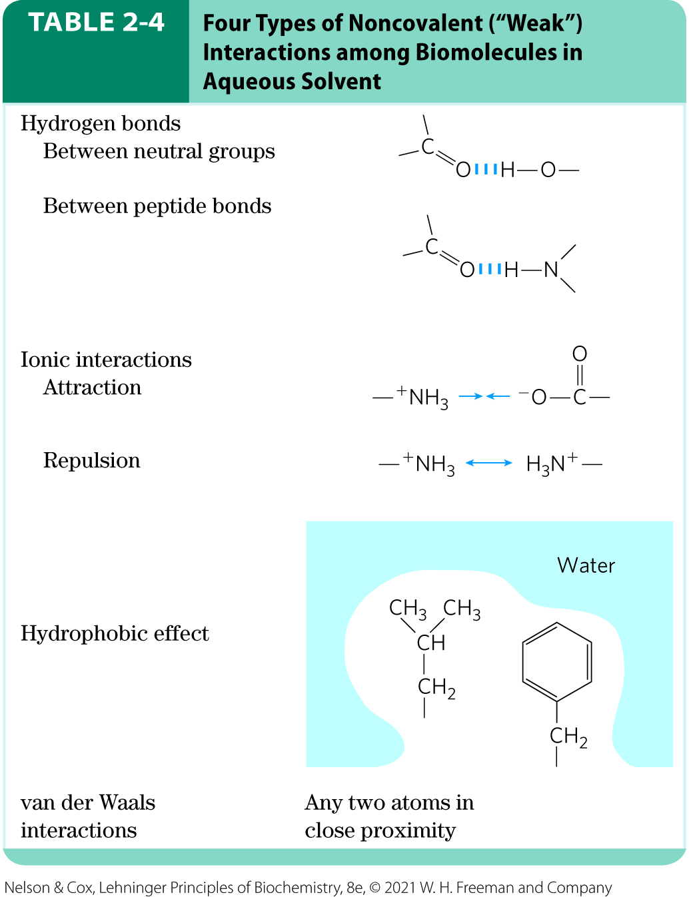
Weak Interactions Are Crucial to Macromolecular Structure and Function
noncovalent interactions are much weaker than covalent bonds
continually forming and breaking

Slide 27
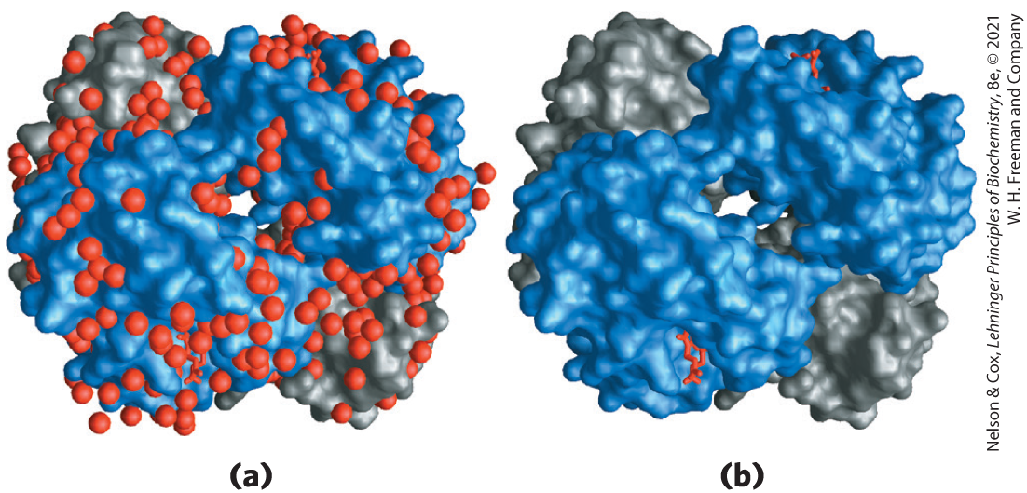
The Cumulative Effect of Weak Interactions
for macromolecules, the most stable structure usually maximizes weak interactions
H₂O molecules are often found to be bound so tightly to biomolecules that they are part of the crystal structure

Slide 28
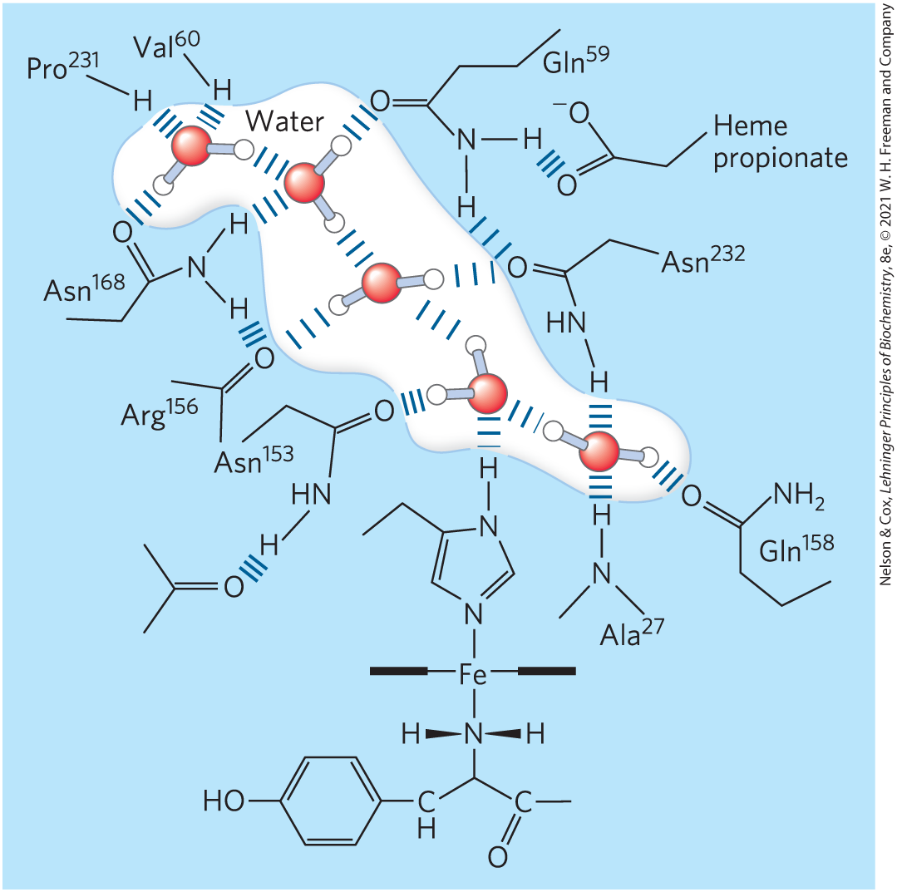
Water Can Be Essential to Protein Function
cytochrome f:
  has a chain of five bound H₂O molecules
  may provide a path for protons to move through the membrane

Slide 29
Concentrated Solutes Produce Osmotic Pressure
solutes alter the colligative properties of the solvent
  vapor pressure
  boiling point
  melting point (freezing point)
  osmotic pressure
effect depends on the number of solute particles (molecules or ions) in a given amount of water

Slide 30
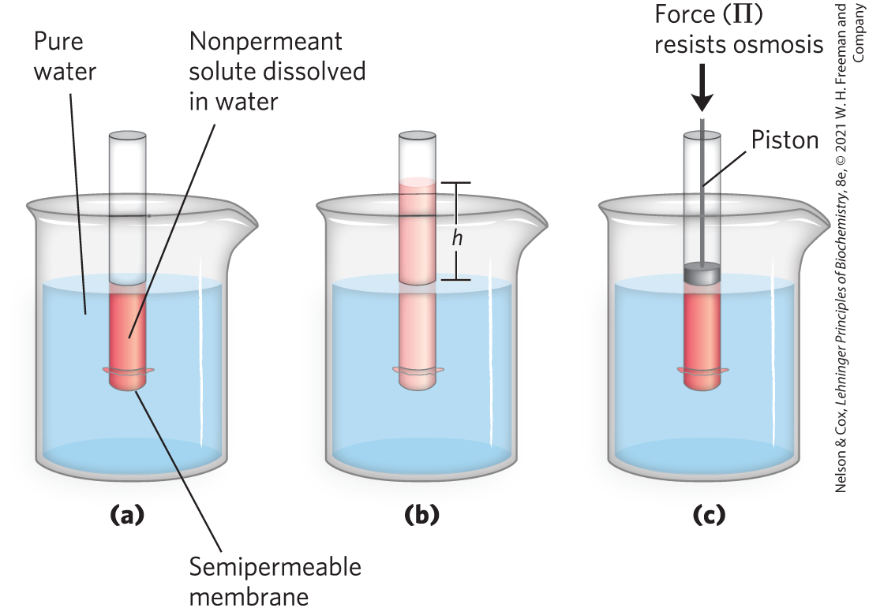
The Movement of Water from Higher to Lower Concentrations Produces Osmotic Pressure

Slide 31
Osmolarity and Osmosis
osmolarity = the product of the van’t Hoff factor i and the solute’s molar concentration, c
osmosis = water movement across a semipermeable membrane driven by differences in osmotic pressure

Slide 32
2.2 Ionization of Water, Weak Acids, and Weak Bases

Slide 33
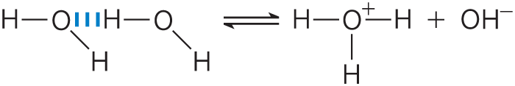
Pure Water Is Slightly Ionized
H₂O molecules have a slight tendency to undergo reversible ionization to yield a hydrogen ion (a proton) and a hydroxide ion:
(Eqn 2-1)
hydrogen ions are immediately hydrated to form hrydonium ions (H₃O⁺):

Slide 34
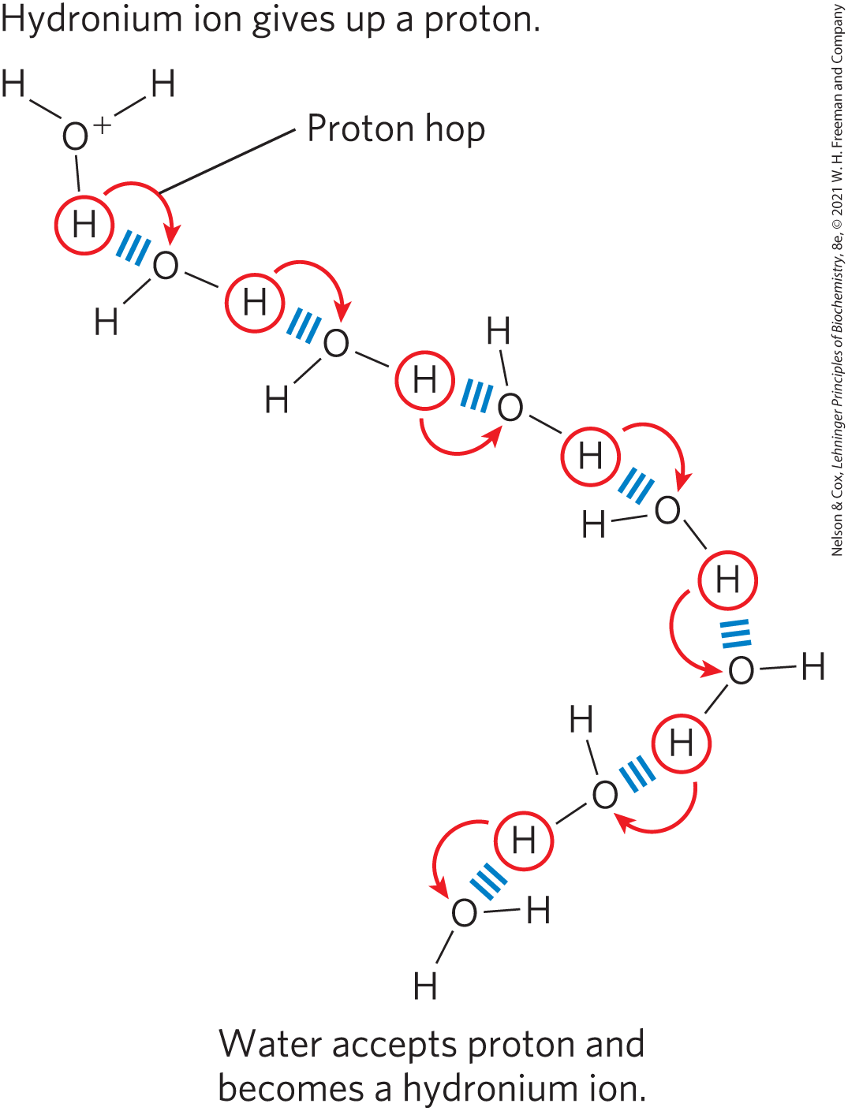
Proton Hopping
“proton hopping” results in high ionic mobility

Slide 35
The Ionization of Water Is Expressed by an Equilibrium Constant
the equilibrium constant for the reversible ionization of H₂O is
(Eqn 2-3)
in pure H₂O at 25˚C, the concentration of H₂O is:

Slide 36
The Ion Product of Water
substituting 55.5 m in the equilibrium constant expression yields:
(Eqn 2-4)
where K_{w} is the ion product of water at 25˚C.

Slide 37
Calculating the Ion Product of Water
in pure water at 25˚C,
substituting this value in:

Slide 38
Neutral pH
neutral pH = exactly equal concentrations of H⁺ and OH⁻, as in pure water
at neutral pH:

Slide 39
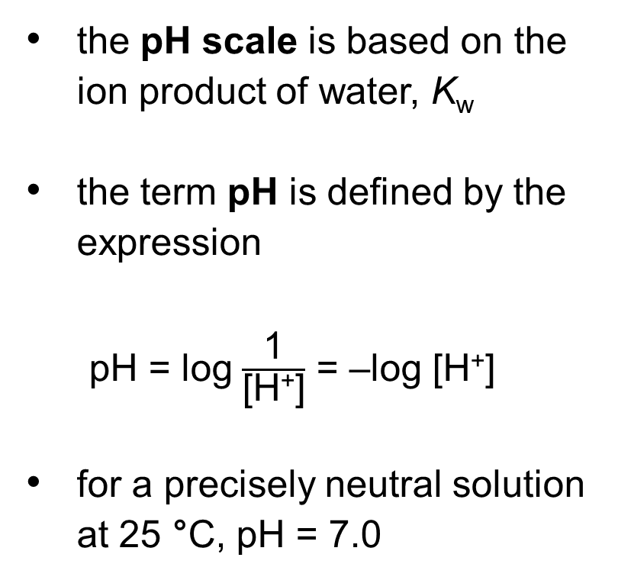
The pH Scale Designates the H⁺ and OH– Concentrations
Table 2-5 The pH Scale
the pH scale is based on the ion product of water, K_{w}
the term pH is defined by the expression
pH = log $\frac{\text{1}}{\text{[}\text{H}\text{+}\text{]}}$ = –log [H⁺]
for a precisely neutral solution at 25 °C, pH = 7.0
[H⁺] (M) | pH | [OH–] (M) | pOHª
10⁰(1) | 0 | 10^{–14} | 14
10^{–1} | 1 | 10^{–13} | 13
10^{–2} | 2 | 10^{–12} | 12
10^{–3} | 3 | 10^{–11} | 11
10^{–4} | 4 | 10^{–10} | 10
10^{–5} | 5 | 10^{–9} | 9
10^{–6} | 6 | 10^{–8} | 8
10^{–7} | 7 | 10^{–7} | 7
10^{–8} | 8 | 10^{–6} | 6
10^{–9} | 9 | 10^{–5} | 5
10^{–10} | 10 | 10^{–4} | 4
10^{–11} | 11 | 10^{–3} | 3
10^{–12} | 12 | 10^{–2} | 2
10^{–13} | 13 | 10^{–1} | 1
10^{–14} | 14 | 10⁰(1) | 0
ªThe expression pOH is sometimes used to describe the basicity OH– concentration of a solution; pOH is defined by the expression pOH = –log [OH–], which is analogous to the expression for pH. Note that in all cases, pH + pOH = 14

Slide 40
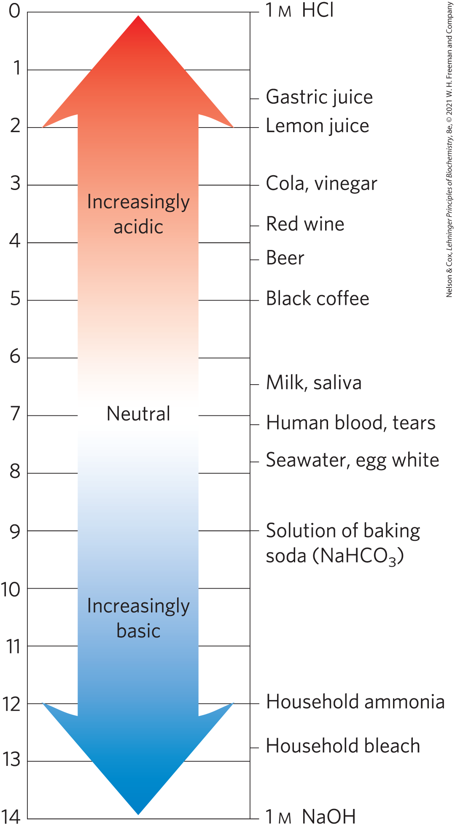
The pH of Some Aqueous Fluids
pH values > 7:
  alkaline or basic
  concentration of OH– is greater than that of H⁺
pH values < 7:
  acidic
  concentration of H⁺ is greater than that of OH–

Slide 41
pH and Medical Diagnoses
acidosis = pH of blood plasma below the normal value of 7.4
  common in people with severe, uncontrolled diabetes
alkalosis = pH of blood plasma above the normal value of 7.4
extreme acidosis or alkalosis can be life-threatening

Slide 42
Weak Acids and Bases Have Characteristic Acid Dissociation Constants
conjugate acid-base pair = a proton donor and its corresponding proton acceptor
the stronger the acid, the greater its tendency to lose its proton

Slide 43
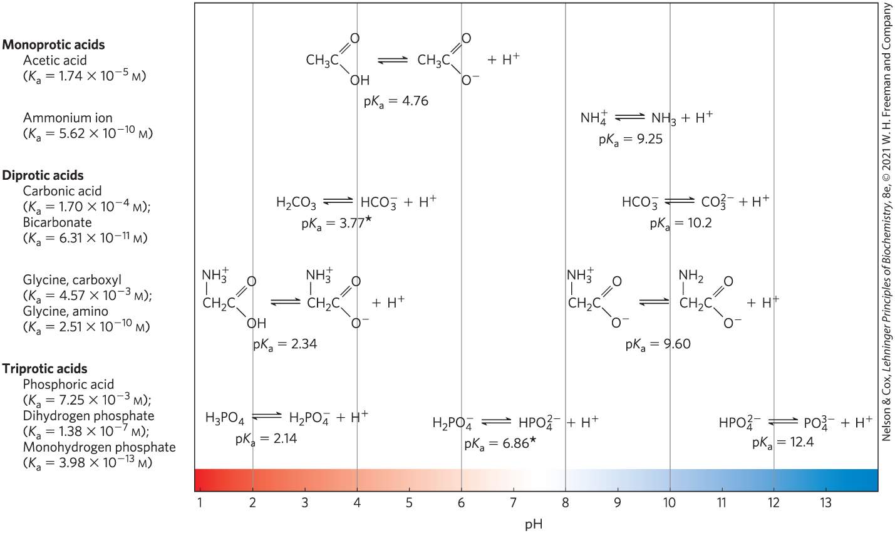
Conjugate Acid-Base Pairs

Slide 44
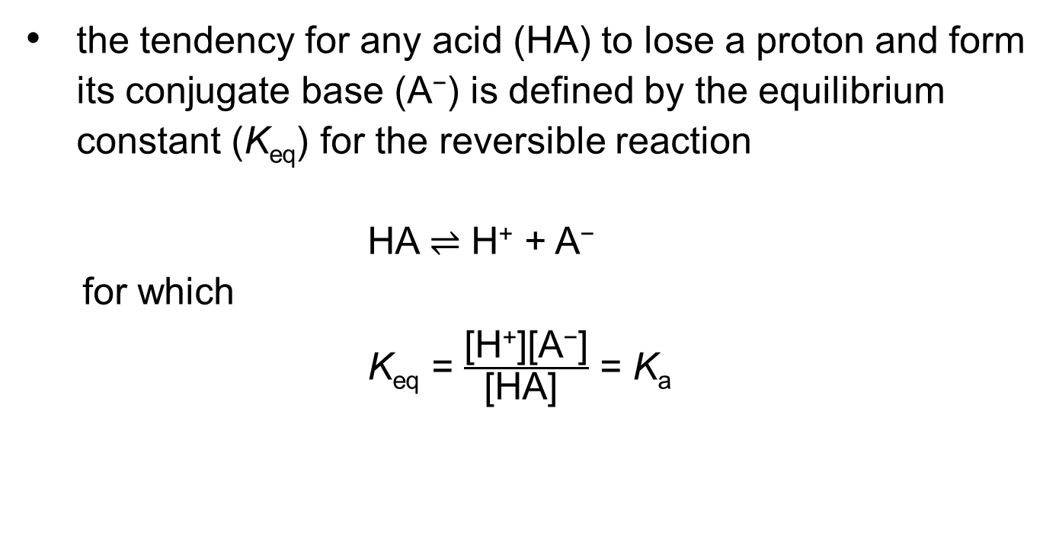
Ionization Constants
the tendency for any acid (HA) to lose a proton and form its conjugate base (A⁻) is defined by the equilibrium constant (K_{eq}) for the reversible reaction
HA ⇌ H⁺ + A⁻
  for which
  K_{eq} = $\frac{\text{[}\text{H}\text{+}\text{][}\text{A}\text{−}\text{]}}{\text{[}\text{HA}\text{] }}$ = K_{a}

Slide 45
Stronger Acids Have Larger Ionization Constants

Slide 46
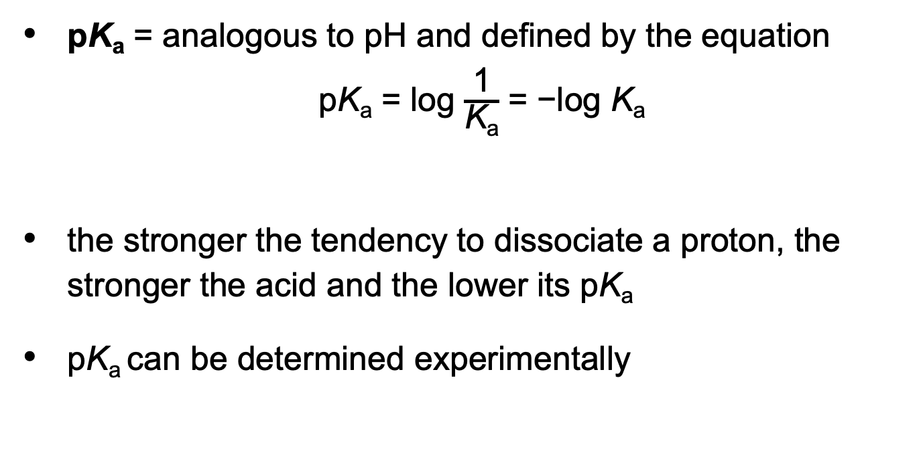
pK_{a}
pK_{a} = analogous to pH and defined by the equation
pK_{a} = log $\frac{\text{1}}{\text{K}\text{a}}$ = −log K_{a}
the stronger the tendency to dissociate a proton, the stronger the acid and the lower its pK_{a}
pK_{a} can be determined experimentally

Slide 47
Titration Curves Reveal the pK_{a} of Weak Acids
titration curve = a plot of pH against the amount of NaOH added

Slide 48
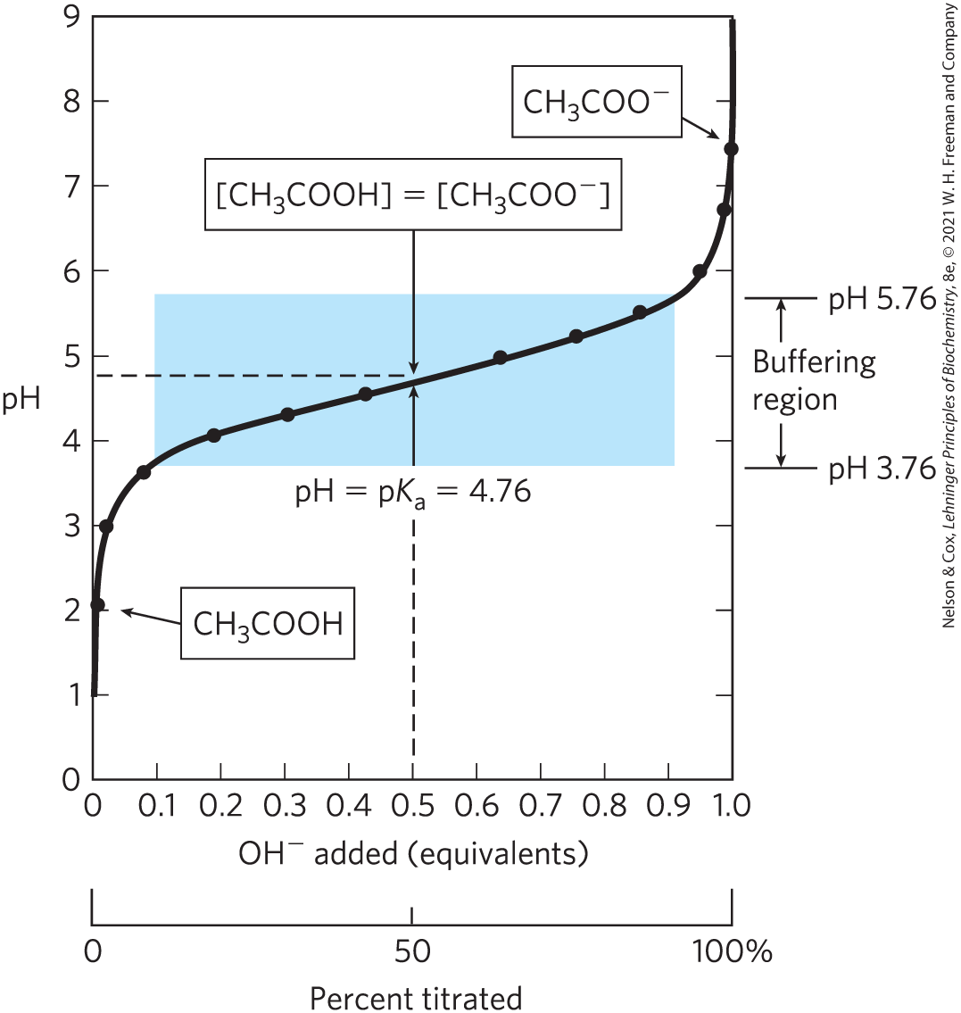
The Titration Curve of Acetic Acid
at the midpoint, the pH of the equimolar solution = the pK_{a} of acetic acid

Slide 49
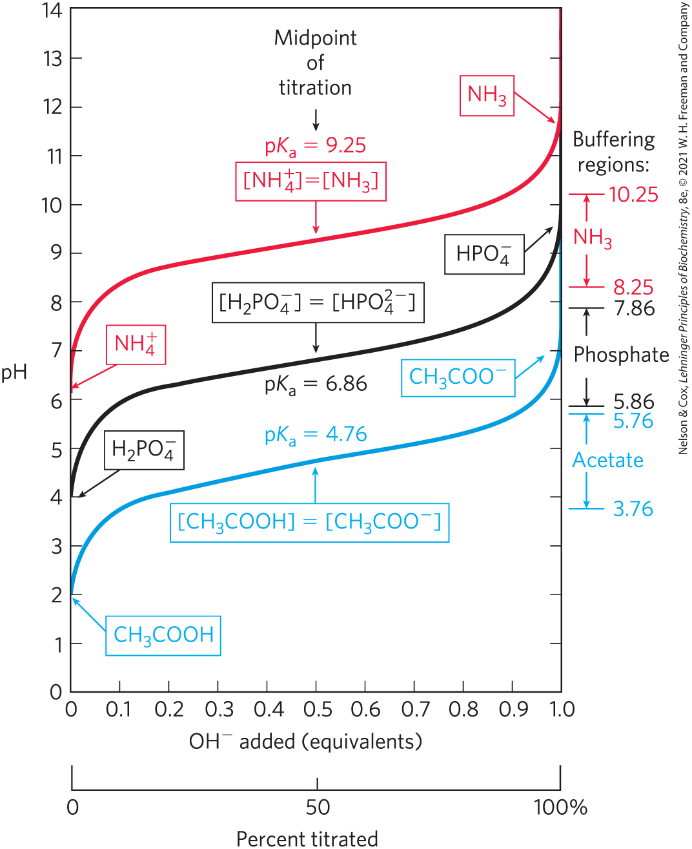
Comparison of the Titration Curves of Three Weak Acids
a weak acid and its anion—a conjugate acid-base pair—can act as a buffer

Slide 50
Principle 4 (1 of 2)
Enzymes, which catalyze all of the processes inside a cell, have evolved to function optimally at near-neutral (physiological) pH. However, enzymes that function in intracellular compartments of low or high pH show their greatest activity and stability at those pH values.

Slide 51
Buffers Are Mixtures of Weak Acids and Their Conjugate Bases
buffers = aqueous systems that tend to resist changes in pH when small amounts of acid (H⁺) or base (OH–) are added
a buffer system consists of a weak acid (the proton donor) and its conjugate acid (the proton acceptor)

Slide 52
The Buffering Region
buffering region = the flat zone of a titration curve

Slide 53
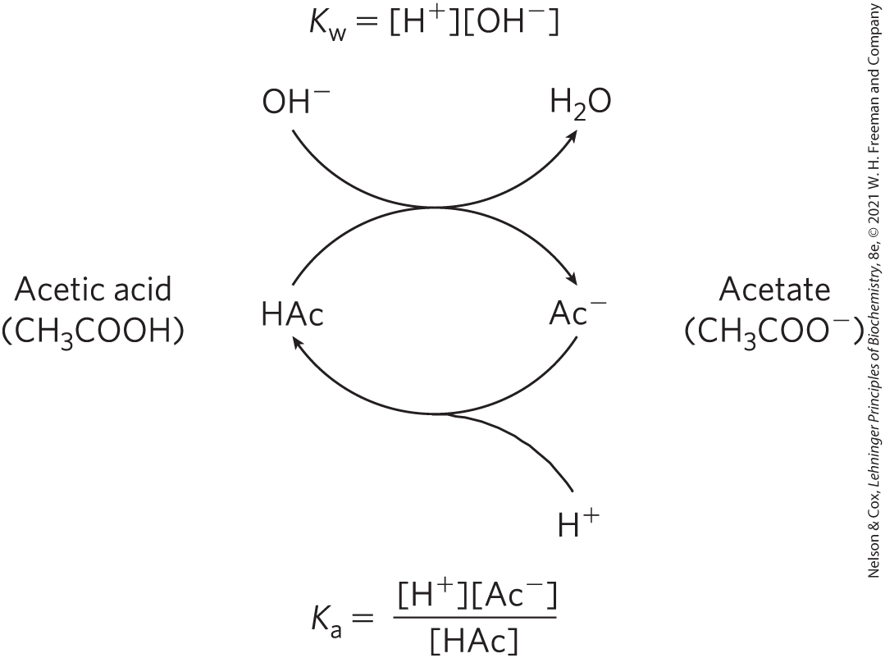
The Acetic Acid–Acetate Pair as a Buffer System

Slide 54
The Henderson-Hasselbalch Equation Relates pH, pK_{a}, and Buffer Concentration
Henderson-Hasselbalch equation = describes the shape of the titration curve of any weak acid
(Eqn 2-9)

Slide 55
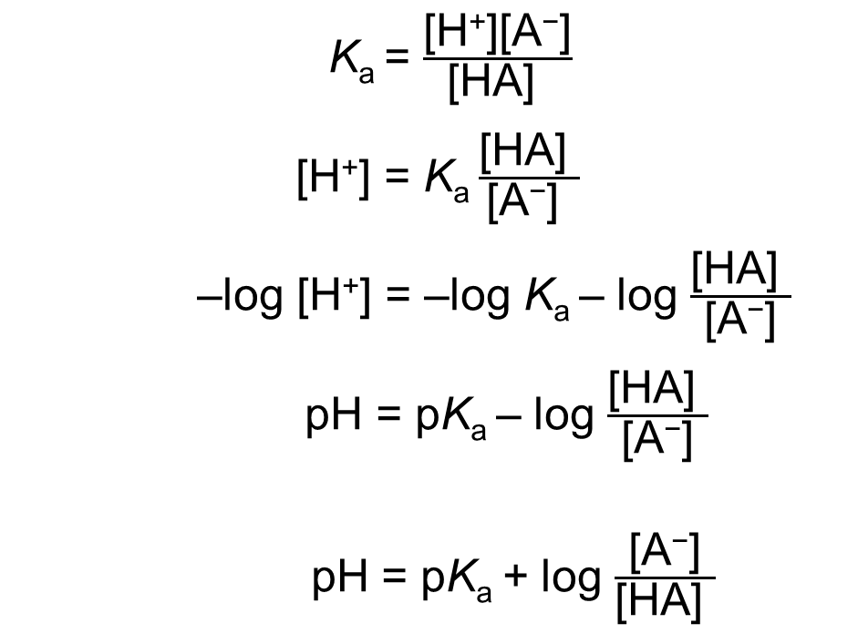
Deriving the Henderson-Hasselbalch Equation
K_{a} = $\frac{\text{[}\text{H}\text{+}\text{][}\text{A}\text{−}\text{]}}{\text{[}\text{HA}\text{] }}$
[H⁺] = K_{a} $\frac{\text{[}\text{H}\text{A}\text{] }}{\text{[}\text{A}\text{−}\text{] }}$
–log [H⁺] = –log K_{a} – log $\frac{\text{[}\text{HA}\text{] }}{\text{[}\text{A}\text{−}\text{]}}$
pH = pK_{a} – log $\frac{\text{[}\text{HA}\text{] }}{\text{[}\text{A}\text{−}\text{]}}$
pH = pK_{a} + log $\frac{\text{[}\text{A}\text{−}\text{]}}{\text{[}\text{H}\text{A}\text{] }}$
(Eqn 2-9)

Slide 56
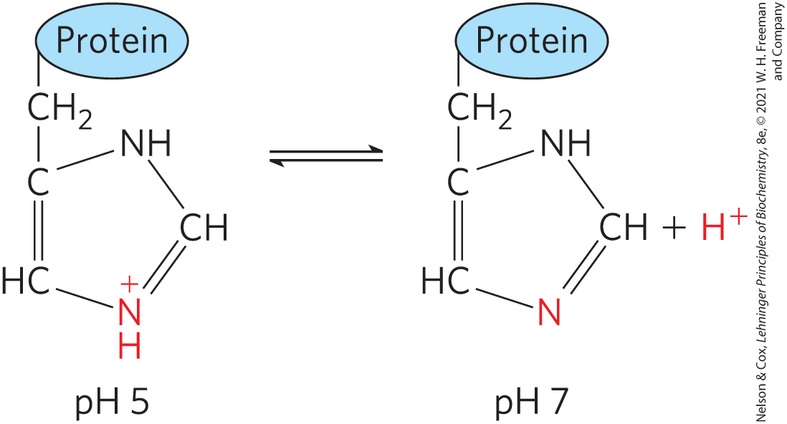
Weak Acids or Bases Buffer Cells and Tissues against pH Changes
proteins containing histidine (side chain pK_{a} of 6.0) residues buffer effectively near neutral pH

Slide 57
The Phosphate Buffer System
the phosphate buffer system acts in the cytoplasm of all cells:
H₂PO₄⁻ ⇌ H⁺ + HPO₄²⁻
HPO₄²⁻ acts as a proton donor and HPO₄²⁻ acts as a proton acceptor
buffer system is maximally effective at a pH close to its pK_{a} of 6.86
  works over a range between 5.9 and 7.9

Slide 58
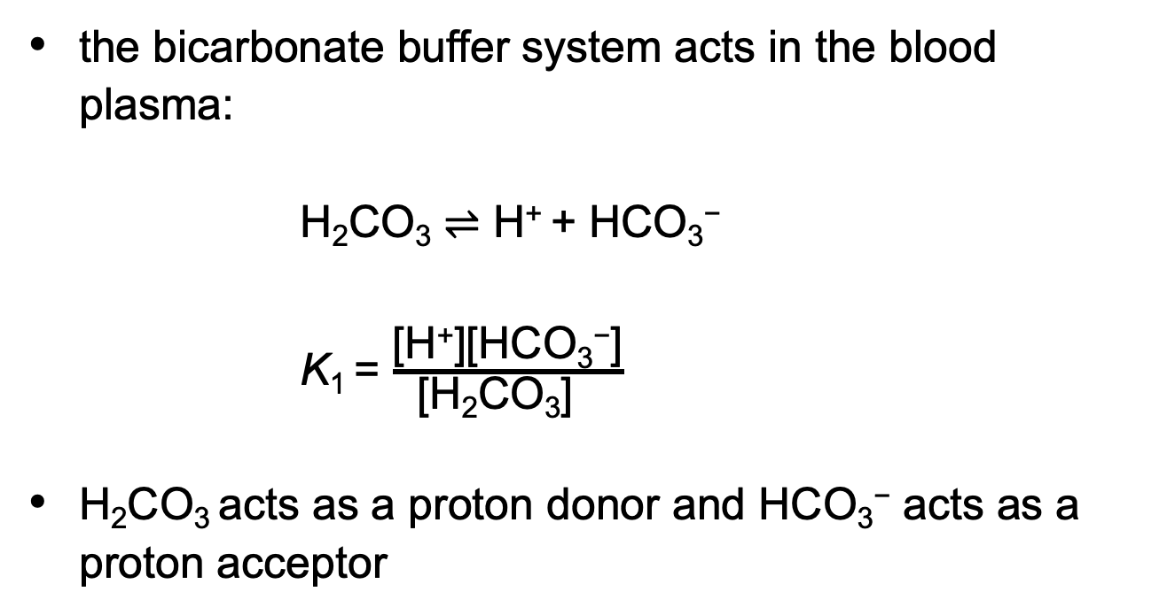
The Bicarbonate Buffer System
the bicarbonate buffer system acts in the blood plasma:
H₂CO₃ ⇌ H⁺ + HCO₃⁻
K₁ = $\frac{\text{[}\text{H}\text{+}\text{][}\text{HCO}\text{3}\text{−}\text{]}}{\text{[}\text{H}\text{2}\text{CO}\text{3}\text{] }}$
H₂CO₃ acts as a proton donor and HCO₃⁻ acts as a proton acceptor

Slide 59
The pH of a Bicarbonate Buffer System
the pH of a bicarbonate buffer system exposed to a gas phase depends on:
  the concentration of HCO₃–
  the partial pressure of CO₂ (pCO₂) = the concentration of CO₂ in the gas phase
buffer system is effective near pH 7.4

Slide 60
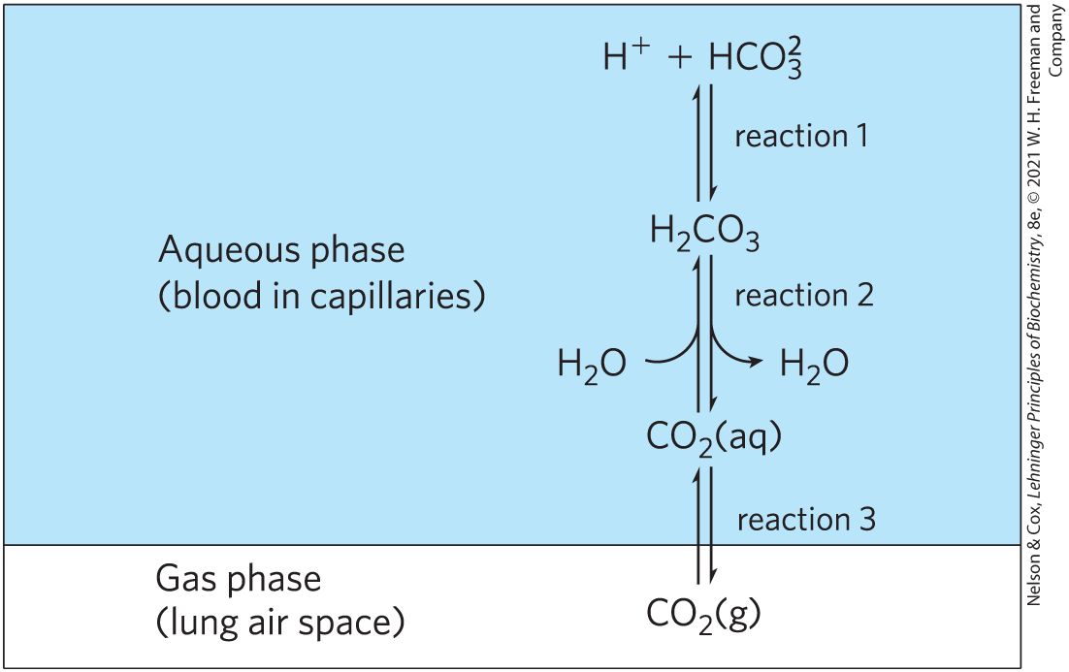
The Bicarbonate Buffer System Involves Three Reversible Equilibria
the rate of respiration (controlled by the brain stem) can quickly adjust these equilibria to keep the blood pH nearly constant
hyperventilation raises blood pH

Slide 61
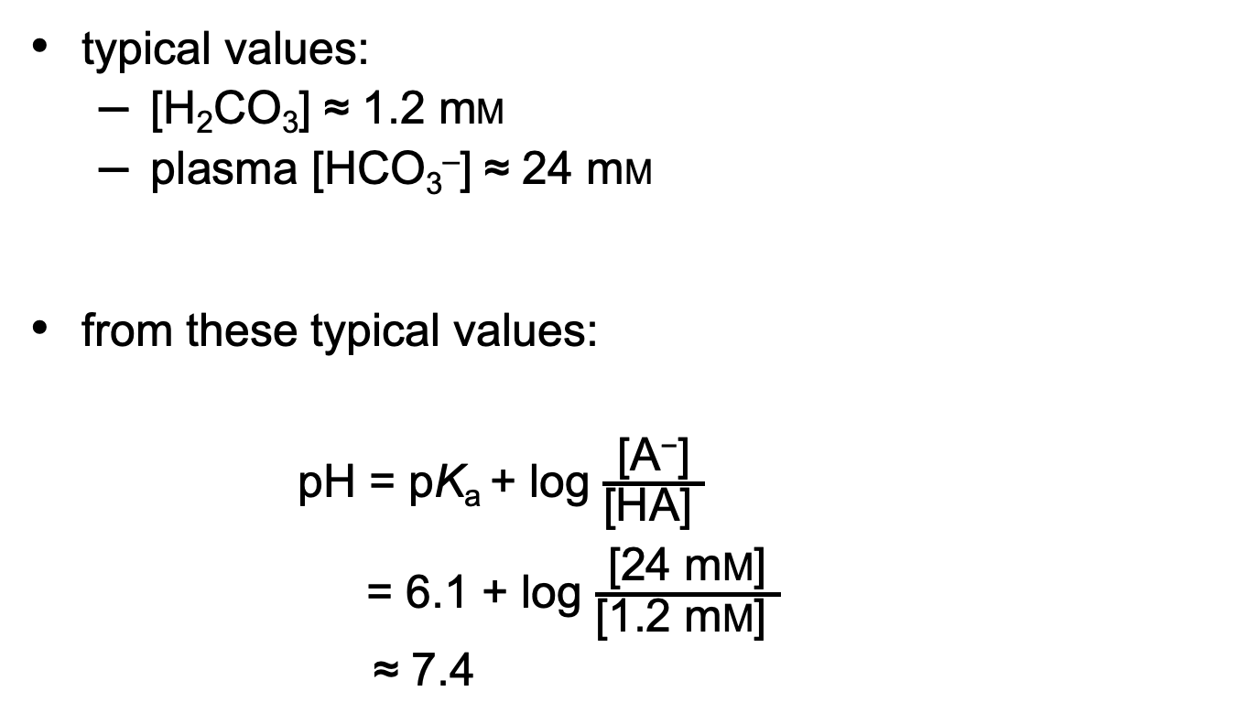
Calculating Blood pH
typical values:
  [H₂CO₃] ≈ 1.2 mM
  plasma [HCO₃–] ≈ 24 mM
from these typical values:
pH = pK_{a} + log $\frac{\text{[}\text{A}\text{−}\text{]}}{\text{[}\text{HA}\text{] }}$
= 6.1 + log $\frac{\text{[}\text{24 }\text{m}\text{M}\text{]}}{\text{[}\text{1.2 }\text{m}\text{M}\text{] }}$
≈ 7.4

Slide 62
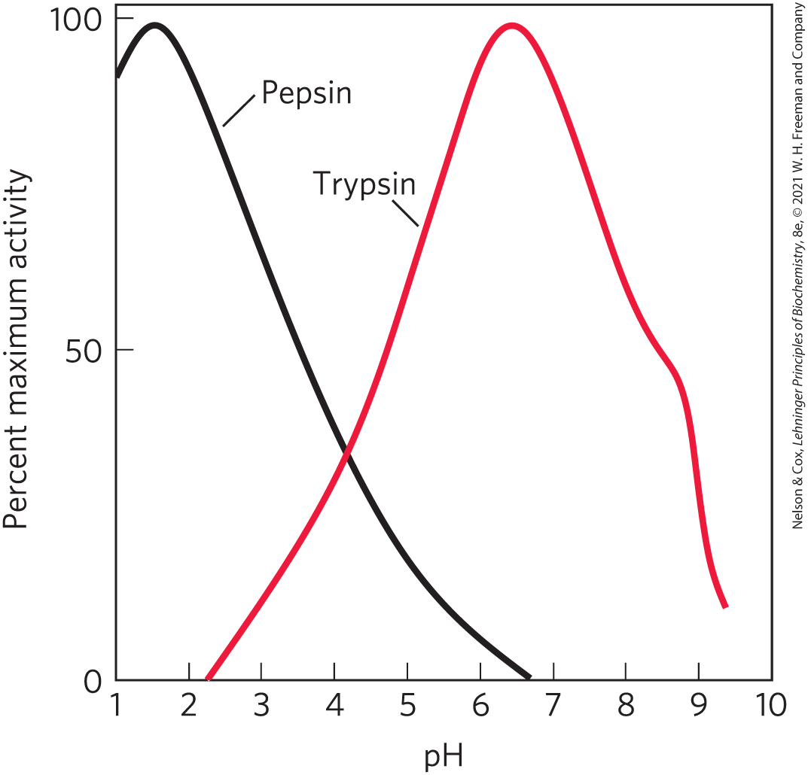
Untreated Diabetes Produces Life-Threatening Acidosis
optimum pH = the characteristic pH at which enzymes typically show maximum catalytic activity

Slide 63
Untreated Diabetes Mellitus
results in acidosis, the accumulation of high concentrations of two carboxylic acids, β-hydroxybutyric acid and acetoacetic acid
dissociation of these acids lowers the pH of blood plasma to less than 7.35
severe acidosis causes enzymes to not function properly

