Slide 1

1 The Foundations of Biochemistry
© 2021 Macmillan Learning

Slide 2
Life Arose on Earth around 4 Billion Years Ago
simple microorganisms:
  extracted energy from chemical compounds and sunlight
  used energy to make biomolecules from the simple elements and compounds on the Earth’s surface

Slide 3

Principle 1 (1 of 2)
Cells are the fundamental unit of life. Although they vary in complexity and can be highly specialized for their environment or function within a multicellular organism, they share remarkable similarities.

Slide 4

Principle 2 (1 of 6)
Cells use a relatively small set of carbon- based metabolites to create polymeric machines, supramolecular structures, and information repositories. The chemical structure of these components defines their cellular function. The collection of molecules carries out a program, the end result of which is reproduction of the program and self-perpetuation of that collection of molecules—in short, life.

Slide 5

Principle 3 (1 of 5)
Living organisms exist in a dynamic
steady state, never at equilibrium with
their surroundings. Following the laws of thermodynamics, living organisms extract energy from their surroundings and employ it to maintain homeostasis and do useful work. Essentially all of the energy obtained by a cell comes from the flow of electrons, driven by sunlight or by metabolic redox reactions.

Slide 6

Principle 4 (1 of 5)
Cells have the capacity for precise self-replication and self-assembly using chemical information stored in the genome. A single bacterial cell placed in a sterile nutrient medium can give rise to a billion identical “daughter” cells in 24 hours. Each cell is a faithful copy of the original, its construction directed entirely by information contained in the genetic material of the original cell. On a larger scale, the progeny of vertebrate animals share a striking resemblance to their parents, also the result of their inheritance of parental genes.

Slide 7

Principle 5 (1 of 3)
Living organisms change over time by gradual evolution. The result of eons of evolution is an enormous diversity of life forms, fundamentally related through their shared ancestry, which can be seen at the molecular level in the similarity of gene sequences and protein structures.

Slide 8
What Is Biochemistry?
biochemistry = describes the structures, mechanisms, and chemical processes shared by all organisms

Slide 9
1.1 Cellular Foundations

Slide 10
Principle 1 (2 of 2)
Cells are the fundamental unit of life. Although they vary in complexity and can be highly specialized for their environment or function within a multicellular organism, they share remarkable similarities.

Slide 11
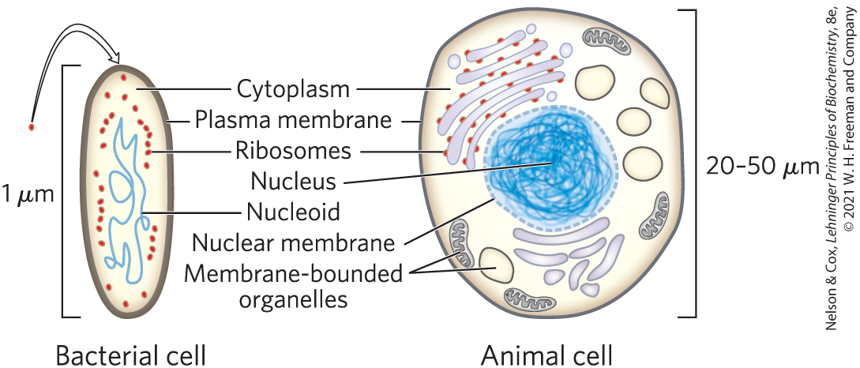
Cells Are the Structural and Functional Units of All Living Organisms

Slide 12
The Plasma Membrane
plasma membrane = defines the periphery of the cell
  composed of lipid and protein molecules
  thin, flexible, hydrophobic barrier around the cell
  contains embedded transport proteins, receptor proteins, and membrane enzymes

Slide 13
Cytoplasm Contains Cytosol and Suspended Particles
cytoplasm = internal volume enclosed by the plasma membrane
  composed of the cytosol (an aqueous solution) and a variety of suspended particles (such as mitochondria, chloroplasts, ribosomes, and proteasomes)
cytosol = highly concentrated solution
  contains enzymes, RNA, amino acids, nucleotides, metabolites, coenzymes, and inorganic ions

Slide 14
The Nucleoid or Nucleus of a Cell Stores the Genome
genome = complete set of genes, composed of DNA
  bacteria and archaea (formally grouped as prokaryotes) store their genome in a nucleoid
  eukaryotes store their genome in a membrane-enclosed nucleus

Slide 15
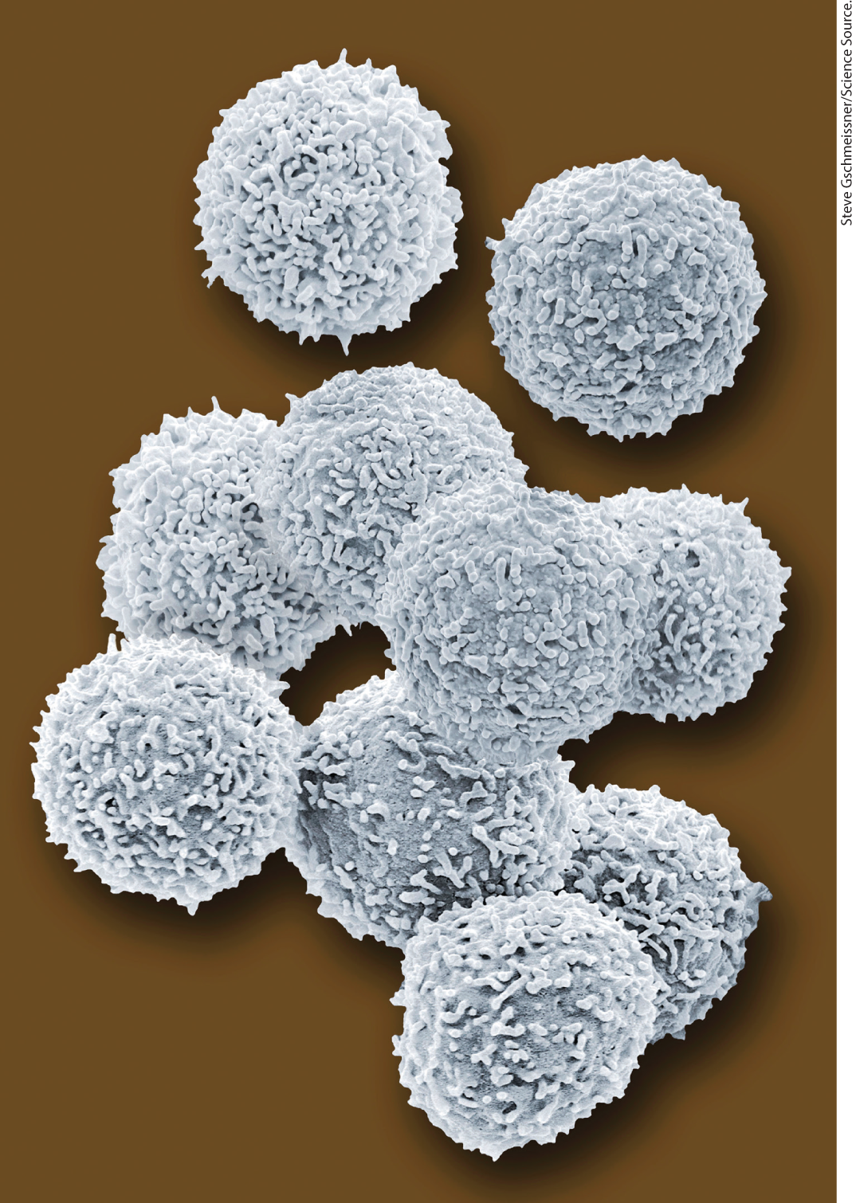
Cellular Dimensions Are Limited by Diffusion
cells are microscopic:
  animal and plant cells:
  5 to 100 μm in diameter
  unicellular microorganisms: 1 to 2 μm long
upper limit of cell size is likely set by the rate of transport and the need to deliver O₂ to all parts of the cell
  as size increases, surface-to-volume ratio decreases
human lymphocytes

Slide 16
Organisms Belong to Three Distinct Domains of Life
Bacteria = inhabit soils, surface waters, and the tissues of other living or decaying organisms
Archaea = inhabit extreme environments
Eukarya = all eukaryotic organisms
  more closely related to archaea than bacteria

Slide 17
Archaea and Bacteria Subgroups Are Distinguished by Their Habitats
aerobic = plentiful supply of O₂; organisms transfer electrons from fuel to O₂ for energy
anaerobic = devoid of O₂; organisms transfer electrons to nitrate, sulfate or CO₂ for energy
  obligate anaerobes = die when exposed to O₂
  facultative anaerobes = can live with or without O₂

Slide 18
Principle 3 (2 of 5)
Living organisms exist in a dynamic
steady state, never at equilibrium with
their surroundings. Following the laws of thermodynamics, living organisms extract energy from their surroundings and employ it to maintain homeostasis and do useful work. Essentially all of the energy obtained by a cell comes from the flow of electrons, driven by sunlight or by metabolic redox reactions.

Slide 19
Organisms Differ Widely in Their Sources of Energy and Biosynthetic Precursors
phototrophs = trap and use sunlight
chemotrophs = derive energy from oxidation of a chemical fuel
autotrophs = can synthesize all their biomolecules directly from CO₂
heterotrophs = require some preformed organic nutrients made by other organisms

Slide 20
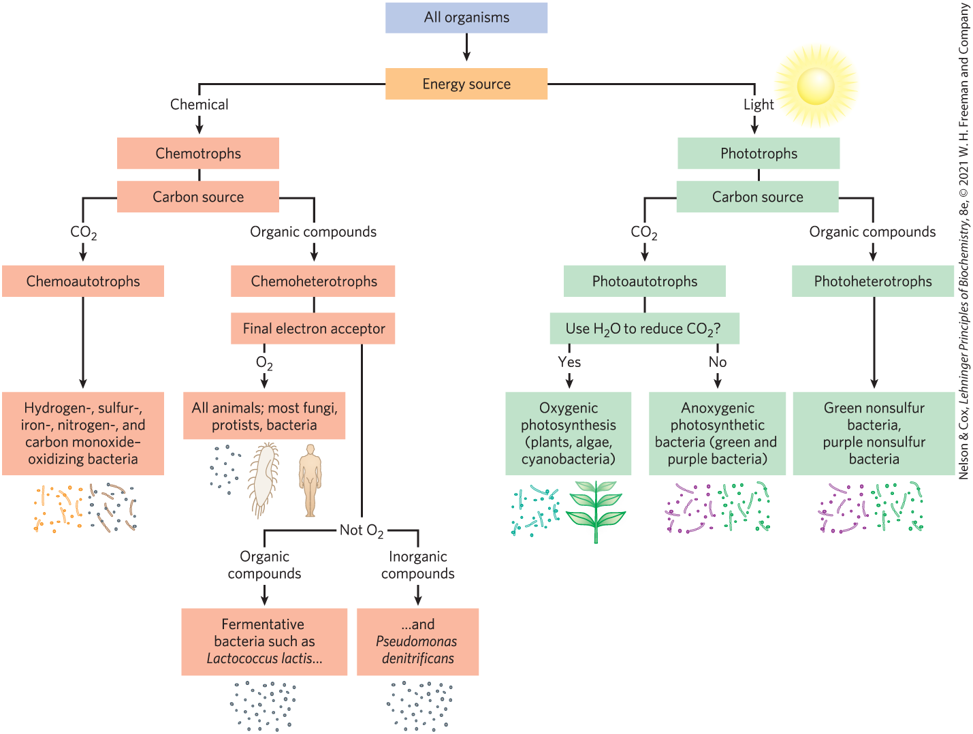
Classifying Organisms According to Their Source of Energy

Slide 21
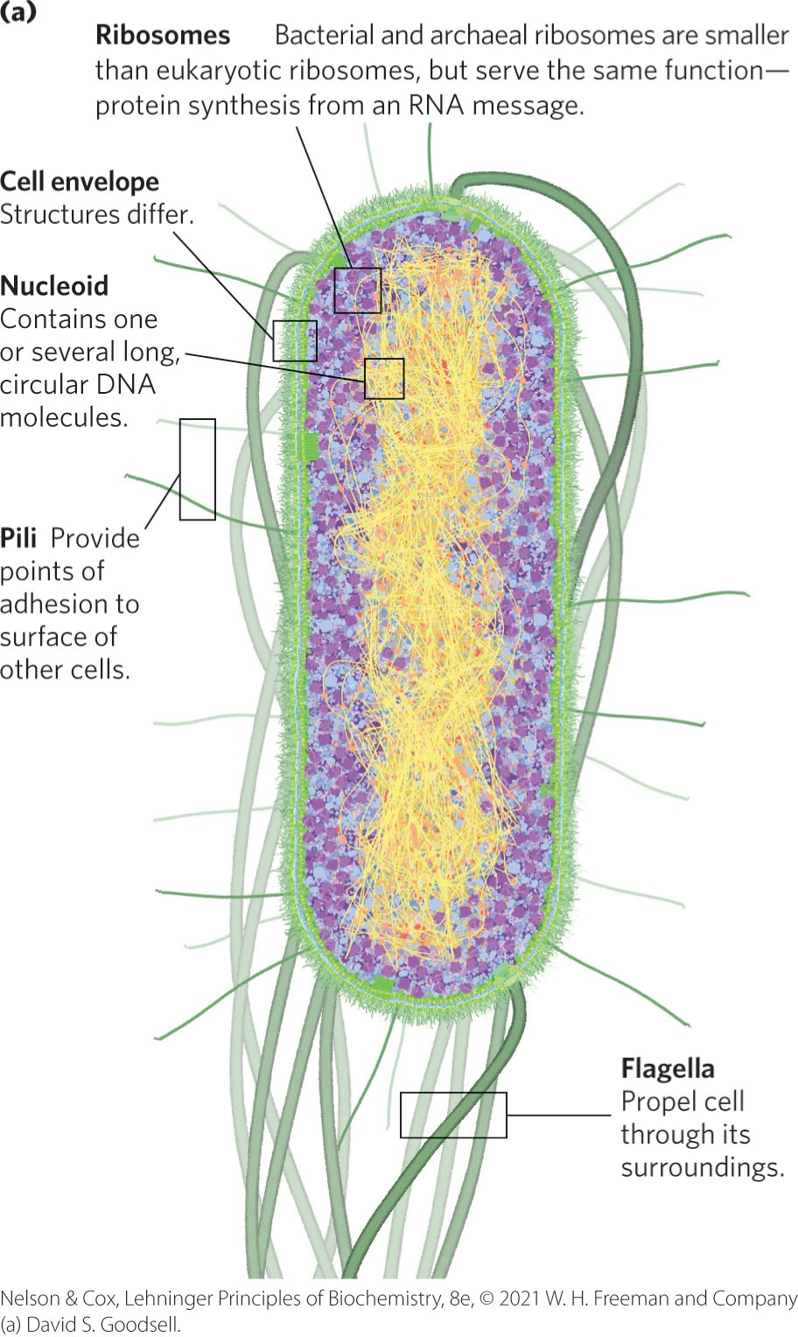
Bacteria and Archaeal Cells Share Common Features but Differ in Important Ways
cell envelope = composed of plasma membrane, outer membrane, and peptidoglycan (high molecular weight polymer)

Slide 22
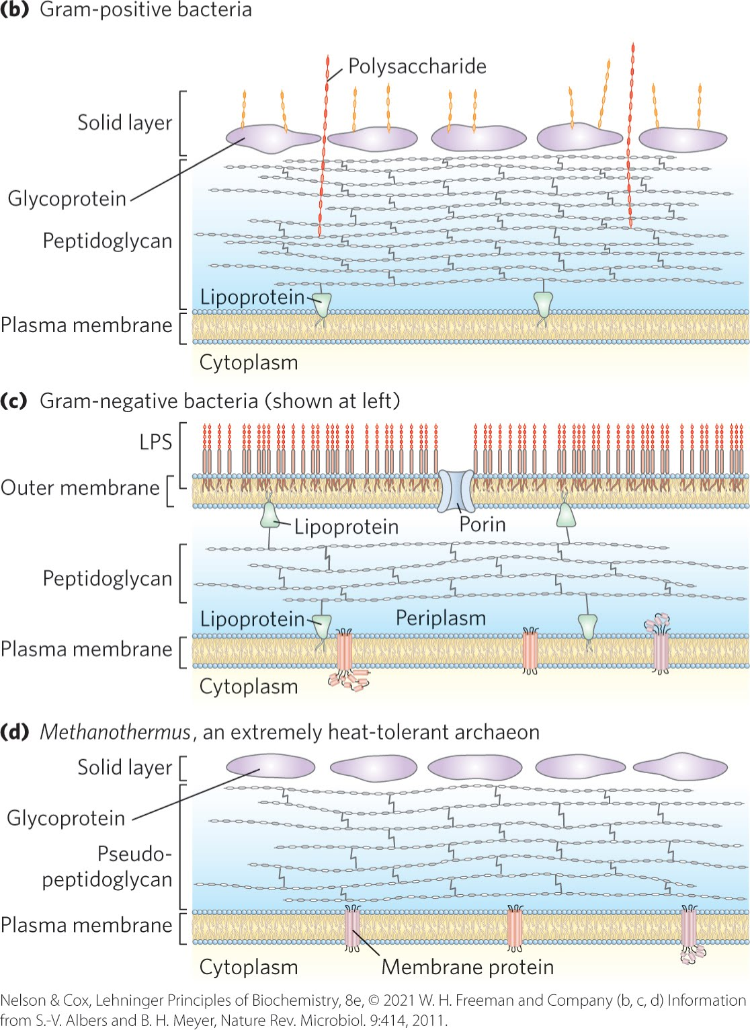
Bacterial and Archaeal Cell Envelopes
gram-positive bacteria:
  colored by Gram’s stain
  thick peptidoglycan layer outside plasma membrane
  lack an outer membrane
gram-negative bacteria:
  outer membrane composed of a lipid bilayer
archaea:
  layer of peptidoglycan or protein confers rigidity on their cell envelopes

Slide 23
Principle 2 (2 of 6)
Cells use a relatively small set of carbon- based metabolites to create polymeric machines, supramolecular structures, and information repositories. The chemical structure of these components defines their cellular function. The collection of molecules carries out a program, the end result of which is reproduction of the program and self-perpetuation of that collection of molecules—in short, life.

Slide 24
The E. coli Cytoplasm
contains ribosomes, enzymes, metabolites, cofactors, and inorganic ions.
the nucleoid contains a single, circular molecule of DNA
plasmids = smaller, circular segments of DNA that confer resistance to toxins and antibiotics in the environment

Slide 25
Eukaryotic Cells Have a Variety of Membranous Organelles, Which Can Be Isolated for Study
mitochondria = the site of most of the energy-extracting reactions of the cell
endoplasmic reticulum and Golgi complexes = play central roles in the synthesis and processing of lipids and membrane proteins
peroxisomes = site of the oxidation of very-long-chain fatty acids and detoxification of reactive oxygen species
lysosomes = filled with digestive enzymes
granules or droplets containing stored nutrients, such as starch and fat

Slide 26
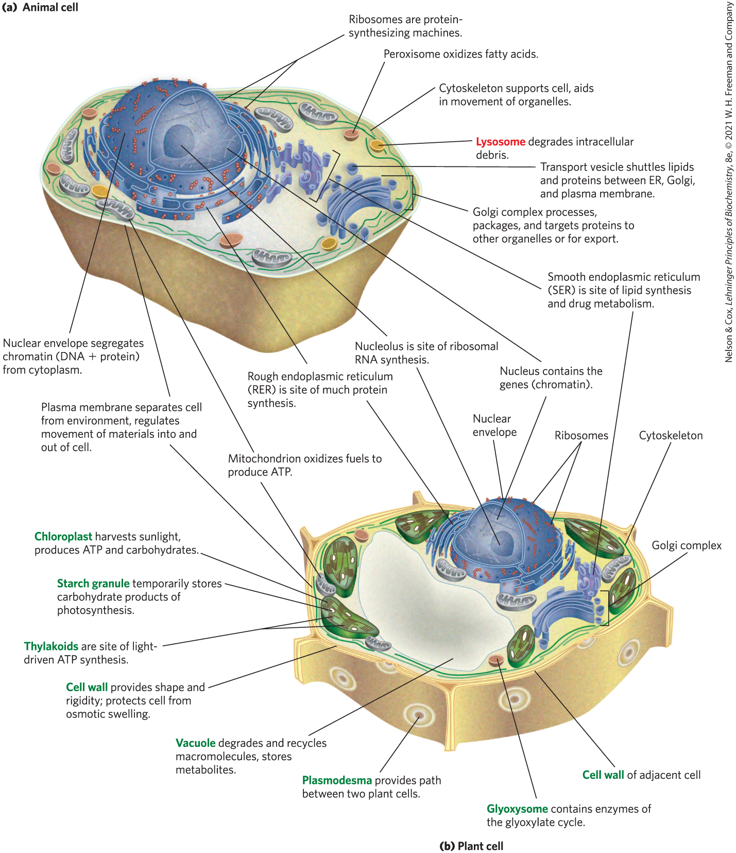
Eukaryotic Cell Structure

Slide 27
The Cytoplasm Is Organized by the Cytoskeleton and Is Highly Dynamic
cytoskeleton = three-dimensional network of protein filaments in eukaryotic cells
  actin filaments
  microtubules
  intermediate filaments
filaments undergo constant disassembly into their protein subunits and reassembly into filaments

Slide 28
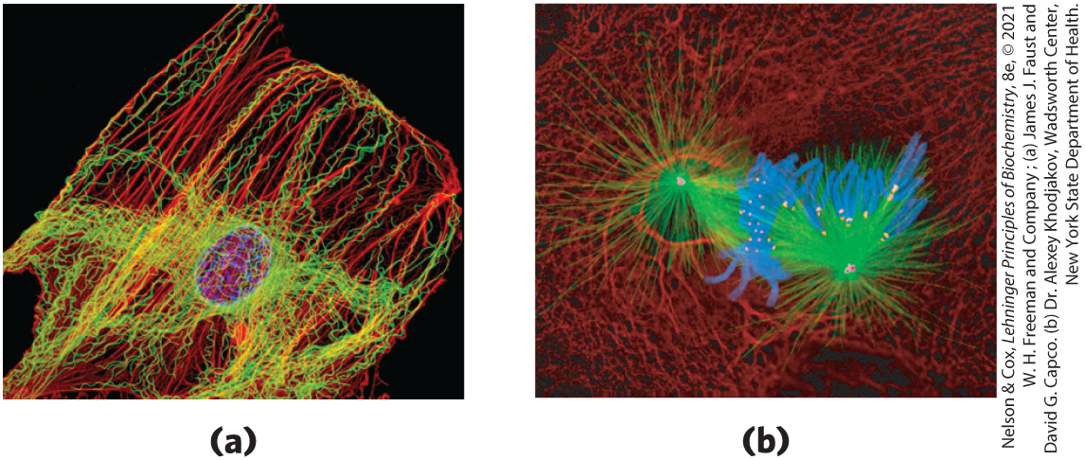
Cytoskeletal Filaments
actin filaments microtubules
chromosomes
microtubules
kinetochores
chromosomes centrosomes
intermediate filaments

Slide 29
The Structural Organization of the Cytoplasm
endomembrane system = segregates specific metabolic processes and provides surfaces on which certain enzyme-catalyzed reactions occur
exocytosis and endocytosis = mechanisms of transport (out of and into cells, respectively)
  involve membrane fusion and fission
  provide paths between the cytoplasm and the surrounding medium

Slide 30
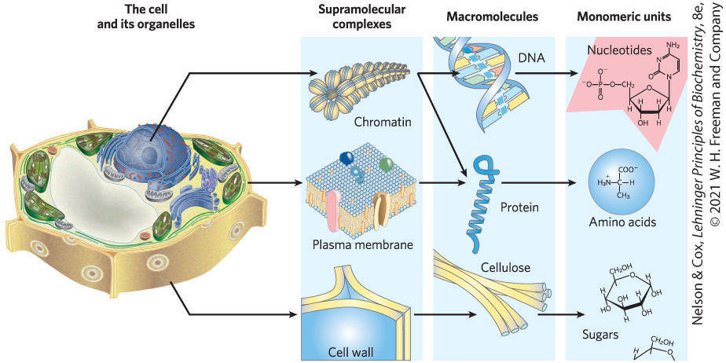
Cells Build Supramolecular Structures
held together by noncovalent interactions (hydrogen bonds, ionic interactions, van der Waals interactions, and the hydrophobic effect)

Slide 31
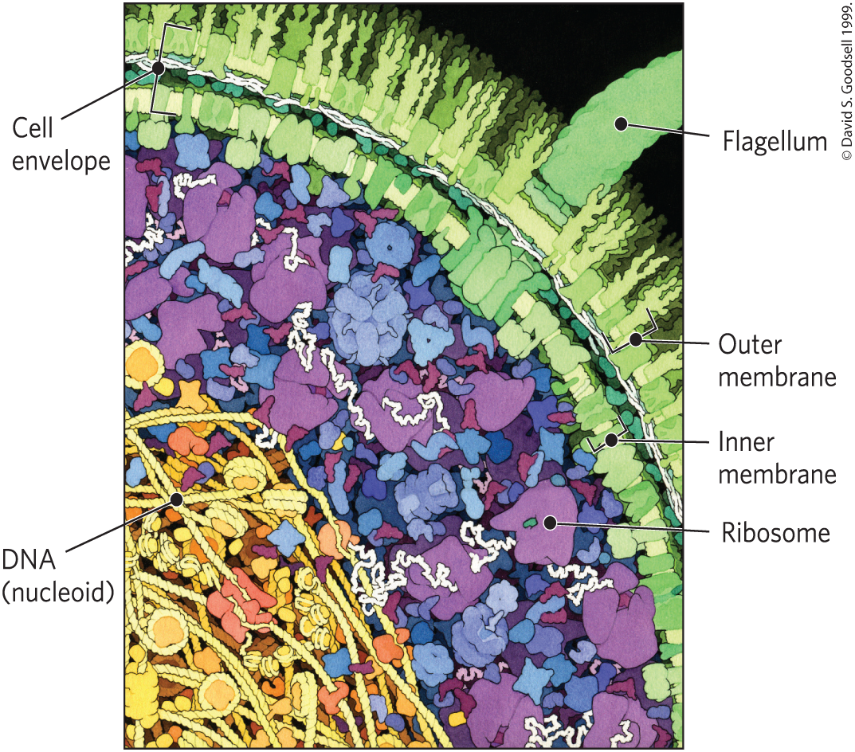
In Vitro Studies May Overlook Important Interactions among Molecules
in vitro = “in glass”
in vivo = “in the living”
molecules may behave differently in vivo and in vitro

Slide 32
1.2 Chemical Foundations

Slide 33
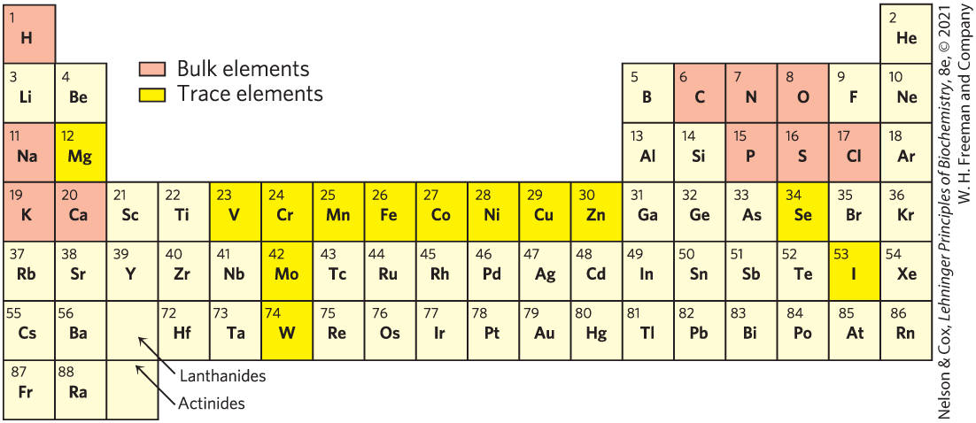
Elements Essential to Animal Life and Health

Slide 34
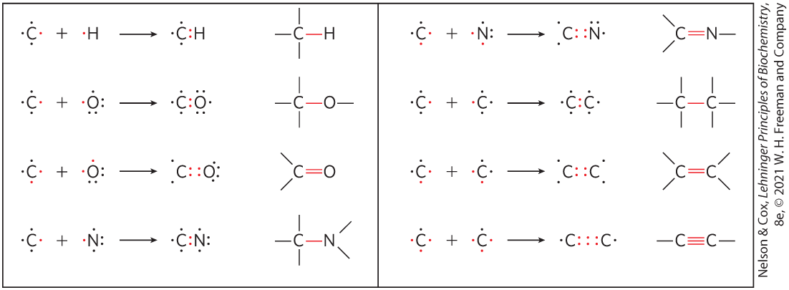
Biomolecules Are Compounds of Carbon with a Variety of Functional Groups
carbon can form covalent single, double, and triple bonds

Slide 35
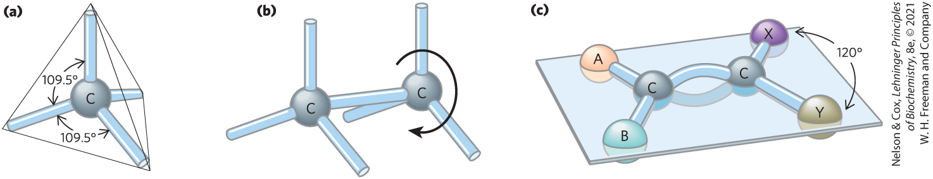
Geometry of Carbon Bonding
carbon atoms have a characteristic tetrahedral arrangement of their four single bonds
free rotation around each single bond
limited rotation about the axis of a double bond

Slide 36
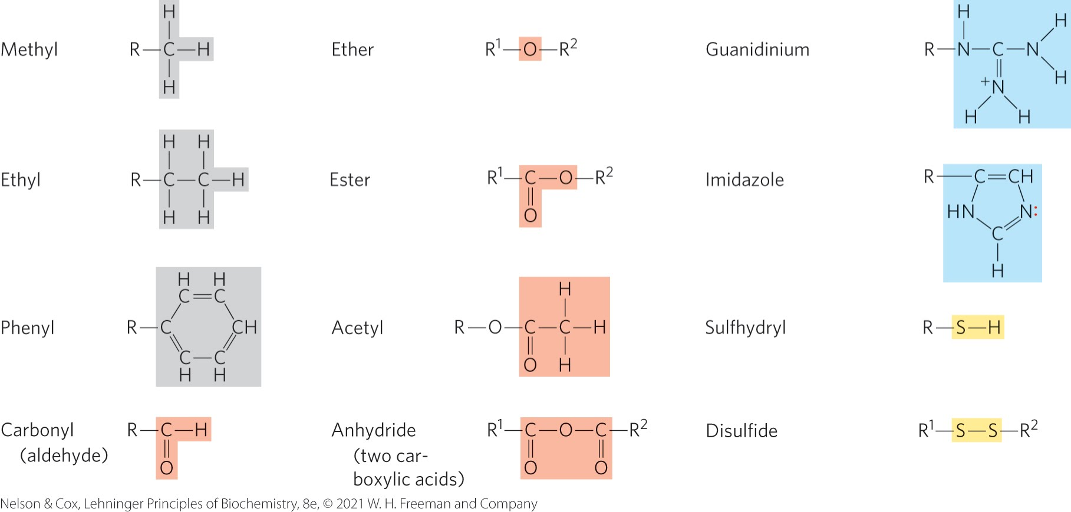
Common Functional Groups of Biomolecules

Slide 37
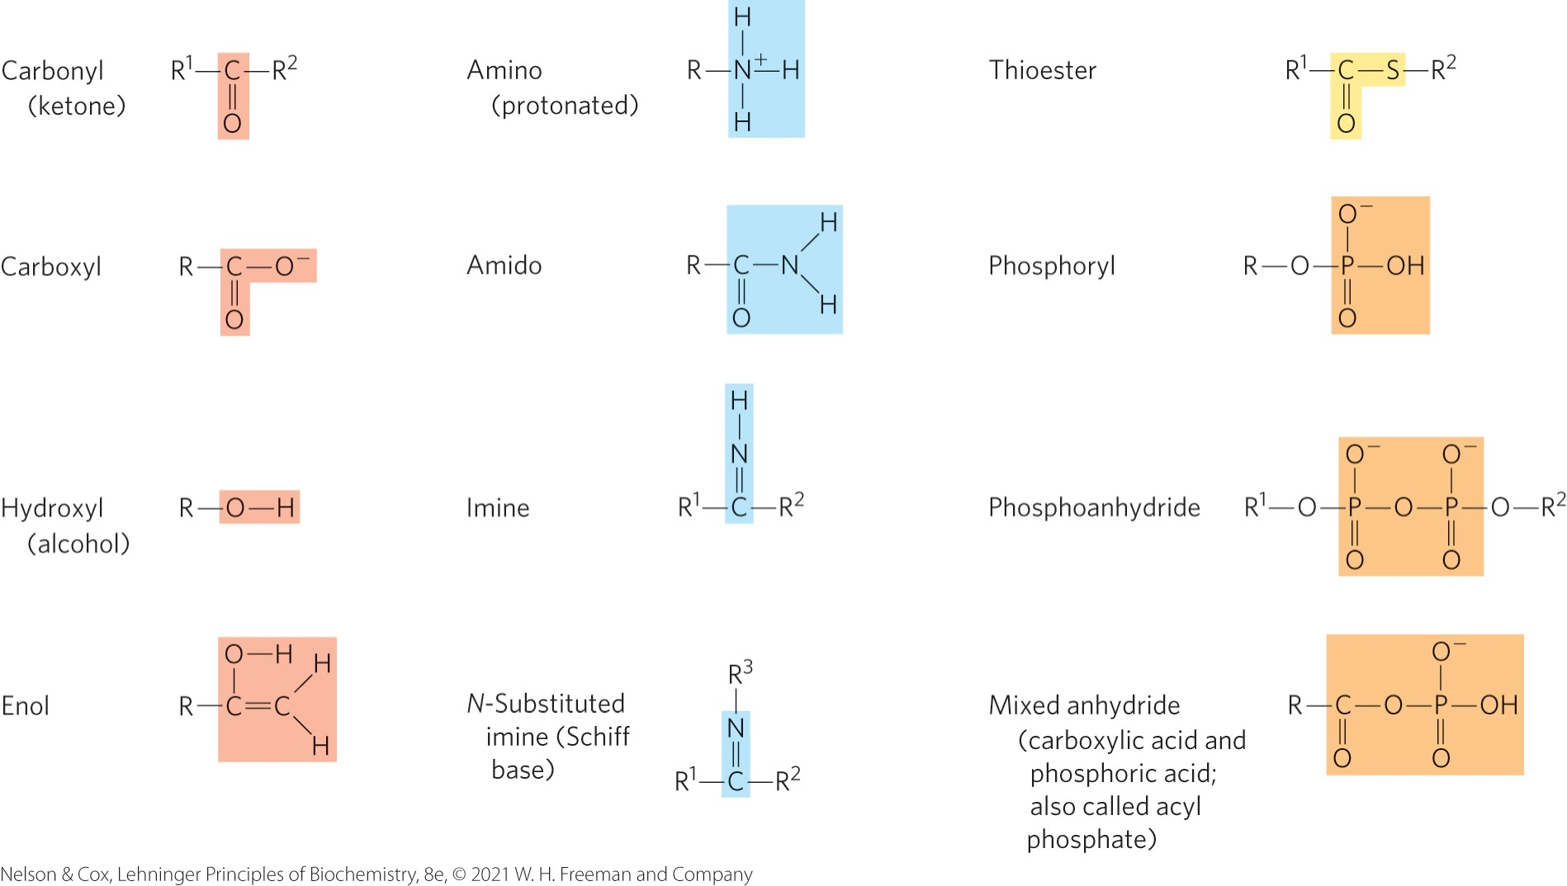
Additional Functional Groups of Biomolecules

Slide 38
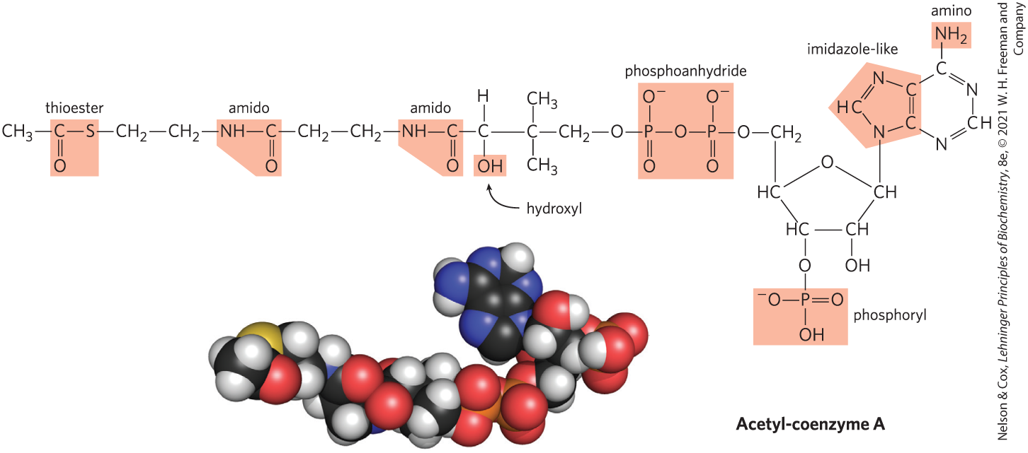
Many Biomolecules Are Polyfunctional

Slide 39
Cells Contain a Universal Set of Small Molecules
central metabolites:
  common amino acids
  nucleotides
  sugars and their phosphorylated derivatives
  mono-, di-, and tricarboxylic acids
secondary metabolites = specific to the organism
metabolome = entire collection of small molecules in a given cell under a specific set of conditions
  metabolomics = the systematic characterization of the metabolome under very specific conditions

Slide 40
Macromolecules Are the Major Constituents of Cells
macromolecules = polymers with molecular weights above ~5,000 that are assembled from relatively simple precursors
  proteins
  nucleic acids
  polysaccharides
oligomers = shorter polymers
informational macromolecules = name for proteins, nucleic acids, and some oligosaccharides, given their information-rich subunit sequences

Slide 41
Protein Macromolecules
proteins = long polymers of amino acids
  can function as enzymes, structural elements, signal receptors, transporters
proteome = sum of all the proteins functioning in a cell
proteomics = the systematic characterization of this protein complement under a specific set of conditions

Slide 42
Nucleic Acid Macromolecules
nucleic acids = DNA and RNA = polymers of nucleotides
  store and transmit genetic information
  some RNA molecules have structural and catalytic roles in supramolecular complexes
genome = entire sequence of a cell’s DNA or RNA
genomics = the characterization of the structure, function, evolution, and mapping of genomes

Slide 43
Polysaccharide Macromolecules
polysaccharides = polymers of simple sugars
  energy-rich fuel stores
  rigid structural components of cell walls (in plants and bacteria)
  extracellular recognition elements that bind to proteins on other cells
glycome = entire complement of carbohydrate-containing molecules

Slide 44
Lipid Molecules
lipids = water-insoluble hydrocarbon derivatives
  structural components of membranes
  energy-rich fuel stores
  pigments
  intracellular signals
lipidome = the lipid containing molecules in a cell

Slide 45
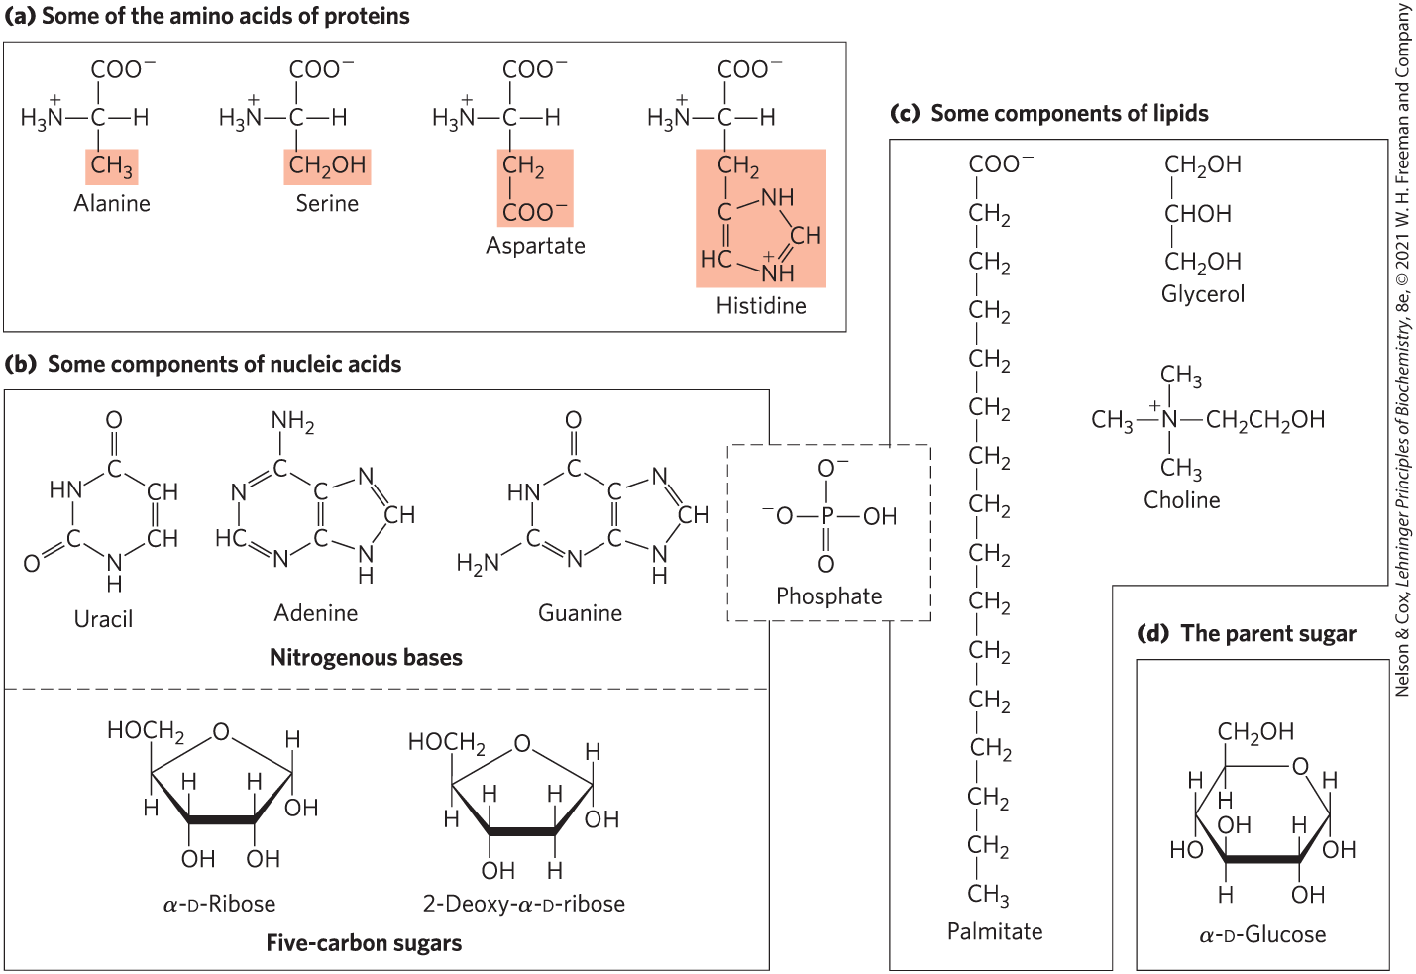
Building Blocks of Biochemistry

Slide 46
Major Classes of Biomolecules in E. coli Cells
Table 1-1 Molecular Components of an E. coli Cell
 | Percentage of total weight of cell | Approximate number of different molecular species
Water | 70 | 1
Proteins | 15 | 3,000
Nucleic acids: DNA | 1 | 1–4
Nucleic acids: RNA | 6 | >3,000
Polysaccharides | 3 | 20
Lipids | 2 | 50ª
Monomeric subunits and intermediates | 2 | 2,600
Inorganic ions | 1 | 20
Source: A. C. Guo et al., Nucleic Acids Res. 41:D625, 2013.
ªIf all permutations and combinations of fatty acid substitutions are considered, this number is much larger.

Slide 47
Three-Dimensional Structure Is Described by Configuration and Conformation
configuration = the fixed spatial arrangement of atoms
stereoisomers = molecules with the same chemical bonds and same chemical formula
stereospecific = requiring specific conformations in the interacting molecules
  describes typical interactions between biomolecules

Slide 48
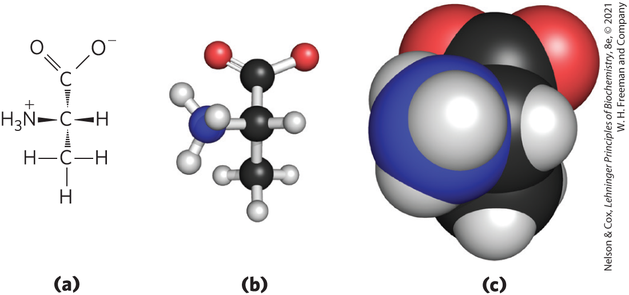
Illustrating Stereochemistry

Slide 49
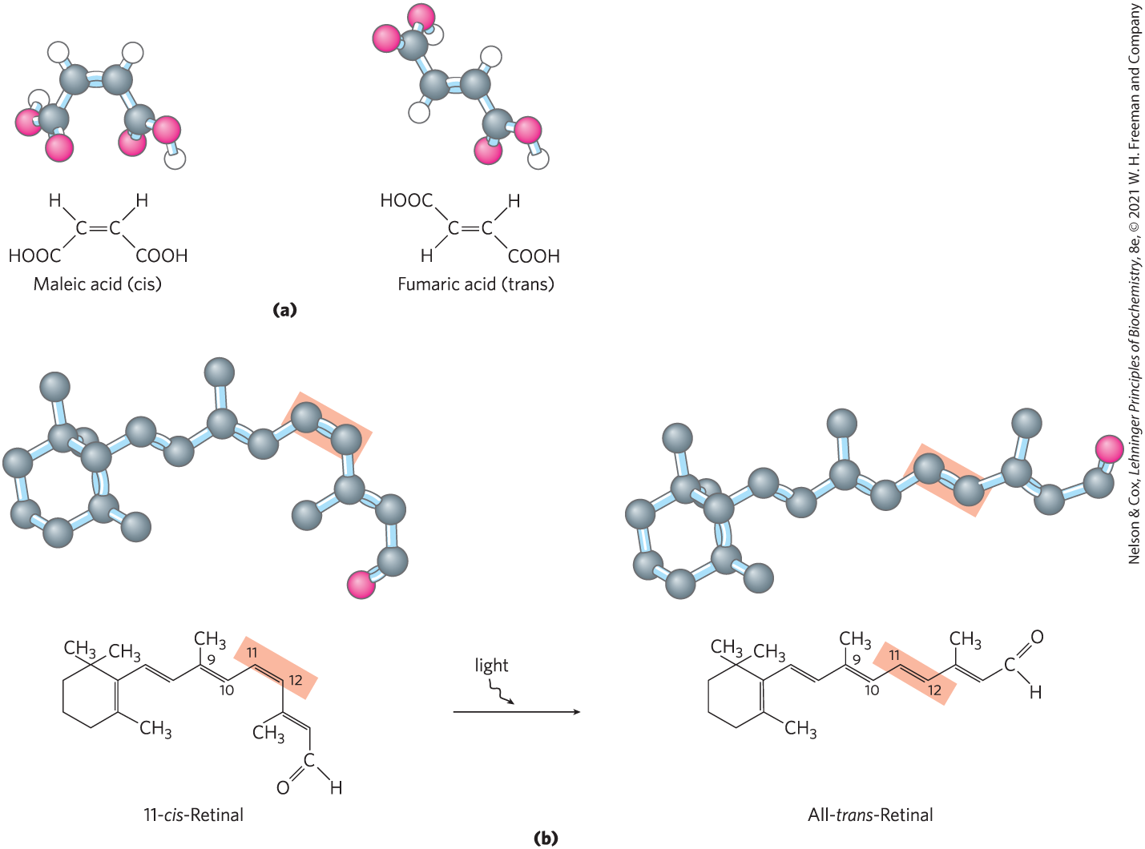
Configurations of Geometric Isomers
geometric isomers, or cis-trans isomers = differ in the arrangement of substituent groups with respect to the double bond

Slide 50
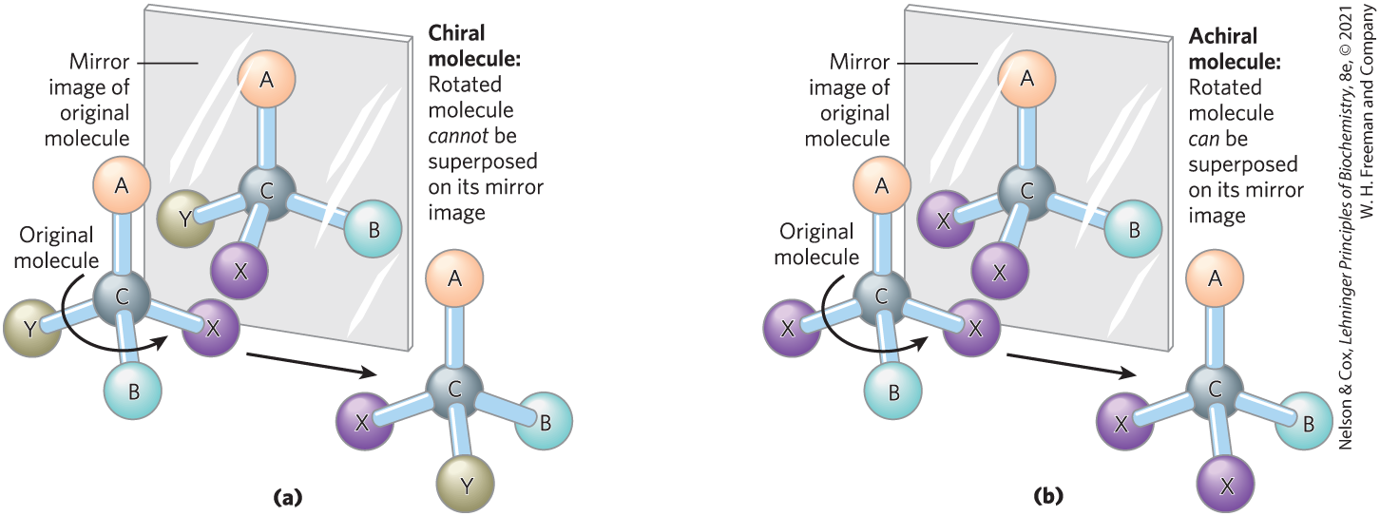
Chiral and Achiral Molecules
chiral centers = asymmetric carbons
a molecule can have 2^{n} stereoisomers, where n is the number of chiral carbons

Slide 51
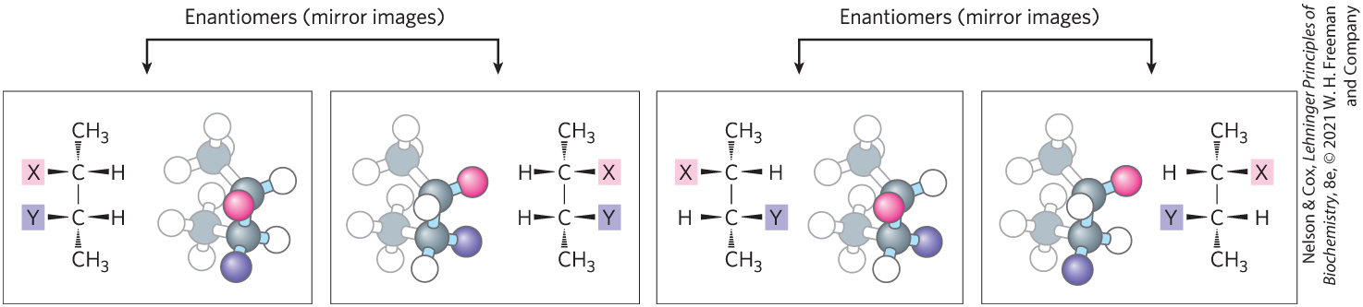
Enantiomers and Diastereomers
enantiomers = stereoisomers that are mirror images of each other
diastereomers = stereoisomers that are not mirror images of each other

Slide 52
Optical Activity of Enantiomers
enantiomers have nearly identical chemical reactivities, but differ in optical activity
a racemic mixture (equimolar solution of two enantiomers) shows no optical rotation

Slide 53
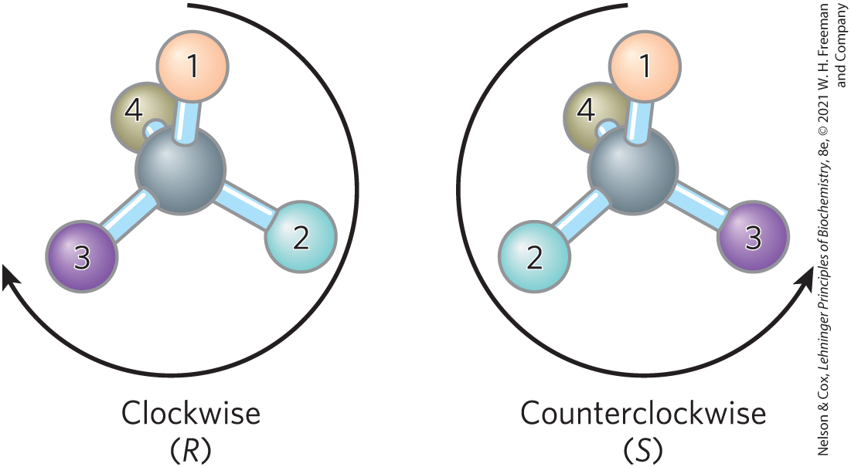
Naming Stereoisomers Using the RS System
each group attached to a chiral carbon is assigned a priority, where:
—OCH₃ > —OH > —NH₂ > —COOH > —CHO >
—CH₂OH > —CH₃ > —H

Slide 54
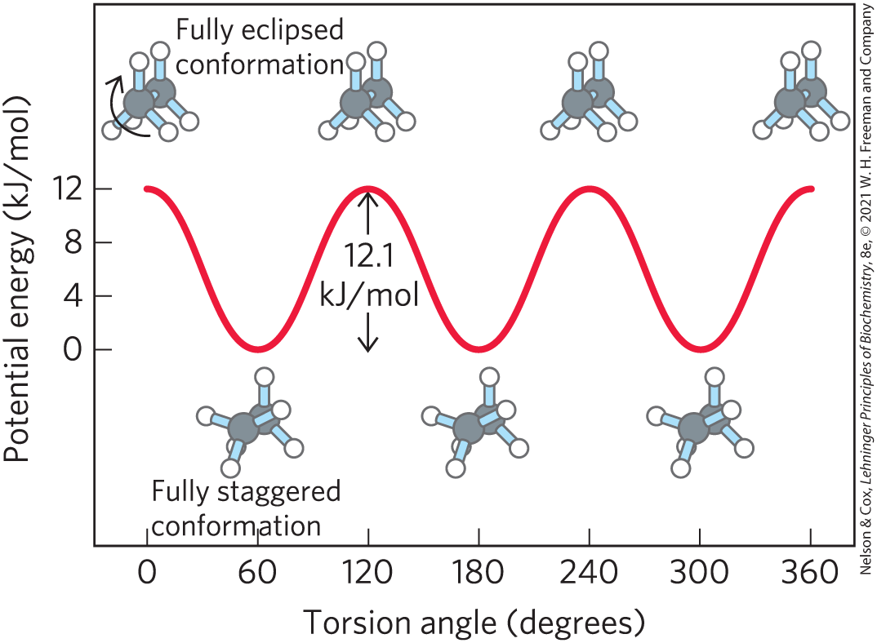
Molecular Conformation
conformation = the spatial arrangement of substituent groups that are free to assume different positions in space

Slide 55
Principle 2 (4 of 6)
Cells use a relatively small set of carbon- based metabolites to create polymeric machines, supramolecular structures, and information repositories. The chemical structure of these components defines their cellular function. The collection of molecules carries out a program, the end result of which is reproduction of the program and self-perpetuation of that collection of molecules—in short, life.

Slide 56
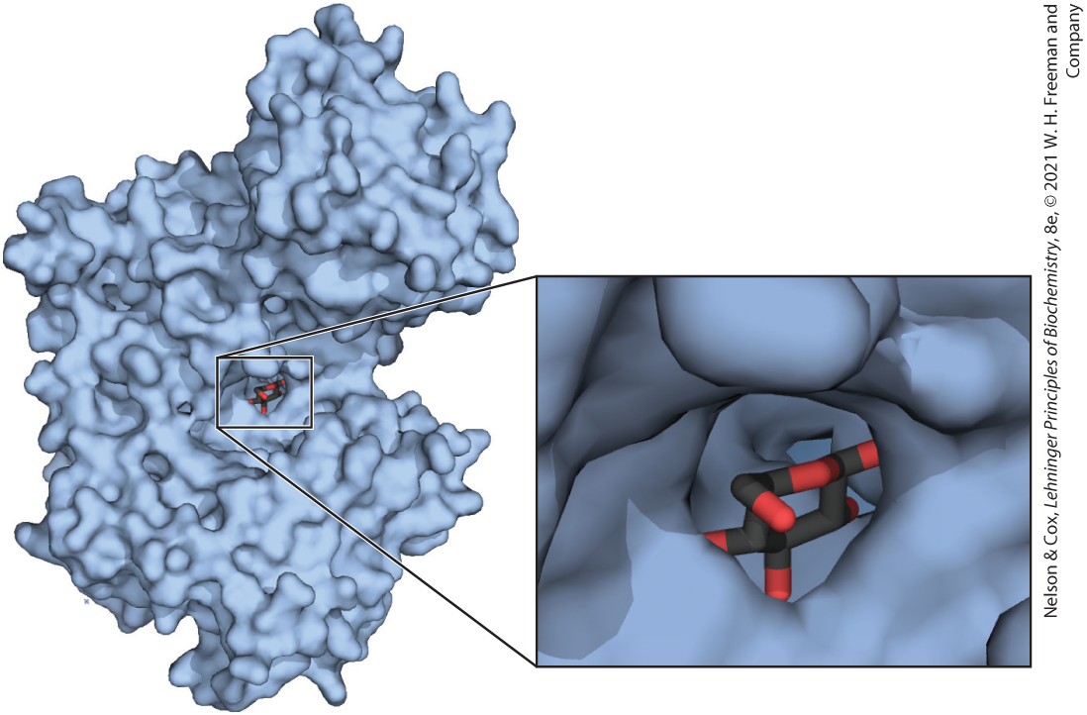
Interactions between Biomolecules Are Stereospecific

Slide 57
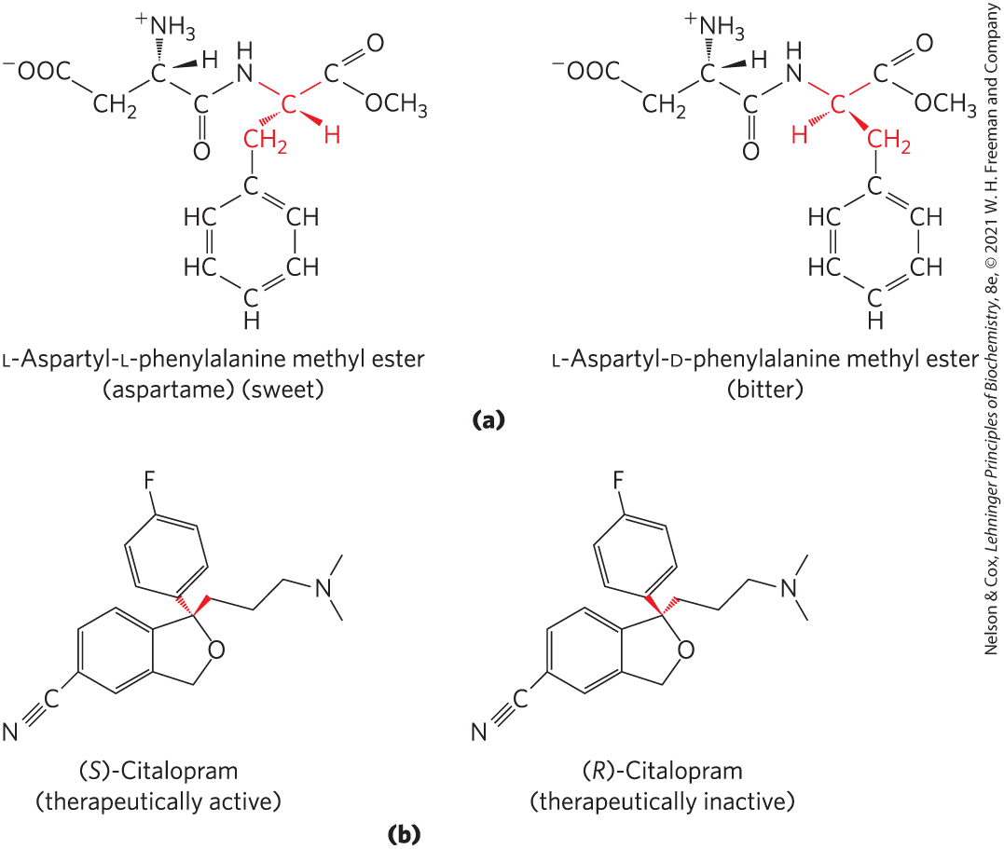
Biological Systems Can Distinguish Stereoisomers
stereospecificity = the ability to distinguish between stereoisomers

Slide 58
1.3 Physical Foundations

Slide 59
Living Organisms Exist in a Dynamic Steady State, Never at Equilibrium with Their Surroundings
small molecules, macromolecules, and supramolecular complexes are continuously synthesized and broken down
living cells maintain themselves in a dynamic steady state distant from equilibrium
maintaining steady state requires the constant investment of energy

Slide 60
Organisms Transform Energy and Matter from Their Surroundings
system = all the constituent reactants and products, the solvent that contains them, and the immediate atmosphere
universe = system and its surroundings
types of systems:
  isolated = system exchanges neither matter nor energy with its surroundings
  closed system = system exchanges energy but not matter with its surroundings
  open system = system exchanges both energy and matter with its surroundings

Slide 61
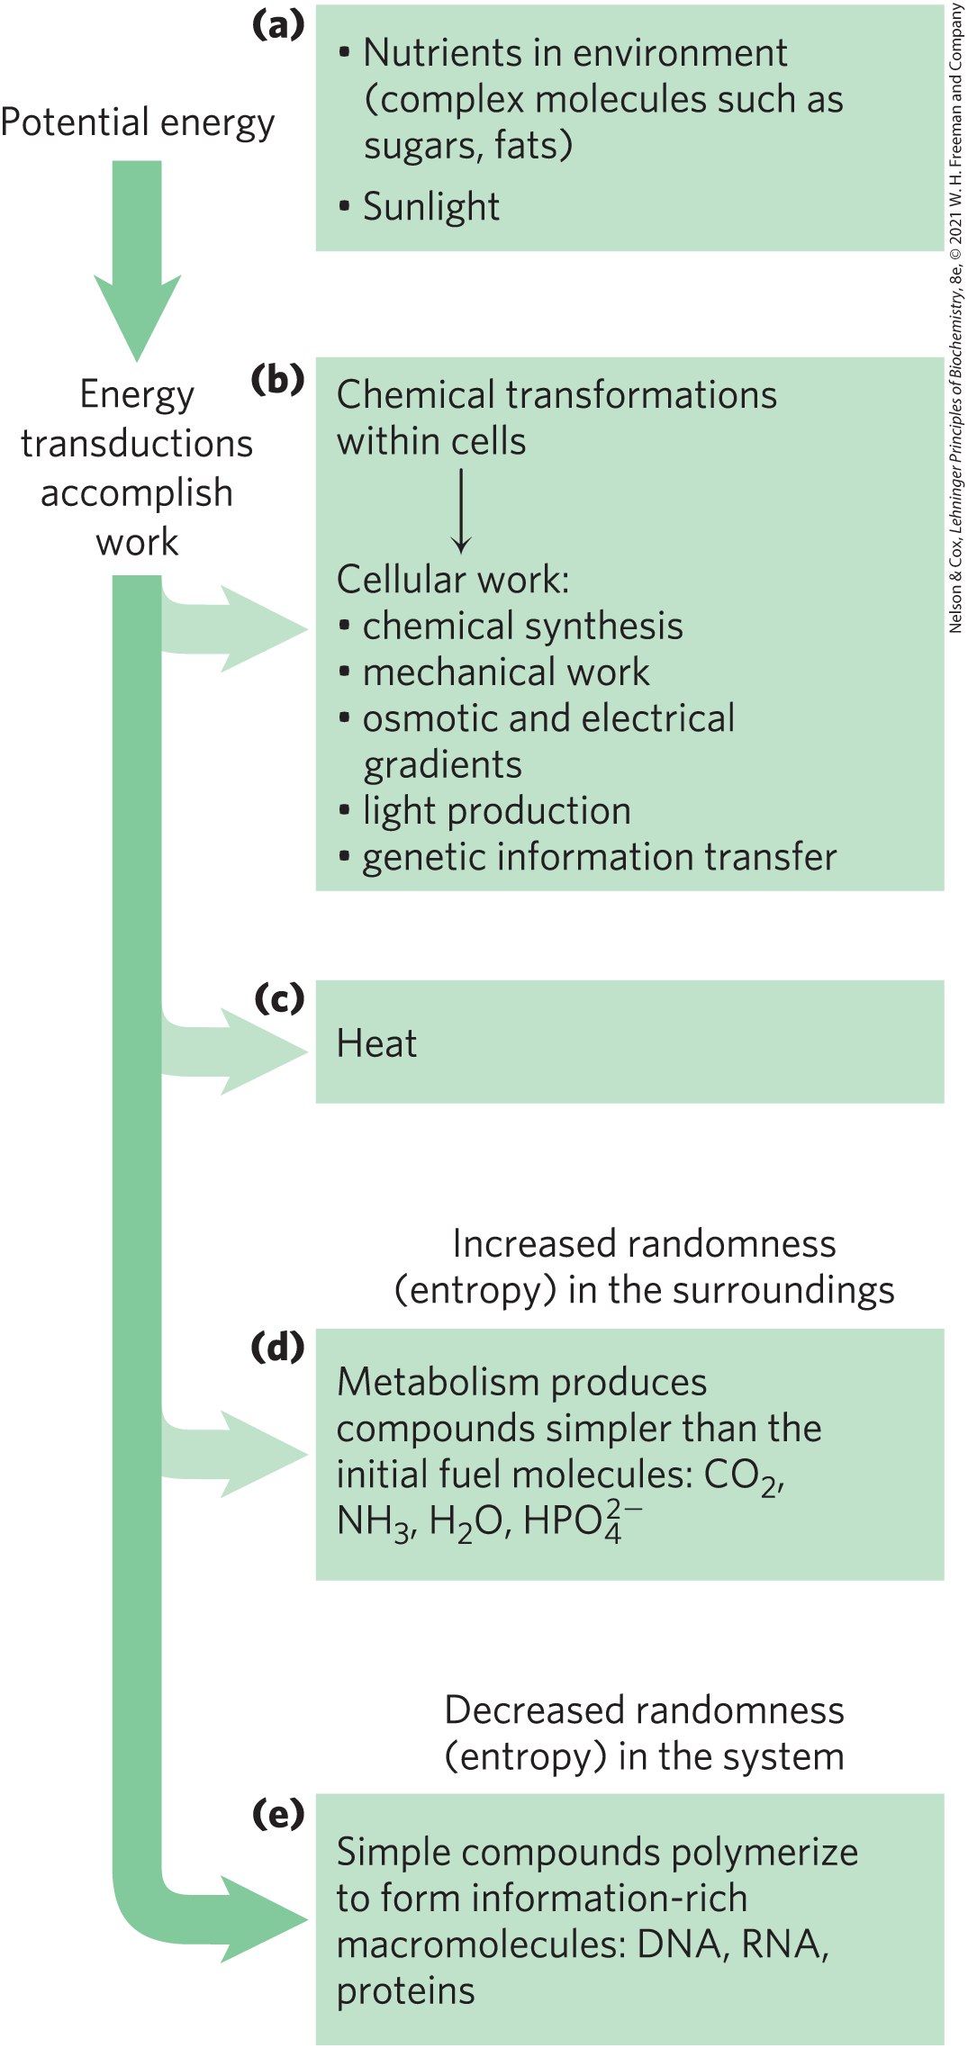
Energy Transformation in Living Organisms
first law of thermodynamics: in any physical or chemical change, the total amount of energy in the universe remains constant, although the form of the energy may change

Slide 62
Principle 3 (3 of 5)
Living organisms exist in a dynamic
steady state, never at equilibrium with
their surroundings. Following the laws of thermodynamics, living organisms extract energy from their surroundings and employ it to maintain homeostasis and do useful work. Essentially all of the energy obtained by a cell comes from the flow of electrons, driven by sunlight or by metabolic redox reactions.

Slide 63
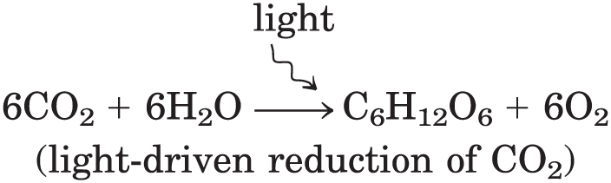
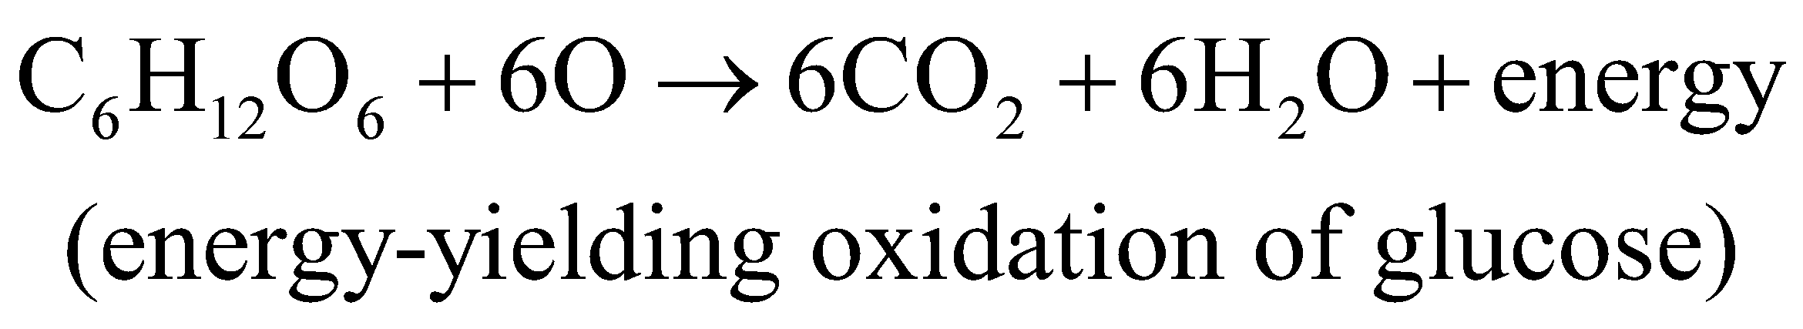
Extracting Energy from the Surroundings
photoautotrophs:
chemotrophs:

Slide 64
Oxidation-Reduction Reactions
autotrophs and heterotrophs participate in global cycles of O₂ and CO₂, driven by sunlight, making these two groups interdependent
oxidation-reduction reactions = one reactant is oxidized (loses electrons) as another is reduced (gains electrons)
  describes reactions involved in electron flow

Slide 65
Creating and Maintaining Order Requires Work and Energy
second law of thermodynamics: randomness in the universe is constantly increasing
entropy, S = represents the randomness or disorder of the components of a chemical system

Slide 66
Free Energy, G
enthalpy, H = heat content, roughly reflecting the number and kinds of bonds
free energy, G, of a closed system = H – TS,
where H represents enthalpy, T represents absolute temperature, and S represents entropy

Slide 67
Free-Energy Change, ∆G
free-energy change, ∆G = ∆H − T∆S
  where ∆H is negative for a reaction that releases heat, and ∆S is positive for a reaction that increases the system’s randomness
spontaneous reactions occur when ∆G is negative

Slide 68
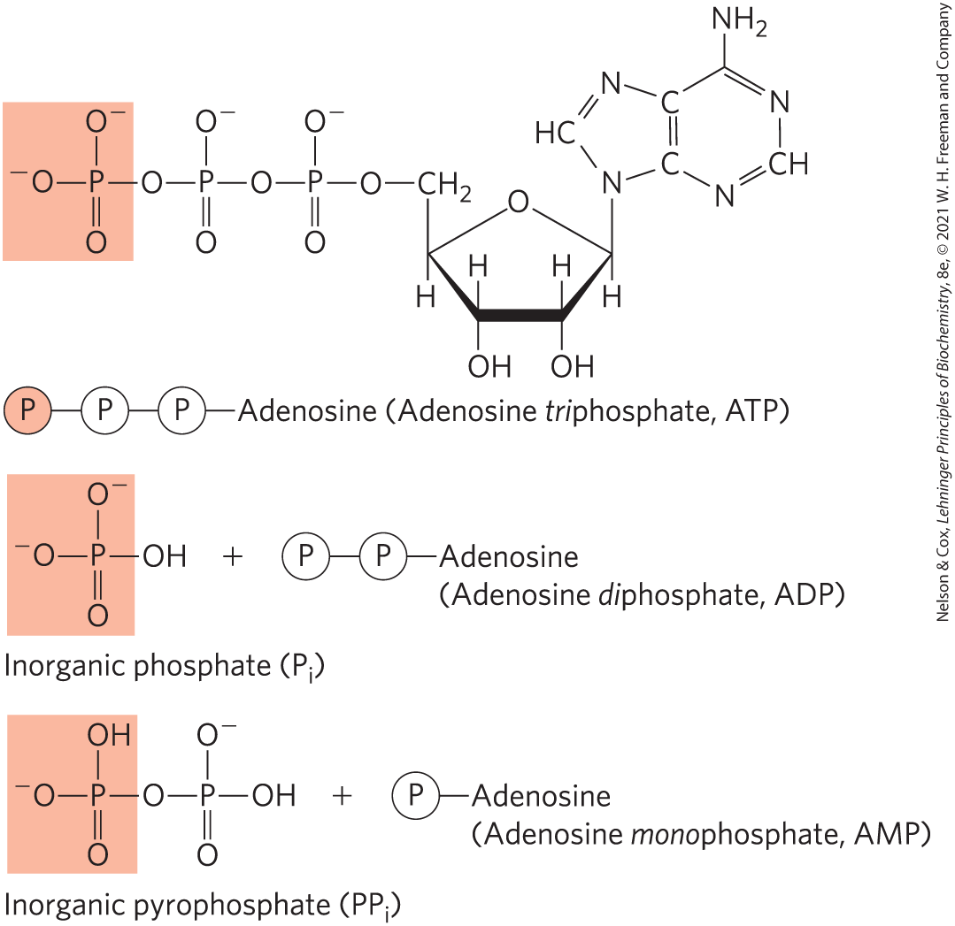
Coupling Reactions
energy-requiring (endergonic) reactions are often coupled to reactions that release free energy (exergonic)
the breakage of phosphoanhydride bonds in ATP is highly exergonic

Slide 69
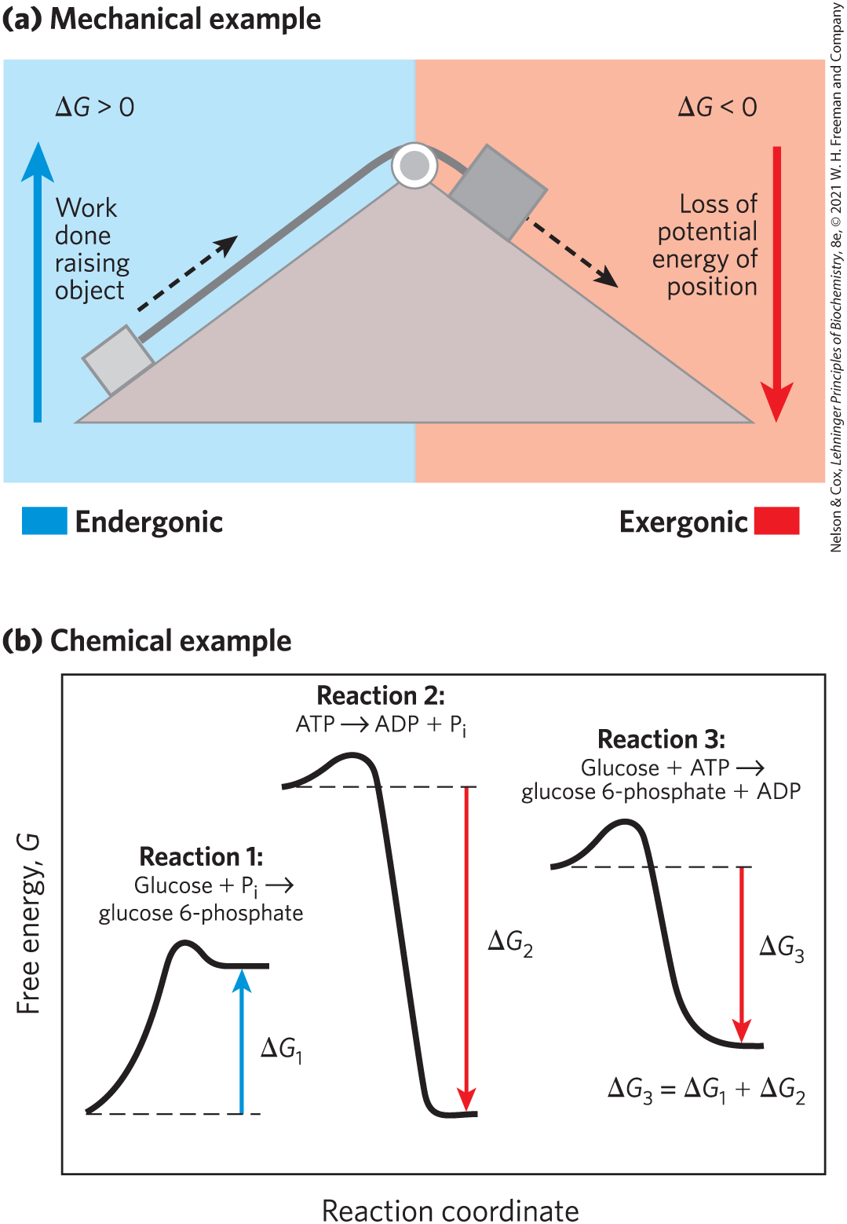
Energy Coupling Links Reactions in Biology
free-energy change, ∆G = amount of energy available to do work
  always less than the theoretical amount of energy released
in closed systems, chemical reactions proceed spontaneously until equilibrium is reached

Slide 70
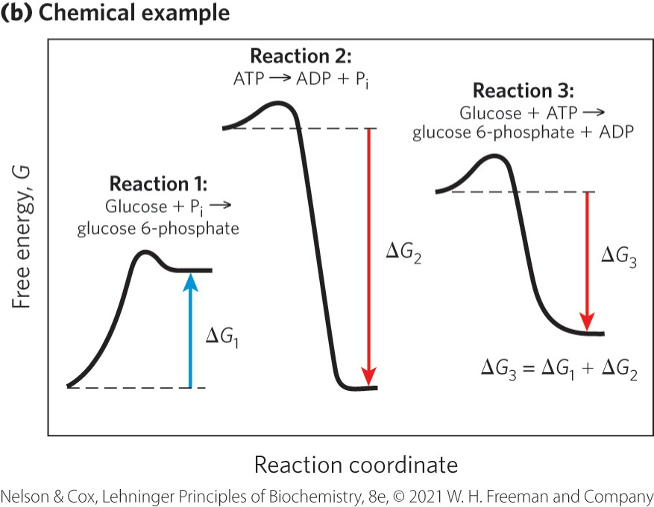
Reaction Coordinate Diagrams
reaction coordinate diagrams = illustrates how exergonic reactions can be coupled to endergonic reactions
reaction 1: endergonic; ∆G₁ is positive
reaction 2: exergonic; ∆G₂ is negative
reaction 3: ∆G₃ is negative

Slide 71
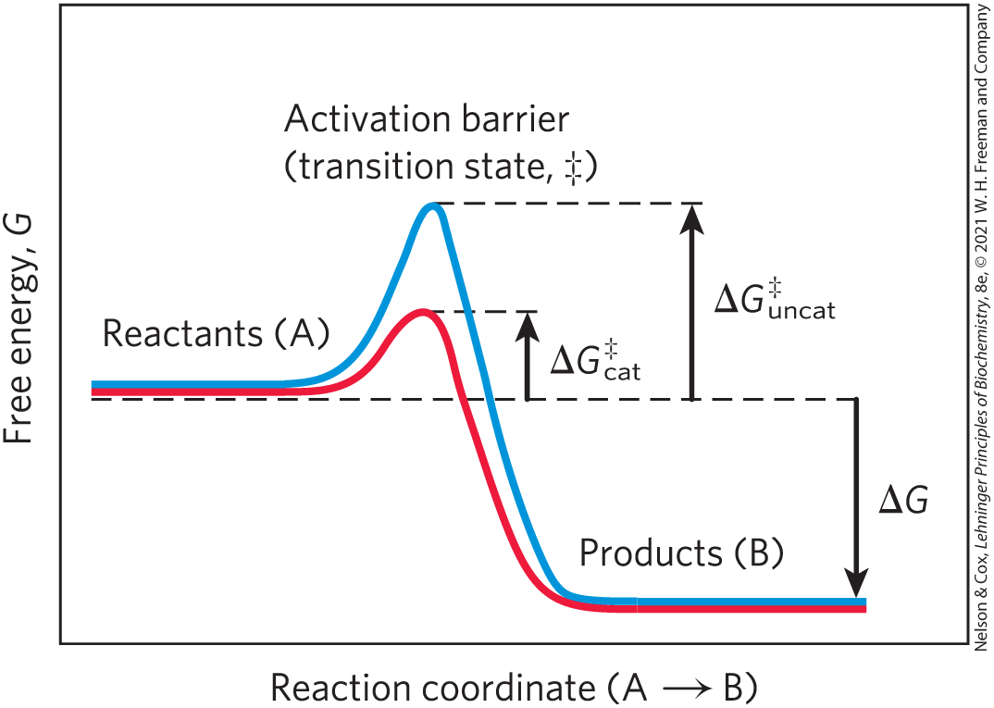
Enzymes Promote Sequences of Chemical Reactions
enzymes = greatly enhance reaction rates of specific chemical reactions without being consumed in the process
transition state = higher free energy than reactant or product
activation energy, ∆G‡ = difference in energy between the reactant in its ground state and its transition state

Slide 72
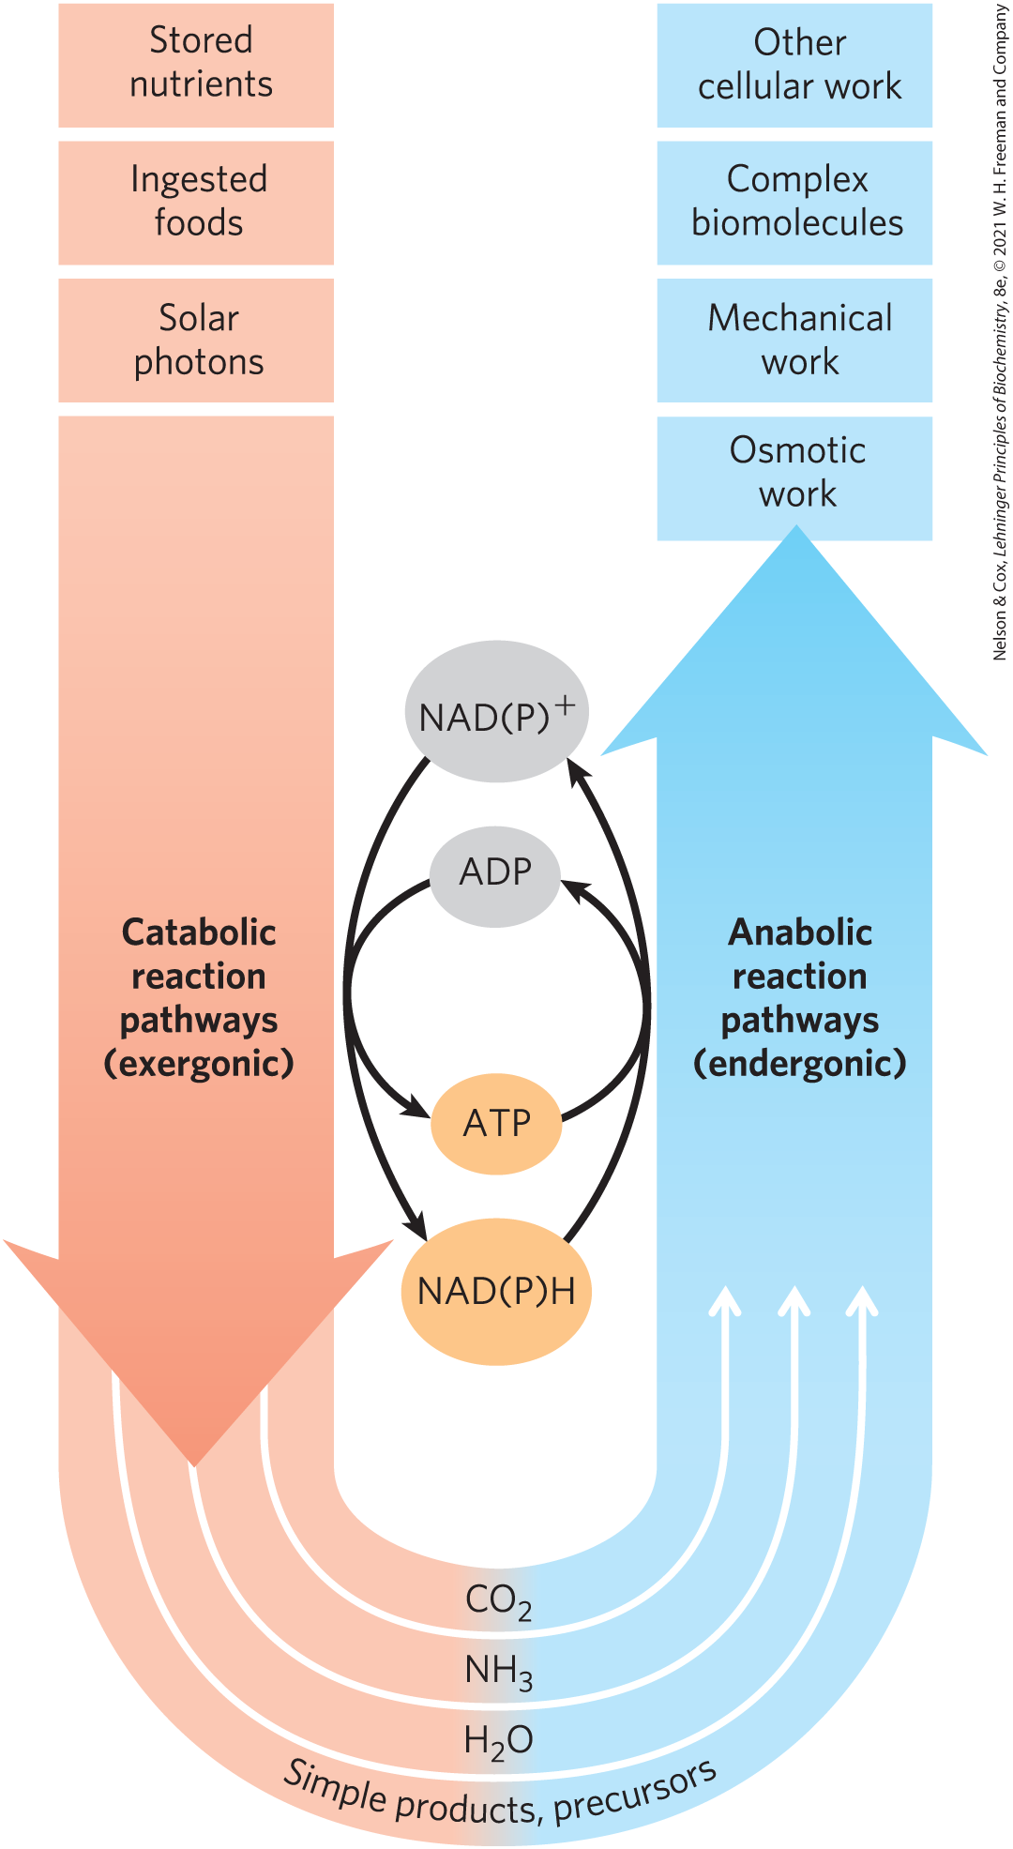
Catabolism and Anabolism
pathways = sequences of consecutive reactions in which the product of one reaction becomes the reactant in the next
catabolism = degradative, free-energy-yielding reactions
  drives ATP synthesis
  produces the reduced electron carriers NAD(P)H
anabolism = synthetic pathways that require the input of energy

Slide 73
Principle 2 (5 of 6)
Cells use a relatively small set of carbon- based metabolites to create polymeric machines, supramolecular structures, and information repositories. The chemical structure of these components defines their cellular function. The collection of molecules carries out a program, the end result of which is reproduction of the program and self-perpetuation of that collection of molecules—in short, life.

Slide 74
Metabolism
metabolism = overall network of enzyme-catalyzed pathways, both catabolic and anabolic
unity of life = pathways of enzyme-catalyzed reactions that act on the main constituents of cells—proteins, fats, sugars, and nucleic acids—are nearly identical in all living organisms

Slide 75
Principle 3 (5 of 5)
Living organisms exist in a dynamic
steady state, never at equilibrium with
their surroundings. Following the laws of thermodynamics, living organisms extract energy from their surroundings and employ it to maintain homeostasis and do useful work. Essentially all of the energy obtained by a cell comes from the flow of electrons, driven by sunlight or by metabolic redox reactions.

Slide 76
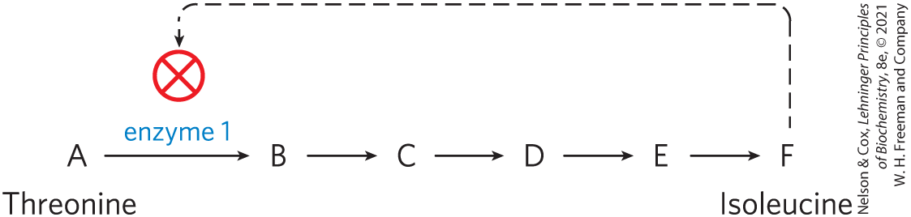
Metabolism Is Regulated to Achieve Balance and Economy
feedback inhibition = keeps the production and utilization of each metabolic intermediate in balance
systems biology = tasked with understanding complex interactions among intermediates and pathways in quantitative terms

Slide 77
1.4 Genetic Foundations

Slide 78
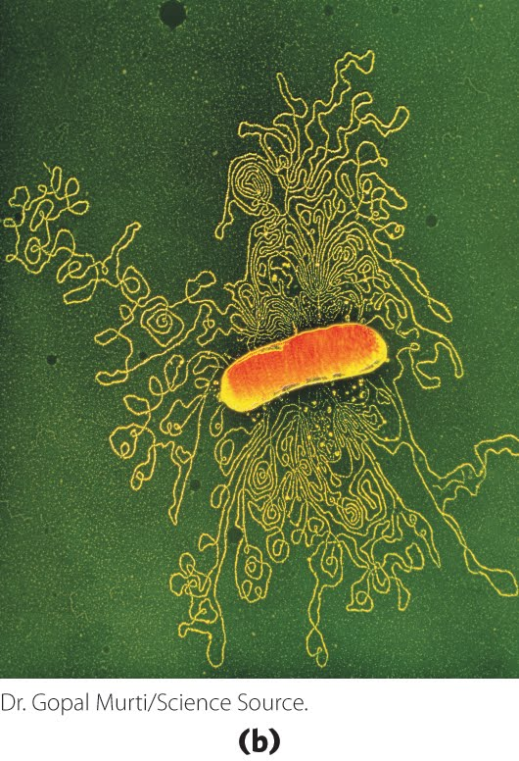
Genetic Information Is Encoded in DNA
deoxyribonucleic acid, DNA = sequence of the monomeric subunits (deoxyribonucleotides)
  encode the instructions for forming all other cellular components
  provide a template to produce identical DNA molecules

Slide 79
Genetic Continuity Is Vested in Single DNA Molecules
DNA of an E. coli cell is a single molecule containing 4.64 million nucleotide pairs
  must be replicated perfectly to give rise to identical progeny by cell division

Slide 80
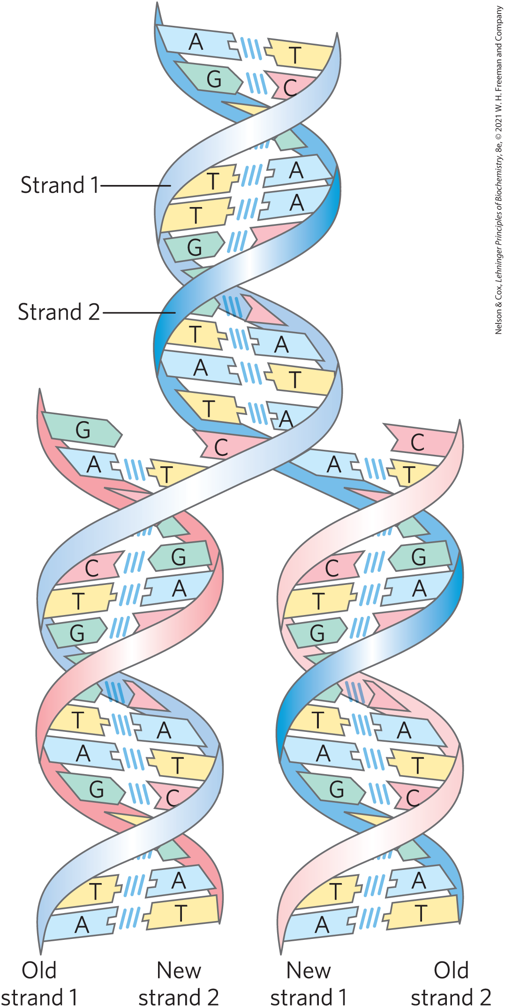
The Structure of DNA Allows Its Replication and Repair with Near-Perfect Fidelity
deoxyribonucleotides = monomeric subunit that make up the DNA polymer
  each deoxyribonucleotide in one strand pairs specifically with a complementary deoxyribonucleotide in the opposite strand
  strands are held together by hydrogen bonds

Slide 81
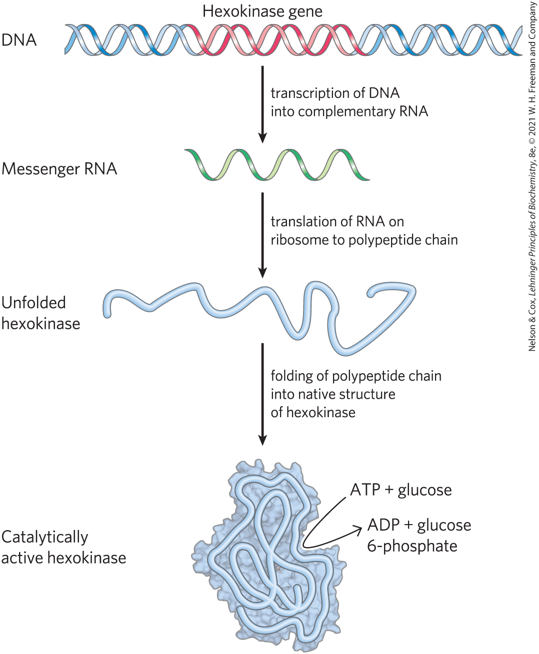
The Linear Sequence in DNA Encodes Proteins with Three-Dimensional Structures
native conformation = precise three-dimensional structure of a protein
  crucial to protein function

